Slide 1
Customized offers for mobile-based games
SSAD-6 (Team 29)
Yahnit Sirineni
Subrahmanyam Makam
Adrian Joseph Alva

Slide 2

Client details
Name: Mr. Ravi Kiran, GoLive gaming solutions, CIE, IIIT Hyderabad

Slide 3
Customized offers: What and Why
Identify customer preferences and differentiate customers into groups with similar preferences
Knowledge about customer is put into practice to give the customer exactly what he/she wants

Slide 4
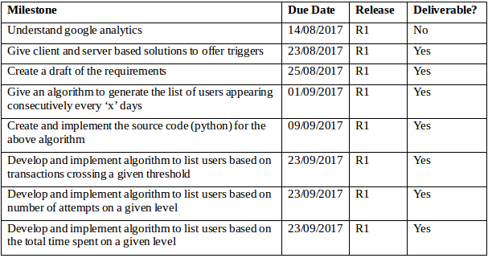
Milestones

Slide 5
Technologies used
Python 2.7 and above
JavaScript
Google Analytics
APPICE
GameSparks

Slide 6
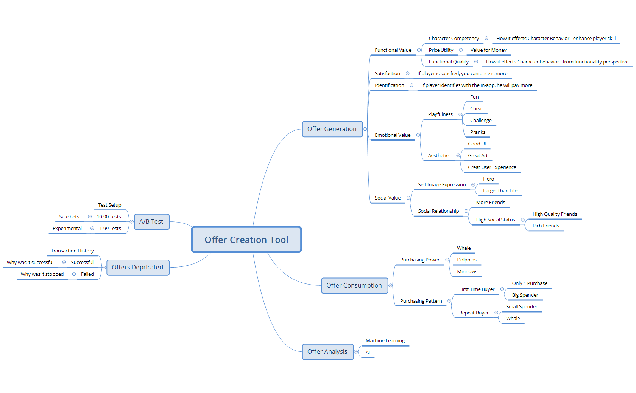

Slide 7

Triggering the offer
The process of triggering an offer involves two aspects
WHAT should the offer contain?
WHEN should the offer be given?
RELEASE 1

Slide 8
Identifying potential offer users
The potential for offer use identifies directly with the player’s involvement in the game
More interest implies more likelihood at buying the offer!

Slide 9
How to identify which behaviour to capture for triggering an offer?
We use Google Analytics, a popular web analytics service to analyse and identify parameters required to customize the offer
In particular, we use the user explorer feature of google analytics that extensively captures all the data of every user

Slide 10
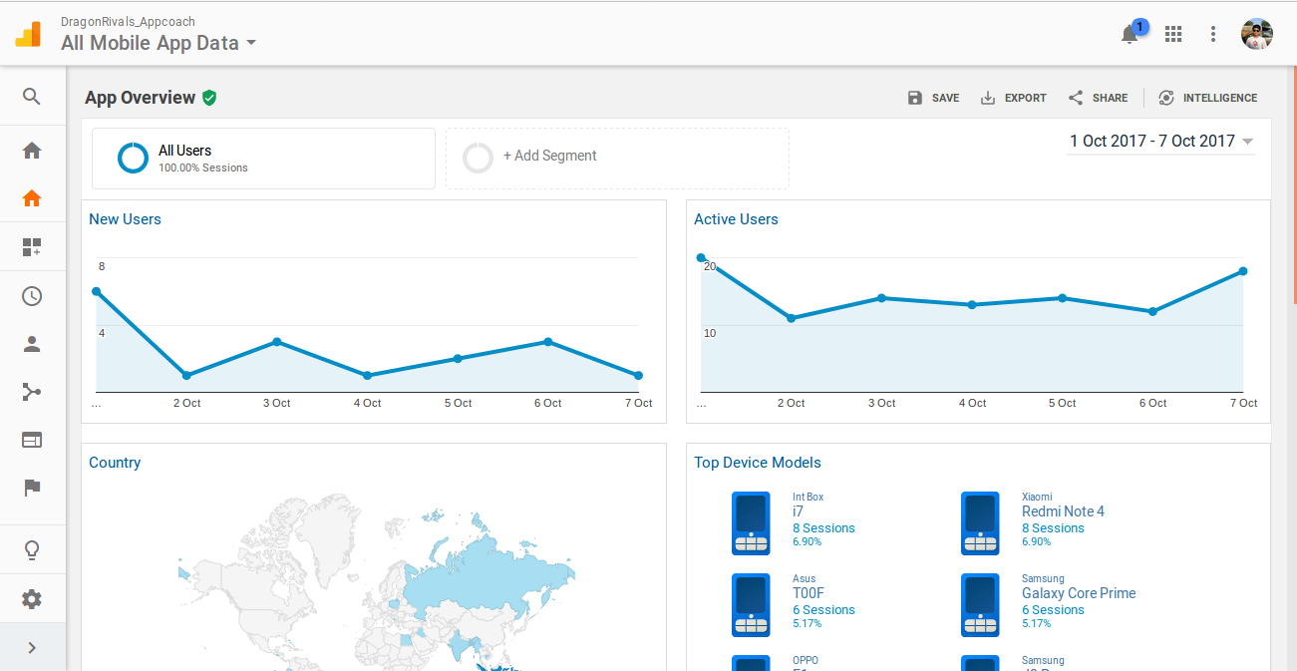
What Google Analytics looks like

Slide 11
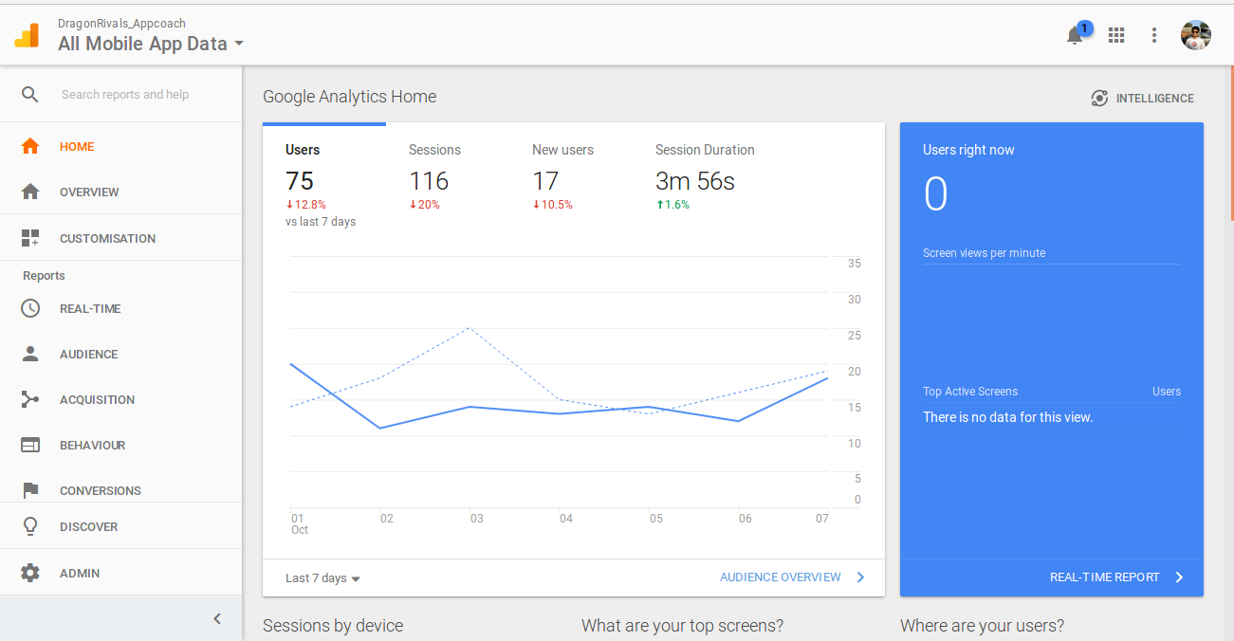
Data Overview

Slide 12
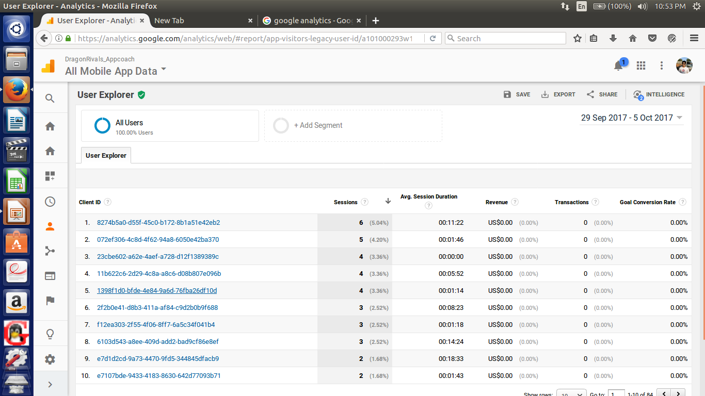
What user explorer looks like

Slide 13
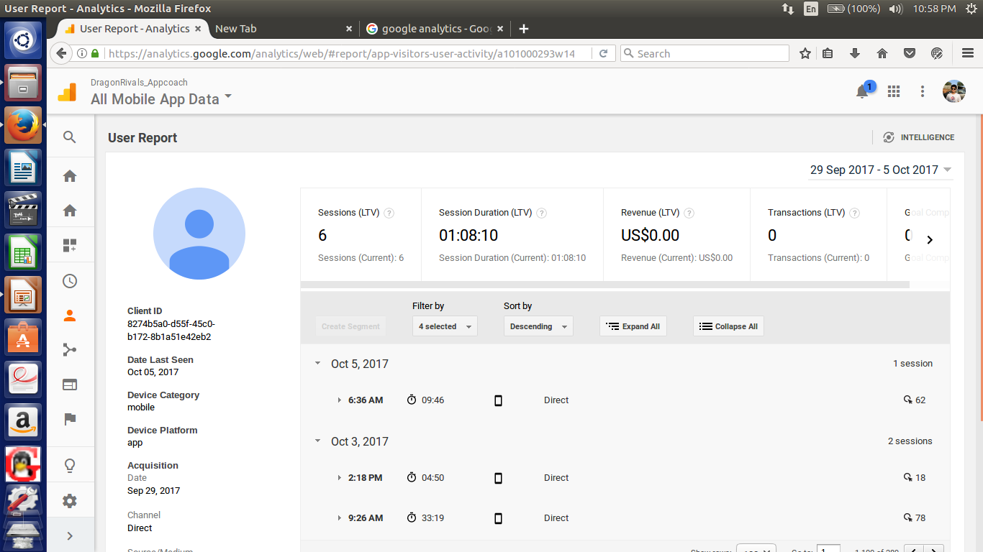
Every user’s sessions are listed

Slide 14
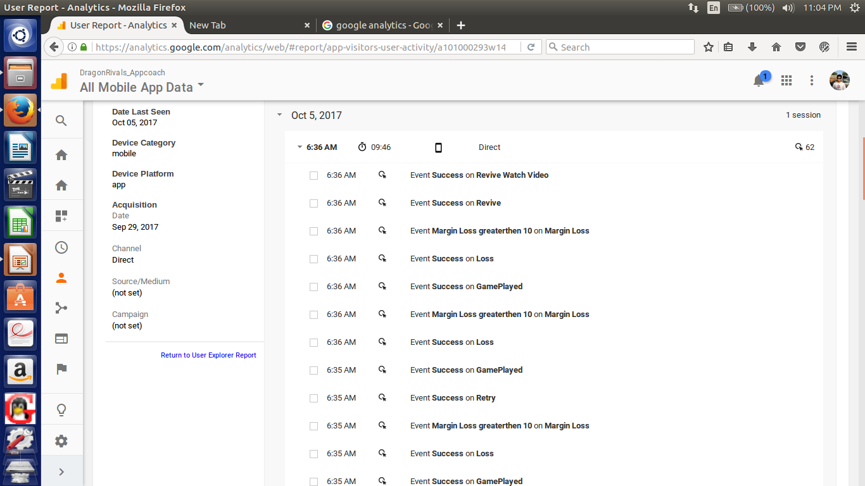
Every session’s details are provided

Slide 15
How to quantify a player’s interest or involvement?
In this release, we use four parameters to IDENTIFY players with a similar behaviour towards a game
Any game in general has different stages or levels increasing in difficulty

Slide 16
Parameters to identify users
For a given time period (say two weeks)
Number of consecutive days the game was played
Number of times a level was attempted
Money spent so far on offers
Total amout of time spent playing a level

Slide 17
Data format used from APPICE database
Session: Each time the game is opened
Session Object: An object that contains fields that represent the data of the session
The session object exists in the format of a JSON object
We are given a collection or array of such session objects of ALL the sessions of ALL the users for a given time period

Slide 18
Number of consecutive days the game was played
Example of a session object
{
"rtime": 1498329966,
"eventTime": 1498349760,
"user_id": "3622beb0bcc4d0eb9fcff3c95931f631d998e8a8",
"key": "Session_Start",
"did": "9f114887-c00d-4a65-8559-0eb15ae118f8",
"sid": "558d78e7-cecc-4b19-9c4a-846112412dd2",
"createdAt": 1498355527,
"utime": "1498329960"
}

Slide 19
Differentiating/Classifying users
We can classify players into groups based on
Session time (For example, the player should have a minumum session time of 5 hours between consecutive sessions)
Minimum number of consecutive appearances (For example, the player should have atleast played consecutively at least once per day for 5 consecutive days)

Slide 20
Number of times a level was attempted
Example of a session object
{
"rtime": 1498329966,
"eventTime": 1498349760,
"user_id": "3622beb0bcc4d0eb9fcff3c95931f631d998e8a8",
"key": "Level_event",
"did": "9f114887-c00d-4a65-8559-0eb15ae118f8",
"sid": "558d78e7-cecc-4b19-9c4a-846112412dd2",
"createdAt": 1498355527,
"utime": "1498329960",
"event_name": "Level 7 Failed"
}

Slide 21
Differentiating/Classifying users
We can classify players into groups based on
Attempt threshold (For example, the player should have attempted level 9 atleast 4 times)

Slide 22
Total money spent so far
Example of a session object
{
"rtime": 1498329966,
"eventTime": 1498349760,
"user_id": "3622beb0bcc4d0eb9fcff3c95931f631d998e8a8",
"key": "Session_Start",
"did": "9f114887-c00d-4a65-8559-0eb15ae118f8",
"sid": "558d78e7-cecc-4b19-9c4a-846112412dd2",
"createdAt": 1498355527,
"utime": "1498329960",
"transaction_amount": 10
}

Slide 23
Differentiating/Classifying users
We can classify players into groups based on
Transaction threshold (For example, the player must have spent atleast 3 dollars on offers till now)

Slide 24
Total time spent on a level
Example of a session object
{
"startTime": 1498329966,
"eventTime": 1498349760,
"user_id": "3622beb0bcc4d0eb9fcff3c95931f631d998e8a8",
"key": "Level_event",
"did": "9f114887-c00d-4a65-8559-0eb15ae118f8",
"sid": "558d78e7-cecc-4b19-9c4a-846112412dd2",
"endTime": 1498355527,
"utime": "1498329960",
"event_name": "Level 7 event"
}

Slide 25
Differentiating/Classifying users
We can classify users based on
Time threshold (For example, the player must have played level 7 for atleast a total time of 25 minutes in the time period)

Slide 26
Future Plans
Introduce some behavioral characteristics like emotional value, social value, functional value and further develop the classification techniques for different users.

