Slide 1
Introduction to Flask
Bruce Webber
3/19/2016

Slide 2
Overview
Welcome
Flask
Getting the code
Python virtual environments
Example web applications
  Hello World!
  Simple example with template
  Less simple example: Team Accolade
Flask extensions

Slide 3
Flask
Web framework written in Python
“micro” framework
  Jinja2 for templates
  Werkzeug for WSGI
Easy to get started
Add extensions as needed

Slide 4
Getting the Code
Install Python from https://www.python.org/
Install pip (maybe included with Python)
Install virtualenv
  pip install virtualenv
Create a directory and unzip the files
  We'll call this the project directory
Use an editor that supports “soft tabs”

Slide 5
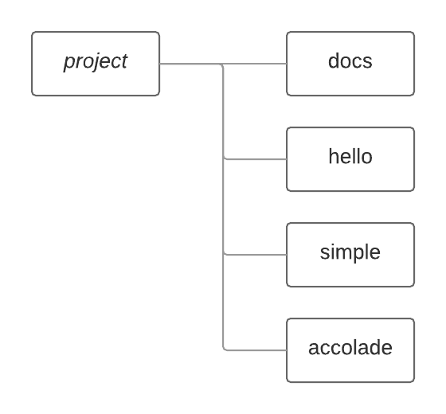
Directory Structure

Slide 6
Python Virtual Environments
A virtual environment has its own installation directory for packages
Separate from other Python virtual environments
Avoids dependancy hell
Can be located anywhere; does not have to be with application code
Create with the command
  virtualenv ENV

Slide 7
Create the Virtual Environment
In the project directory, create a virtual environment called venv
  virtualenv venv
Activate the environment
  source venv/bin/activate (Linux)
  venv/Scripts/activate (Windows)
Observe your prompt
You can deactivate the virtual environment
  deactivate

Slide 8
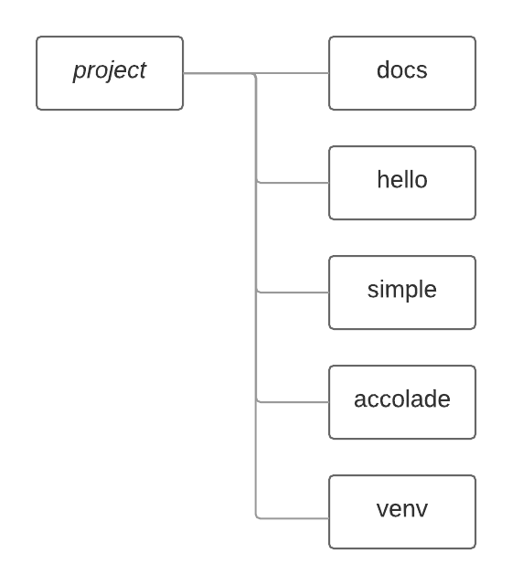
Directory Structure

Slide 9
Install Flask
With the virtual environment activated:
  pip install Flask

Slide 10
Hello World!
Make hello the current directory
Execute the command
  python hello.py
The application listens on localhost:5000
app.route() decorator
See results in browser

Slide 11
Simple Example
Make simple the current directory
Execute the command
  python webapp.py
app.debug = True
render_template()

Slide 12
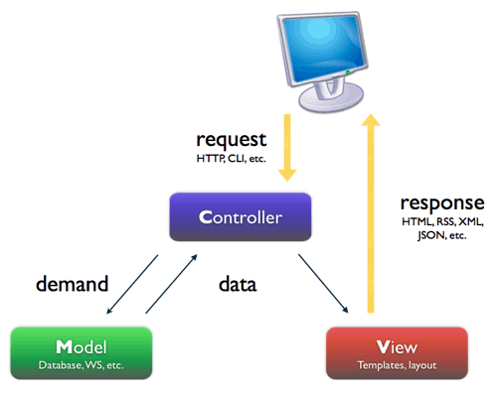
Model – View - Controller

Slide 13
Flask-SQLAlchemy
SQLAlchemy is an object-relational mapping (ORM) toolkit
Flask-SQLAlchemy is a Flask extension which provides support for SQLAlchemy
Install with
  pip install flask-sqlalchemy

Slide 14
Team Accolade
Make accolade the current directory
Execute the command
  python webapp.py
Twitter Bootstrap
Config file
url_for()
SQLAlchemy model
Sqlite database for development

Slide 15
Flask Extensions
Flask-WTF for form handling
Flask-Login, Flask-Security
Flask-Admin
...
You don't need Flask extensions
Why not Django?

Slide 16
License
This work is licensed under the Creative Commons Attribution-ShareAlike 4.0 International License. To view a copy of this license, visit http://creativecommons.org/licenses/by-sa/4.0/.

