Slide 1
Intro to SQLAlchemy
Bruce Webber
3/18/2017

Slide 2
Topics
What's a database?
Working with SQLite
Python's built-in SQLite support
The SQLAlchemy ORM
Database migrations

Slide 3
Databases
A set of tables
Tables have rows and columns
Tables may be related (joined)
Spreadsheet analogy

Slide 4
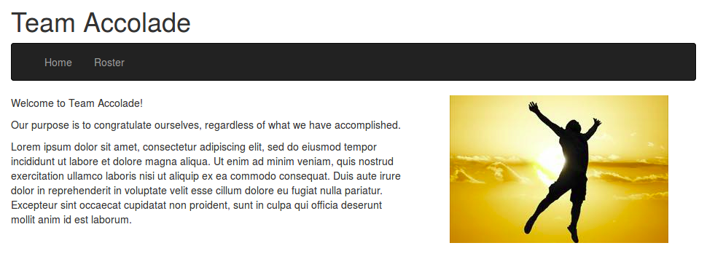
Database Example
From my award-winning (*) Intro to Flask presentation
(*) A salesman at a car dealership boasted to me about the award-winning mechanic
Who worked there. The award was issued by the car manufacturer.

Slide 5
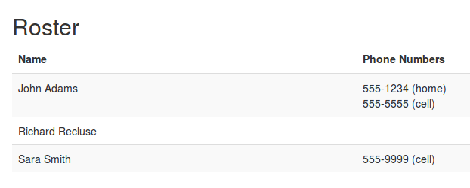
Database Example

Slide 6
Working with SQLite
SQLite uses single-file databases
Great for development and local app DBs
Install the sqlite software
  On Ubuntu (and other Debian-based distros)
  sudo apt-get install sqlite
GUI tools such as Sqliteman
Open a database (may be new)
  sqlite3 roster.db

Slide 7
Python Virtual Environments
A virtual environment has its own installation directory for packages
Separate from other Python virtual environments
Avoids dependancy hell
Can be located anywhere; does not have to be with application code
Create with the command
  virtualenv -p python3 ENV

Slide 8
Python and SQLite
Support in the standard library
import sqlite3
SQLite software not required
Similar approach for other database flavors
Database-specific code
  Can be optimized
  Must be ported

Slide 9
SQLAlchemy
A Python Object Relational Mapper (ORM)
Installation:
  pip install sqlalchemy
Tables are represented by classes (a model)
Pythonic
Cross-database support

Slide 10
Database Migrations
Application changes may include both code and database schema
Database migration – code to alter database schema (forward and backward)
Ideally database supports ALTER TABLE statement
Alembic is a Python database migration tool

