Slide 1
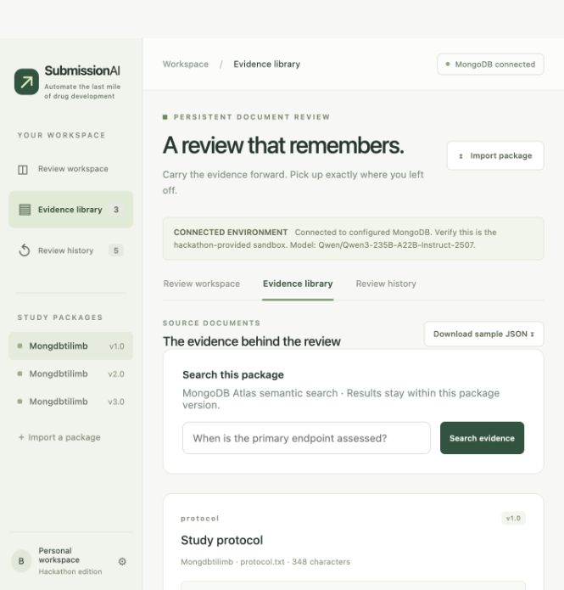
3-MINUTE LIVE DEMO · 0:00–0:20
Start at the source package
0:00–0:20
Frame the job
SAY
SubmissionAI carries review evidence across document revisions, so teams can see what changed and what still needs attention.
POINT OUT
Point to the V1 package and its protocol, SAP, and checklist. The rehearsal data is synthetic.
Move to Review history and open the saved V1 run. Do not start a fresh review in the timed demo.
PRIVATE REHEARSAL CUE DECK · KEEP OFF SCREEN DURING JUDGING
01
Notes:
Private run-of-show notes. Do not project this cue deck: the event asks for a live technical demo, not a presentation.
Open the demo website at http://127.0.0.1:8765/. Start with the V1 package, then use Review history to open the completed initial V1 run. Do not click Start review or Run one step during the timed run; those can make fresh model and embedding requests.
Say: ‘SubmissionAI carries review evidence across document revisions, so teams can see what changed and what still needs attention.’ The three documents are synthetic fixtures; no real patient or clinical data is shown.

Slide 2
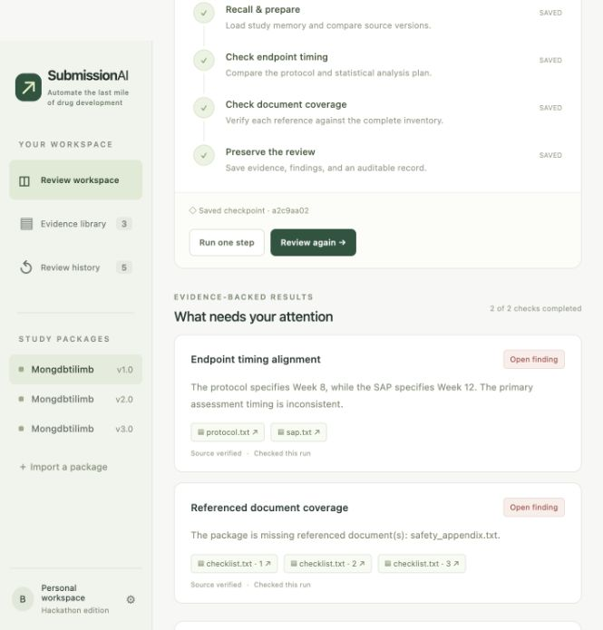
3-MINUTE LIVE DEMO · 0:20–0:55
V1 surfaces two concrete findings
0:20–0:55
Show the result
SAY
The protocol says Week 8, the SAP says Week 12, and the checklist names a safety appendix that is not in the package.
POINT OUT
Click the protocol, SAP, and checklist citations. Each finding is tied to the current source text.
2 checks · 5 citations verified
Initial V1 used 3 model calls and 3 Atlas vector retrievals. All five citations matched the current documents.
PRIVATE REHEARSAL CUE DECK · KEEP OFF SCREEN DURING JUDGING
02
Notes:
Use the completed initial V1 run, ID prefix 666069f9. Point out the protocol/SAP difference and the missing safety_appendix.txt. Click a citation to show the exact current passage in the source inspector.
The initial V1 run recorded 3 model calls, 3 vector retrievals, and 5,084 chat tokens; all five citations verified against the current package. Chat token counts exclude embedding requests. These are explicit synthetic consistency checks, not clinical or regulatory findings.
Evidence: docs/rehearsal_v1.json and demo/v1.json.

Slide 3
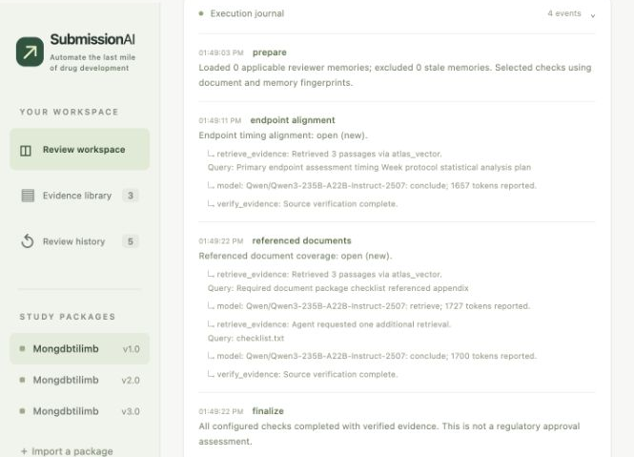
3-MINUTE LIVE DEMO · 0:55–1:20
Follow one review through the trace
0:55–1:20
Make the work inspectable
SAY
The log shows Atlas retrieving passages, the model proposing a decision, and a separate verifier checking the evidence.
POINT OUT
Call out atlas_vector → model → verify_evidence. Then flash the retrieval query code.
continuity/retrieval.py · version-scoped search
{ "$vectorSearch": {
"numCandidates": 120, "limit": 6,
"filter": {"study_id": …,
"package_id": …} } }
PRIVATE REHEARSAL CUE DECK · KEEP OFF SCREEN DURING JUDGING
03
Notes:
The initial V1 trace includes an extra retrieval for the checklist question: the agent can request one additional evidence query, then must conclude or return unresolved. The execution trace visibly reports atlas_vector retrieval, the Nebius Qwen chat decision, and independent evidence verification.
Code references: continuity/retrieval.py:72-100 for query embedding, package/study/profile filters, $vectorSearch, score, and projection; continuity/reviewer.py:222-262 for the bounded one-extra-retrieval loop and verifier call. The code excerpt on the slide is editable and simplified to fit; use the repository source for the exact implementation.
Do not claim that every line shown was written during the event; see the contribution-boundary slide and pending organizer ruling.

Slide 4
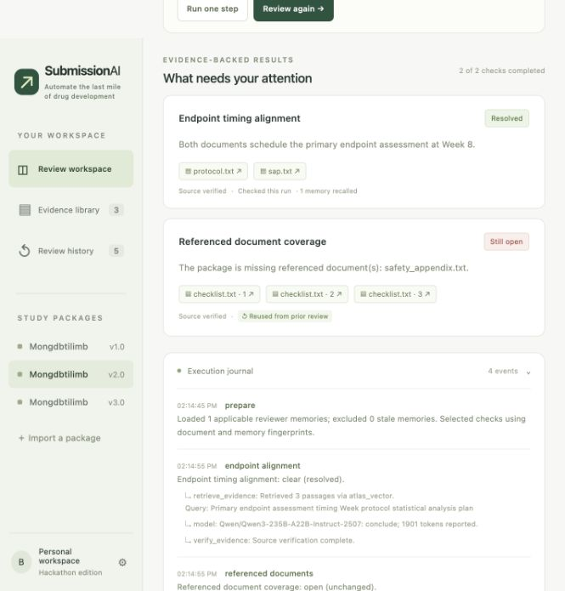
3-MINUTE LIVE DEMO · 1:20–1:50
V2 resolves one check and reuses another
1:20–1:50
Change one source
SAY
In V2 the SAP now matches Week 8. Timing resolves; the unchanged appendix check is reused, and the source-backed note is recalled.
POINT OUT
The journal says one applicable memory loaded and the coverage fingerprint matched.
1 model call · 1 check reused
V2 measured 1,901 chat tokens. The final checkpoint and citations were read back and verified.
PRIVATE REHEARSAL CUE DECK · KEEP OFF SCREEN DURING JUDGING
04
Notes:
Open saved V2 run 079e6bce. The only changed document is sap.txt. The endpoint check resolves with Week 8 citations from protocol and SAP. The missing appendix finding stays open and is reused because its checklist and full document inventory are unchanged. The approved note is recalled because its source protocol is unchanged.
Measured V2: 1 check executed, 1 reused, 1 model call, 1 retrieval, 1,901 chat tokens. Checkpoint read-back and source citations passed.
Code references: continuity/workflow.py:36-53 and 173-201; continuity/memory.py:5-32. Evidence: docs/rehearsal_v2.json.

Slide 5
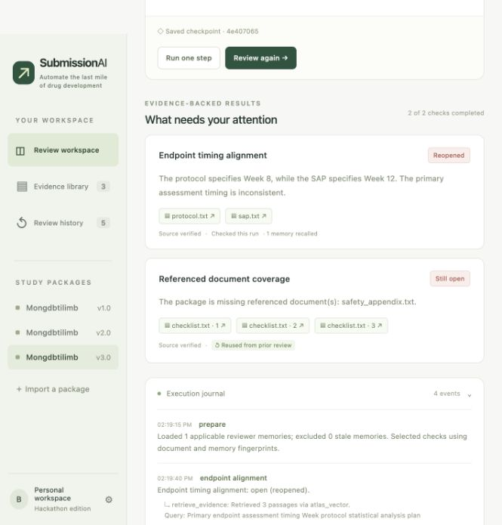
3-MINUTE LIVE DEMO · 1:50–2:15
V3 reopens the changed conclusion
1:50–2:15
Show change awareness
SAY
When Week 12 returns in V3, the timing issue reopens. The unchanged coverage result remains reusable.
POINT OUT
The status transition is ‘reopened’; the citations point to V3’s current protocol and SAP.
1 model call · 1 check reused
V3 incremental used 1,932 chat tokens in this paired synthetic trial.
PRIVATE REHEARSAL CUE DECK · KEEP OFF SCREEN DURING JUDGING
05
Notes:
Open saved incremental V3 run 8a796406. It uses the same V2 baseline, V3 package, memory, and model settings as the full V3 comparator. The SAP returns to Week 12, so endpoint_alignment changes from clear to reopened. Referenced-document coverage is unchanged and reused.
The result is still a synthetic example. It demonstrates transition tracking and selective reuse, not clinical or regulatory correctness.
Evidence: docs/rehearsal_v3_comparison.json. Transition implementation: continuity/workflow.py:56-68.

Slide 6
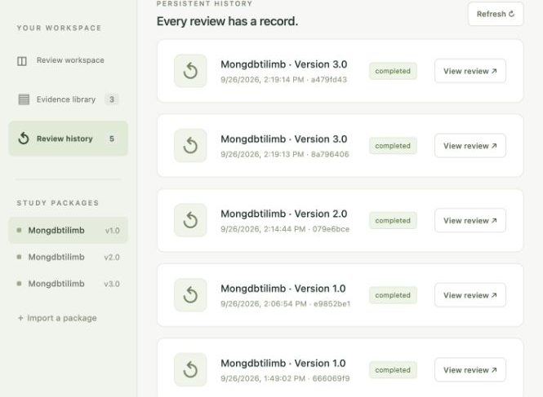
3-MINUTE LIVE DEMO · 2:15–2:45
Compare incremental and full review
Same V2 baseline, V3 documents, reviewer note, and model settings
Metric | Full | Incremental
Model calls | 3 | 1
Vector retrievals | 3 | 1
Checks reused | 0 | 1
Chat tokens | 5,274 | 1,932
Elapsed | 29.80 s | 27.28 s
One synthetic paired run. Chat tokens exclude embeddings. Similar elapsed times do not support a speedup claim.
SAY
Same verified findings; fewer calls and tokens in this run.
PRIVATE REHEARSAL CUE DECK · KEEP OFF SCREEN DURING JUDGING
06
Notes:
Use the two V3 rows at the top of Review history to identify the paired runs, then state the saved measurements. The runs share the same V2 baseline, V3 package, memory, and model settings.
Incremental: 1 check executed, 1 reused, 1 model call, 1 vector retrieval, 1,932 chat tokens, 27.28 seconds. Full: 2 checks executed, 0 reused, 3 model calls, 3 vector retrievals, 5,274 chat tokens, 29.80 seconds. Citations were verified against current sources and both checkpoints were read back. Chat tokens exclude embedding requests.
Say explicitly: ‘This is one controlled synthetic trial. It shows fewer calls and chat tokens here, not a general accuracy or speed guarantee.’ The table is editable. Evidence: docs/rehearsal_v3_comparison.json.

Slide 7
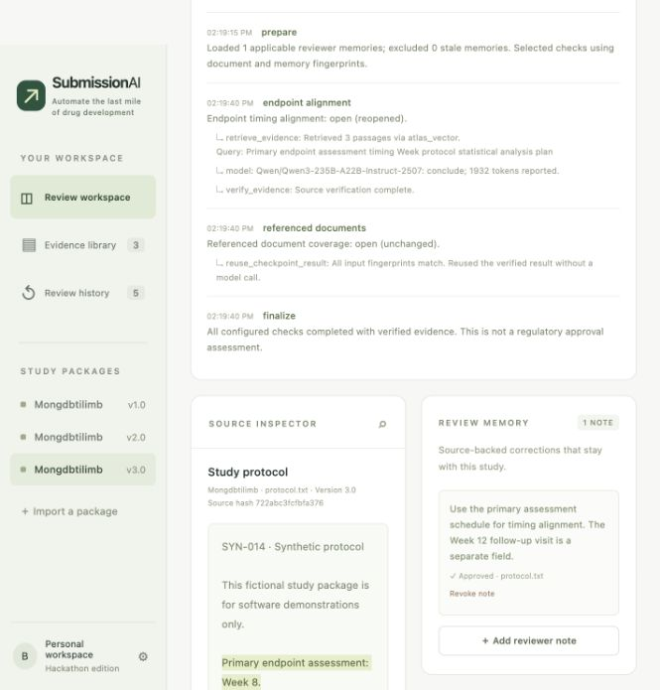
3-MINUTE LIVE DEMO · 2:45–3:00
End on the source and the scope
2:45–3:00
Close with a limit
SAY
The point is traceable review continuity across a small versioned workflow—not automated clinical or regulatory judgment.
POINT OUT
Leave the exact protocol quote and execution trace on screen. Stop without starting a new run.
Synthetic package · source verified
Do not claim billions of tokens, weeks of autonomy, or broad review coverage from this rehearsal.
PRIVATE REHEARSAL CUE DECK · KEEP OFF SCREEN DURING JUDGING
07
Notes:
Finish on the exact quoted source and execution trace. Close with: ‘This is a prototype for a narrow set of explicit synthetic checks. It preserves review state and evidence across the versions shown; it is not a clinical or regulatory review system.’
The rehearsal covered three synthetic versions and one graceful server restart. It does not demonstrate billions of tokens, weeks of autonomous operation, or recovery from every failure mode. Do not overstate the horizon claim.

Slide 8
Q&A PREP · SYSTEM CONTRACT
What goes in, and what comes out?
INPUT
HARNESS
OUTPUT
Versioned study package
study_id + version
protocol, SAP, checklist, supporting docs
Optional reviewer-approved note, tied to an exact source quote and document hash
Bounded review graph
Retrieve passages for each explicit check
Model proposes a structured result
Verifier checks it against current text and the complete document inventory
Per-check result
open · clear · unresolved
Explanation + exact citations
missing document names
Transition, execution trace, metrics, and durable checkpoint
One-sentence answer
SubmissionAI takes versioned documents and approved, source-bound notes; it returns narrow, source-verified findings and a resumable record of how each conclusion was reached.
PRIVATE REHEARSAL CUE DECK · KEEP OFF SCREEN DURING JUDGING
08
Notes:
Q: What are the inputs?
A: A JSON package with study ID, version, and documents identified by filename/kind/text (protocol, SAP, checklist, and optional supporting documents). An optional reviewer note has an exact quote, source document, summary, applicable check IDs, and approval status.
Q: What are the outputs?
A: For each supported check, open/clear/unresolved, an explanation, citations, missing filenames, a change transition (new/resolved/reopened/unchanged), model/retrieval metrics, an event trace, and a durable checkpoint.
The current fixture has two narrow checks: explicit primary-endpoint timing alignment and checklist-vs-inventory document coverage. It does not evaluate clinical evidence or regulatory compliance. Source: continuity/schemas.py; continuity/reviewer.py; continuity/workflow.py.

Slide 9
Q&A PREP · AUTHORSHIP AND EVENT SCOPE
What is my contribution?
IN THE PRE-EVENT BASELINE
DOCUMENTED POST-BASELINE WORK
The recorded harness snapshot is dated Sep 26, 2026 at 08:34 EDT; the guide lists 10:30 EDT as hacking start. It already contained:
Durable review checkpoints and resume
Source-bound reviewer memory
Version/dependency fingerprints and finding transitions
Review UI, initial chat model and Voyage-based Atlas vector retrieval
Repository notes list Nebius Qwen embeddings and profile-scoped retrieval validation, Responses API/provider hardening, interactive evidence search, and the Atlas/Nebius V1–V3 rehearsal and paired comparison.
The reports verify when tests ran; they do not timestamp every code change.
ELIGIBILITY RULING PENDING
Do not claim the whole project was built during the event. Say which work predates the event, describe later changes only where dated evidence supports them, and follow the organizers’ ruling.
PRIVATE REHEARSAL CUE DECK · KEEP OFF SCREEN DURING JUDGING
09
Notes:
Recommended answer if judges ask what you built during the hackathon:
‘This is my solo project, and I need to be transparent about its history. The core harness predates the event window, so I am not claiming that baseline as event-built. The repository documents later provider/retrieval extensions and a live Atlas/Nebius rehearsal with a paired incremental-versus-full measurement, but those reports establish test times, not the coding time of every change. I have asked the organizers to rule on eligibility and will follow their decision.’
Do not say the repository was built entirely during the event. docs/DEVELOPMENT_HISTORY.md records baseline commit 335c7d0d52cba2d8178b3f2bc447d6fb9ebbe200 at 2026-09-26 08:34:54 EDT; docs/EVENT_ELIGIBILITY.md says the guide's listed hacking start is 10:30 EDT and that no ruling has been received. The post-baseline table there cautions that exact coding times are not established.

Slide 10
Q&A PREP · MONGODB AND RETRIEVAL
How Atlas Vector Search is used
SOURCE TEXT
CHUNK + EMBED
STORE IN ATLAS
FILTER + SEARCH
Immutable package docs
with stable IDs and hashes
›
1,600-char windows
1,200-char stride
Qwen3 Embedding · 4,096D
›
evidence_chunks
text + source metadata
vector + profile
›
$vectorSearch
cosine · top 6
version-scoped pre-filter
THE QUERY CONTRACT
Filter before similarity search by study_id + package_id + embedding_profile. With k = 6, numCandidates = max(6 × 20, 100) = 120. Query and document vectors use the same embedding profile.
WHY MONGODB HERE
One Atlas cluster holds package documents, review records, reviewer memory, evidence chunks, and the LangGraph checkpoint store. Atlas applies metadata filters and vector ranking in the same retrieval query, keeping candidates inside the current study/version/profile.
Vector search supplies candidate passages; it does not prove a conclusion or prevent hallucinations by itself.
PRIVATE REHEARSAL CUE DECK · KEEP OFF SCREEN DURING JUDGING
10
Notes:
Technical answer: each source is split into overlapping text windows of at most 1,600 characters, starting every 1,200 characters (400-character overlap). With the current Nebius profile, Qwen/Qwen3-Embedding-8B produces 4,096-dimensional embeddings. The vector index uses cosine similarity and filter fields study_id, package_id, embedding_profile.
For queries, the same profile embeds the question. Qwen query text is prefixed with an instruction. The aggregation uses $vectorSearch with those metadata pre-filters, limit 6, and numCandidates max(limit*20,100), so the default query considers 120 candidates for 6 returned passages. The model receives retrieved passages plus the full document inventory and approved memories; it may ask for one additional retrieval.
Why MongoDB: documents and application records are BSON documents; Atlas Vector Search ranks the embedded chunks while filtering by current study/package/profile; LangGraph checkpoints use MongoDBSaver on the same configured database. This is useful integration for this workload, not a claim that MongoDB is always more accurate or faster than another database.
Code: continuity/retrieval.py:51-116; continuity/storage.py:104-125; continuity/workflow.py:71-91. Current index: evidence_qwen3_4096 (per docs/rehearsal_v1.json).
MongoDB primary documentation:
https://www.mongodb.com/docs/vector-search/
https://www.mongodb.com/docs/vector-search/indexes/vector-search-type/
https://www.mongodb.com/docs/vector-search/query/aggregation-stages/vector-search-stage/

Slide 11
Q&A PREP · RELIABILITY AND SCOPE
How do you keep the review grounded?
How does memory stay trustworthy?
A user approves it; it stores an exact source quote and source hash. Recall excludes it when that document hash changes.
What stops an unsupported model answer?
Strict structured output; at most one extra retrieval; exact current-source citation checks; status checked against explicit rules and complete inventory. Conflicts become unresolved.
Why not just reuse every old result?
Each check fingerprints only its dependencies plus memory and model/retrieval settings. Unresolved results are never reused; a full-review mode provides a comparator.
Does this prove billions of tokens or weeks of autonomy?
No. The rehearsal covers three synthetic versions and one graceful server restart. It does not prove weeks of operation or recovery from every failure.
Supported today: 2 explicit synthetic checks · Human review for unresolved cases · No clinical, safety, or regulatory approval advice
PRIVATE REHEARSAL CUE DECK · KEEP OFF SCREEN DURING JUDGING
11
Notes:
Q: How is memory different from replaying the full chat?
A: It is a reviewer-approved structured note, attached to a source document and exact quote, with a source hash and applicable checks. recall_memory returns it only while the source hash matches; changed source makes it stale and excludes it.
Q: How do you control model errors?
A: The model must return a strict structured decision. Citations must appear exactly in the current package. An independent verifier compares the model status and missing-document list with the explicit check contract; a mismatch or unsupported claim is unresolved. Missing files are derived from explicit checklist requirements versus the complete inventory, never from a vector search miss. No sample output is substituted after an invalid provider response.
Q: How does selective reuse avoid stale results?
A: Endpoint alignment depends on protocol/SAP hashes; coverage depends on checklist content and the complete document inventory. Relevant approved memories and provider/model/API/retrieval/index settings also participate in the fingerprint. The workflow does not reuse unresolved results.
Q: Does it really sustain billions of tokens or weeks?
A: Not yet. The implemented prototype carries state across the three synthetic package versions and passed a graceful server restart rehearsal. It does not establish long-running autonomy at that scale, reliability under every crash, model quality across real regulatory submissions, or general speed/accuracy.
Code: continuity/memory.py:5-32; continuity/reviewer.py:82-99, 102-123, 222-262; continuity/workflow.py:36-53, 173-201.

