Slide 1
Going Live

Slide 2
Check-Up Session
How’s it going?
After 1 week of Bootcamp, how are you holding up?
What feedback do you have so far?

Slide 3

Instructor Feedback
Seriously, mind-blown.

Slide 4
Instructor Feedback
Things I’ve noticed people doing incredibly well:
All of you are handling an enormous volume of information.
All of you are asking the right questions.
You notice the right details.
You all help each other out.
And, most importantly, you are figuring out things on your own.

Slide 5
A Few Admin Things…

Slide 6
Instructor Feedback
Remember, Homework #1 is due on Saturday.
Homework Link: Homework #1 Link
Remember to submit Homework via GitHub (& GitHub Pages)
And seriously!
Submit whatever you have! Don’t get a 0.
(Even if you don’t like what you’ve made.)

Slide 7
Office Hours + Additional Help
Also, remember….
In Class Office Hours: 45 minutes before class, 30 minutes after.
Review In Class Material (Exercises and Slides): https://upenn.bootcampcontent.com/upenn-bootcamp/PENNPHI201904FSF2-LOL/tree/master/01-html-git-css/01-Class-Content
Re-Watch Class Videos:
1.1 The Zen of Coding
1.2 Git'N Pro with HTML and CSS
1.3 Heroes of CSS

Slide 8
Recapping

Slide 9

Recap
In just one whirlwind week we’ve covered:
Full-Stack Development Conceptually
Terminal / Git Bash
HTML Syntax
Git Concepts and Commands
CSS Purpose, Syntax, and Styles
Floating
Positioning
Box Model
Chrome Dev Tools
How to Learn on Your Own!!

Slide 10

Full-Stack Development?
Notes:
What is Full-Stack Development?

Slide 11
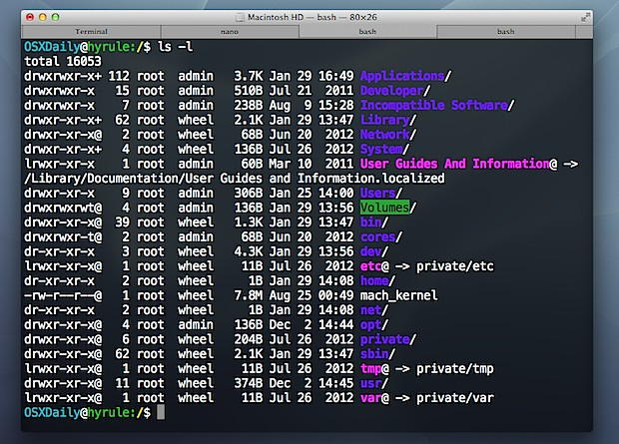
> Intro to Console
Notes:
Which console command is used to make new files? Switch directories?

Slide 12

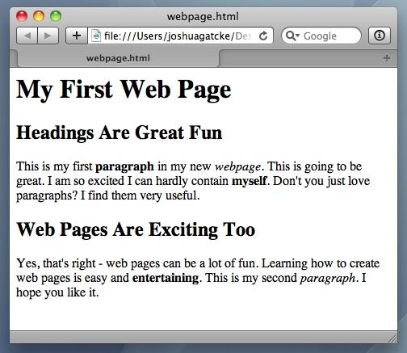
<title> Intro to HTML </title>
HTML is one of the three base languages behind every single website.
It defines all of the basic content and a bit of formatting.

Slide 13



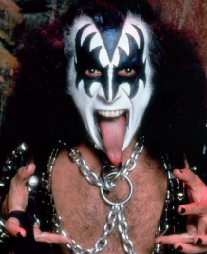

Pushing and Pulling to GitHub
1
2
3
4
GitHub Branch
Pull Code
Push Code
Pull Code
Pull Code
Push Code
Pull Code
Push Code
Notes:
Why is Git Collaboration so important? (Code conflicts + Version history)

Slide 14
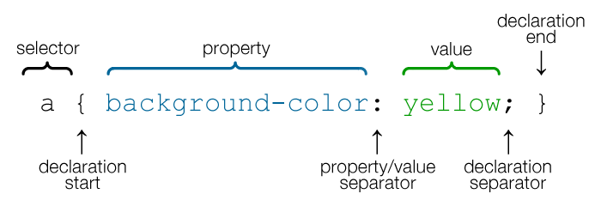
CSS Syntax
CSS works by hooking onto selectors added into HTML using “classes and identifiers”.
Once hooked, we apply styles to those HTML elements using CSS.

Slide 15
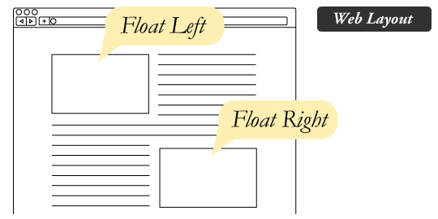
The Concept of “Flow”
In HTML/CSS, (by default) every element displayed is governed by a concept called “flow.”
This means that HTML elements force their adjacent elements to flow around them.

Slide 16
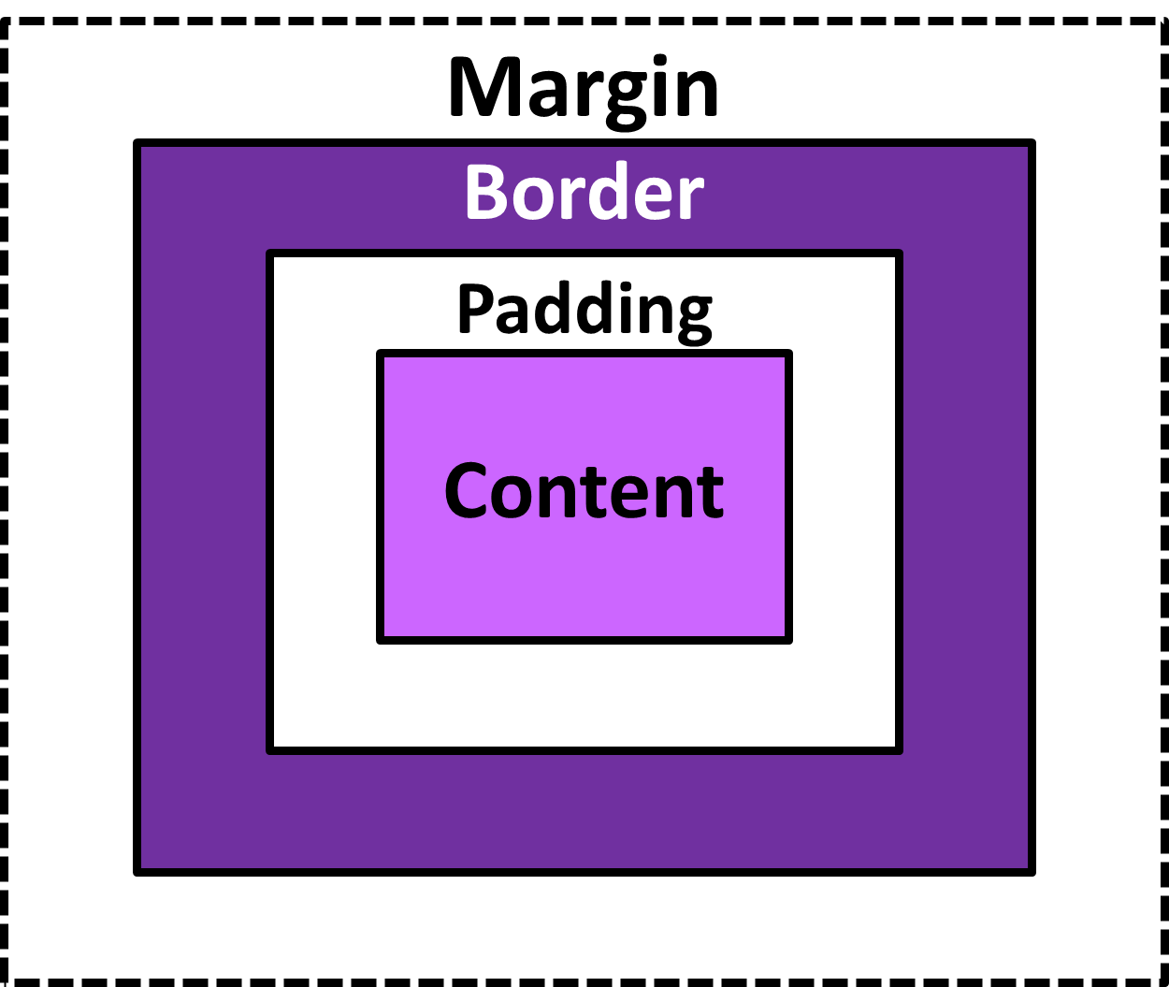
The Box Model
The Box Model wraps every CSS element in padding, border and margin – allowing developers to modify spacing styles.

Slide 17
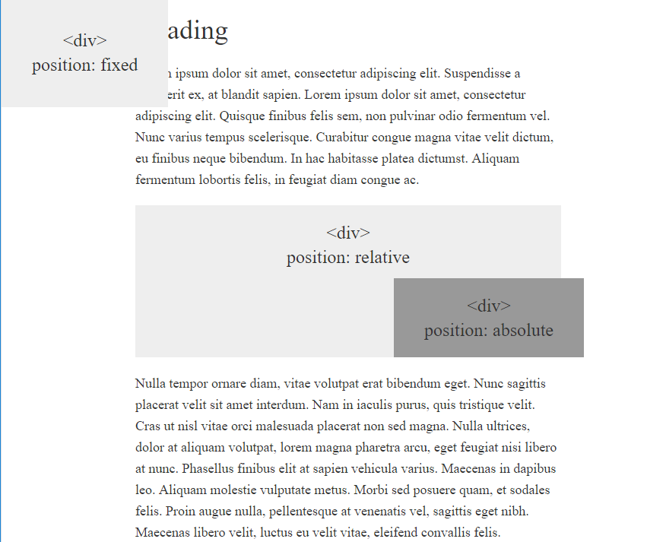
CSS Positioning
We can orient our HTML elements in relation to space with CSS positioning (static, relative, fixed, absolute).

Slide 18









How to Learn…
Notes:
In your fumblings, you’ve already learned one of the most important lessons of all: how to find things on your own

Slide 19

General Questions / Issues?
Notes:
Any lingering questions, issues, confusions, uncertainties?

Slide 20
Double Take

Slide 21
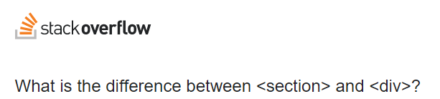
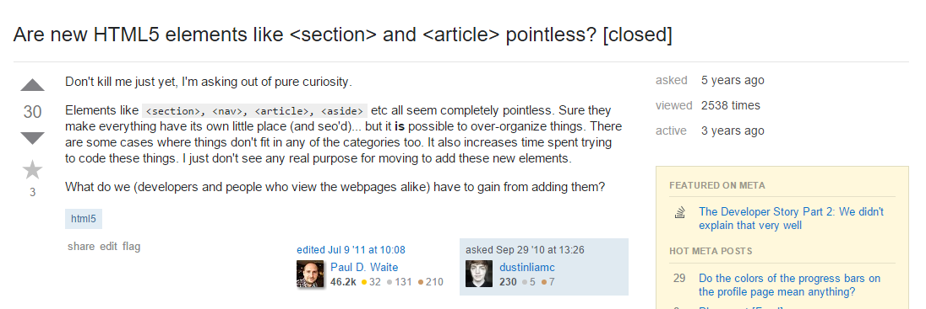
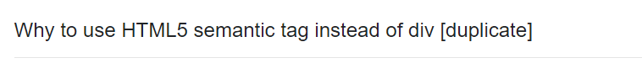

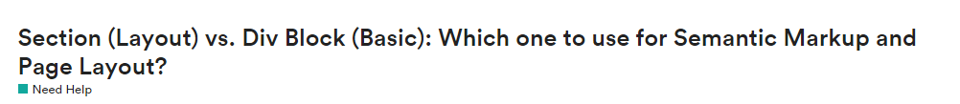
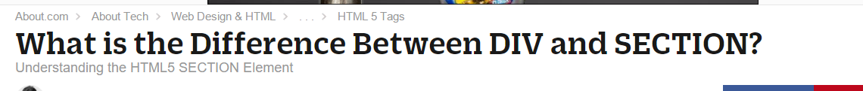
Divs, Sections, Navs, Etc….
Notes:
Common questions…[next]

Slide 22
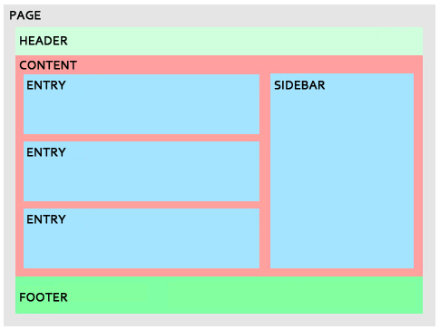
Divs, Sections, Navs, Etc….
All web layouts are inherently composed of containers, traditionally called “divs.”

Slide 23
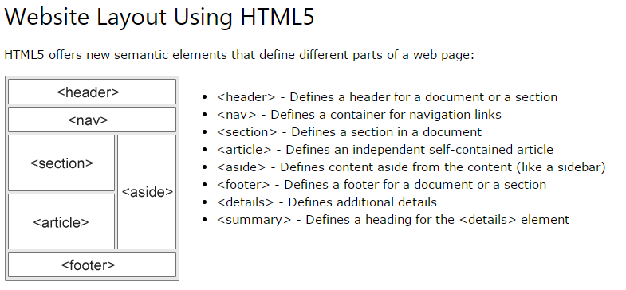
Divs, Sections, Navs, Etc….
HTML5 introduced the concept of “semantic layouts,” meaning “divs” could be given more meaningful names.
In theory, this helps with organization and search engine optimization.

Slide 24
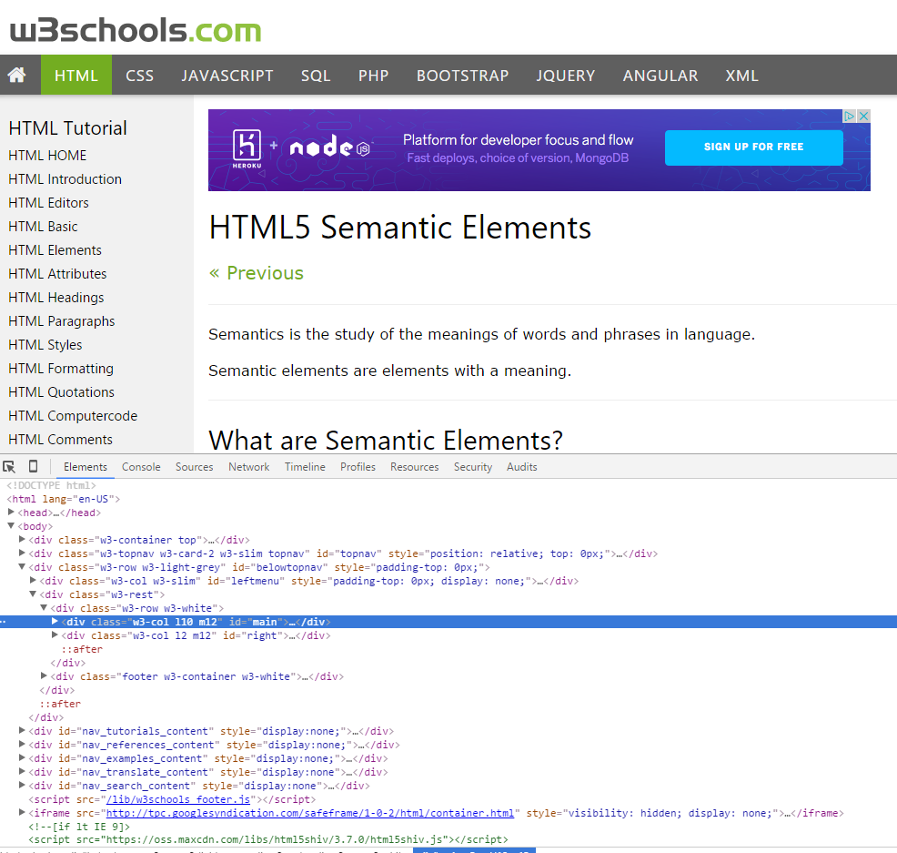
Divs, Sections, Navs, Etc….
That said… many (if not most) websites, seem to still be using basic divs.
There are reasons for this that we’ll showcase in later sections.
Additionally, it’s possible to include “semantics” by using id names and classes.

Slide 25
Divs, Sections, Navs, Etc….
div?
Section?
Bottom line: Follow your homework’s instructions. But when you get out in the “real world,” follow the convention of where you work!
Notes:
There is no hard-and-fast rule about when to use which one.

Slide 26

Classes vs. IDs
Classes = Barcode (all iPod)
IDs = Serial Number (unique iPod)
When choosing between a CSS ID and a CSS Class follow the convention:
Classes (.classname) are to be used if the same style will be used on multiple HTML elements.
IDs (#idname) are to be used if a style is unique to that HTML element.
Notes:
Classes are reusable elements. Essentially blocks of CSS that you plan on using to style many different elements on the page.
IDs are single use styles. They offer specificity and uniqueness.

Slide 27
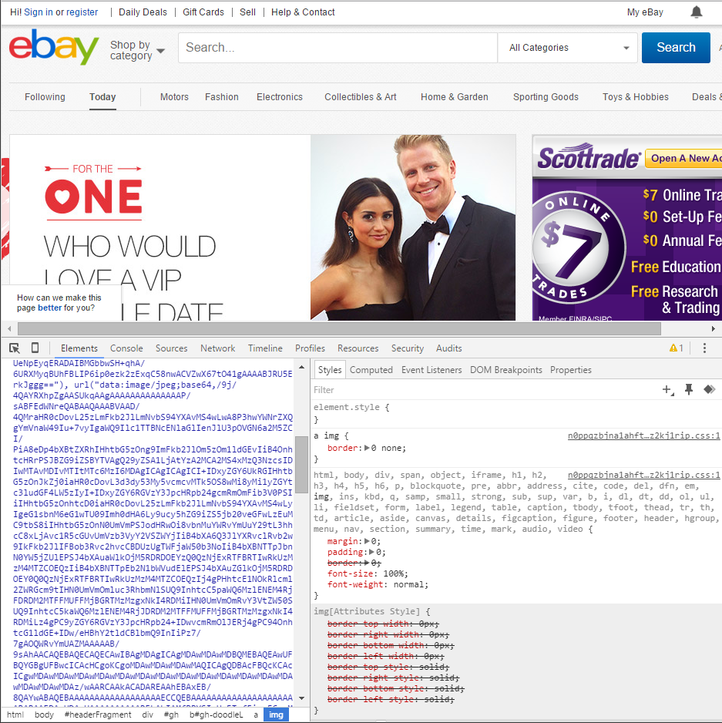
Chrome Developer Tools (Inspector)
This is one of the most frequent tools you will use in web development.
It allows you to truly debug your web designs.
Start using it!
Notes:
Incredibly important for developers...

Slide 28
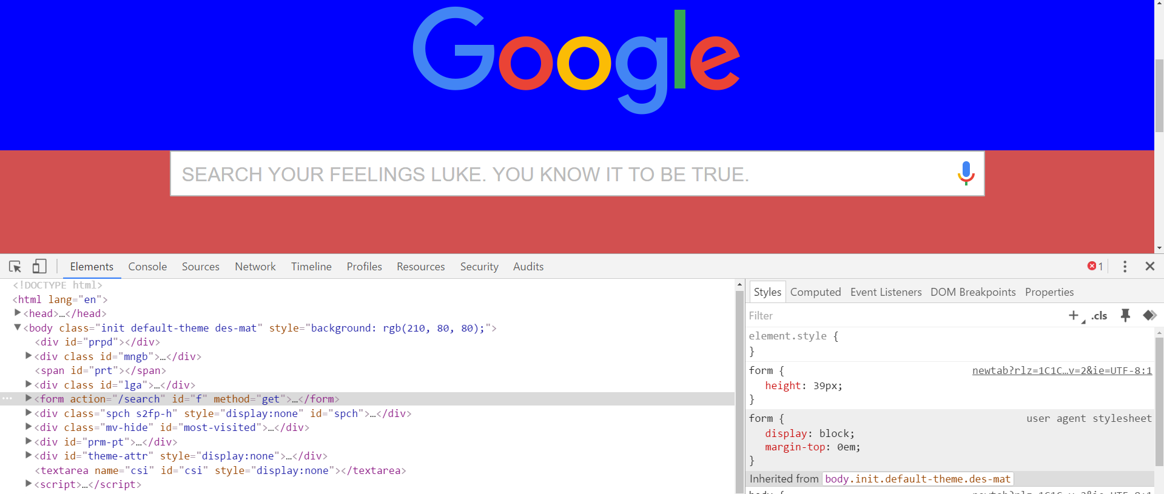
Modifying Sites
You can edit any page’s HTML and CSS with Chrome Developer Tools.
Plus, you’ll see your results instantly.

Slide 29
INSTRUCTOR DEMO!
Instructor: Demo
(Chrome Developer Tools)
Notes:
‹#›

Slide 30
> YOUR TURN!!
Suggested Time: 15 min
Assignment
For the next 15 minutes, take a website you commonly use (Amazon, Google, Huff Po, etc.) and heavily modify it using the Chrome Developer Tools.
Be sure to at least modify:
Content (Change words)
Colors
Spacing
Send a screenshot to the class’s slack general channel when you’re done.

Slide 31
> YOUR TURN!!
Suggested Time: 10 min
Assignment
For the next 10 minutes, edit any site that you’ve been working on in-class or for homework with Chrome Developer Tools.
Be sure to at least modify:
Content (Change words)
Colors
Spacing

Slide 32
CSS Resets

Slide 33
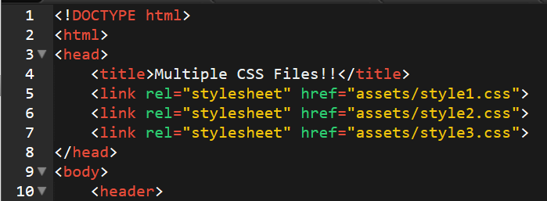
Loading Multiple CSS Files ***(Very Important!!!)***
An incredibly powerful technique: deploying multiple CSS files simultaneously.
This lets developers to create complex designs made up of abounding design elements.
Just remember: the loading order matters!!!
Notes:
CSS can be loaded in multiple files, each of which is additive on the last.
So order matters - later CSS files will “overwrite” previous ones if there is a repeat.

Slide 34
INSTRUCTOR DEMO!
Instructor: Demo
(1-3_CSSFiles.html | 3-MultipleCSS)
Notes:
‹#›

Slide 35
What Browser?
By a show of hands…
Which browser do you use?

Slide 36
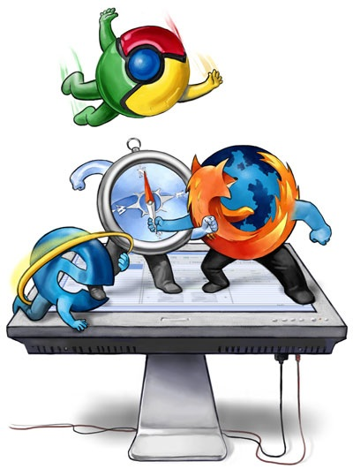
Battle of the Browsers
Under the hood, web browsers often render web pages differently than their competition.
These disparities could mean HTML/CSS displaying differently in each web client.
Because of these potential divergences, web developers need to make their websites cross-browser compatible.
Notes:
As of now, each browser determines for itself how things like headers, paragraphs, and tables should look. The font and thickness is all pre-set by the browser. This can create situations where your website will look on way in one browser and another way in another browser.
Cross-browser compatibility is critical in web development. This is particularly important when you are creating an app with millions of users.

Slide 37
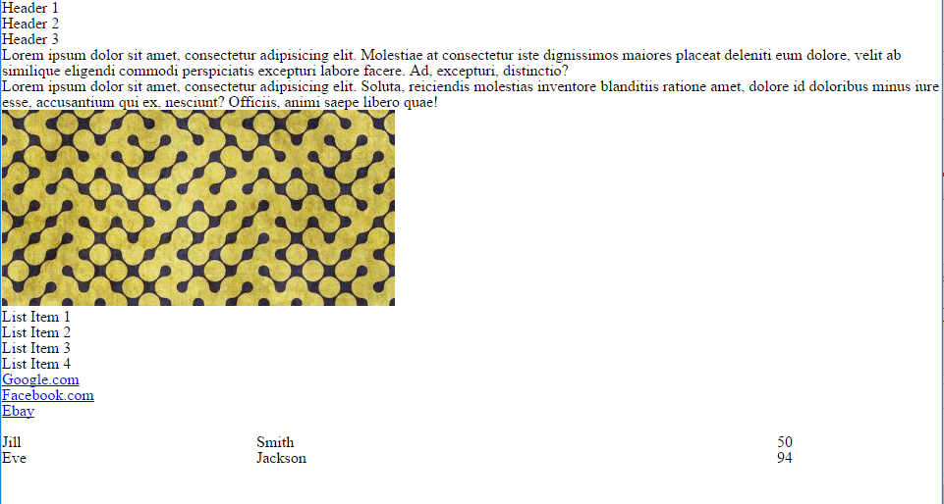
Reset.css (or Normalize.css)
Reset.css will “reset” all browser-specific CSS. This means your site will appear the same in all browsers.
However, you will have to re-style everything yourself.
Notes:
You can incorporate a reset.css file, made available online, that ensures that your site will look the very same in different browsers. It resets any default styling that the browser adds.)

Slide 38
INSTRUCTOR DEMO!
Instructor: Demo
(Example.html | 4-ResetCSS)
Notes:
‹#›

Slide 39
Why CSS Resets Matter
It’s important for creating browser-compatible websites
It’s an example of using someone else’s CSS in your website!!!
It’s a common Front-End Developer Interview question.

Slide 40
> YOUR TURN!!
Suggested Time: 10 min
Assignment
Follow the instructions given via Slack to incorporate a reset.css file into a basic HTML file.
Note the impact the reset file makes after its inclusion.

Slide 41
To the Web with GitHub!

Slide 42
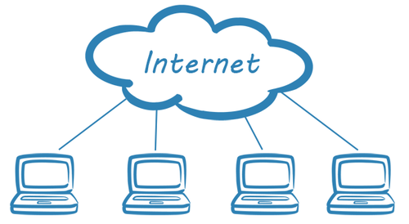
The Internet
A deep and complex diagram above on how the internet works.
Notes:
Now that you’ve created a few basic webpages locally, it’s about time we started putting these pages online for the world to see. To do this we are going to be hosting our websites on GitHub Pages...see next slide

Slide 43

The World Will See Our Greatness!
GitHub provides hosting for static websites – which means we can deploy our websites and applications onto their servers for the world to see.
Notes:
When we say deploy, what we mean is this. So far your websites have only been accessible on your own computers. In order for your websites to be accessible by the public it needs to be deployed on a server.
First a couple of concepts:
Host - a web host is the activity or business of providing storage space and access for websites. You cannot put a website online without it being hosted on a server somewhere.

Slide 44
Together Now…
Let’s all login to GitHub

Slide 45
INSTRUCTOR DEMO!
Instructor: Demo
(GitHub Pages Deployment - Personal)
Notes:
Github Pages allows you to create two different types of sites (we will be going over both methods).
Personal/organization sites for your account
Sites that are specific to a project/repository
‹#›

Slide 46
Deploying Static Personal Site – GitHub Pages
Basic Steps:
Create a new repo that is named `_username_.github.io`
Navigate into a folder and clone the repo into it
Build your files
Add, commit, and push your changes into the repository
Notes:
Recap for Static Personal Site

Slide 47
> YOUR TURN!!
Suggested Time: 15 min
Assignment
Time to take your newfangled website and deploy it to the cloud (in this case, GitHub Pages).
Additional instructions to be sent via Slack.

Slide 48
INSTRUCTOR DEMO!
Instructor: Demo
(GitHub Pages Deployment - Project)
Notes:
Not every website can be a personal website as there are many times in which we will want to create websites that are customized for specific projects. Luckily for us, GitHub Pages includes a VERY simple way to deploy webpages for individual projects as well.
‹#›

Slide 49
Deploying a Static Project Site – GitHub Pages
Basic Steps:
1. Create a new repository on your GitHub account. You can name this repository whatever you would like.
2. Once inside of the repository, create a new file and name it `index.html`
3. Add some very basic HTML into this file, save it, and then navigate into your repository's Settings tab.
4. Scroll down to the GitHub Pages section and then, in the section labeled "Source", select that you would like to use the master branch as your source.
5. Navigate to `<username>.github.io/<repositoryname>` and you will find that your new web page has gone live!
Notes:
You might be wondering how to get a custom domain for your project as opposed to a site that is clearly linked to your GitHub account…
Custom domains are more heavily coveted since they are more easily searchable online. This means that custom domains have to be purchased from companies known as "DNS Providers". These companies allow users to buy and register unique domain names and connect that name to an IP address. GitHub Pages does not sell domain names.
Don’t worry about custom domains at this time since it is not necessary for the web work that we will be doing. If you really wish to link a webpage of yours to a custom domain, however, GitHub Pages has great documentation on how to go about doing this.

Slide 50
> YOUR TURN!!
Suggested Time: 15 min
Assignment
Build a newfangled website, and deploy it to GitHub Pages as a project instead of a personal site.
Additional instructions to be sent via Slack.

Slide 51
Practice Through Frustration
Keep Practicing!
It gets better.

Slide 52
Questions?

Slide 53
Homework 1 - Help?
Notes:
With the remainder of class

Slide 54
EXTRA MATERIAL

Slide 55
And Back to Git…

Slide 56

The Group Project
OMG. I HAZ THE GREATEST HTML IDEA!!!!!
SpongeSite.com
Notes:
‹#›

Slide 57

The Group Project
Programming Away…
Spongebob’s idea is dumb. We should call it…
PrincezzzSite.com
Notes:
‹#›

Slide 58
The Group Project
The Group Project – Tragedy #1
Programming Away…
Now they have two completely different versions.
Programming Away…
Notes:
‹#›

Slide 59
The Group Project – Push vs Pull
Main Branch (Spongebob’s)
Spongebob continues programming
1
2
3
4
5
This is NON-IDEAL
Prince pushes his code changes into the main branch.
If Prince is allowed to push his code, it could seriously ruin Spongebob’s vision and working code.
Prince’s Branch
Notes:
‹#›

Slide 60
The Group Project – Push vs Pull
Main Branch (Spongebob’s)
Spongebob continues programming
1
2
3
4
5
Prince’s Branch
Notes:
‹#›

Slide 61
The Group Project – Push vs Pull
Main Branch (Spongebob’s)
Spongebob continues programming
1
2
3
4
5
Ideal Approach – Using Pull Requests
Because Spongebob controls the “master branch” he must elect to pull Prince’s Code. All Prince can do is submit a “pull request”
This is the ideal way to maintain code in version control.
?
Prince’s Branch
Notes:
‹#›

Slide 62
General Steps for Git Pull Requests
Create a new branch of on your local computer git branch <BRANCH NAME>
Checkout that branch (locally) on your machine git checkout <BRANCH NAME>
Add / Commit your changes (will automatically save to this branch) git add –A git commit –m “Comment”
Push your branch to GitHub
git push origin <BRANCH NAME>
Submit a Pull Request on GitHub
Other user must accept these changes on GitHub

Slide 63
INSTRUCTOR DEMO!
Git Pull Request
Notes:
‹#›

Slide 64
> YOUR TURN!!
Assignment
Time to take your newfound collaborative git skills to the real-world. Find a partner and follow the steps sent via slack to
Share each other’s code
Make modifications
Submit a Pull Request
Accept the Pull Changes

Slide 65
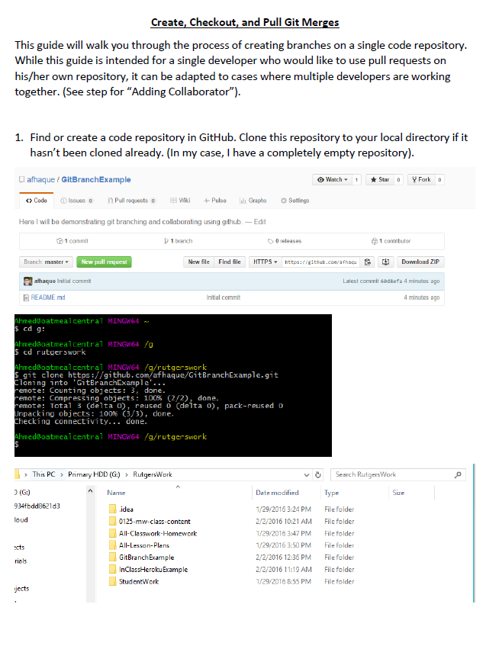
Follow our Guide!
Step-by-step guide
on creating Git Pull Requests

Slide 66
Don’t Worry!
We’ll be coming back to this.
You won’t need this fully until Week 8.
Notes:
‹#›

Slide 67
Practice At Home
But practice when you can!
You don’t need a partner to submit pull requests!
Notes:
‹#›

