Slide 1
The Limits of Predictions for
0.990
Online Bipartite Matching
the advice-free baseline
A Unified Experimental Study
0.009
left for perfect advice
Zhuolun Li
MSc in Computer Science · School of Computer Science · University of Bristol
0.472
unguarded following
Predictions are robustness insurance, not a performance lever.
Notes:
Good morning, and thank you for reading the thesis. My project is an experimental study of learning-augmented algorithms for online bipartite matching — algorithms that are handed a prediction about the future and are supposed to exploit it when it is good and survive it when it is bad. The single sentence I would like you to leave with is on the slide: on average-case inputs, predictions in this problem are robustness insurance, not a performance lever. Everything I show in the next fifteen minutes is either evidence for that sentence or an attempt to break it. I will spend about four minutes on the problem and the method, seven on the results, and the last few on what the project achieved and where it falls short.

Slide 2
THE PROBLEM
Irrevocable decisions under uncertainty
resources
requests, in arrival order
Resources are known in advance; requests arrive one at a time.
Each request must be matched to a free compatible resource, or dropped, before the rest of the input is seen.
No decision can be undone.
1
2
3
request 4's only compatible
resource was already taken
Online advertising · ride-hailing dispatch · AI-inference request routing
4
dashed = compatible · solid = matched
Performance = the matching produced ÷ the offline optimum on the same instance.
Notes:
Online bipartite matching is the canonical model of irrevocable sequential allocation. One side of the graph — the resources — is known in advance. The other side, the requests, arrives one at a time. Each request must be matched to a free compatible resource, or dropped, immediately, before you see the rest of the input. Nothing can be undone. That abstraction sits underneath online advertising, ride-hailing dispatch, and request routing in modern inference-serving systems. Throughout, performance is the ratio of the matching an algorithm produces to the offline optimum on the same instance — so 1.0 means it did as well as an algorithm that saw the whole input in advance.

Slide 3
BACKGROUND
Two guarantees, two families of algorithm
Consistency
Robustness
near-optimal when the prediction is good
no worse than a prediction-free algorithm when it is wrong
1
MinPredictedDegree
2
Test-and-fallback
consumes a prediction of how contended each resource will be, and serves the scarcest first
tests a prediction of the arrival mix on a short prefix of the requests, then commits to following it or falling back
prediction: one number per resource
prediction: a histogram over request types
Both were analysed only in isolation — each on its own inputs, its own notion of prediction error, and almost entirely in worst-case theory.
Notes:
The influential idea in this area is to hand such an algorithm a prediction about the input and ask for two guarantees at once. Consistency: near-optimal performance when the prediction is good. Robustness: no worse than a prediction-free algorithm when the prediction is wrong. For matching specifically, two families exist. MinPredictedDegree consumes a prediction of how contended each resource will be, and protects the scarcest resources first. The test-and-fallback family tests a prediction of the arrival mix on a short prefix of the requests, and then commits — either to following the prediction or to falling back on an advice-free baseline. The problem is at the bottom of the slide. These two families had only ever been analysed in isolation: each on its own input model, its own notion of prediction error, and almost entirely through worst-case theory. There was no common ground on which to compare them, or to ask what a prediction is actually worth.

Slide 4
AIMS AND OBJECTIVES
Three questions
How do the two families actually compare, head to head, under one prediction-error model — and how much does a prediction buy on realistic data?
answered experimentally
1
What are the failure modes of the adaptive test-and-fallback mechanism: the cost of its test, and the calibration of its accept/reject decision?
answered experimentally
2
Why does the average-case experience differ so sharply from the worst-case promise — is the wall an artefact, or is it necessary?
answered in outlook form
3
The first two are answered experimentally; the third in outlook form, and I say exactly how far that goes.
Notes:
The thesis is organised around three questions. Q1 is the comparison question: how do these algorithms actually compare, head to head, on common inputs under a single error model — and how much does a prediction buy on realistic data? Q2 goes inside the adaptive mechanism: what does its test cost, how well is its accept-or-reject decision calibrated, and where does it go wrong? Q3 is the "why" question: the gap between the worst-case promise and the average-case experience — is it an accident of the algorithms and generators I happened to choose, or is it necessary? The first two I answer experimentally. The third I answer in outlook form, and I will be explicit later about exactly how far that answer goes.

Slide 5
METHOD
One harness: only the prediction varies
1
Same instances
identical graphs, arrival sequences, offline optimum (Hopcroft–Karp) and paired random streams for every algorithm
Validated before use
I reproduced the published experimental study of Borodin, Karavasilis and Pankratov before adding any prediction-based work.
2
Structured error
four error models injected along the structure of the instance, not as i.i.d. noise
5 / 5
3
Stated uncertainty
paired trials, 95% confidence intervals on every reported ratio
qualitative claims reproduced, all within an absolute difference of 0.02 — despite a different language and a different max-flow routine.
4
Reproducible
every figure and table regenerated from a fixed seed by one script
Run on synthetic families, six real-world graphs, and real request traces (Wikipedia, Azure, Mooncake).
Notes:
Here is the instrument. One harness, in which every algorithm sees the same graphs, the same arrival sequences, the same offline optimum, and the same paired random streams — so within a comparison, the only thing that varies is the prediction. One choice matters more than the rest: the errors are structured, injected along the structure of the instance rather than as independent noise. I will come back to why that mattered. On the right is the discipline point. Before building anything on this harness I reproduced the published study of Borodin, Karavasilis and Pankratov. All five qualitative claims I checked reproduce within 0.02 — with a different language and a different max-flow routine. That is what lets me attribute every later difference to the algorithms rather than to my infrastructure. It then runs on synthetic families, six real-world graphs, and three real traces.

Slide 6
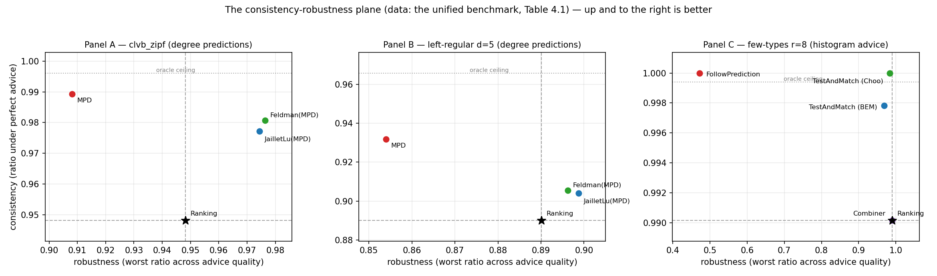
FINDING 1 · THE UNIFIED BENCHMARK
Every wide gap is a downside gap
Consistency–robustness plane: up and to the right is better, and the star marks the advice-free floor.
0.990
0.009
0.472
0.990
advice-free Ranking
already reaches
total headroom left
for perfect advice
unguarded prediction-
following collapses to
the guarded algorithm
holds, whatever the advice
Notes:
This is the central result, and the figure is the consistency–robustness plane: each algorithm is a point, horizontal axis is how it does under the worst advice, vertical axis is how it does under perfect advice. Up and to the right is better. Read the four numbers underneath. On the few-types instances, the advice-free baseline — Ranking, which uses no prediction at all — already reaches 0.990 of the offline optimum. Perfect advice reaches 0.999. So the entire consistency headroom, the whole prize for having a good prediction, is 0.009. Now the other side. An algorithm that simply follows the same prediction without guarding itself collapses to 0.472 when the prediction is bad — less than half the optimum, and far below the baseline that ignores predictions entirely. The guarded algorithm holds 0.990 whatever the advice. So the asymmetry is roughly fifty to one. Every wide gap in this benchmark is a downside gap; nothing widens on the upside. The practical worth of these sophisticated algorithms is not that they win — it is that they never crash.

Slide 7
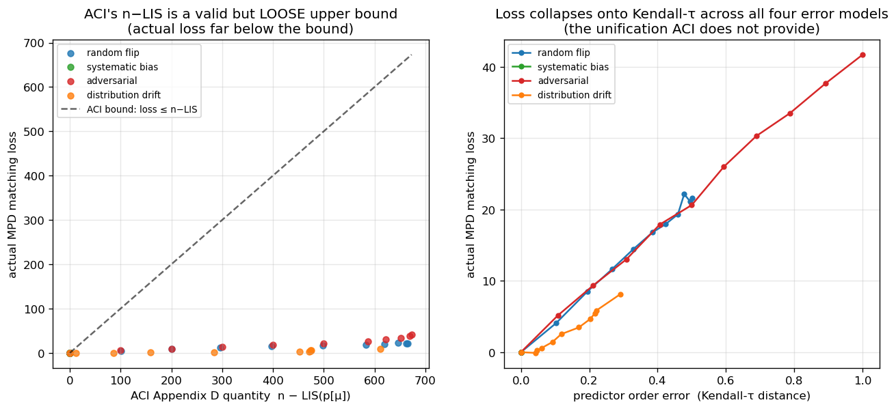
FINDING 2 · THE RESIDUAL LOSS
What governs the loss is order, not magnitude
All four error models collapse onto one Kendall-τ curve (Spearman ρ = 0.979).
A monotone rescaling of the predictor changes nothing at all.
The known n − LIS bound is loose by 16–75× and saturates — it cannot tell a harmful prediction from a harmless one.
(a) realised loss against the known bound · (b) the same loss against Kendall-τ
Attribution: order-dependence itself is Aamand–Chen–Indyk's theorem. Mine is the characterisation — which order measure governs the loss, and how loose the known bound is.
Notes:
The loss is small — so what governs it? The algorithm consumes its predictor only through the ordering it induces, so the question is not how large the error is but which order error matters. Plotted against a Kendall-tau order error — the fraction of resource pairs ranked in the wrong relative order — all four error models collapse onto one curve, Spearman 0.979. A purely monotone rescaling has zero order error and, as predicted, zero loss. The left panel also shows the known bound from the literature is correct but loose by sixteen to seventy-five times, and saturates near its maximum for every non-trivial error — so it cannot tell a harmful prediction from a harmless one. On credit: that order rather than magnitude matters is Aamand, Chen and Indyk's theorem. Mine is the characterisation — which order measure governs the loss, and how much room their bound leaves.

Slide 8
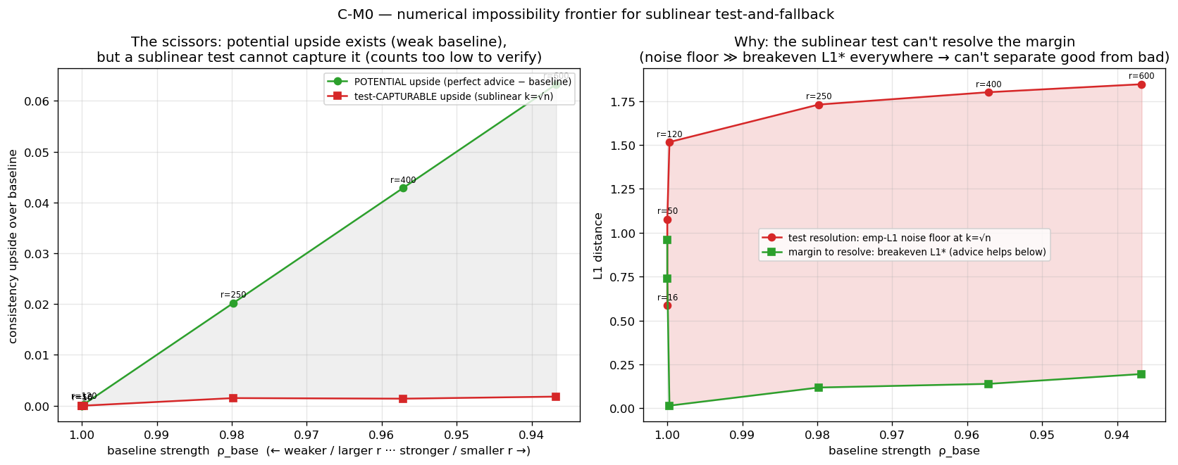
FINDING 3 · TEST-AND-FALLBACK
A more accurate test can make a worse decision
The worst-case-calibrated threshold is far too lenient on average-case inputs.
So a larger, more accurate prefix test decides worse than a small, noisy one.
Recalibration removes the pathology and exposes what is underneath.
The resolution limit
No practical acceptance threshold can capture an upside smaller than its own estimator's noise — and this holds across the whole difficulty range, not just at one setting.
Potential upside grows as the baseline weakens; the upside a sublinear test can safely capture stays near zero. The curves separate rather than converge.
Notes:
Question two: what goes wrong inside the adaptive mechanism. First, a calibration pathology. The acceptance threshold is calibrated against the baseline's proved worst-case ratio, which on average-case inputs is far too lenient. The consequence is counter-intuitive: a small, noisy prefix over-estimates the distance, rejects borderline advice and lands safely on the floor — right, but for the wrong reason. A larger, more accurate prefix measures correctly, accepts, and does worse. More measurement, worse decision. Recalibrating removes that pathology, and exposes the deeper thing: the resolution limit. No practical threshold can capture an upside smaller than its own estimator's noise. The figure is the one to remember. Sweeping the number of request types sweeps the baseline's strength. As the baseline weakens the potential upside grows — the upper curve — but the upside a sublinear test can safely capture stays pinned near zero across the whole range. The curves separate rather than converge.

Slide 9
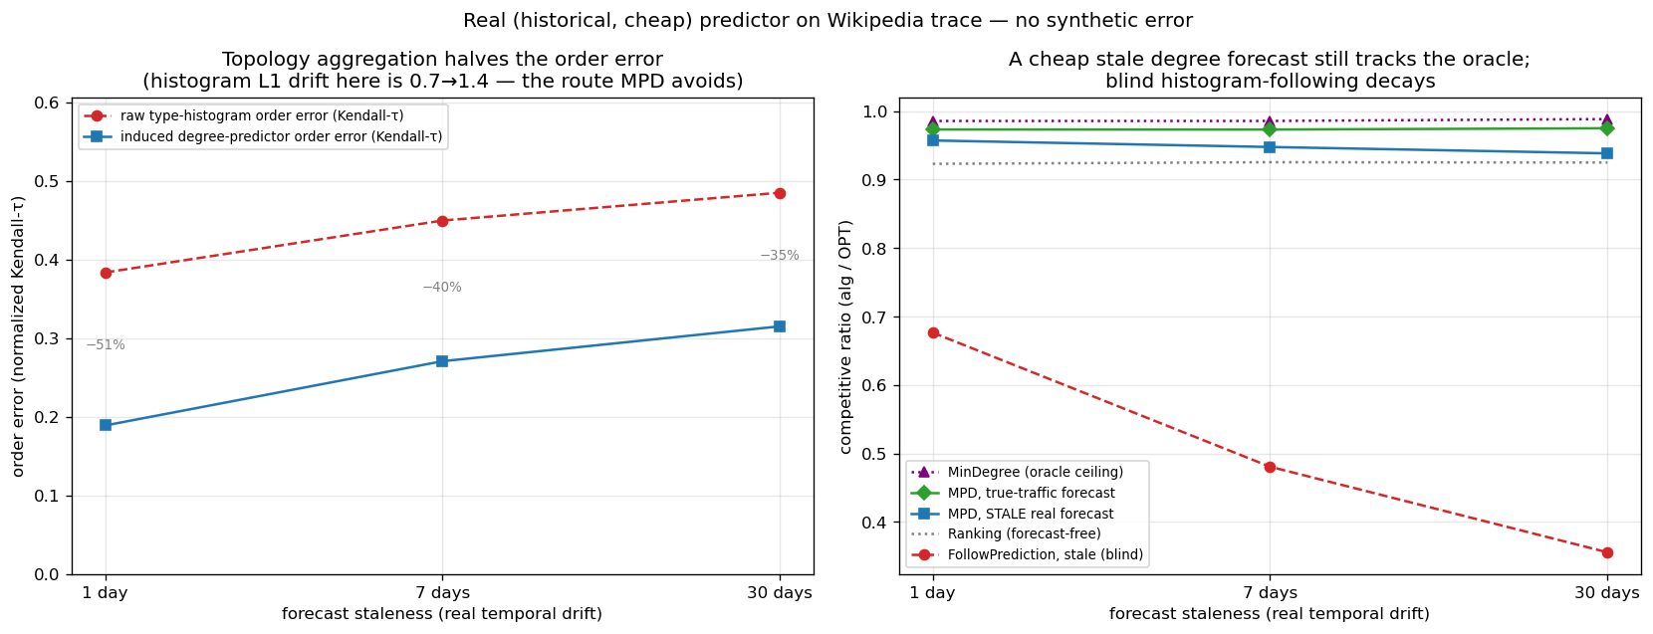
EXTERNAL VALIDITY
It survives real predictors and real graphs
27–68%
of the available gap captured by a linear-time count
0.11 ms
to compute, against 4.4 ms for the optimum itself
A cheap, non-ML predictor: last-window Wikipedia pageview counts, so the error is genuine temporal drift.
Why it works: aggregating the forecast onto the topology halves its order error — and order is all the algorithm consumes.
6 / 6
The same forecast, consumed without a guard, collapses to 0.36 — far below the 0.92 baseline.
real-world graphs on which the crash finding still holds
Notes:
A benchmark on synthetic instances is only worth as much as its external validity, so I replaced the synthetic knob with the cheapest realistic predictor I could think of: last-window historical counts from a real Wikipedia pageview trace, where the error is genuine temporal drift rather than injected noise. Three things. The predictor is cheap — a linear-time count, about a tenth of a millisecond, against four and a half milliseconds to compute the optimum once. Its benefit is real but partial: it captures between twenty-seven and sixty-eight percent of the available gap, falling with staleness, and it never drops below the baseline. And the reason it survives is the mechanism from the previous slide. Aggregating the forecast onto the serving topology roughly halves its order error — and order is the only thing the algorithm consumes. Consuming the very same forecast through the raw histogram route, without a guard, collapses to 0.36 against a 0.92 baseline. I also re-ran the whole roster on six real-world graphs — social, biological and economic. The crash finding holds on all six.

Slide 10
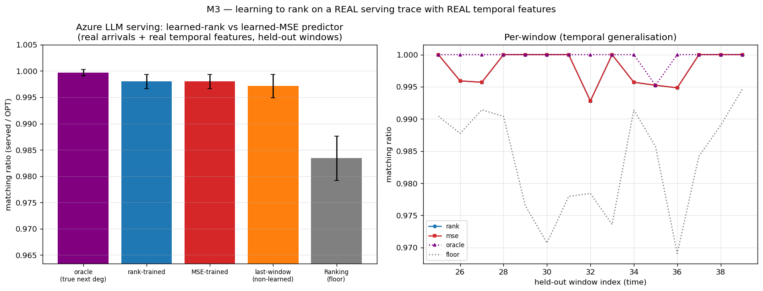
NEGATIVE RESULTS
Two attempts to get past the wall
Reported as results, not omitted.
The mechanism is real: with engineered features, training the predictor for order beats training it for accuracy — 0.989 vs 0.974 — while fitting the truth worse.
M0
But the advantage is doubly gated, and peaks at +1.3% of the ratio.
M1
M3: rank- and MSE-trained predictors are indistinguishable on real features.
Second attempt: a tail objective
And on genuine temporal features from a real trace it vanishes: identical order (τ = 0.126 both), identical matching.
If throughput is too forgiving, try latency. Under bursty load the best non-predictive policy comes within 3% of a policy that knows the future exactly.
M3
Notes:
I did not simply accept the wall. Two attempts to get past it, both reported as results rather than left out. First, train the predictor better: since the algorithm consumes only the ordering, train it with an order-aware loss. M0 shows the mechanism is real — with engineered features the rank-trained predictor reaches 0.989 against 0.974 while fitting the truth worse. M1 shows the advantage is doubly gated and peaks at just over one percent. M3 is decisive: on genuine temporal features from a real trace the two predictors produce identical order and identical matchings. The divergence that powers the idea is a property of engineered features. Second, change the objective — if throughput is too forgiving, try tail latency under bursty load. There the best non-predictive policy comes within three percent of a policy that knows the future exactly. Both negatives reinforce the finding rather than escaping it.

Slide 11
THEORY · OUTLOOK
Why the wall should be expected
Every test-and-fallback algorithm, deciding by any measurable rule on its prefix, satisfies
(1 − η_{c}) ≤ η_{r} + γ_{k} + o(1)
forgone upside ≤ robustness loss + how far apart the two prefix distributions are
“Consistent and robust” becomes a question of sample complexity: how long a prefix is needed to tell good advice from bad?
The stakes are capped by the baseline's slack — so on strong-baseline instances the required prefix exceeds the whole instance.
≈ 0.004
the upside the reading says no rule can capture at the benchmark's parameters — exactly the order of the upsides I measured.
Scope: only the inequality above is proved here. The budget law behind the number, and whether it extends past decomposable families, is not established in this thesis.
Notes:
Question three. Is the wall an accident of my inputs, or should it be expected? I prove one inequality. Take two instance distributions sharing the same advice — one where following it helps, one where it hurts. Every test-and-fallback algorithm, deciding by any measurable rule on its prefix, satisfies the displayed bound: the upside it forgoes is bounded below by its robustness loss plus the statistical distance between the two prefix distributions. The proof is a short conditioning argument — no function of the prefix can behave differently on two prefix distributions that are statistically close. That converts "consistent and robust" into a question of sample complexity. Reading my measurements through it: the stakes are capped by the slack the baseline leaves, so on strong-baseline instances the prefix you would need exceeds the whole instance. At the benchmark's parameters that puts the uncapturable upside at about 0.004 — exactly the order of the upsides I measured. On scope, because this is where I would expect you to push: only the inequality is proved here. The budget law behind the number, and whether it extends beyond decomposable families, is not established in this thesis, and I say so wherever the outlook is used.

Slide 12
EVALUATION
What the project achieved, and what it did not
The brief: met, with one substitution
With hindsight
1
reproduction and graph types as asked; the extension went to learning-augmented, not streaming — Appendix A.7 now adds that arm
Right structured error models — the proposal's own design bet, and i.i.d. noise would have hidden the order effect entirely
My RQ1 and RQ3: met
2
the theoretical ordering does not match the practical one; the fallback mechanism's real cost is measured in full
Right validating against Borodin et al. before building anything on the harness
RQ2: met in part
3
Debatable measuring only matching size — a second objective should have run through the whole benchmark
the order-error curve is stronger than I asked for; where algorithms' curves cross is answered only qualitatively
Not delivered: the adversarial arm
Process I ran the synthetic stages before the real-feature test; the cheaper, decisive experiment should have come first
4
my proposal made arrival order an independent variable — I worked only in known-i.i.d., the model where my headline is most likely to hold
Notes:
Let me be explicit about how far the project got against its own aims, because I think that is the fair way to be examined. The brief I was given asked me to reproduce some of Borodin et al.'s experiments, extend them with additional algorithms, and compare on different graph types. The reproduction and the graph types are done. The extension is done but not in the direction the brief suggested — it named streaming or offline algorithms, and my proposal substituted the learning-augmented family, on the argument that its theory had outrun its experiments. I raised that with my supervisor before starting and I would defend it, but it is a substitution rather than an addition. Against my own proposal: RQ1, whether the theoretical ordering matches the practical one, is answered, and the answer is no — the worst-case-designed algorithms are the weakest advice-free entries here. RQ3, the real cost of the fallback mechanism, is answered most completely. RQ2, the shape of the error curves and where they cross, only in part. And one thing I promised and did not deliver. My proposal made arrival order an independent variable, to be reported separately for random, adversarial and real order. I worked only in known-i.i.d. Real order appears through the traces, but there is no adversarial arm — and known-i.i.d. is exactly the model where my headline is most likely to hold. That removed the one condition that could have falsified it, which is why it heads the future work.

Slide 13
CONCLUSION
Where predictions cannot help
1
A cheap, order-faithful predictor already captures nearly all there is to capture.
Where to look next
Adversarial or non-stationary arrivals, where the baseline is provably far from optimal
Objectives on which the baseline is not near-optimal
Completing the budget–stakes law
2
The sophisticated machinery earns its keep as insurance, not as performance.
3
Finding out whether to trust a prediction costs more, on these inputs, than the prediction is worth.
Recognising where predictions cannot help is, I hope, as useful as knowing where they can.
Thank you — happy to take questions.
Notes:
To close. On average-case online matching the honest verdict has three parts. A cheap, order-faithful predictor already captures nearly all there is to capture. The sophisticated machinery earns its keep as insurance rather than as performance. And finding out whether to trust a prediction costs more, on these inputs, than the prediction is worth. Where should someone look for predictions that genuinely pay? Precisely where I did not: adversarial or non-stationary arrival orders, where the advice-free baseline is provably far from optimal; objectives on which the baseline is not near-optimal, such as tail latency or fairness; and finishing the budget–stakes law so that the outlook becomes a characterisation rather than a reading. This is a study of the limits of a popular idea on one well-understood problem. Recognising where predictions cannot help is, I hope, as useful as knowing where they can. Thank you. I am happy to take questions.

Slide 14
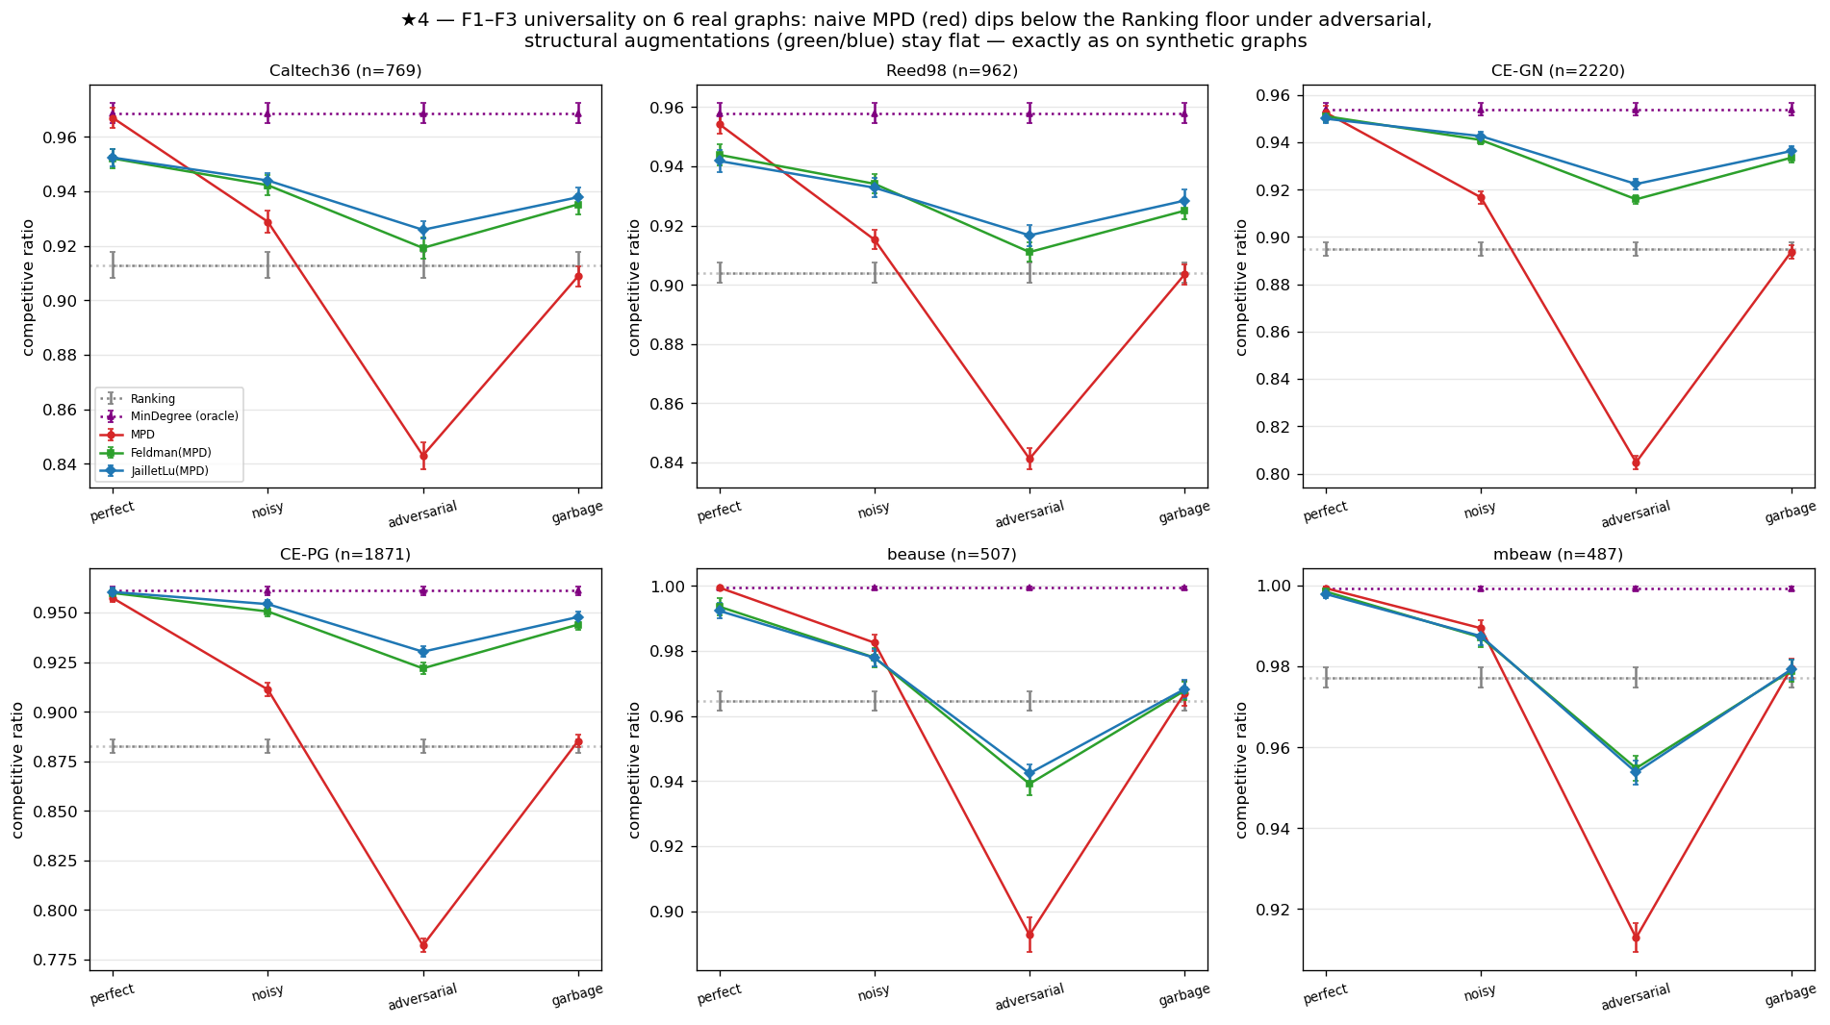
FOR QUESTIONS
Backup · the four findings on six real graphs
F1
naive following falls below the advice-free floor on all six, by 0.06 to 0.10
F2
structural robustness holds qualitatively on all six; strictly on the four social and biological graphs
F3
the consistency upside is small everywhere (mean +0.049) and smallest exactly where the baseline is strongest
F4
the augmentation rescues the worst-case-designed algorithms: 0.73–0.77 lifted to 0.99
Notes:
Backup slide. The four findings of the unified benchmark, re-run on six real-world graphs from Network Repository — two Facebook social, two C. elegans biological, two economic input-output. F1 and F3, the two load-bearing findings, hold on all six. F2 holds qualitatively on all six and strictly on four; the two exceptions are the dense economic graphs, where matching is nearly trivial — so there is neither upside to capture nor much downside to protect. That boundary is F3's own mechanism at work rather than an exception to it. F4 is the most dramatic: the worst-case-designed algorithms are the weakest advice-free entries on these graphs, and the prediction lifts them by 0.26.

Slide 15
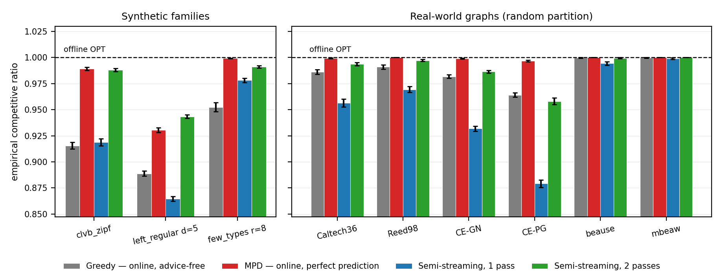
FOR QUESTIONS · APPENDIX A.7
Backup · the relaxation ladder
The brief suggested streaming or offline algorithms. Placed as a ladder of relaxations of the same instance, they separate the online model's two constraints — bounded memory, and no revision.
One pass is not a free lunch — edge arrival with O(n) memory is worse than online Greedy on seven of nine graphs — 0.879 against 0.964 on CE-PG. Both leave maximal matchings; grouping a node's edges together is what helps.
The second pass is the lever — one revision pass beats a perfect degree prediction on seven of nine, including all six real graphs (CE-PG +0.079 against +0.033).
So the residual gap is irrevocability — not missing information. But a second pass is not an online algorithm — where decisions are physically committed, prediction is the only route.
Notes:
Backup slide: the relaxation ladder, Appendix A.7. This is the arm the brief actually suggested — streaming or offline algorithms — done at reduced scope after the main work, and arranged so it speaks to my own question rather than sitting beside it. Semi-streaming means the graph arrives as a stream of edges, memory is O(n), and you may take several passes; so relative to online vertex arrival it takes memory away and gives revision back. Two things came out. First, one pass is not a free lunch: it is worse than online Greedy on seven of the nine graphs, because vertex arrival groups a node's edges together and a random edge order does not. Second, the second pass is the lever — one revision pass buys more than a perfect degree prediction on seven of nine, including every real graph. That locates the residual gap in irrevocability rather than in missing information, which is the same conclusion Chapter 6 reaches from the other side. The honest caveat is that a second pass is not an online algorithm at all: where the decision is physically committed on arrival, prediction is the only one of the two routes available. The ladder measures the size of each route's upside, not its applicability.

Slide 16
FOR QUESTIONS
Backup · limitations, stated plainly
Input model
Known-i.i.d. throughout. The wall is an average-case statement; I do not claim it for adversarial arrival order.
Test model
An empirical ℓ1 surrogate for the unimplemented tolerant tester, following the original authors.
Objective
Matching size only. On tail latency, fairness or recompute cost the picture could differ.
Data breadth
Each real modality is exercised by one trace.
Theory scope
One proved inequality plus a quantitative reading. No theorem beyond that is claimed.
Scale: 16 figures, all regenerated from a fixed seed by a single script; reproduction guide in Appendix A.
Notes:
Backup slide: the limitations, as stated in the thesis. The two I would volunteer first if asked what most constrains the conclusion are the input model and the objective. The wall is an average-case statement in the known-i.i.d. model, and it is a statement about matching size. Both are named in the future work as exactly where a positive counterpart should be looked for. On the test model: the surrogate is what the original authors specify, and section 10.2 argues its blindness is structural rather than an implementation artefact — but that argument is an interpretation of measurements, not a measurement of an actual tolerant tester.

