Slide 1
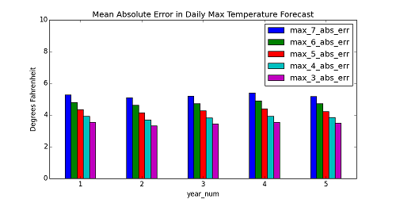
Accuracy of NWS Medium Range Weather Forecasts
Jan 8, 2011 – Jan 7, 2016
General Assembly – Data Science class project
Bruce Aker
January 21, 2016

Slide 2
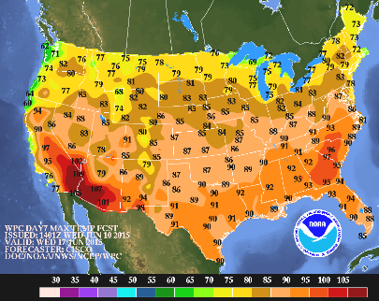
Hypothesis: Errors in weather forecasting are decreasing and there is very little systematic error
I. Forecast Data: Historical weather forecasts are available from WPC* (part of NWS) in graphical format. These are medium range forecasts (valid for 3, 4, 5, 6 and 7 days ahead) and include daily maximum and minimum temperature and the probability of precipitation for various weather stations around the continental United States.
Maximum temperature forecast issued 6/10/15 valid for 6/17/15 (7 day forecast)
*See Addendum for abbreviations
DAY7_MAX_2015061012_filled.gif

Slide 3
II. Obtaining the forecast weather numbers: the forecast numbers are embedded in the graphic image (.gif) of a map of the U.S. A procedure was developed to extract these numbers
III. Extraction Procedure: the numbers contained up to three characters (within range -99 to 999) from a set of eleven characters (0, 1, 2,…, 9, -). The character font, color (black), size, location was (almost) always the same. There was no other black color, no anti-aliasing and the character overwrote the other colors. The strategy was to search the pixel array at certain locations for the pixel patterns of the characters comprising the number using Python (poor man’s OCR).
((1,1,1,1,1,1,1,1,0), # 2 upside down
(1,1,1,1,1,1,1,1,0),
(0,1,1,0,0,0,1,1,0),
(0,0,1,1,0,0,0,1,0),
(0,0,0,1,1,0,0,0,0),
(0,0,0,0,1,1,0,0,0),
(0,0,0,0,0,1,1,0,0),
(0,0,0,0,0,1,1,1,0),
(0,0,0,0,0,1,1,1,0),
(1,0,0,0,0,1,1,1,0),
(1,1,0,0,1,1,1,1,0),
(0,1,1,1,1,1,1,0,0),
(0,0,1,1,1,1,0,0,0)),
Python tuple with 1’s (pixel in the character) highlighted

Slide 4
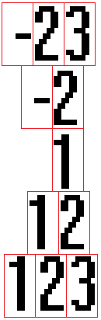
Searched for 88 weather stations, identified by ICAO ID, e.g. KSEA for Seattle Tacoma airport
The starting position of the number varied depending upon number of characters and negative or positive.
Search for negative numbers first, otherwise might erroneously find a positive number

Slide 5
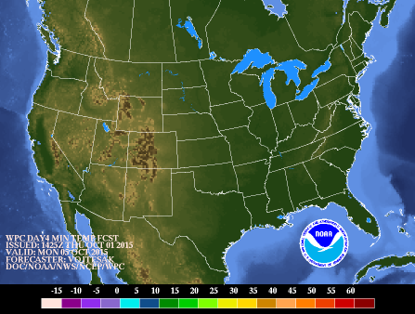
IV. Missing Data: Some of the graphics were missing numbers:
2015100112_DAY4_MIN_filled.gif
Some image files were completely missing: 2/29/12, 3/3/13
One image file was missing it’s number for Muncie, IN
Some early image files missing numbers for several locations
Image size smaller (and smaller font) for before ~December 2012
Precipitation forecast mostly not available in 2011

Slide 6
V. Obtaining GIF image files: systematically named and publicly available via HTTP.
www.wpc.ncep.noaa.gov/archives/medr/20150125/DAY7_MIN_2015012512_filled.gif
Downloaded with Python using the requests module and then wrote to disk as a binary file
VI. Convert .GIF images to .BMP images:
GIF is a compressed format – harder to work with the pixel data
BMP is uncompressed format – pixel data laid out systematically in memory
Used Python PIL module (Python Image Library) to convert
VII. Obstacles overcome:
1.) Subtle file name change on 12/8/12:
DAY7_MIN_20150125_filled.gif DAY7_MIN_2015012512_filled.gif
2.) Some numbers were to the right or left by one pixel, for example, a few locations display single digit positive numbers one pixel to the left in the precipitation forecast images. Two other cases like this.

Slide 7
VIII. Obtaining the observed weather data:
Data is available from NOAA > NCEI (formerly NCDC) > CDO > Web Services v2
Used Python requests and JSON modules
Obtained for each day data types: TMax, TMin, PRCP, SNOW
www.ncdc.noaa.gov/cdo-web
All responses are JSON and are a single item or a collection of items with metadata
Limited to 5 requests per second and 1000 requests per day
JSON response row limit (in 'results' list) defaults to 25, max is 1000 (set 'limit' query string)
Need a token, easily obtained via email
Obstacles overcome:
1.) Find set of weather stations in which both forecast and observables was available
2.) Find weather station identifier needed by CDO: WBAN ID, not COOP ID as specified in examples on website, not ICAO ID (cross-reference the IDs using the MSHR)
IX. Accuracy of data:
Several forecast numbers extracted from the image files were compared to the numbers displayed in the images and found to be identical.
Several of the downloaded observable numbers were compared to another NWS website and found to be identical

Slide 8
X. Combining the forecast and observed data:
Long table of Forecast data:
wea_stn_cd,issue_date,forecast_type_day,wea_num,valid_date_calcd
KABE,20110101,min_7,20,20110108
KABQ,20110101,min_7,25,20110108
KACV,20110101,min_7,38,20110108
KACY,20110101,min_7,20,20110108
KALB,20110101,min_7,17,20110108
.
.
.
2.66 million rows, 86 MB
Long table of observations:
wea_stn_cd,valid_date,wea_num_type,wea_num
KABE,20110108,prcp,0.039
KABE,20110108,tmin,9.0
KABE,20110108,tmax,27.0
KABE,20110108,snow,0.59
KABE,20110109,prcp,0.0
KABE,20110109,tmin,21.0
KABE,20110109,tmax,30.0
KABE,20110109,snow,0.0
.
.
.
626,000 rows, 15 MB
So, using Python and pandas, pivot on forecast_type_day and wea_num_type (index = Wea_Stn, Valid_date) and join to get…

Slide 9
…one wide table with all data:
wea_stn_cd,valid_date,max_3,max_4,max_5,max_6,max_7,min_3,min_4,min_5,min_6,min_7,pop1_3,pop1_4,pop1_5,pop1_6,pop1_7,pop2_3,pop2_4,pop2_5,pop2_6,pop2_7,prcp,snow,tmax,tmin
KGRB,20151224,36.0,38.0,39.0,40.0,42.0,29.0,32.0,32.0,31.0,32.0,40.0,52.0,38.0,31.0,27.0,17.0,23.0,19.0,16.0,23.0,0.012,0.0,37.0,30.2
.
.
.
160,000 rows, 18 MB
Unique row ID: wea_stn_cd (e.g. KSEA) and valid_date (YYYYMMDD)

Slide 10
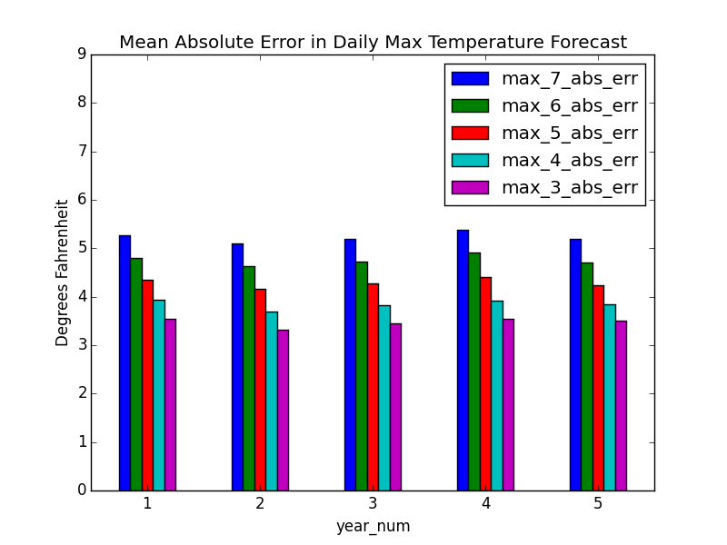
XI. Analysis:
Calculate average of Abs(Forecast minus Observed) and plot by year_num
(year_num = 1 is 1/8/11 – 1/7/12)

Slide 11
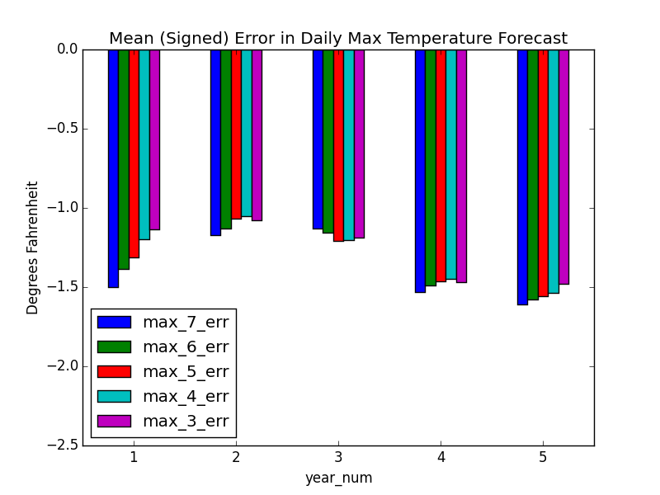
Calculate average of Forecast minus Observed and plot by year_num
(systematic error, negative number means forecast too low)

Slide 12
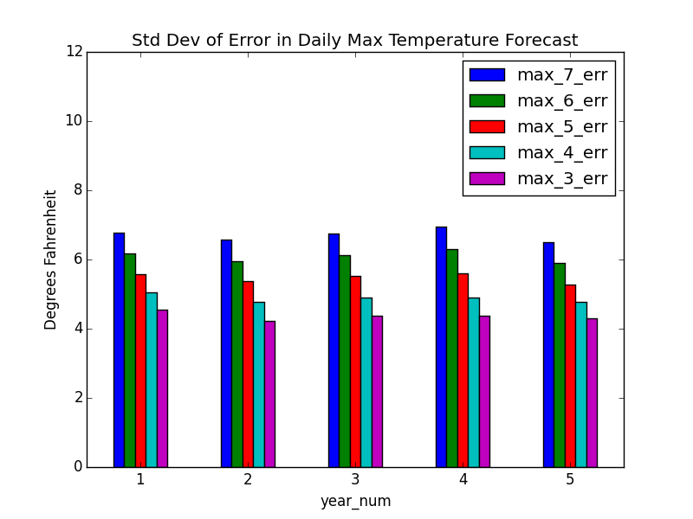
Calculate standard deviation of Forecast minus Observed and plot by year_num
(random error)

Slide 13
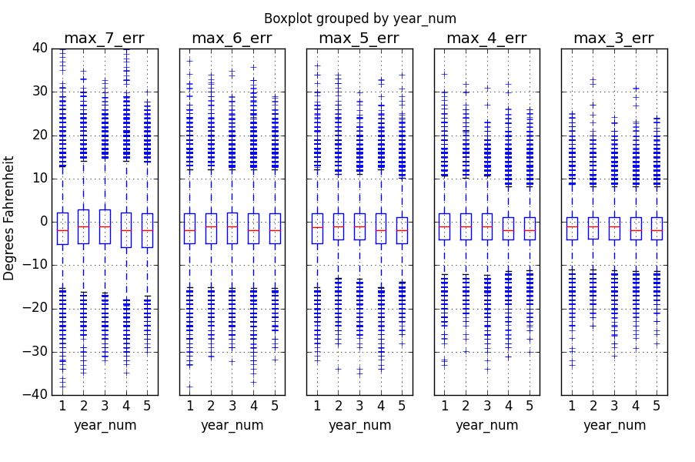
Box Plot(s) summarizes the data best
(shows location and variation, medians all below zero)

Slide 14
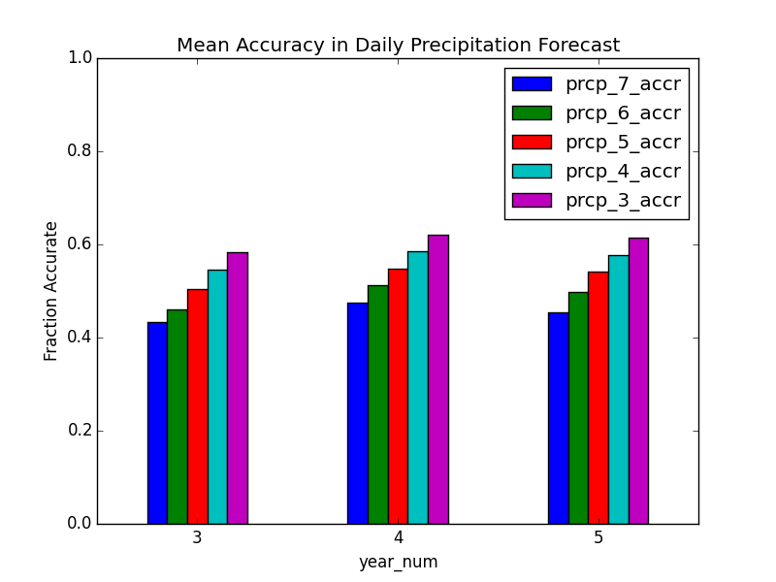
If Probability of Precipitation <= 5% and no rain or snow then score 1
Or if Probability of Precipitation > 5% and measureable rain or snow then score 1
Otherwise score 0

Slide 15
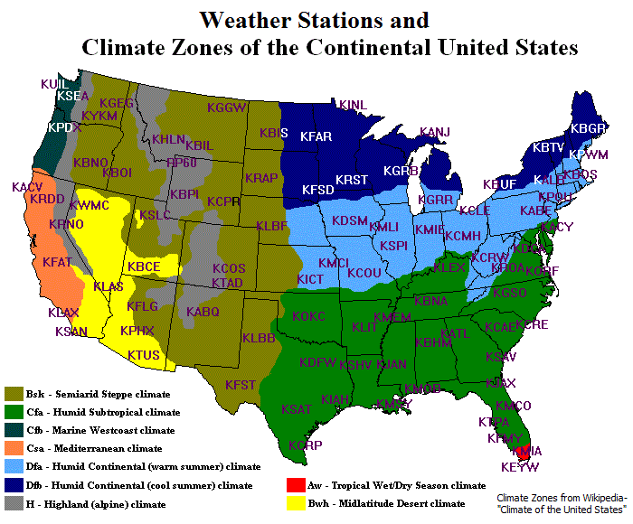
XII. To do: analyze errors by climate zone

Slide 16
XIII. More To Do:
Investigate outliers
Investigate missing data
Check for duplicate data
Check for non-ASCII characters
Analyze errors by season, month of the year, etc.
Analyze errors by variation of daily normal values (e.g. variation of normal maximum temperature for a given day of the year and weather station)
Obtain forecast data from the nonstandard images, nonstandard font
Further investigate accuracy of data

Slide 17
ADDENDUM
All units either °F, inches, or percent (for pop1, pop2, dly-prcp-pctall, dly-snow-pctall)
GENERAL
COOPID - Weather station ID, 6 digits, sometimes prefaced with USC00
Error = forecasted – observed (for temperatures)
ICAO Code/ID - Identifier for weather station (e.g. KSEA for Seattle Tacoma airport)
STNID - (weather) station ID, issued by NCEI (formerly NCDC), 8 digits
stn_id_cdo - (weather) station ID needed by CDO website (WBAN, COOP,...), prefaced with a key, e.g. GHCND:USW00024243, COOP:USC00123456
WBANID - Weather station ID, 5 digits, sometimes prefaced with USW000
Wea_stn_cd – ICAO weather station code/ID (e.g. KSEA for Seattle-Tacoma airport)
Weather number – value for tmax, tmin, prcp, snow, predicted min/max temp, POP
Z = UTC, e.g. 1425Z = 14:25 UTC (Universal Coordinated Time)
ABBREVIATIONS
CDO - Climate Data Online
COOP - Cooperative Observer Program
GHCN - Global Historical Climatology Network
HPC Hydrometeorological Prediction Center (now WPC)
ICAO - International Civil Aviation Organization
MSHR - Master Station History Report
NCDC - National Climate Data Center (now NCEI)
NCEI - National Centers for Environmental Information (née NCDC)
NCEP National Centers for Environmental Prediction
NOAA - National Oceanic and Atmospheric Administration
NWS - National Weather Service
OCR – Optical Character Recognition
WBAN - Weather Bureau, Air Force, Navy
WFO - Weather Forecast Office
WPC - Weather Prediction Center (née HPC)

Slide 18
ADDENDUM CONTINUED:
FORECASTS
Forecast_Day – 3 thru 7 days ahead (WPC medium range forecasts)
Forecast_Type – Min/max temp or POP
Issue date – date forecast was issued (YYYYMMDD)
MAX_3 – predicted maximum temperature 3 days ahead (resolution 1°F)
MAX_7 – predicted maximum temperature 7 days ahead (resolution 1°F)
MIN_3 – predicted minimum temperature 3 days ahead (resolution 1°F)
MIN_7 – predicted minimum temperature 7 days ahead (resolution 1°F)
POP1 – Probability of Precipitation (>= 0.01") at 1200Z (percent)
POP2 – Probability of Precipitation (>= 0.01") at 0000Z (percent)
Valid date – date forecast is valid for (YYYYMMDD)
Valid_date_calcd – calculated from issue date and forecast day (e.g. 3,4,5,6,7) (YYYYMMDD)
wea_num - value for forecasted min/max temp, POP
OBSERVABLES – actual weather data
prcp - observed rain amount, does not include snow, resolution ~0.004 inches
snow - observed snowfall amount, resolution ~0.04 inches
tmax – observed max temp, resolution ~0.2°F
tmin – observed min temp, resolution ~0.2°F
Valid date – date observation was made (YYYYMMDD)
wea_num_type - tmax, tmin, prcp, or snow
wea_num - value for tmax, tmin, prcp, snow
DAILY NORMALS (calculated from 1981 - 2010; resolutions: temperature 0.1°F, precipitation 0.01", snowfall 0.1", probability 0.1%)
(dly-)tmax-normal - Long-term averages of daily maximum temperature
(dly-)tmax-stddev - Long-term standard deviations of daily maximum temperature
(dly-)tmin-normal - Long-term averages of daily minimum temperature
(dly-)tmin-stddev - Long-term standard deviations of daily minimum temperature
(dly-)prcp-50pctl - 50th percentiles of daily nonzero precipitation totals for 29-day windows centered on each day of the year
(dly-)prcp-pctall - Probability of precipitation >= 0.01 inches for 29-day windows centered on each day of the year (aka DLY-PRCP-PCTALL-GE001HI)
(dly-)snow-50pctl - 50th percentiles of daily nonzero snowfall totals for 29-day windows centered on each day of the year
(dly-)snow-pctall - Probability of snowfall >= 0.1 inches for 29-day windows centered on each day of the year (aka DLY-SNOW-PCTALL-GE001TI)
Valid_day - day of the year for which normal applies (MMDD)
wea_num_type - dly-tmax-normal, dly-tmax-stddev, dly-tmin-normal, dly-tmin-stddev, dly-prcp-50pctl, dly-prcp-pctall, dly-snow-50pctl, or dly-snow-pctall

