Slide 1


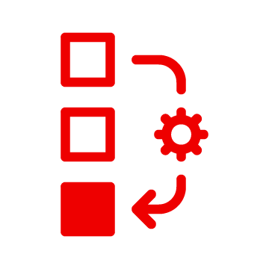












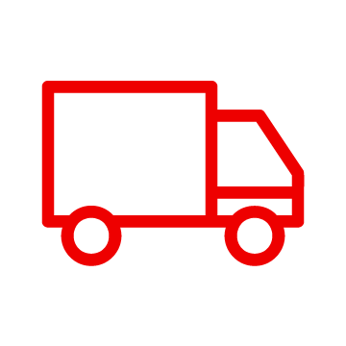

Supply Chain Optimization
Business Drivers
Container Platform
Resilient inventory management systems handle unexpected events and disruption to ensure business success
Customer
Supply Assurance Control Tower
Business Automation
Right product at the right time, matching customer expectations
Colleague
Fulfilment Optimization
API Management
Data Storage
Supplier Partner
Vendor
Inventory Analysis & AI
Integration
Enhanced customer experience with inventory matching customer demand
Red Hat Software as a Service
Increased margins and improved net zero benefits due to reduce food waste and spoilage
Events
Core Application Systems
Perfect product delivery delighting customers
Order Management
Supply Chain Systems
Transport System
Catalog Management System

Slide 2
Demand Risk
Business Drivers
Container Platform
Manage inventory turnover
Customer
Supply Assurance Control Tower
Business Automation
Manage capacity across the enterprise and with suppliers
Colleague
Fulfilment Optimization
API Management
Data Storage
Supplier Partner
Vendor
Inventory Analysis & AI
Integration
Enhanced customer experience with inventory matching customer demand
Red Hat Software as a Service
Handle overstock and understock
Events
Core Application Systems
Order Management
Supply Chain Systems
Transport System
Catalog Management System

Slide 3
Loss and Waste Management
Business Drivers
Container Platform
Create a world-class sensing and risk-monitoring operation
Customer
Supply Assurance Control Tower
Business Automation
Accelerate automation in extended workflows,integrating loss and waste management into the core supply chain
Colleague
Fulfilment Optimization
API Management
Data Storage
Supplier Partner
Vendor
Inventory Analysis & AI
Integration
Protect reputation
Red Hat Software as a Service
Avoid penalties and fines
Events
Core Application Systems
Order Management
Supply Chain Systems
Transport System
Catalog Management System

Slide 4
Delivery Optimization
Business Drivers
Container Platform
Resilient inventory management systems handle unexpected events and disruption to ensure business success
Customer
Supply Assurance Control Tower
Business Automation
Right product at the right time, matching customer expectations
Colleague
Fulfilment Optimization
API Management
Data Storage
Supplier Partner
Vendor
Inventory Analysis & AI
Integration
Enhanced customer experience with inventory matching customer demand
Red Hat Software as a Service
Increased margins and improved net zero benefits due to reduce food waste and spoilage
Events
Core Application Systems
Perfect product delivery delighting customers
Order Management
Supply Chain Systems
Transport System
Catalog Management System

Slide 5
Product Timeliness
Business Drivers
Container Platform
Public safety
Customer
Supply Assurance Control Tower
Business Automation
Product liability claims
Colleague
Fulfilment Optimization
API Management
Data Storage
Supplier Partner
Vendor
Inventory Analysis & AI
Integration
Demonstrate due diligence for safety
Red Hat Software as a Service
Identify and manage stock with reducing relevance to reduce financial loss
Events
Core Application Systems
Order Management
Supply Chain Systems
Transport System
Catalog Management System

Slide 6
Intelligent Order
Business Drivers
Container Platform
Increasing deliveries direct to consumer
Customer
Supply Assurance Control Tower
Business Automation
Need for delivery price-point optimization and improvement
Colleague
Fulfilment Optimization
API Management
Data Storage
Supplier Partner
Vendor
Inventory Analysis & AI
Integration
Customer satisfaction to drive repeat business
Red Hat Software as a Service
Events
Core Application Systems
Order Management
Supply Chain Systems
Transport System
Catalog Management System

Slide 7
Perfect Order
Business Drivers
Container Platform
Supply chain operators will use technologies that provide significant insights into how supply chain performance can be improved
Customer
Supply Assurance Control Tower
Business Automation
Eliminate “out of stock”occurrences
Colleague
Fulfilment Optimization
API Management
Data Storage
Supplier Partner
Vendor
Inventory Analysis & AI
Integration
Optimizes inventory costs by balancing inventory to operational demand
Red Hat Software as a Service
Improve stock allocation to improve space utilization
Events
Core Application Systems
Reduce dormant/non-moving inventory
Order Management
Supply Chain Systems
Transport System
Catalog Management System

Slide 8

Returns Management
Business Drivers
Container Platform
Increase customer loyalty with appropriate returns policies
Customer
Supply Assurance Control Tower
Business Automation
Minimizing returns losses
Colleague
Fulfilment Optimization
API Management
The return process is an opportunity to upsell
Data Storage
Supplier Partner
Vendor
Inventory Analysis & AI
Integration
Identify fraudulent returns
Red Hat Software as a Service
Events
Provide sustainable transport of returned items
Core Application Systems
Order Management
Supply Chain Systems
Transport System
Catalog Management System
Handle disposal of hazardous material correctly
Notes:
The Supply Assurance platform can then combine AI and Data to increase transparency of the supply chain across the enterprise.
A Control Tower provides intelligent analysis of inventory and provides actions that can satisfy customer demand.
Fulfillment optimization provides visibility into inventory location and provides trade offs to balance customer requirements and enhance sustainability.
And inventory analysis keeps up-to-date actionable data on inventory to balance needs across the enterprise.

Slide 9


Disaster Readiness
Container Platform
Business Drivers
Customer
Store or
branch
facilities
Monitor for disruptive environmental conditions
Container Platform
Queued transactions
Predict potential impacts
Supply Assurance Control Tower
Business Automation
Fulfilment Optimization
API Management
Reconfigure supply chain, Reposition inventory
Data Storage
Inventory Analysis & AI
Integration
Red Hat Software as a Service
Route deliveries around impacted areas
Events
Core Application Systems
Continue operations when disconnected from corporate data center
Order Management
Supply Chain Systems
Transport System
Environmental Alert System
Notes:
Monitor for disruptive environmental conditions such as severe weather, wildfires, flooding, air quality, and carbon emissions and send alerts when detected.
Predict potential impacts of climate change and weather across the business using climate risk analytics.
Reconfigure supply chain Some critical but vulnerable suppliers will go out of business.
Reposition inventory in anticipation of certain regions or facilities facing disaster.
Route deliveries around impacted areas.
Continuous operation when store are disconnected from corporate data center.

Slide 10
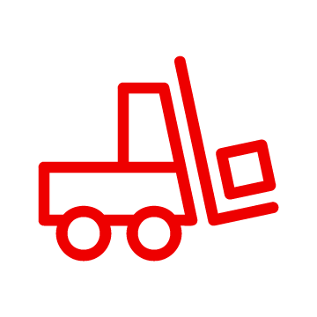
Sustainable Enterprise
Business Drivers
Container Platform
Sustainability is good for business
Customer
Intelligent
Asset / Facility Management
Business Automation
Reduce energy costs
Colleague
Green IT
API Management
Data Storage
Supplier Partner
Vendor
Sustainable
Supply
Integration
Include sustainability criteria in decision making
Red Hat Software as a Service
Improve cost efficiency of data centers and cloud
Events
Core Application Systems
Automate transparency across companies to reach next-generation supply chain efficiency
Warehouse Management
Order Management
Supply Chain Systems
Transport System
Catalog Management System

Slide 11


Transparent Supply
Business Drivers
Container Platform
Enhance traceability
Customer
Intelligent
Asset / Facility Management
Business Automation
Increase efficiency and speed in reducing disruptions
Colleague
Green IT
API Management
Improve financing, contracting, and international transactions
Data Storage
Supplier Partner
Vendor
Sustainable
Supply
Integration
Red Hat Software as a Service
Reduce loss, increase efficiency regarding waste management
Events
Automate transparency across companies to reach next-generation supply chain efficiency
Core Application Systems
Warehouse Management
Order Management
Supply Chain Systems
Transport System
Catalog Management System

Slide 12






Green IT
Business Drivers
Container Platform
Sustainability is good for business
DevOps
Intelligent
Asset / Facility Management
Reduce cost to compute
Site Reliability Engineer
Cluster
Management
Green IT
Facility
Managers
Cluster
Security
Develop forecasts and cost models for cloud and data center operations
Data Storage
Sustainable
Supply
Application Resource Manager
Safely turn off compute that is not in use
Red Hat Software as a Service
Monitors
Events
Develop data for FinOps to operate effective across teams
Core Application Systems
Warehouse Management
Order Management
Supply Chain Systems
Transport System
Catalog Management System
Manage compute clusters efficiently

Slide 13




Sustainable Facility
Business Drivers
Container Platform
Sustainability is good for business
Employees
Intelligent
Asset / Facility Management
Business Automation
Sustainability
Team
Reduce energy and facility maintenance costs
Green IT
API Management
Facility
Manager
Data Storage
Include ESG criteria in decision making
Sustainable
Supply
Integration
Red Hat Software as a Service
Prioritize environmental improvement projects
Events
Core Application Systems
Improve capital project management capabilities
Warehouse Management
Order Management
Supply Chain Systems
Transport System
Catalog Management System

Slide 14

Smart Energy
Business Drivers
Container Platform
Sustainability is good for business
Customer
Intelligent
Asset / Facility Management
Business Automation
Colleague
Energy represents significant cost in business
Green IT
API Management
Supplier Partner
Vendor
Demonstrate ROI with data-driven energy cost savings
Data Storage
Sustainable
Supply Control Tower
Integration
Prioritize capital improvement projects
Red Hat Software as a Service
Events
Facilities maintenance responses can provide energy cost savings
Core Application Systems
Warehouse Management
Order Management
Supply Chain Systems
Transport System
Catalog Management System

