Slide 1













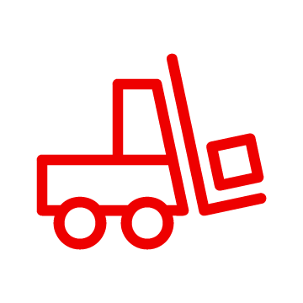


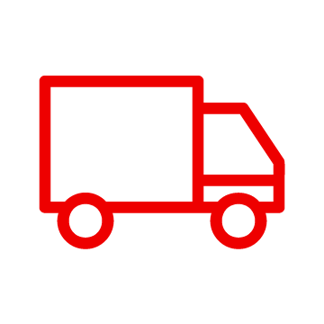

Sustainable Enterprise
Business Drivers
Container Platform
Sustainability is good for business
Customer
Intelligent
Asset / Facility Management
Business Automation
Reduce energy costs
Colleague
Green IT
API Management
Data Storage
Supplier Partner
Vendor
Sustainable
Supply
Integration
Include sustainability criteria in decision making
Red Hat Software as a Service
Improve cost efficiency of data centers and cloud
Events
Core Application Systems
Automate transparency across companies to reach next-generation supply chain efficiency
Warehouse Management
Order Management
Supply Chain Systems
Transport System
Catalog Management System

Slide 2


Transparent Supply
Business Drivers
Container Platform
Enhance traceability
Customer
Intelligent
Asset / Facility Management
Business Automation
Increase efficiency and speed in reducing disruptions
Colleague
Green IT
API Management
Improve financing, contracting, and international transactions
Data Storage
Supplier Partner
Vendor
Sustainable
Supply
Integration
Red Hat Software as a Service
Reduce loss, increase efficiency regarding waste management
Events
Automate transparency across companies to reach next-generation supply chain efficiency
Core Application Systems
Warehouse Management
Order Management
Supply Chain Systems
Transport System
Catalog Management System

Slide 3






Green IT
Business Drivers
Container Platform
Sustainability is good for business
DevOps
Intelligent
Asset / Facility Management
Reduce cost to compute
Site Reliability Engineer
Cluster
Management
Green IT
Facility
Managers
Cluster
Security
Develop forecasts and cost models for cloud and data center operations
Data Storage
Sustainable
Supply
Application Resource Manager
Safely turn off compute that is not in use
Red Hat Software as a Service
Monitors
Events
Develop data for FinOps to operate effective across teams
Core Application Systems
Warehouse Management
Order Management
Supply Chain Systems
Transport System
Catalog Management System
Manage compute clusters efficiently

Slide 4




Sustainable Facility
Business Drivers
Container Platform
Sustainability is good for business
Employees
Intelligent
Asset / Facility Management
Business Automation
Sustainability
Team
Reduce energy and facility maintenance costs
Green IT
API Management
Facility
Manager
Data Storage
Include ESG criteria in decision making
Sustainable
Supply
Integration
Red Hat Software as a Service
Prioritize environmental improvement projects
Events
Core Application Systems
Improve capital project management capabilities
Warehouse Management
Order Management
Supply Chain Systems
Transport System
Catalog Management System

Slide 5
Asset Lifecycle
Business Drivers
Container Platform
Extend asset life
Employees
Intelligent
Asset / Facility Management
Business Automation
Sustainability
Team
Meet strict compliance on asset disposal
Predictice Maintenance
API Management
Assets
Manager
Data Storage
Predict and mitigate asset failure
Sustainable
Supply
Integration
Red Hat Software as a Service
Streamline replacement work order and asset tracking
Events
Core Application Systems
Reduce Capex and maintenance expenses
Warehouse Management
Order Management
Supply Chain Systems
Transport System
Catalog Management System

Slide 6

Smart Energy
Business Drivers
Container Platform
Sustainability is good for business
Customer
Intelligent
Asset / Facility Management
Business Automation
Colleague
Energy represents significant cost in business
Green IT
API Management
Supplier Partner
Vendor
Demonstrate ROI with data-driven energy cost savings
Data Storage
Sustainable
Supply Control Tower
Integration
Prioritize capital improvement projects
Red Hat Software as a Service
Events
Facilities maintenance responses can provide energy cost savings
Core Application Systems
Warehouse Management
Order Management
Supply Chain Systems
Transport System
Catalog Management System

