Slide 1
Version Control for Everyone
How Git + Your Browser = Superpowers
💻
🔀
🌐
✅
You Edit
Git Tracks
Team Reviews
Approved!
Friday Training | Bruce Dombrowski
No CLI required. Just your browser.

Slide 2
😫 The Problem: File Chaos
Sound familiar?
The real questions:
📄 budget_FINAL.xlsx
🤔 Which version is current?
📄 budget_FINAL_v2.xlsx
🔍 What changed between versions?
📄 budget_FINAL_v2_REVISED.xlsx
👤 Who made this change?
📄 budget_FINAL_v2_REVISED_FIXED.xlsx
📅 When was it changed?
📄 budget_ACTUAL_FINAL_USE_THIS.xlsx
❓ Why was it changed?
📄 budget_ACTUAL_FINAL_USE_THIS(1).xlsx
🔒 Can we prove the audit trail?
📄 Copy of budget_DONT_DELETE.xlsx
🤝 Did the team approve this?

Slide 3
🎉 The Solution: Git + Browser
Git tracks every change. Your browser shows it. No software to install.
📜
🔎
👫
Complete
History
See What
Changed
Team
Review
Every version saved
automatically.
Nothing lost. Ever.
Line-by-line diffs.
Green = added.
Red = removed.
Everyone reviews
before it goes live.
Built-in approval.

Slide 4
🎯 How It Works: 5 Easy Steps
📝
💾
📤
💬
✅
Edit
Save
Commit
Review
Approve
Edit your file
(Excel, CSV,
whatever)
Save like
you always do
Click 'Commit'
(one click saves
the version)
Team reviews
in their browser
(comments + diffs)
Approved = merged
to the official
version
💡 The whole team does this in their browser. No command line. No special software.

Slide 5
💻 What You See in Your Browser
📁 budget.csv — Changed 3 lines
Department, Q1 Budget, Q2 Budget, Status
Engineering, $150000, $155000, Active
- Marketing, $80000, $80000, Active
+ Marketing, $80000, $95000, Active ← budget increased!
Operations, $200000, $200000, Active
- Sales, $120000, $120000, Active
+ Sales, $120000, $135000, Active ← budget increased!
HR, $90000, $90000, Active
- IT, $175000, $175000, Pending
+ IT, $175000, $175000, Active ← status changed!
👉 Instantly see exactly what changed, who changed it, and when.

Slide 6
📊 But What About My Excel Files?
Excel is binary (can't see diffs). Solution: auto-convert to CSV!
🚫 Before: Can't See Changes
✅ After: Full Visibility
📄 budget.xlsx uploaded
📄 budget.xlsx + budget.csv
💬 "Binary file changed"
🔎 CSV shows every change
🤷 No idea what's different
🟢 Green = added, 🔴 Red = removed
😒 "Just trust me, I updated it"
🤝 Team approves in browser
💢 Audit nightmare
🏆 Audit-ready automatically
💡 A pre-commit hook auto-converts Excel to CSV. You never think about it.

Slide 7
🌳 Branches: Safe Experimentation
Make changes in a branch. Team reviews. Merge when approved.
📝 Edit, edit, edit
your-changes
💬 Team reviews
(Merge Request)
main
🌱 Branch off
✅ Merge!
🛡️ Safety Guardrails (set once, enforced forever):
🔒 No one can push directly to main — all changes go through review
👫 Required approvers must sign off before merge
🔄 If you change your code after approval, approvals reset automatically

Slide 8
🏛️ Why This Matters: Built-in Compliance
Everything the auditor needs is automatic. No extra paperwork.
📝
👤
📋
🔒
Change Control
(NIST CM-3)
Separation of
Duties (AC-5)
Audit Trail
(AU-3)
Access Control
(AC-6)
Every change tracked
with who, what, when,
and why
Author cannot approve
their own changes.
Systematically enforced.
Complete, timestamped,
tamper-evident history.
No gaps possible.
Least privilege.
View-only for reviewers.
Role-based access.
💡 The auditor opens a URL. Everything is there. Meeting over in 5 minutes.

Slide 9
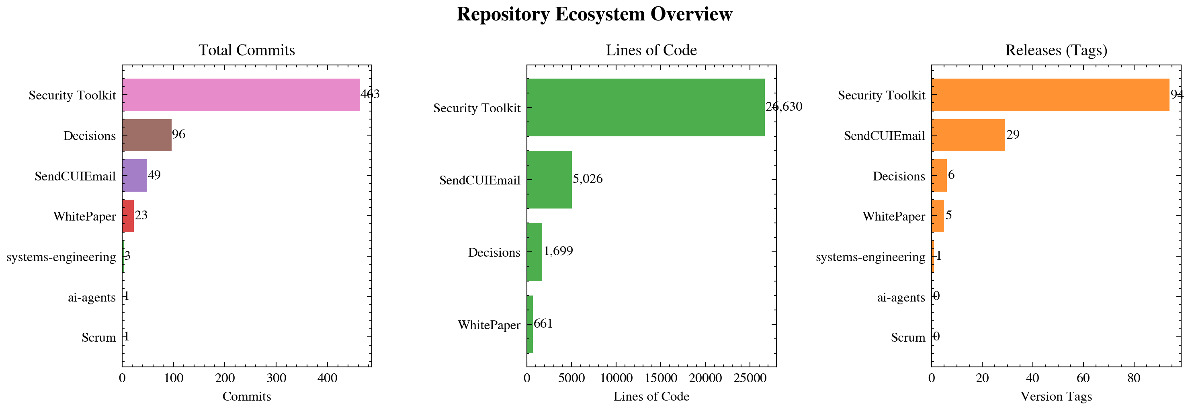
📊 What This Looks Like in Practice
636 commits across 7 repositories in 3 weeks. All tracked. All auditable.
One engineer + AI agents = this output.

Slide 10
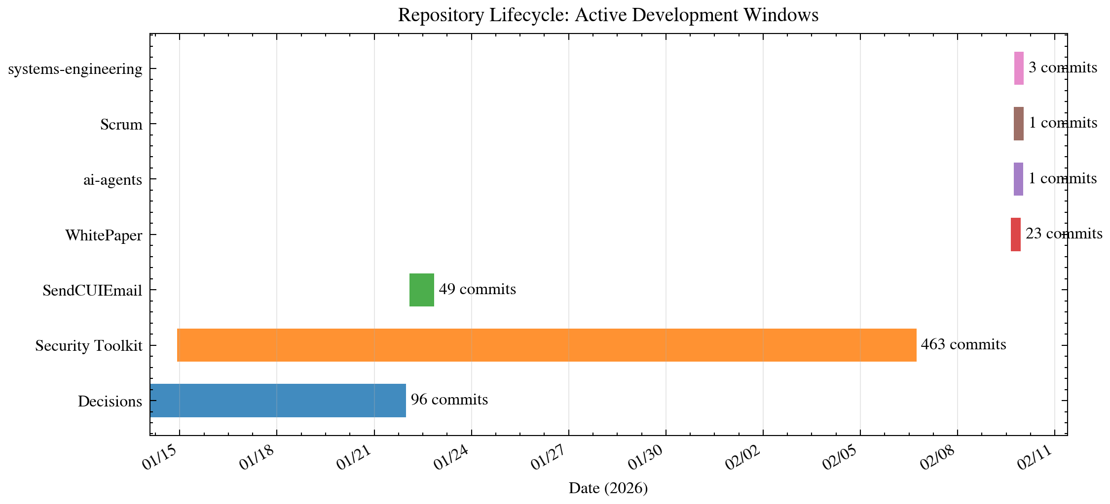
📅 When Things Happened
Each bar = one project's active development window. All running concurrently.

Slide 11
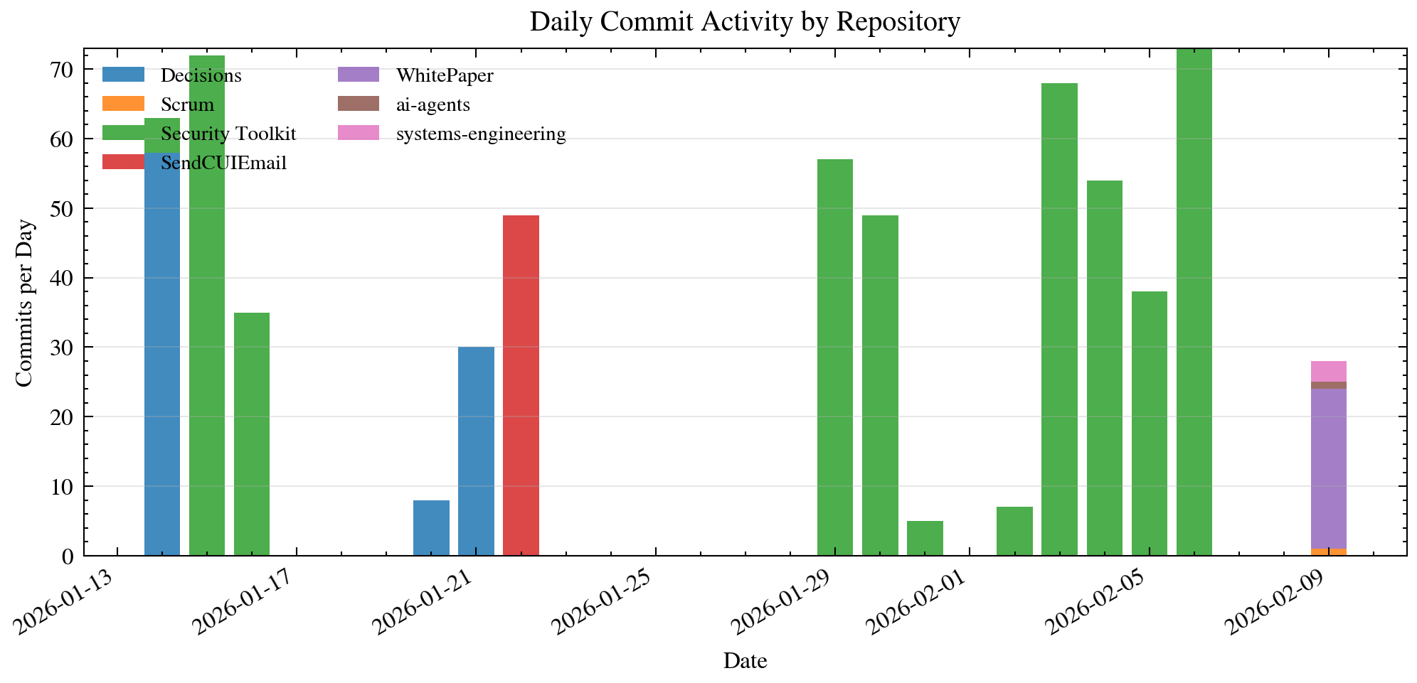
📈 Daily Commit Activity
Every bar = a day of tracked, auditable work. Colors = different projects.

Slide 12
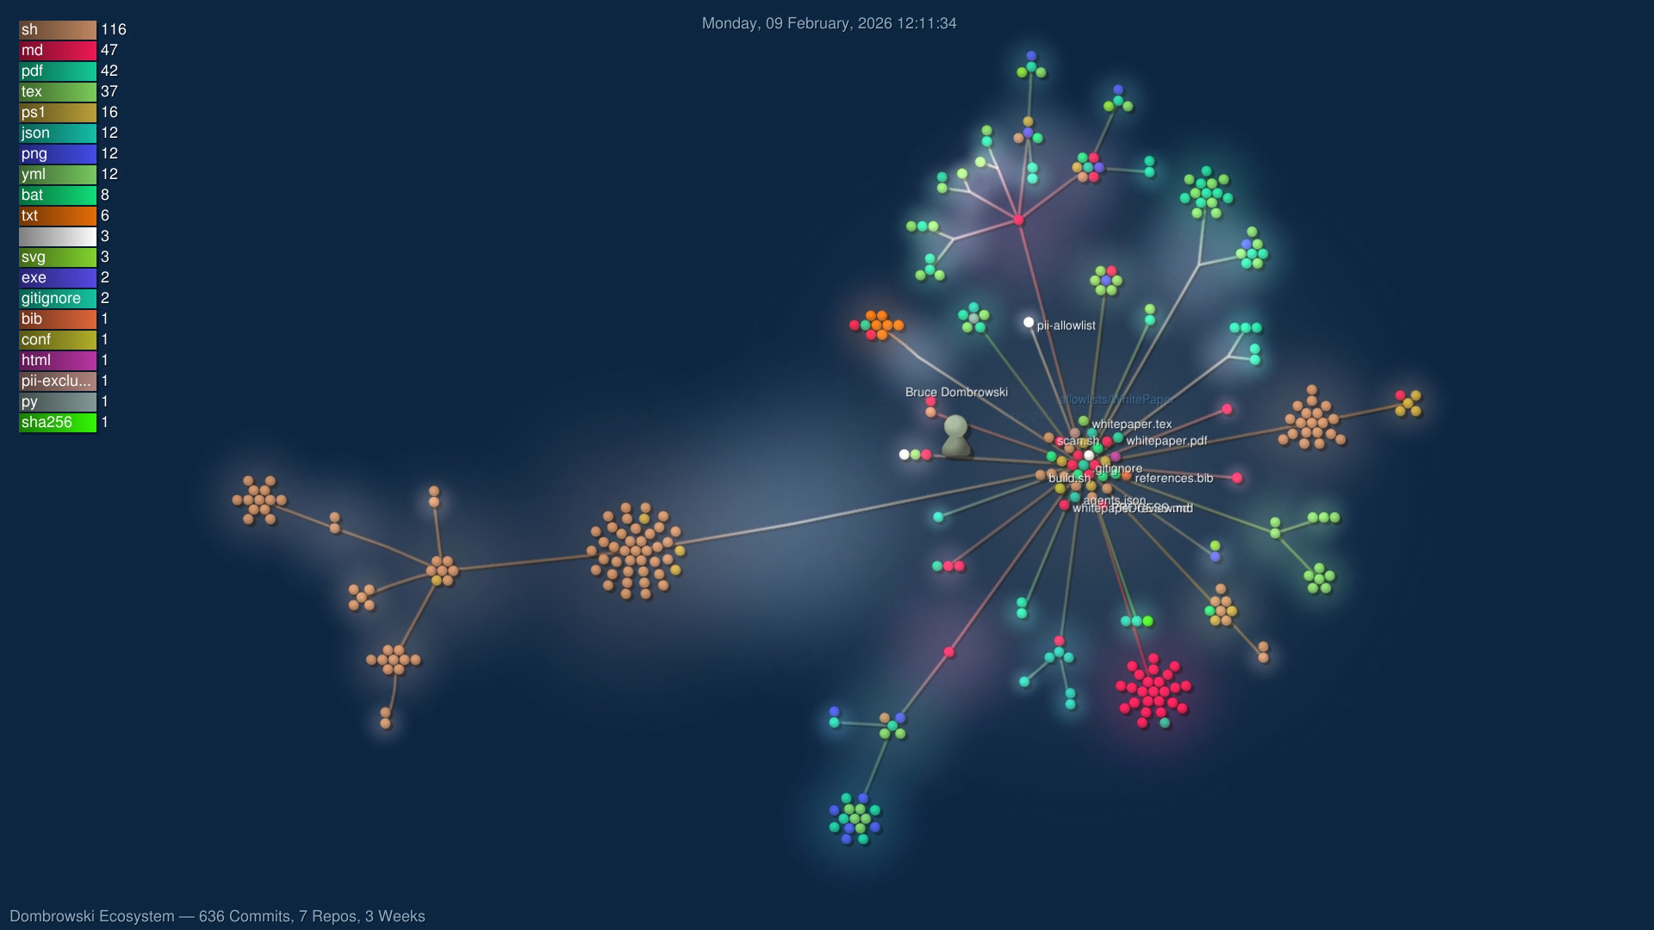
🌌 The Whole Ecosystem, Visualized
636 commits. 7 repos. 34,000+ lines of code. 3 weeks. One engineer.
(We have a 40-second animated video of this too 🎬)

Slide 13
🚀 Getting Started: Your First 5 Minutes
1
📧 You'll get an email invitation to the GitLab/GitHub project
2
🌐 Click the link — opens in your browser
3
📂 Browse files, click any file to see its contents
4
🕓 Click "History" to see every version ever saved
5
🔍 Click any version to see exactly what changed (the diff)
6
💬 Leave a comment if you have questions or concerns
7
✅ Click "Approve" when you're satisfied with the changes

Slide 14
🌟 You Already Know How to Do This
If you can browse the web, you can review changes.
If you can leave a comment, you can approve a release.
If you can click a link, you have an audit trail.
What used to require:
❌ Spreadsheets of spreadsheets
❌ Email chains of approvals
❌ "Who has the latest version?"
✅ One URL
✅ Complete history
✅ Built-in compliance
Questions? 🙋

