Slide 1
Software Defined Radio Demonstration
Bruce Hart
November 16, 2015

Slide 2
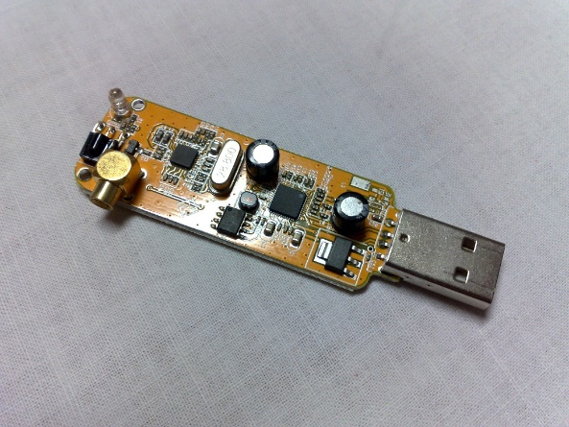
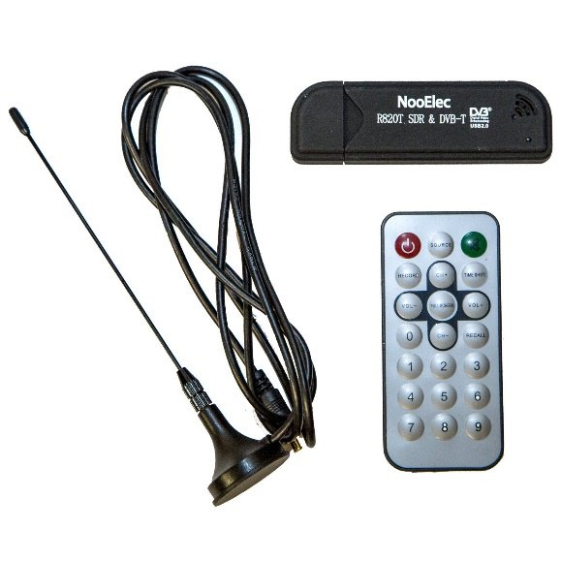
RTL-SDR Chipset
Realtek RTL-2832U controller and tuner
Originally created as a low cost DVB-T receiver in a USB device
Discovered that the chipset can be used as a wideband SDR receiver
Available for less than $20
Tuning range from 24 MHz to 1.7 GHz
Lower tuning ranges possible with hardware HW modification
Instantaneous bandwidth of up to 3.2 MHz

Slide 3
GNURadio Background
Open source software development kit for software defined radio and digital signal processing
Operations are contained into blocks that are connected together to form a system flow.
GNURadio Companion provides a graphical user interface to connect blocks and plot data
Wide variety of blocks come preinstalled:
Signal processing – filtering, gain adjustment, demod
Data sources – generated, RTL-SDR, USRP
Data output – GUI plot, binary file, Tx device, network
Users can also create custom-programmed blocks

Slide 4
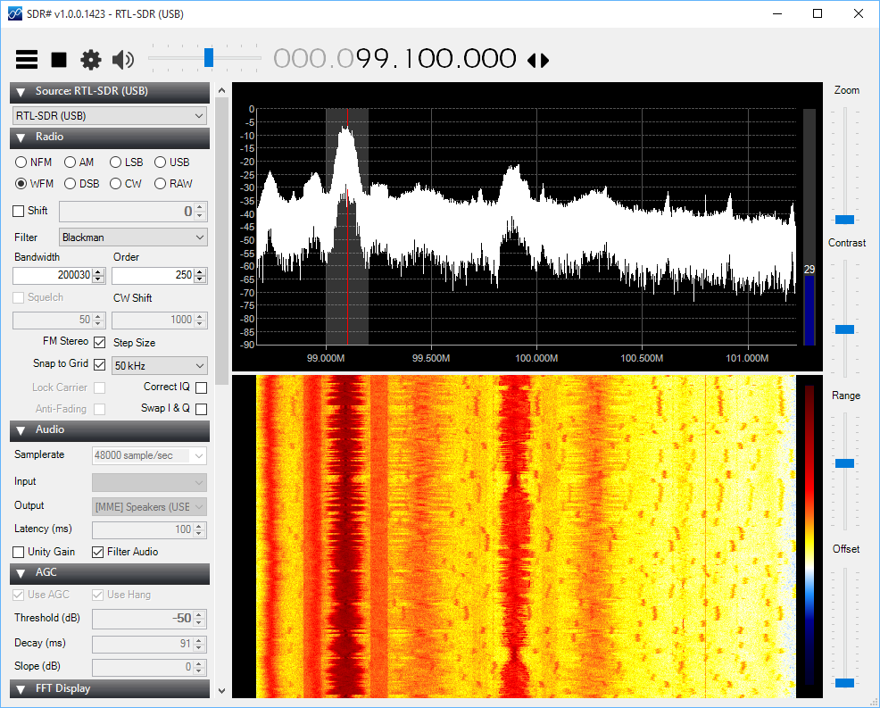
SDRSharp for Windows

Slide 5
Setting Up the RTL-SDR on Linux
Setup is simple in Ubuntu: package manager does most of the work and installs the latest versions
Set up Ubuntu on separate hard drive partition
Install GNURadio:
sudo apt-get install gnuradio-dev
Install GQRX:
sudo apt-get install gqrx-sdr
Install Qt Creator and build tools:
sudo apt-get install build-essential
wget http://download.qt.io/official_releases/qt/5.0/5.0.2/qt-linux-opensource-5.0.2-x86_64-offline.run
chmod +x qt-linux-opensource-5.0.2-x86_64-offline.run
./qt-linux-opensource-5.0.2-x86_64-offline.run

Slide 6
Demonstration Background
Goal: Demonstrate decoding an RF protocol
More interesting than broadcast AM/FM station
Something original that does not replicate demonstration already online
Selected an RC car controller:
49 MHz center frequency
RF protocol is unknown – need to use GNU radio to analyze and build decoder
8 different commands : up, down, left, right, up+left, up+right, down+left, down+right

Slide 7
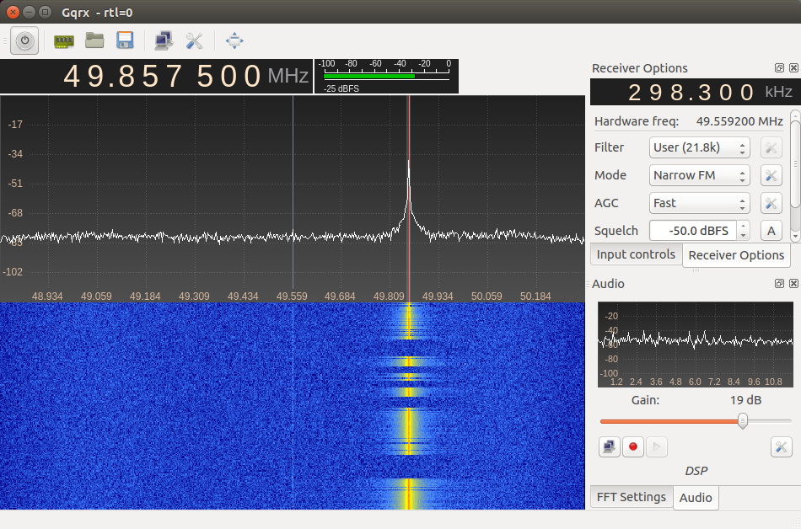
Examining the Signal in GQRX

Slide 8
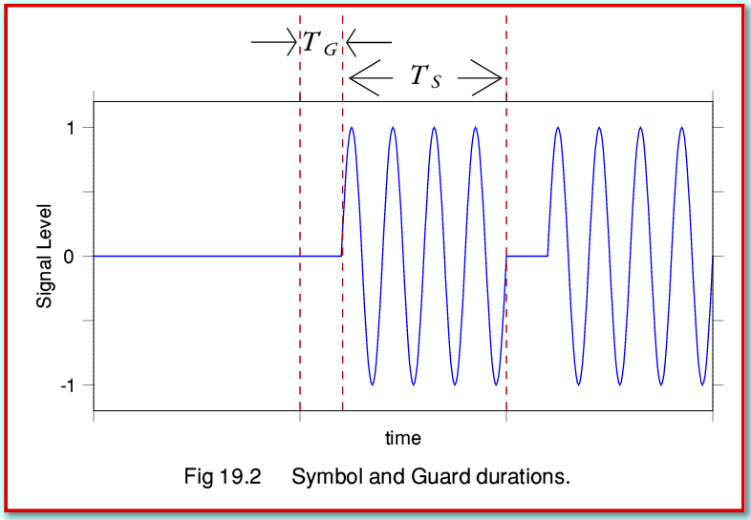
RC Signal Analysis
Plotted data -- hard to see in real time
Used GNURadio to write samples to a file
Discovered the signal is pulsed CW
Also called on-off keying (OOK) or binary keying
Simple signal – easy to generate with cheap electronics
Single frequency – avoids intermod products on cheap amplifier

Slide 9
Signal Decoder
Demodulation is pretty simple: the goal is to get the envelope of the function and then decode the bit sequence
Process: filter on the center frequency, take the root mean squared of the signal
Signal can only take on two values: on or off
Use thresholding to convert to on-off values
How to decode the bit sequence?
Captured all commands to data files
Wrote a C++ program to analyze the data

Slide 10
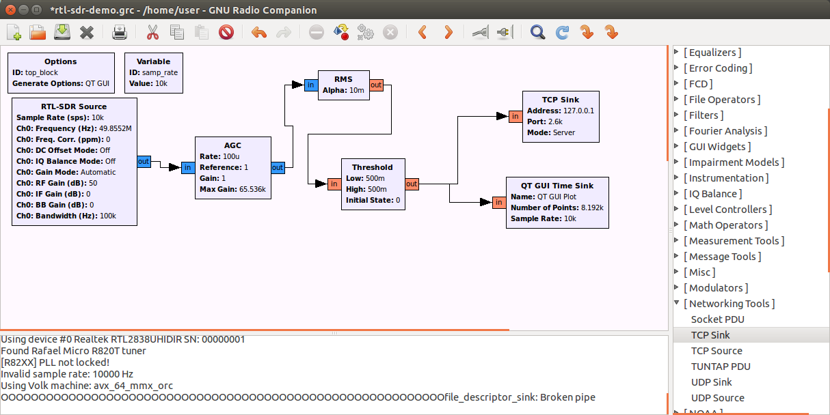
Block Diagram of Receiver

Slide 11
Bit Sequence
Controller sends two types of pulses: short pulse (3 ms) and long pulse (8.25 ms)
Used a 5 ms cutoff to separate short and long pulses
Command always starts with four long pulses followed by a series of short pulses:
UP 10 pulses DOWN 40 pulses
LEFT 58 pulses RIGHT 64 pulses
DOWN + LEFT 52 pulses UP + LEFT 28 pulses
DOWN + RIGHT 46 pulses UP + RIGHT 34 pulses

Slide 12
Bit Decoder
GNURadio feeds output over a local TCP socket to a custom Qt application
Application uses a simple state machine to determine command:
Short pulses increment a counter
Long pulses reset the counter, execute commands
When command is decoded, car icon is moved around on the screen
Qt signals and slots approach makes it easy to buffer up TCP data and process periodically

Slide 13
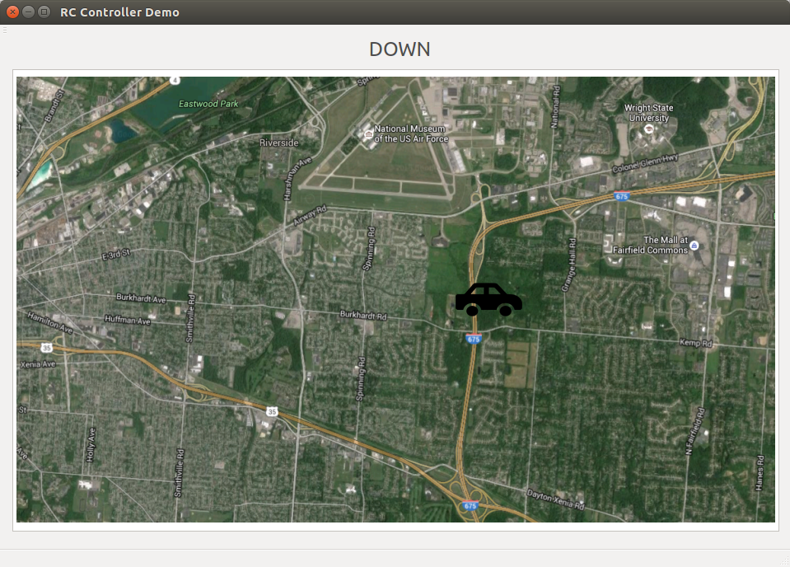
Qt Software Demonstration

Slide 14
Project Summary
Fun project – learned more about GNURadio’s capabilities
Biggest challenges:
Figuring out the RF protocol
Windows driver issue
Using TCP vs. UDP
Possibilities with more time:
Make a two player game with RC controllers at different frequencies
Code improvements: lower sampling rate/data transfer rate, custom GNURadio blocks, direct interface with device via USB driver
Questions?

