Slide 1
Health Insurance Cross Sell Prediction
Team 03
(Bruce) Chang-Hung Hou | Chenli Qiu | Lequn Yu | Qiqi Tang | Yuchen Feng | Shamika Kalwe

Slide 2


Problem Statement
To build a model to predict whether the existing health insurance customers will also be interested in Vehicle Insurance provided by the same company.
Cross Sell

Slide 3

Data Source
link
The kaggle link mentions Analytics Vidhya as its source for this dataset and problem. It also mentions relevant license for public sharing.

Slide 4
Structure of the Dataset (1/2)
Rows | 381,109 | Columns | 12
No. | Variable | Definition
1 | id | Unique ID for the customer
2 | Gender | Gender of the customer
3 | Age | Age of the customer
4 | Driving_License | 0 : No, 1 : Yes
5 | Region_Code | Unique code for the region of the customer
6 | Previously_Insured | 0 : No, 1 : Yes
7 | Vehicle_Age | Age of the Vehicle
8 | Vehicle_Damage | 0 : No, 1 : Yes (damaged in the past)
9 | Annual_Premium | Health Insurance Premium per year
10 | PolicySalesChannel | Anonymized Code for the channel of outreaching to the customer ie. Different Agents, Over Mail, Over Phone, In Person, etc.
11 | Vintage | Number of Days, Customer has been associated with the company
12 | Response | 0 : Not Interested, 1 : Interested
Target Variable

Slide 5


Stakeholders in the problem
Company
Targeted marketing
Increase ticket size per customer
Save marketing cost
Know and understand their customers better
Customer
Having multiple services from one company reduces hassel

Slide 6
Exploratory Analysis

Slide 7
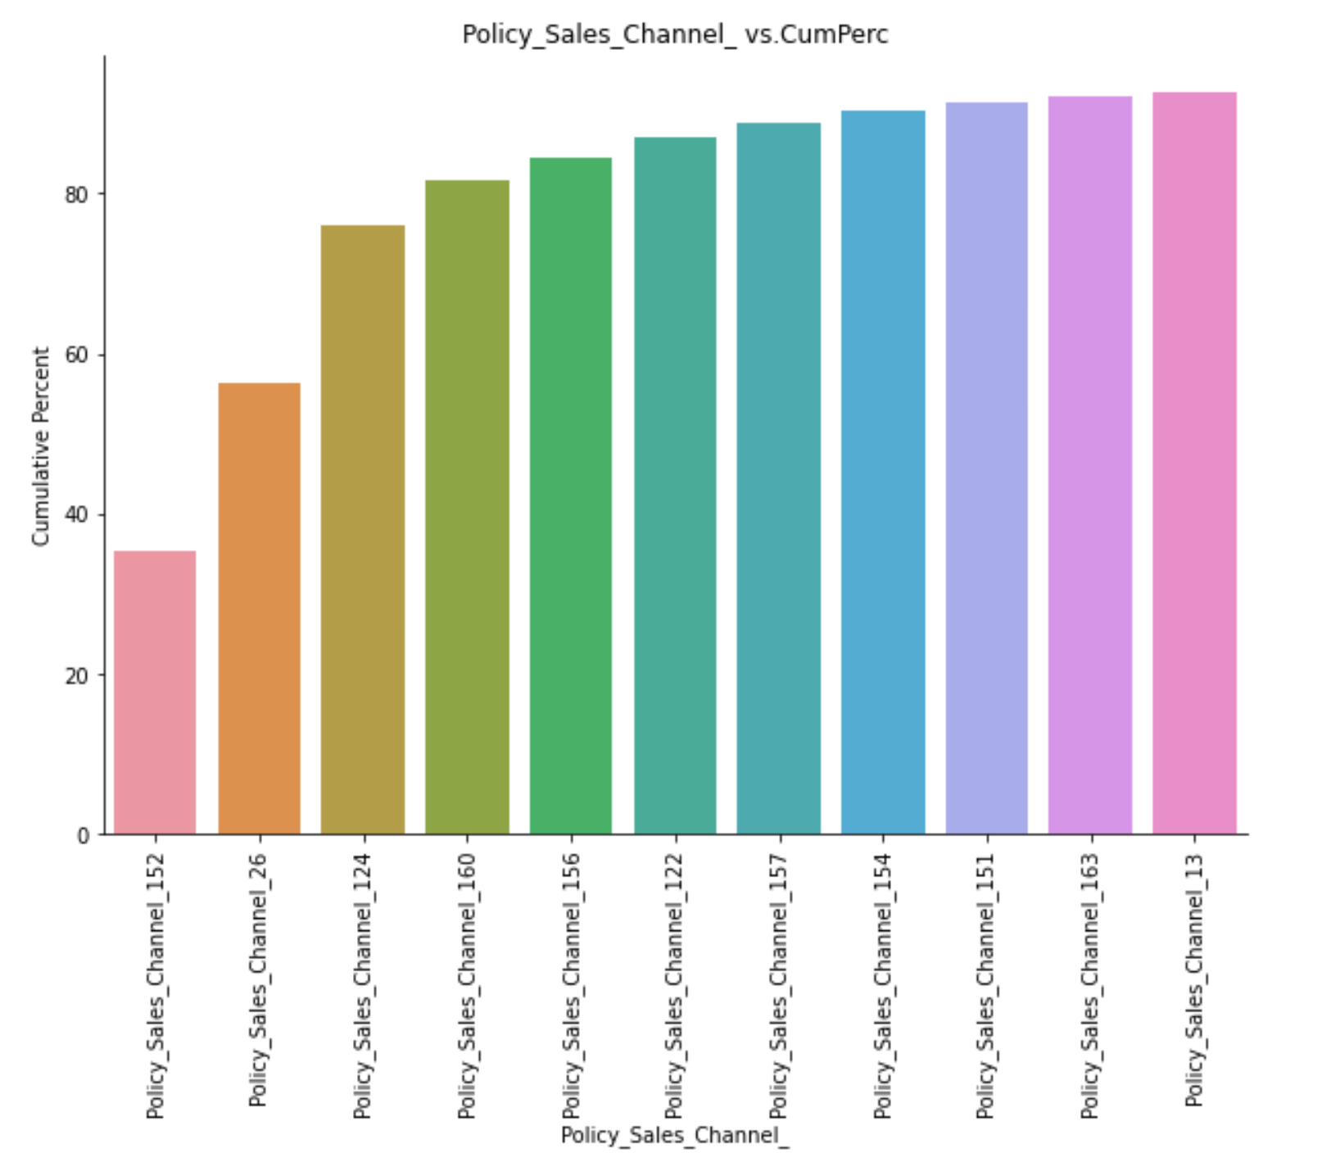
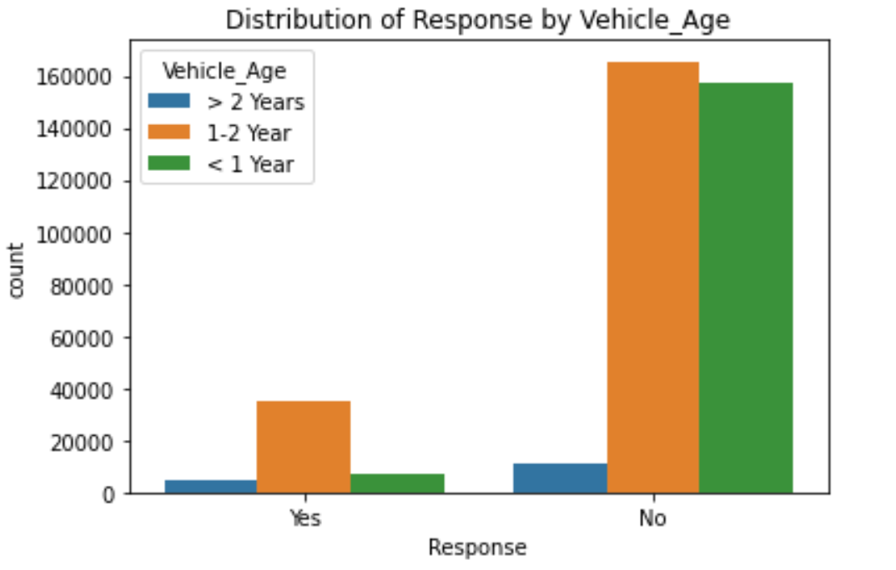
Distribution of Response by Vehicle Age
New car owners have less preference to by an insurance
1-2 Year vehicle owners are more willing to buy car insurances
Top 9 sales channel which customers prefer to buy insurances

Slide 8
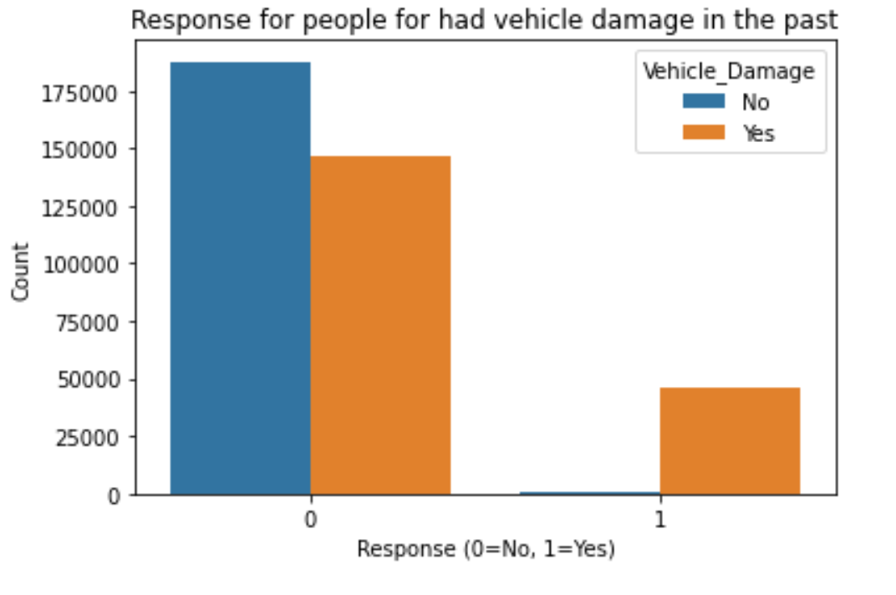
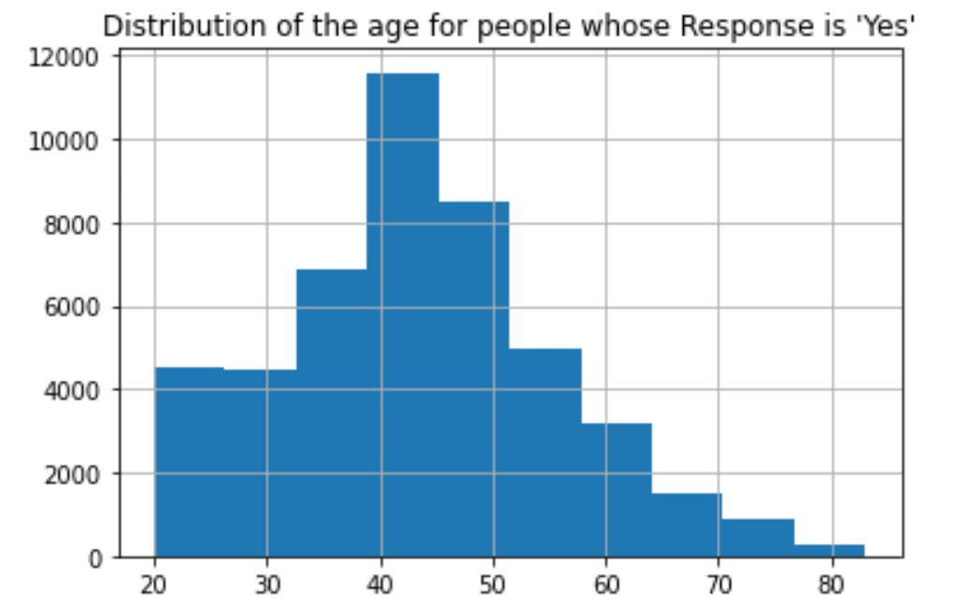
Different Responses of People whether they have accidents
People who do not have accidents in the past are unwilling to buy insurances
People who have accidents in the past are willing to buy insurances
Young people want to buy insurances may because of few driving experiences
40-50 years old people’s responses to purchase insurances are the strongest

Slide 9
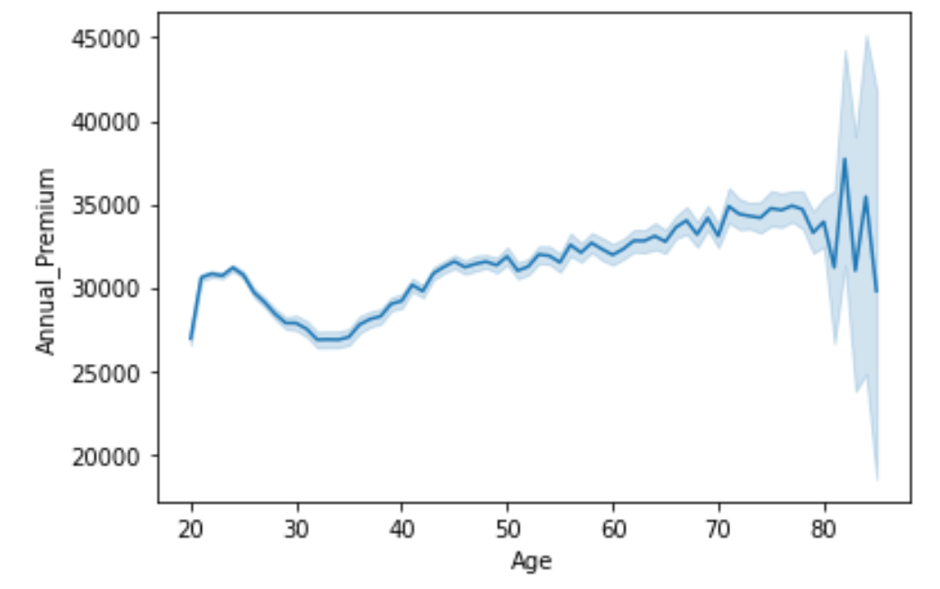
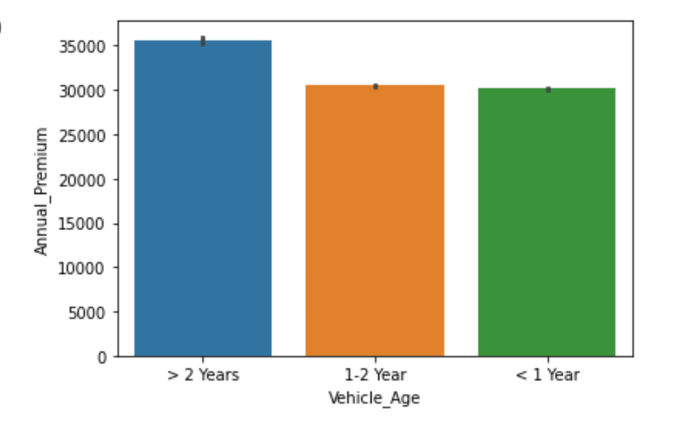
The variances of annual premium
Elderly people prefer to spend money on their insurances
Vehicles which are used more than 2 years have the highest annual payments among other vehicles

Slide 10
Customer Profiling
Feature | Target Variable = 0 Not Interested in Vehicle Insurance (popular/mean value) | Target Variable = 1 Interested in Vehicle Insurance (popular/mean value)
Gender | Male | Male
Age | 38 years | 43 years
Driving_License | Present | Present
Region_Code | 28 | 28
Previously_Insured | Yes | No
Vehicle_Age | 1-2 Year | 1-2 Year
Vehicle_Damage | No | Yes
Annual_Premium | INR 30,419 | INR 31,604
Policy_Sales_Channel | 152 | 26
Vintage | 154 | 154
Highlighted are the differences

Slide 11
Modeling
No sampling
Down sampling
SMOTE sampling

Slide 12
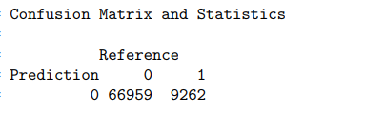
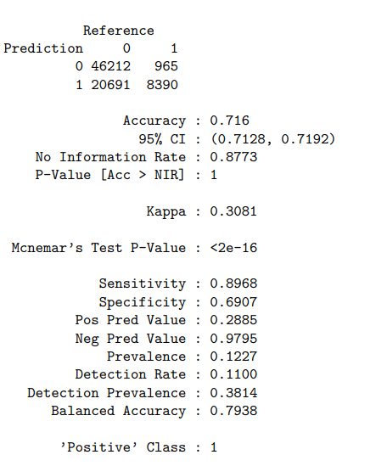
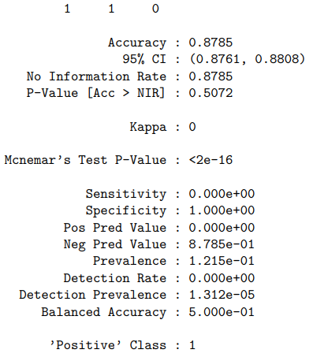
Lasso with vs. without SMOTE
Without SMOTE:
With SMOTE:

Slide 13
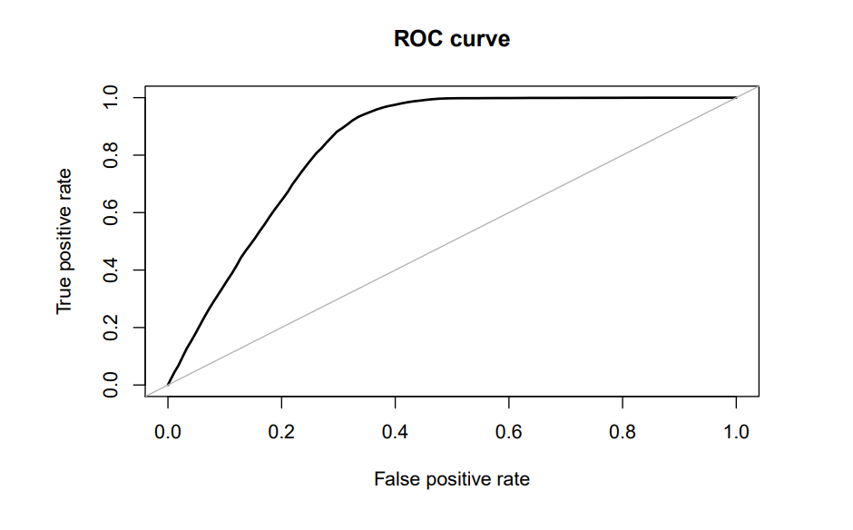
Modeling: Lasso Regression
ROC curve：
randomly choosing
Area under the curve(AUC) : 0.838

Slide 14
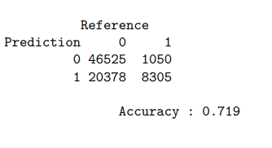
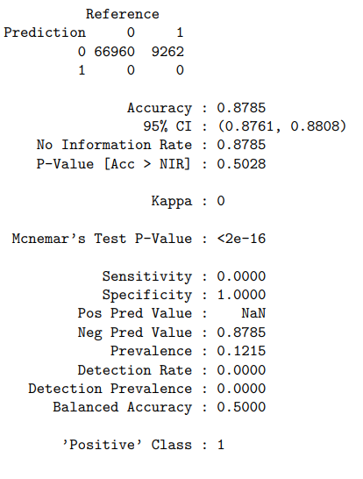
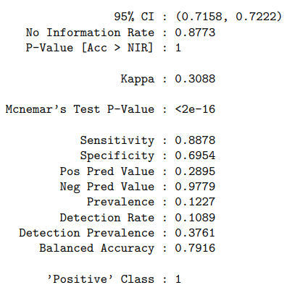
Ridge with vs. without SMOTE
Without SMOTE:
With SMOTE:

Slide 15
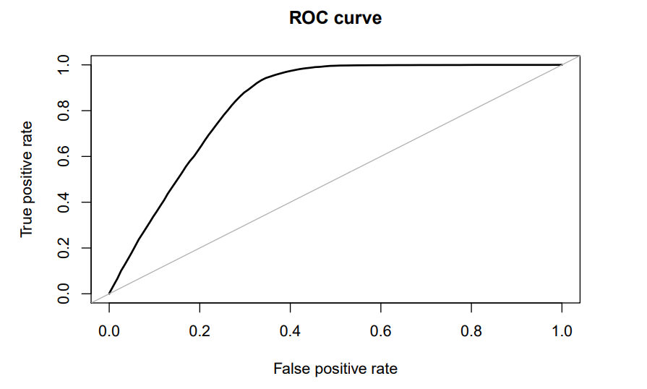
Modeling: Ridge Regression
ROC curve:
randomly choosing
Area under the curve(AUC) : 0.837

Slide 16
Comparison: Lasso vs. Ridge
 | Lasso | Ridge
Sensitivity | 89.68% | 88.78%
Area under the curve(AUC) | 83.8% | 83.7%

Slide 17
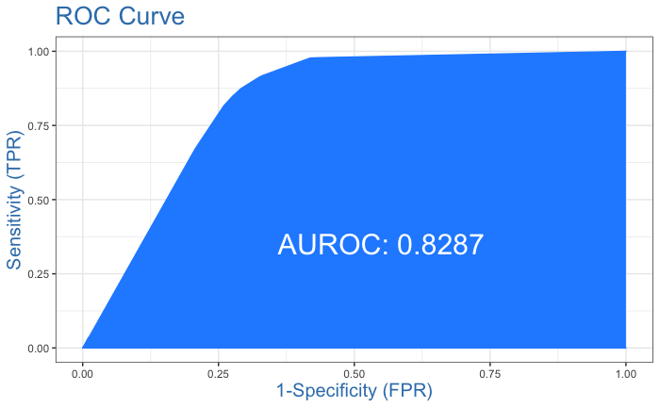
Modeling: Decision Tree (rpart)
Before balancing the data
After balancing the data
Confusion matrix:
Actual
Predicted 0 1
0 67001 9221
1 0 0
Confusion matrix:
Actual
Predicted 0 1
0 48335 1412
1 18439 7932
Accuracy Overall (%): 73.92075
Sensitivity (1) (%): 84.8887
Specificity (0) (%): 72.38596
Feature importance:
Vehicle_Damage
Previously_Insured
Age
Policy_Sales_Channel
Vehicle_Age
Region_Code
Annual_Premium
Driving_License
Gender

Slide 18
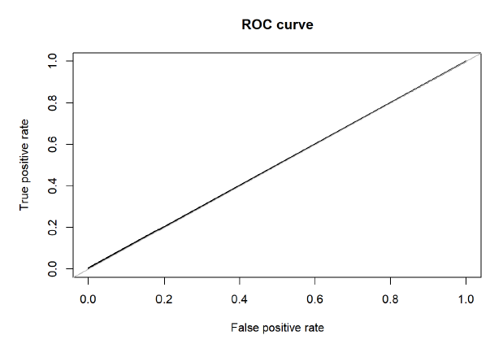
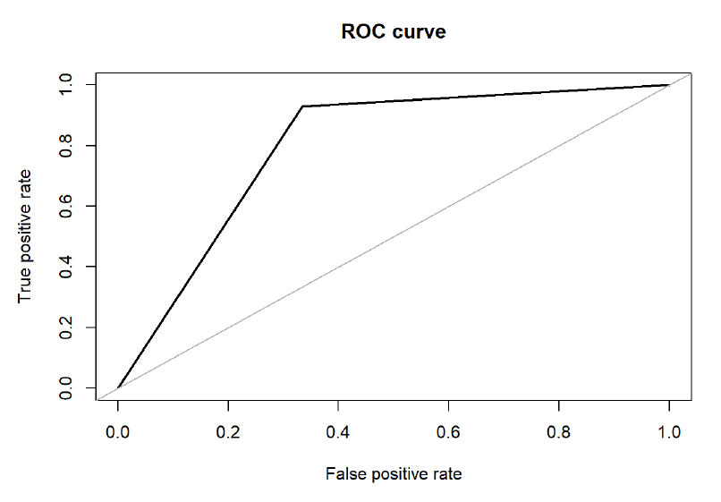
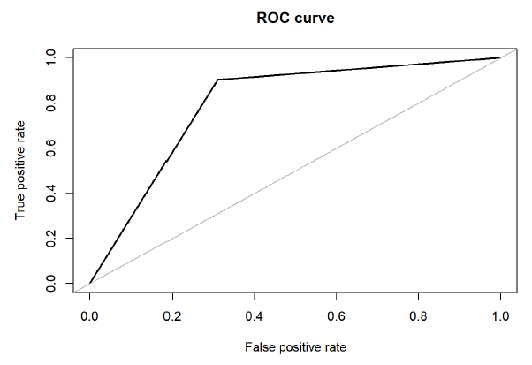
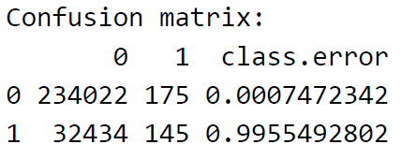
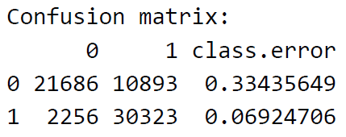
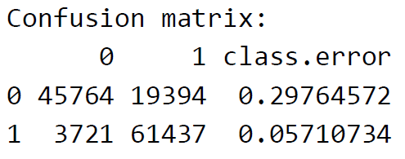
Modeling: Random Forest
Down Sampling
Accuracy: 79.84%
Specificity 0: 66.6%
Sensitivity 1: 93.08%
AUC: 0.798
BEST Model of ALL
No Sampling
Accuracy: 87.78%
Specificity 0: 99.93%
Sensitivity 1: 0.42%
AUC: 0.502
SMOTE
Accuracy: 82.26%
Specificity 0: 70.24%
Sensitivity 1: 94.29%
AUC: 0.797

Slide 19
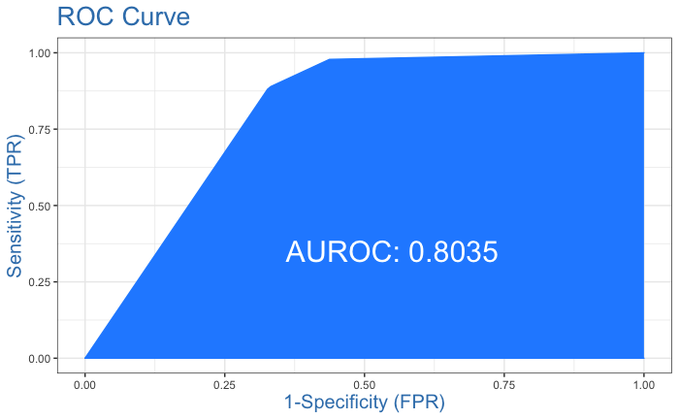
Modeling: Boosting with SMOTE
Confusion matrix:
Actual
Predicted 0 1
0 44961 1114
1 21813 8230
Accuracy Overall (%)
69.87966
Sensitivity (1) (%)
88.07791
Specificity (0) (%)
67.33309

Slide 20
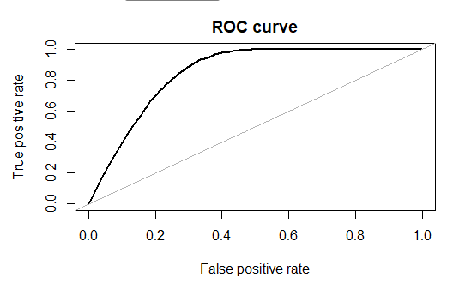
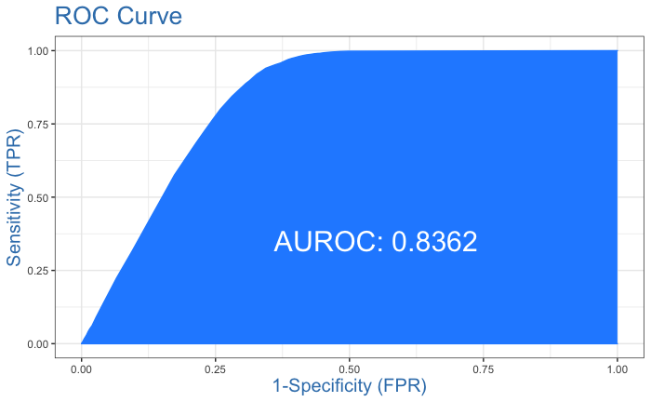
Logistic without & with SMOTE
Confusion matrix:
Actual
Predicted 0 1
0 66929 9256
1 31 6
Accuracy Overall (%): 87.82
Sensitivity (1) (%): 00.064781
Specificity (0) (%): 99.953704
Area under the curve (AUC): 0.848
Confusion matrix:
Actual
Predicted 0 1
0 49473 1870
1 17291 7474
Accuracy Overall (%): 74.82393
Sensitivity (1) (%): 79.98716
Specificity (0) (%): 74.10131

Slide 21
Challenges and Possible Solutions
Area | Challenges | Solutions
Dataset | The size of the train dataset was too high, thus modeling was time consuming | Using methods like SMOTE we were able to reduce the size and remove the imbalance
 | Dataset was highly imbalanced (88%-12%)
 | Policy_Sales_Channel and Region_Code were categorical variables with many categories (150+, 50+ respectively) which resulted in many columns after one-hot encoding. This resulted in poor model performance | We converted the categorical variables into ‘factor’ class and then fed the data to the models
Modeling | Coding in R, as we had little experience with it
 | Difficulty in choosing models as Y was categorical | We decided to use: DT, RF, Boosting, Linear, lasso, ridge, Log R

Slide 22
Conclusions
From EDA we observe some key differences between the two profiles of customers
Imbalance can disturb modeling a lot. So depending on how important is to correctly classify 1 or 0, the imbalance must be treated.
Removing imbalance in the data and using Random Forest model gives us the most decent model, with Sensitivity of 95% (overall accuracy: 82%, Specificity: 70%).
Top 5 features are:
Vehicle_Damage
Previously_Insured
Age
Annual_Premium
Policy_Sales_Channel

Slide 23
Thank you!
Any Questions?

