Slide 1
NIMD Introduction
Jim Herriot
Bruce Sawhill
BiosGroup, Inc.
February 19, 2003
Arlington, VA

Slide 2
Results and Research
Investigation into variations of Einstein problem
Piecing apart the computational process (Mario)
Literature search and research agenda for satisfiability research

Slide 3
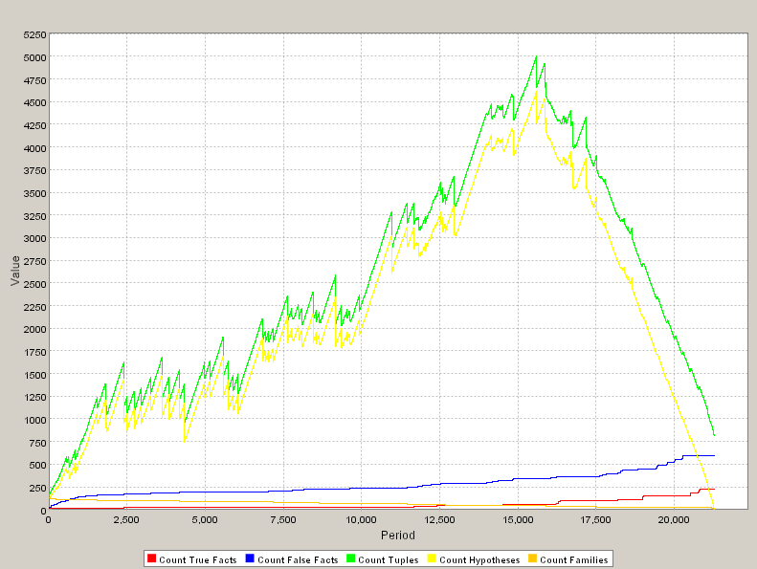

Model statistics

Slide 4
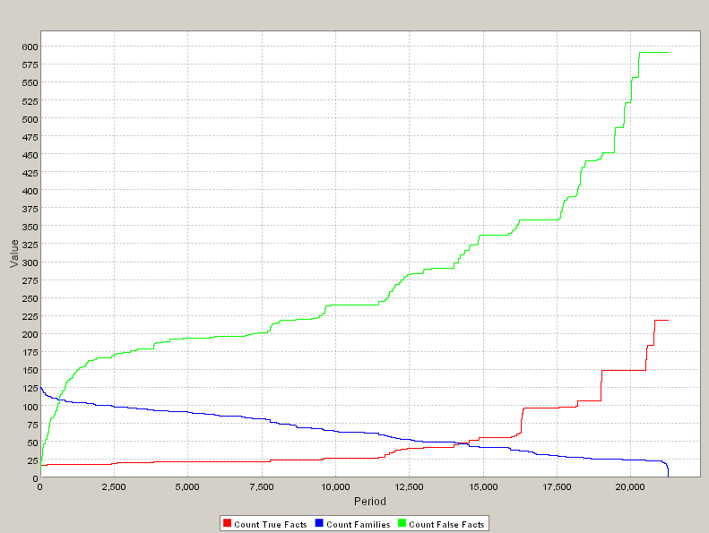
Model stats, con’t.

Slide 5
Research Topics
KSAT General Observations
  Given an arbitrary Boolean expression:
    The a’s take values True or False
    Individual a’s can repeat arbitrarily many times in the expression
  A procedure exists to turn any such expression into “3SAT” . (see Papadimitriou, Computational Complexity)
  These expressions look like:

Slide 6
More KSAT
The 3SAT expressions consist of
  Variables, or “literals”, the c’s
    True or False
  Clauses: The 3 literals inside of each (…)
A phase transition exists at approximately c/v ~ 8 ln2. (Kirkpatrick and Selman, Science, 1994)

Slide 7
Newer KSAT work
Gomes, Selman, et al: Heavy Tailed Phenomena in Satisfiability and Constraint Satisfaction Problems, J. Automated Reasoning 2000
  This work begins to tease apart the microstructure of the satisfiability transition and look at the complexity distribution of problems. Only the worst are intractable, generating hope that a scalable hypothesis generator/solver is possible.
Hoos and Stuetzle: Local Search Algorithms for SAT, J. Automated Reasoning 2000
  An investigation into local distributed search algorithms for solving satisfiability problems. Relevant in terms of building agents to generate and solve hypotheses for NIMD.

Slide 8
Newer KSAT work, con’t.
Giordana, Saitta: Phase Transitions in Relational Learning Machine Learning 2000
  This work generates a connection between the satisfiablity literature and the relational learning literature, attempting to characterize the complexity of certain learning processes. Useful in terms of mapping satisfiability onto human investigaive processes for NIMD.
Mezard, et al.: Analytic and Algorithmic Solution of Random Satisfiability Problems, Science 2002
  Begins to characterize the topology of the search space in satisfiability problems, and to point out the shortcomings of pure local search near the phase transition.

Slide 9
Building on Recent Results
Beginning to investigate ‘vertical KSAT’
  To the left of the phase transition, many solutions
  To the right, no solutions
  At some point, one solution.
  Need to pick apart detailed partial solution structure
We believe that human investigations generally move from left to right
  An incomplete investigation has many partially supported hypotheses ‘competing’ for victory
  Investigative process both adds detail and removes candidates

Slide 10
Vertical KSAT
When there are many solutions:
  Each solution specifies two regions
    Specific values for a set of literals
    ‘Don’t care’ for the remaining set of literals.
  Solutions generally
    Overlap, but not completely
  This generates three classes of regions
    The set of literals where all solutions agree
    The set of literals where all solutions don’t care
    The set of literals where some or all of the solutions disagree

Slide 11
Hypotheses to Investigate
Can we drive local and/or global search with the ‘disputed regions’ How does this relate to the cavity method in the Mezard paper?
Is the ‘degree of disputation’ useful? Can it drive a fitness function in terms of generating new populations of partial solutions (hypotheses)
How do the three classes of logical regions behave near the phase transition? Can this be exploited?

