Slide 1
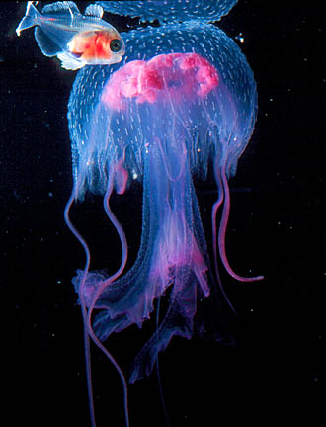
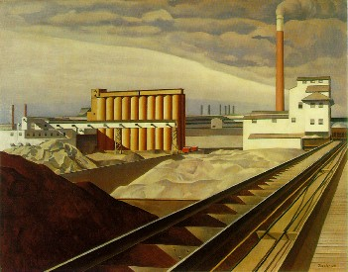
Innovation on the Edge of Chaos:
From metaphor to physical principle and back again
SVII
April 1, 2009
Bruce Sawhill, Ph.D.
Jim Herriot, Ph.D.
FlyMiwok & NextGen Sciences

Slide 2
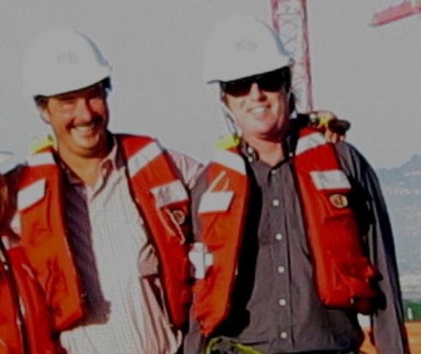
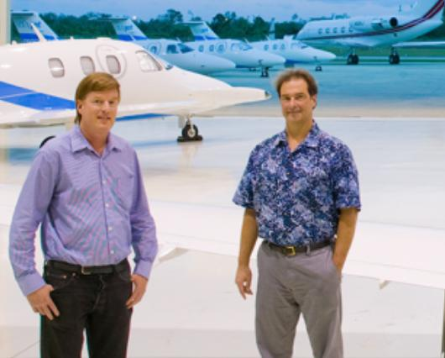

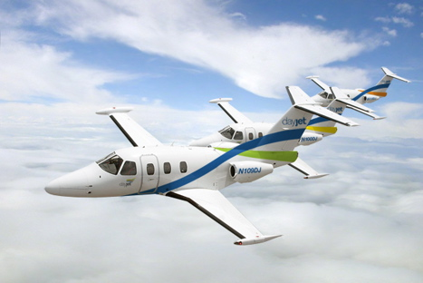


Bruce Sawhill, Ph.D.
Jim Herriot, Ph.D.
ePluribus Research
PartEcon
Particle Economics Research Institute
NextGen Sciences

Slide 3
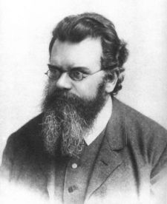
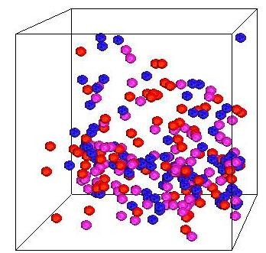
Statistical Mechanics
Ludwig Boltzmann
The great anonymizer

Slide 4

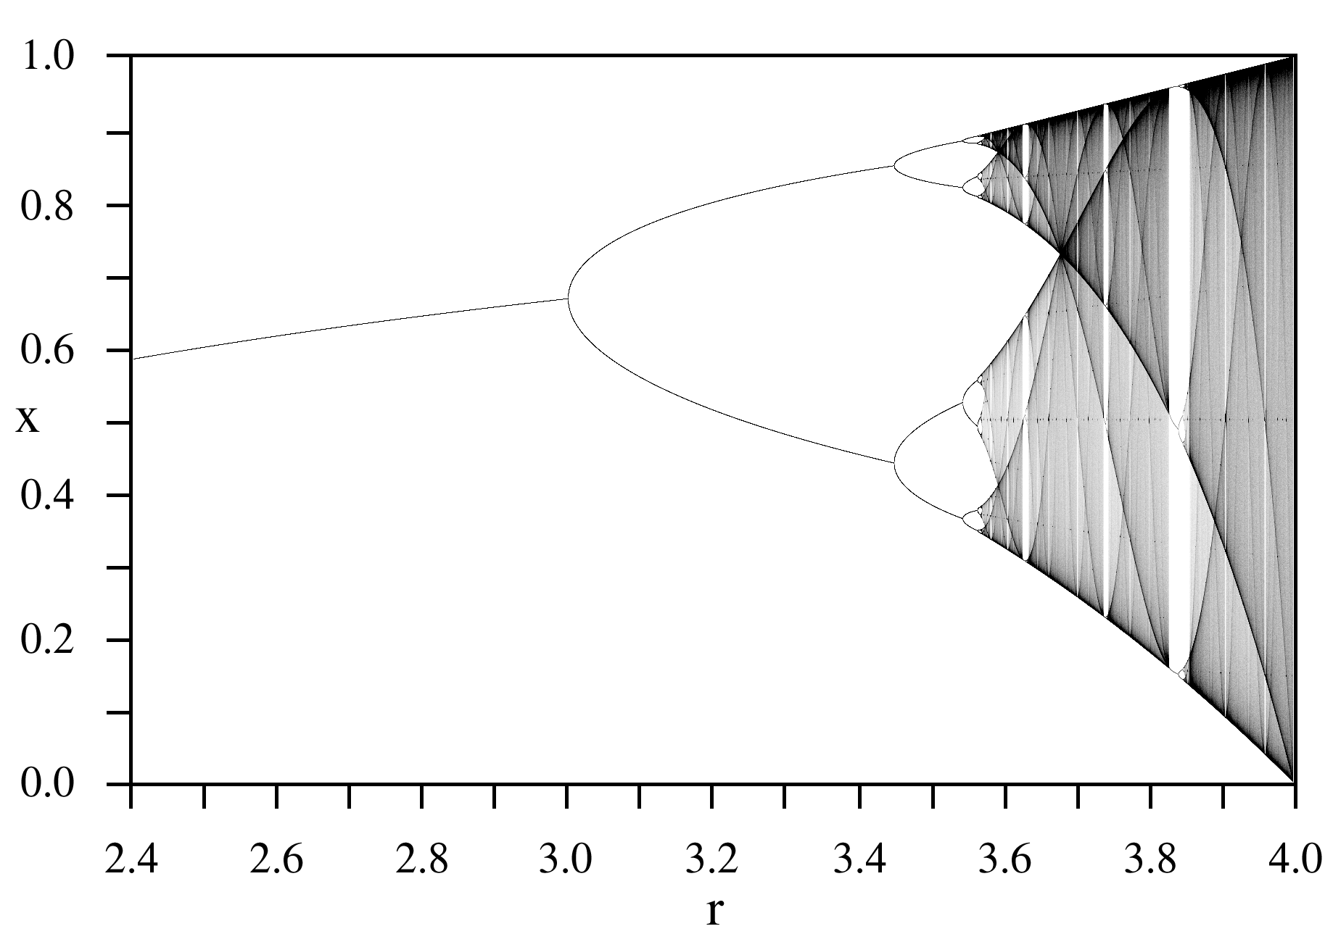
Period Doubling Route to Chaos

Slide 5


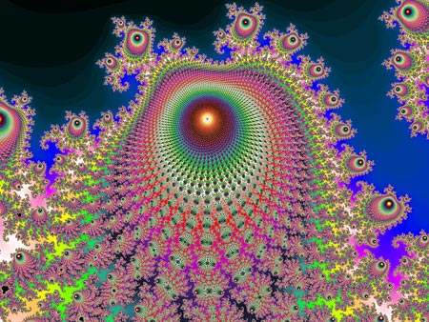

Chaos
Why didn’t Newton discover this?
What is interesting is why the dog didn’t bark

Slide 6
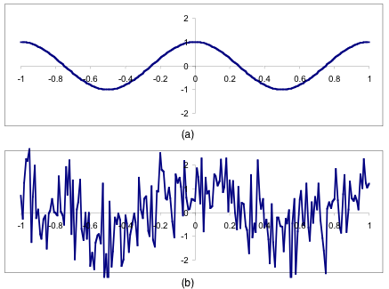
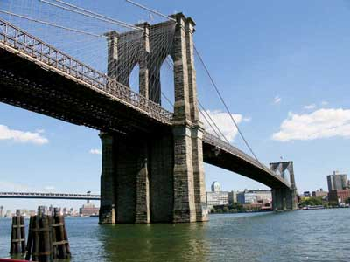
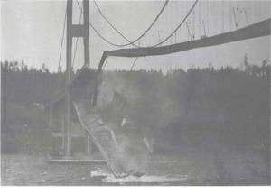
Engineering Part 1
Tacoma Narrows Bridge 1940
Brooklyn Bridge 1883

Slide 7
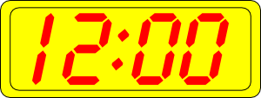
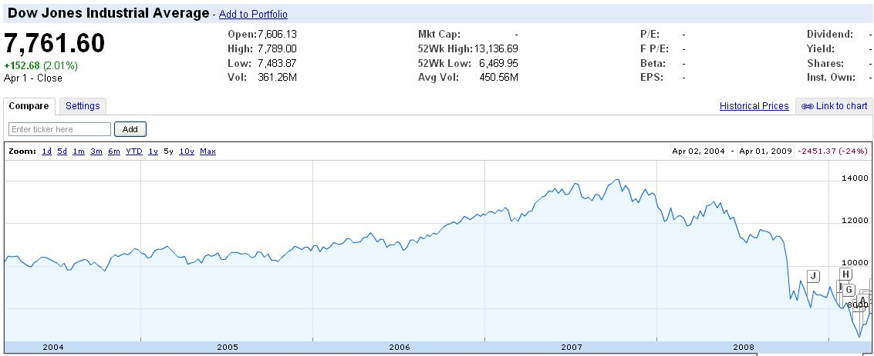
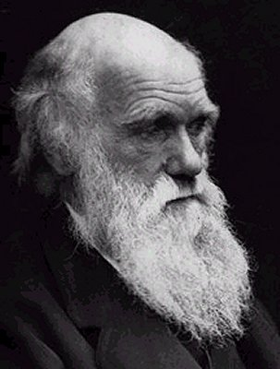
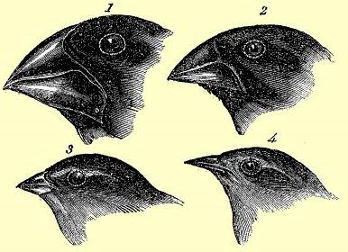
Economics

Slide 8
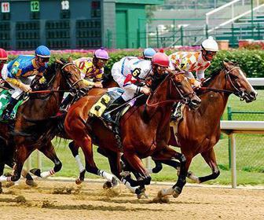
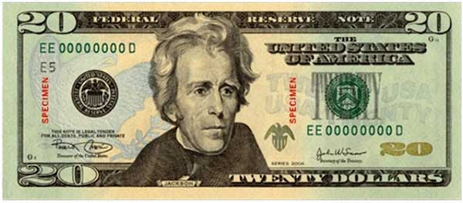
Did we bet on the wrong horse?

Slide 9
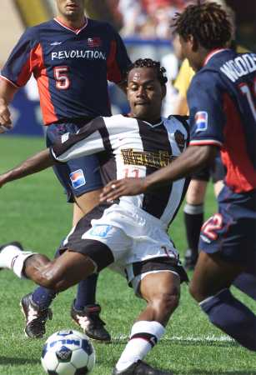
Soccer
brittle solution
I get the ball
Other players

Slide 10
Total Soccer
robust solution
robust
brittle
multiple pathways, optionality

Slide 11
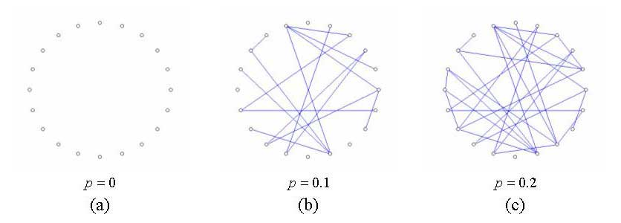
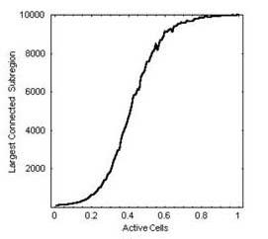
Engineering Luck
Know lots of acquaintances
Plan for serendipity

Slide 12
Thank you
Discussion
Questions
Comments
Bruce Sawhill bruce@flymiwok.com
Jim Herriot jim@flymiwok.com

