Slide 1
GOVERNMENT SCHEME BOT
210701040-BARATH NIVASH KP
210701044-BRUCELIN PRAISE WS

Slide 2
ABSTRACT
This project is a web-based chatbot application that provides information about various Indian government schemes. Featuring a user-friendly interface with a clean and colorful design, the chatbot allows users to inquire about different government initiatives, their eligibility criteria, benefits, and other details. The backend, implemented using Flask, handles user queries and delivers relevant data from a predefined set of 15 prominent schemes. By recognizing keywords in user inputs, the chatbot fetches and displays corresponding scheme details. The application ensures seamless communication between the frontend and backend through Cross-Origin Resource Sharing (CORS), making it a valuable resource for users seeking information about government schemes.

Slide 3
INTRODUCTION
This project introduces a web-based chatbot designed to provide users with comprehensive information about various Indian government schemes. The chatbot features an intuitive and visually appealing interface that allows users to easily inquire about different government initiatives. Powered by a Flask backend, the application processes user queries, retrieves detailed information on 15 major schemes, and presents it in a user-friendly format. The project aims to enhance public awareness and accessibility of government benefits, ensuring users can quickly and easily find relevant scheme details and eligibility criteria.

Slide 4
EXISTING SYSTEM
In the current scenario, information about Indian government schemes is dispersed across multiple platforms, including official government websites, portals, and documents. Users often face challenges in accessing consolidated and comprehensible information due to the fragmented nature of these sources. Searching for specific scheme details, eligibility criteria, and benefits can be time-consuming and overwhelming. Additionally, traditional methods of obtaining this information, such as visiting government offices or navigating through dense websites, lack the interactive and immediate response capabilities that modern users expect. This creates a need for a more streamlined and accessible solution.

Slide 5
PROPOSED SYSTEM
The proposed system is a web-based chatbot designed to provide a centralized, user-friendly platform for accessing information about Indian government schemes. This chatbot leverages an intuitive interface and natural language processing to help users easily inquire about various schemes, including their eligibility criteria, benefits, and other pertinent details. Powered by a Flask backend, the chatbot efficiently handles user queries and retrieves comprehensive information from a predefined database of 15 major government schemes. This system aims to streamline the process of obtaining scheme-related information, making it more accessible and convenient for users, thereby enhancing public awareness and utilization of government benefits.

Slide 6
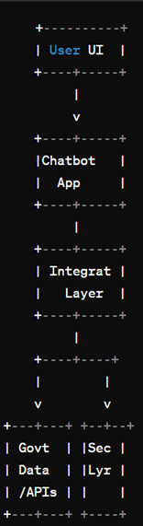
SYSTEM DIAGRAM

Slide 7
SOFTWARE /HARDWARE USED
Hardware: Standard computer hardware with internet connectivity for hosting the web application.
Software:
- Frontend: HTML, CSS, JavaScript for building the user interface.
- Backend: Flask, a Python web framework, for handling server-side logic and API endpoints.
- Database: NoSQL or SQL database to store scheme information (not specified in the provided context).
- Libraries/Frameworks: Flask-CORS for enabling Cross-Origin Resource Sharing, and any additional libraries for enhanced functionality (e.g., Natural Language Processing libraries for improved chatbot capabilities).

Slide 8
MODULES
1. **Frontend Interface**: Implements the user interface using HTML, CSS, and JavaScript.
2. **Backend Logic**: Develops server-side logic using Flask for handling requests and processing queries.
3. **Database Management**: Manages scheme data storage and retrieval using a database system.
4. **Chatbot Functionality**: Implements the chatbot features, including keyword recognition and response generation.
5. **Cross-Origin Compatibility**: Ensures seamless communication between frontend and backend using CORS.

Slide 9
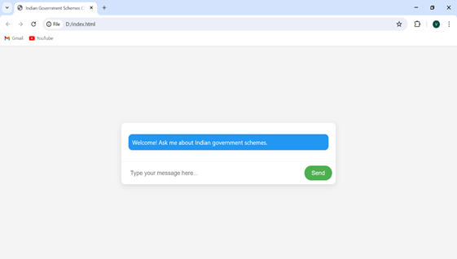
OUTPUT SCREENSHOTS

Slide 10
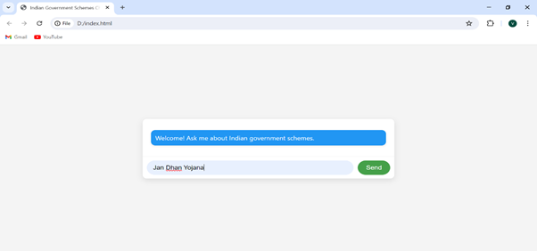
OUTPUT SCREENSHOTS

Slide 11
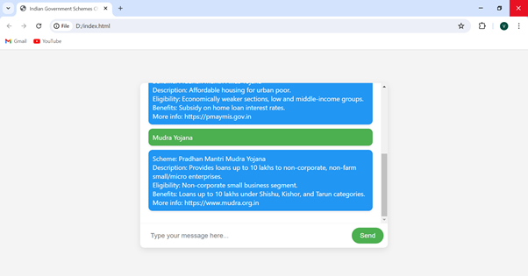
OUTPUT SCREENSHOTS

Slide 12
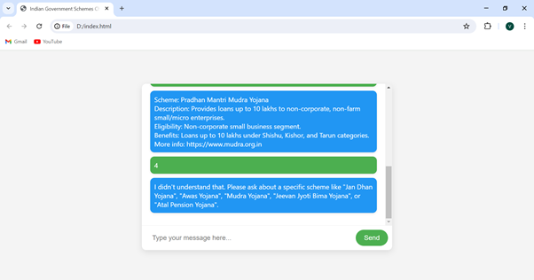
OUTPUT SCREENSHOTS

Slide 13
CONCLUSION
In conclusion, the web-based chatbot application for Indian government schemes provides an efficient and user-friendly platform for accessing comprehensive information about various initiatives. By leveraging intuitive interface design, backend processing with Flask, and database management, the project offers a streamlined solution to bridge the gap between users and scheme details. With its chatbot functionality and cross-origin compatibility, the application enhances accessibility and awareness of government benefits, ultimately empowering users to make informed decisions and utilize available resources effectively.

Slide 14
FUTURE ENHANCEMENTS
Future enhancements for the web-based chatbot application could include expanding the scheme database to encompass new government initiatives, implementing user authentication for personalized experiences, introducing multilingual support for broader accessibility, integrating with social platforms to reach a wider audience, adding interactive features like calculators or quizzes, ensuring accessibility compliance, incorporating a feedback mechanism for user input, utilizing data analytics to refine functionality, developing a mobile application version, and exploring integration with official government portals for real-time data access. These enhancements aim to enhance user engagement, accessibility, and the overall effectiveness of the application in providing valuable information about government schemes to users.

Slide 15
REFERENCES
1. Adarsh Chugh, Avi Aggarwal, "Chatbot-based conversation interface for e-commerce transactions," 2019 IEEE International Conference on Consumer Electronics (ICCE), Las Vegas, NV, USA, 2019, pp. 1-4.
2. H. Nguyen, A. Surana and P. Gupta, "Understanding Customer Reviews of Chatbots," 2021 IEEE International Conference on Big Data (Big Data), Honolulu, HI, USA, 2021, pp. 1-6.
3. Y. Shalyminov, P. Zaytsev and O. Orobets, "Research on Chatbot Architecture: State of the Art," 2020 IEEE International Conference on Artificial Intelligence and Computer Applications (ICAICA), Dnipro, Ukraine, 2020, pp. 179-183.
4. P. Bharti and A. Jain, "Chatbot Based Student Query System Using Natural Language Processing," 2019 IEEE International Conference on Electrical, Computer and Communication Technologies (ICECCT), Coimbatore, India, 2019, pp. 1-4.
5. M. Alsmadi, "Chatbot Adoption in E-government Services: A Systematic Review," 2019 International Conference on Information and Communication Technologies for Ageing Well and e-Health (ICT4AWE), Heraklion, Greece, 2019, pp. 1-10.

