Slide 1

BigQuery

Slide 2
Outline
5W1H
Why query in BigQuery fast
Loading data to BigQuery
Dataset, Tables and Views
Access to BigQuery
Pricing
Security

Slide 3
5W1H
What is BigQuery?
Why should use BigQuery?
Who uses BigQuery?
When to use BigQuery?
Where does BigQuery fit in the Big Data Ecosystem?
How to get started with BigQuery?
Notes:
Để trình bày một ý tưởng, tóm tắt một sự kiện, một bài dạy hoặc bắt đầu nghiên cứu một vấn đề, chúng ta thường tự đặt cho mình những câu hỏi.
Vậy làm sao để ta đặt câu hỏi có thể giúp ta nhanh đạt được mục đích đã đặt ra. Mình sẽ bắt đầu từ kỹ thuật 5W1H

Slide 4
What is BigQuery?
BigQuery is a cloud data warehouse from Google
Standard SQL and ODBC/JDBC drivers
Serverless
Streaming and real-time analytics
Notes:
Data warehouse: Hệ thống dùng để tổng hợp dữ liệu từ nhiều nguồn, report và phân tích.
Standard SQL: Có thể dung SQL query language để query data trong BigQuery
ODBC/JDBC drivers: giao thức tương tác có thể dùng để kết nối với BigQuery (bq commandline) với các applications, qua đó có thể query data trên BigQuery bằng application
Serverless: Không phải là không có server, chỉ là Google Cloud sẽ xử lý hết mọi thứ về cấu hình, và scaling, chúng ta chỉ việc đẩy data vào và sử dụng
Streaming and Real-time analytics: Do BigQuery hỗ trợ query nhanh, nên ta có thể tương tác với data trực tiếp đồng thời integrate với các dịch vụ khác để visualization data

Slide 5
Why should use BigQuery?
Speed
Scalability
Serverless and Managed
Real-time Analytics
SQL based
Integration with Other Google Services
Notes:
Speed: BigQuery is known for its high-speed query performance, thanks to its underlying architecture that parallelizes queries across multiple servers.
Scalability: It can handle petabytes of data, making it suitable for businesses of all sizes.
Serverless & Managed: No need to worry about infrastructure management, as Google takes care of it. You can focus on analysis rather than administration.
Real-time Analytics: BigQuery supports real-time data streaming and can analyze data as it arrives.
SQL-based: Familiar SQL language allows analysts and data scientists to leverage existing skills.
Integration with Other Google Services: Seamlessly integrates with other Google Cloud services like Google Sheets, Data Studio, and more.

Slide 6

Who uses BigQuery?
Data Analysts
Data Engineers
Data Scientists
Business Inelligence Teams
Who needs to use those data
Notes:
Chúng ta có thể có nhiều users để tương tác với data, BigQuery cũng hỗ trợ phân quyền (Access Control) trên Dataset và Table và View tùy theo mục đích users sử dụng

Slide 7
When to use BigQuery
Dealing with large dataset – fast query and analysis
Handling real-time data streams
Collaborating with another data teams and across organization
Running complex analytical queries to gain deeper insights into data

Slide 8
Where does BigQuery fit in the Big Data Ecosystem?
Data Ingestion (Google Cloud Storage, Pub/Sub, Directly)
Data Transformation (Dataflow, Dataproc)
Machine Learning (BigQuery ML)
Data Visualization (Data Studio, DataLab)
Notes:
Data Ingestion: Data can be ingested from various sources, such as Google Cloud Storage, Cloud Pub/Sub, or streaming directly from applications.
Data Transformation: Dataflow and Dataproc can be used to transform and prepare data before loading it into BigQuery.
Machine Learning: BigQuery ML allows users to build machine learning models directly within BigQuery using SQL.
Data Visualization: Data Studio integrates seamlessly with BigQuery to create interactive and shareable reports and dashboards.
BigQuery có những function xử lý

Slide 9

Why query in BigQuery fast?
Columnar Storage
Distributed Computing
Serverless and Managed Service
Data Partitioning
Data Clustering
Cache and Query Result Streaming
Notes:
Columnar storage: In a columnar storage format, data is stored in columns rather than rows, which allows for more efficient data compression and better query performance.
Distributed Computing: Query sumitted -> Sẽ được chia nhỏ ra nhiều tasks nhỏ -> chia cho nhiều servers và chạy song song. => hỗ trợ BigQuery sử lý nhiều datasets lớn hơn kiểu truyền thống chỉ trên 1 con server
Serveless and Managed Service
Data partition: Chia thanh nhiều phần nhỏ, BigQuery chỉ scan những mục liên quan
Data Clustering: Những data liên quan sẽ được store gần với nhau
2 keys chính cần tập trung
- columnar
- distributed để ý khi chọn BigQuery

Slide 10
How to get started with BigQuery
Setup Google Cloud Account
Create BigQuery Project
Load data into BigQuery
Query Data
Visualization Result

Slide 11
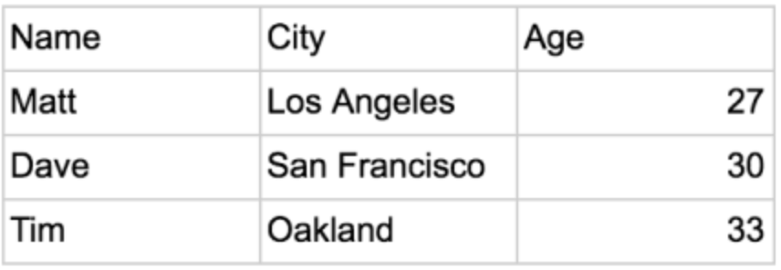
Row Storage
How it write?
How it read?
Append
Notes:
WRITE?
This allows the database write a row quickly because, all that needs to be done to write to it is to tack on another row to the end of the data.
Add a new record. append it to the end of the current data
READ?
Retrieve a row or set of row fast
Issue when aggregation, extra data into memory -> slower than only select
If data in many disks when need to access many disks to get whole data
Adding data to row is quick.
Getting data out require extra memory to be used and multiple disks to be accessed

Slide 12
Columnar Storage
How it write?
How it read?
Not only Append
Notes:
WRITE?
Need to know exactly where to input data not only append new one
READ?
Same problem with row storage but it will different with separate this
Issue when aggregation, extra data into memory -> slower than only select
If data in many disks when need to access many disks to get whole data
Not quick same with row.
Getting data out require extra memory to be used but can be less disks to be accessed to handle aggregation

Slide 13
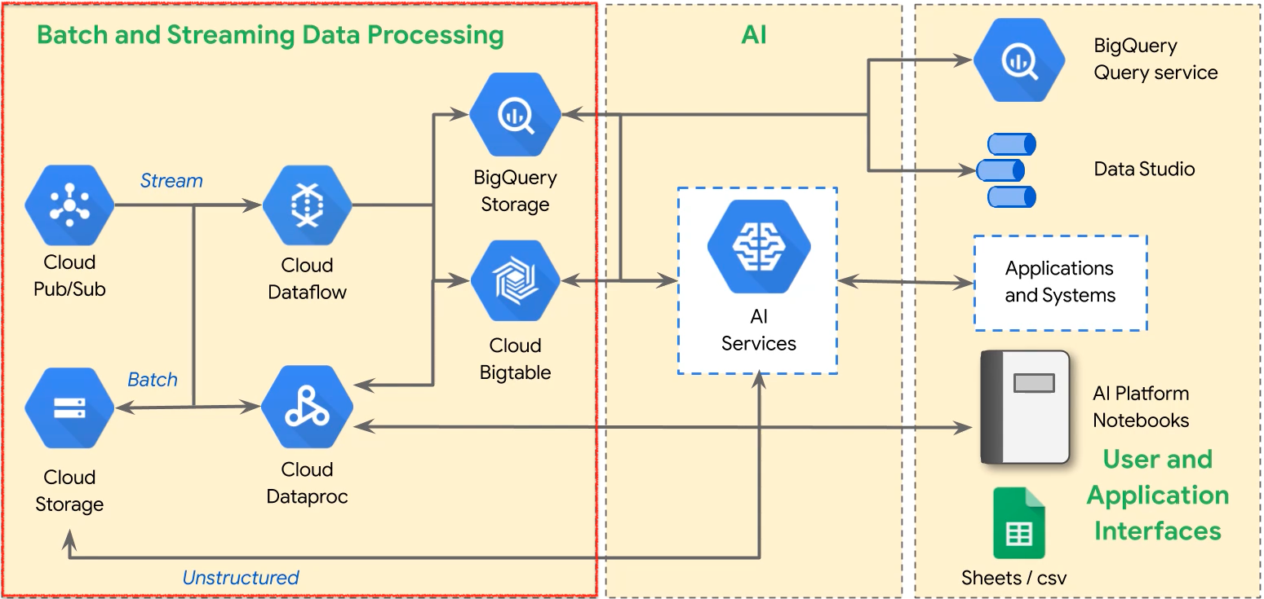
Loading data to BigQuery

Slide 14
Dataset, Tables and Views
MySQL | BigQuery | Definition
Database | Dataset | Holds, Groups and Organizes related tables, views. Can share to specific users or groups
Tables | Tables | Structure collection of data Store amount of data
Views | Views | Virtual table defined by SQL Can share to specific users or groups

Slide 15
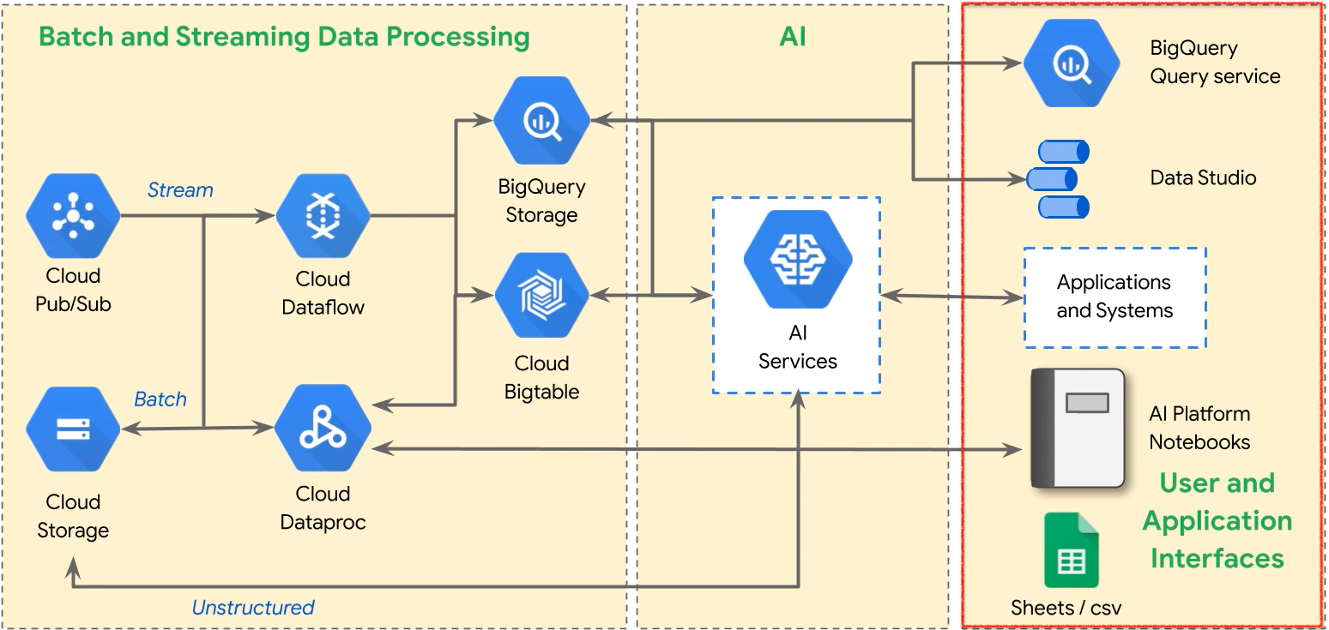
Access to BigQuery

Slide 16

Pricing
Storage costs
Query costs
Free operations
Minimizing costs

Slide 17
Storage costs
Active | Long-term
Define: Data in tables modified in last 90 days | Define: Data in tables not modified in last 90 days
Approximately 2 cents/GB/month | About 1 cent/GB/month
First 10 GB is free | First 10GB is free
Table is edited, pricing reverts to active | Table is not edited, pricing automatically drops to long-term

Slide 18

Query costs
On Demand
Flat rate
Slots: Units of capacity required to execute queries
Note: Careful with your query
Notes:
**On-demand**
- Based solely on usage
- 5$ per TB/month, First 1TB/month free
**Flat-rate**
- Predictable, fixed monthly costs
- $40000/month for 2000 slots*; $10,000 per 500 additional slots

Slide 19
Free Operations
Loading data
Copying data
Exporting data
Delete datasets
Delete tables, views, partitions
Metadata operations

Slide 20

Minimizing Costs
Query only columns you need
Use table preview to explore data
Calculate query price before running
Notes:
**Query only columns you need**
- Under the hood, BigQuery is columnar
Each column stored separately in encrypted, replicated file
**Use table preview to explore data**
Don't run queries just to explore
**Calculate query price before running**
- dry_run flag in CLI
- query validator in UI
- GCP pricing calculator

Slide 21
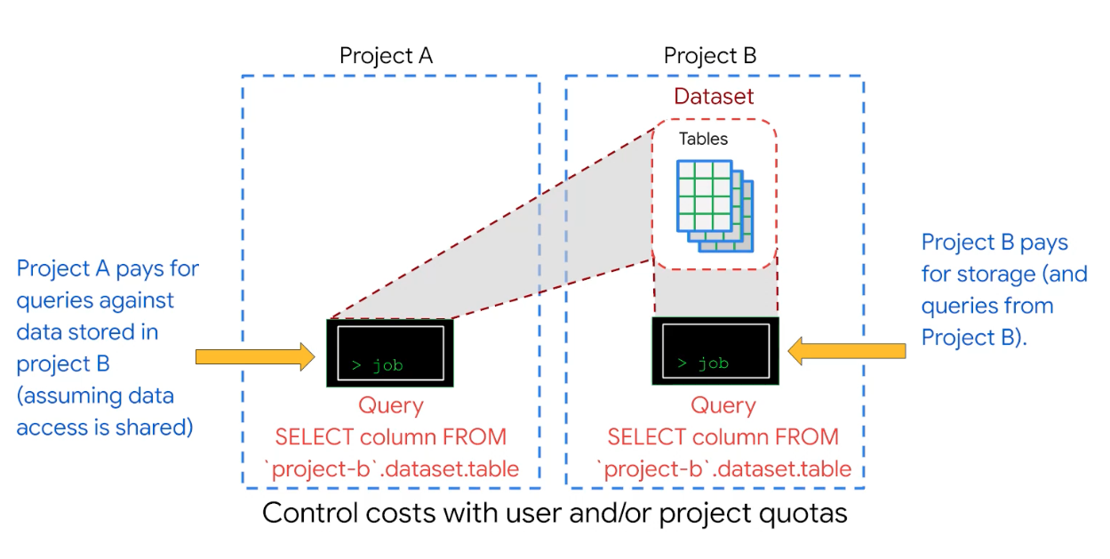
Cost for sharing between many project

Slide 22
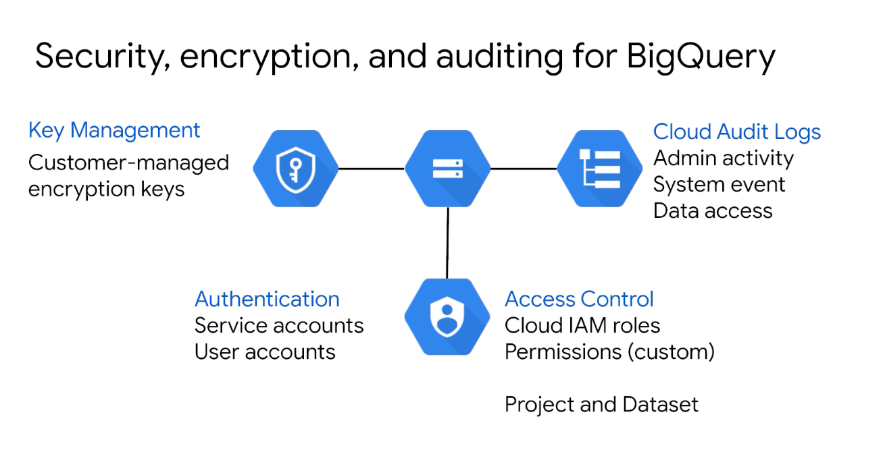
Security

Slide 23
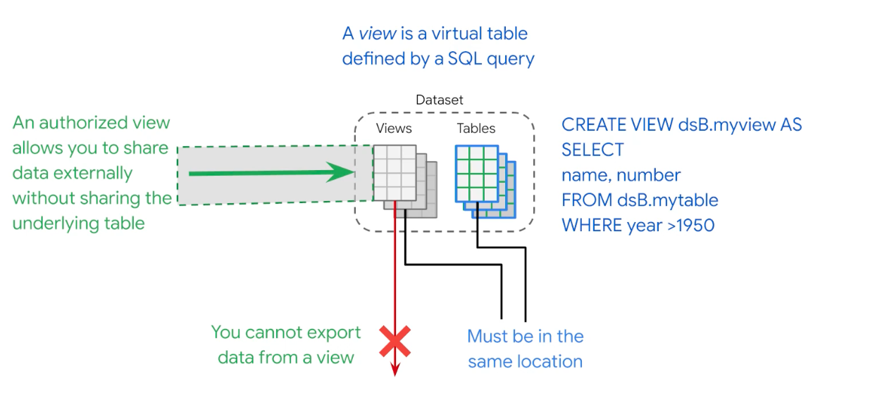
Views access control

Slide 24

DEMO

Slide 25
Reference
https://dataschool.com/data-modeling-101/row-vs-column-oriented-databases/
https://app.pluralsight.com/course-player?clipId=aa68b40c-a411-463c-ba23-74af64587294
https://app.pluralsight.com/library/courses/0d99571d-df43-4455-8134-78accef8f1b7/table-of-contents
https://www.slideshare.net/greenido/idos-paris-big-query-basics
https://www.slideshare.net/TanviParikh1/big-query-50522330
https://openai.com/

