Slide 1
Health Information Management System

Slide 2
Introduction
This short program simulates a basic health information system for managing clients and health programs/services.
To make it work, i created a fake doctor that will do the tasks that the system will help a doctor do such as: Creating a health program, registering a new client, Enrolling a client in one or more programs, Searching for a client and viewing a client’s profile
In a real system, the fake doctor will be replaced by real doctors, probably from a database of company staff.

Slide 3
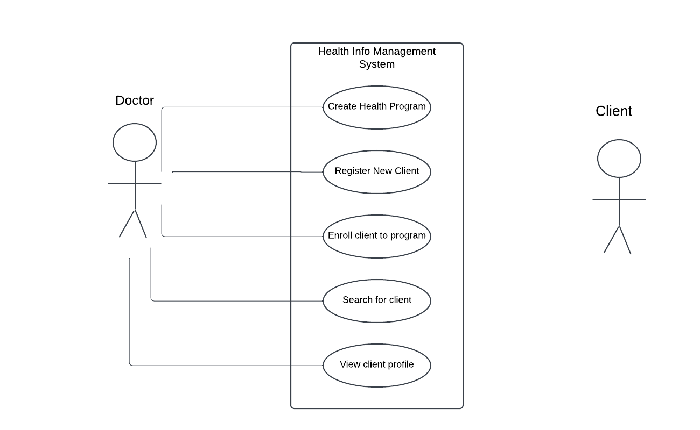
Use case diagram

Slide 4
Technologies used
I used Express js because it is easier and faster to develop prototypes
I used MongoDB for the database. It is a NoSQL database. I decided to use it because it is easier to set up and since it uses documents to represent data, it is easier to add and remove fields.
I used docker to containerize the application for easy delivery and easier deployment.

Slide 5
Solution
From the use case diagram of the system, I identified 5 use cases.
For each of these use cases, i decided to create an API endpoint for them.
I created a fake doctor to interact with the system, since in a real world scenario, the doctirs interacting with the system will have to be logged in to use the system.
I therefore created a login page and endpoint to facilitate the logging in of doctors.

Slide 6
Recommendation
In a real world scenario, i would have made this application secure aginst common web vulnerabilities such as NoSQL attacks, XSS, CSRF and so on.

