Slide 1
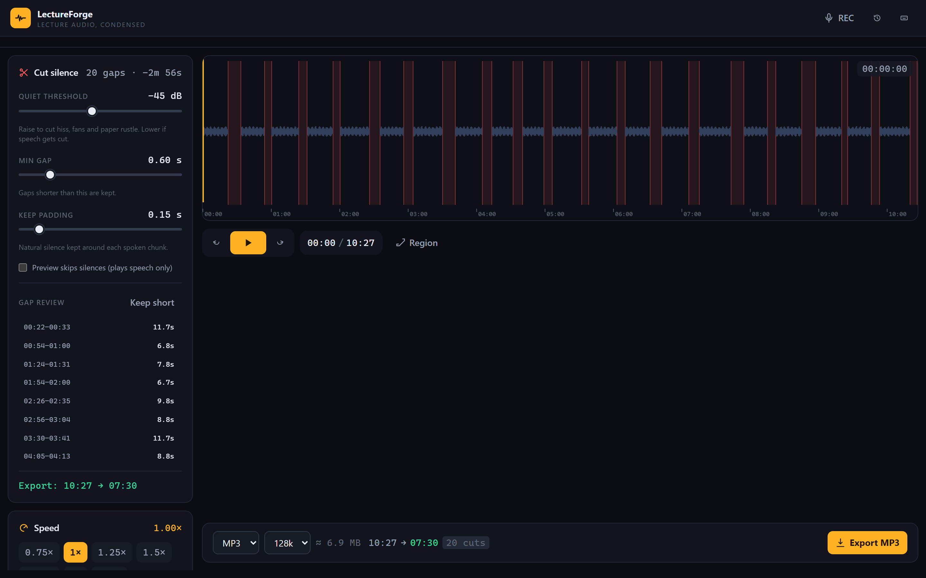
LectureForge
Cut the silence. Keep the lecture.
A browser app that removes dead air from class recordings,
speeds them up without a chipmunk voice, and exports MP3 —
with no upload, no account, and no installation.
20 silent gaps found automatically in a 10-minute lecture
Nash Bruce V. Quiros · BSCS-3 · Multimedia · November 4, 2026
Notes:
Good day! This is LectureForge, my Multimedia final project: a web app that makes lecture recordings shorter. Everything runs inside the browser — no uploads, no accounts.

Slide 2
One hour of lecture. Up to 15 minutes of dead air.
Silence while a class settles, the teacher thinks, or papers shuffle. Hand-cutting it in an editor means finding every silent part yourself.
10–15 min
20+ edits
15+ min
of silence in a typical 1-hour class recording
to select and delete each gap by hand
of careful zooming, selecting, deleting, exporting
Who it helps: students reviewing recorded lectures, and teachers sharing class recordings on slow connections.
Notes:
The problem: recorded classes are full of dead air. Removing it by hand is slow and repetitive — an hour of audio can hide twenty silences.

Slide 3
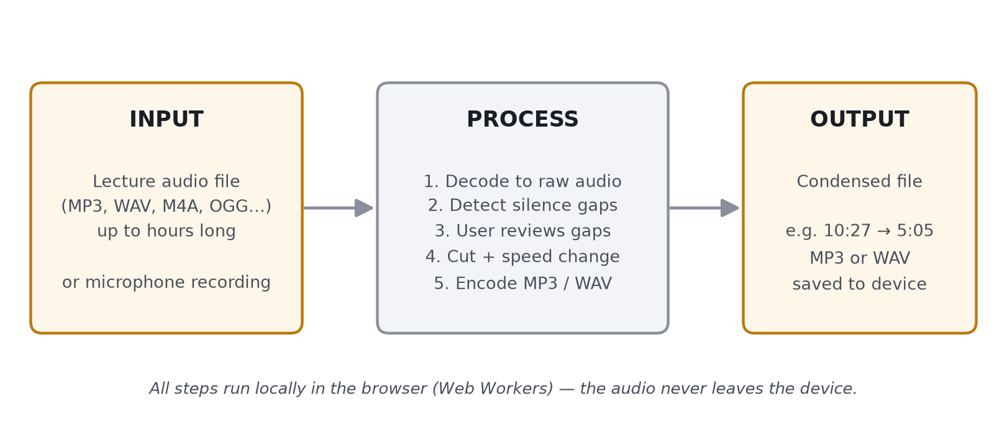
How it works
Loudness is measured in small frames; silent gaps become visible cuts the user reviews before export.
Notes:
Input: any audio file or a mic recording. Process: decode, detect silence, review, cut, optional pitch-preserving speed-up, encode. Output: a shorter MP3 or WAV saved to the device.

Slide 4
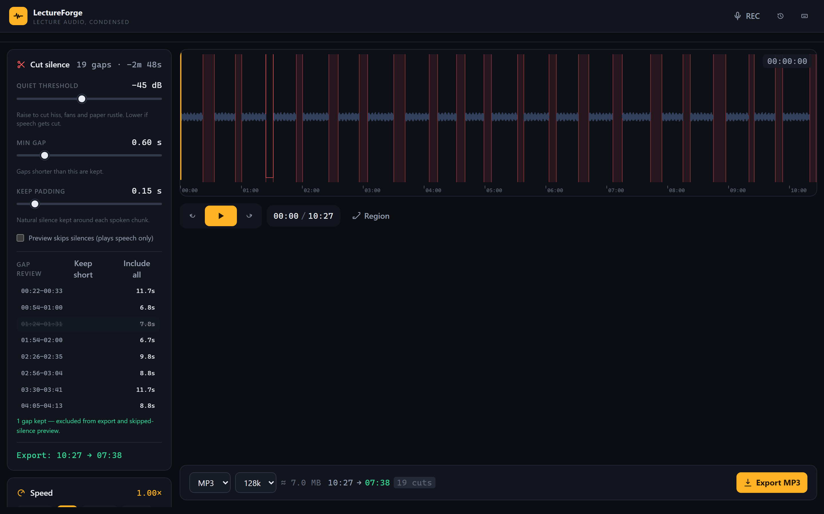
Every cut visible — every cut reviewable
Gaps are marked red on the waveform — found in 2.3 seconds
One click keeps a pause; the estimate updates instantly
Plus: batch queue, microphone recording, offline install (PWA), keyboard shortcuts.
Notes:
Detection is fast — 2.3 seconds for a 105-megabyte file. The gap list gives the user the final say: click a gap to keep it, and the export estimate updates right away.

Slide 5
Tested end to end
All five manual tests passed on a 10.4-minute sample lecture (105 MB, 20 inserted silences):
2.3 s
20 / 20
5:05
25 / 25
to load and analyze the file
silent gaps detected
exact export length
automated engine tests pass
Keeping one gap in review updated the plan from 20 cuts to 19 (10:27 → 07:38) — and the export honored it.
MP3 at 1.5× speed finished in 20.5 s: valid MP3, duration exactly 5:05, natural pitch.
Accessibility audit (axe-core): zero serious findings across all app states; loudness leveling verified.
Notes:
I measured everything on a ten-minute sample: loading, detection, the keep-a-gap review, and the export duration — plus 22 automated tests for the audio engine itself.

Slide 6
Same task, two ways
Cut the silence from the same 10.4-minute lecture
LectureForge
Audacity (manual way)
3 clicks · ~23 seconds
60+ interactions · 15+ minutes
Drop the file (2.3 s analysis)
Review gaps — optional
Export MP3 (20.5 s)
Zoom in, hunt each silence by eye and ear
Select + delete — 20 times over
One mistake can clip a word
Measured: LectureForge timings are from the tests; the Audacity path is the documented manual workflow, estimated.
Notes:
Test five compares the same task: three clicks and about 23 seconds with LectureForge, versus 60-plus interactions and 15-plus minutes doing it manually in Audacity.

Slide 7
Conclusion
What works
Limits
Next
All 5 manual tests passed
20-min lecture → 5:05 in ~23 s
Loudness leveling + mobile layout
Fully offline & private
Audio only — no video files
Recorder needs mic permission
Files >220 MB at lower rate
Safari 15+ only
Video soundtrack support
Chapter markers in exports
Filipino interface
iOS Safari polish
LectureForge · Nash Bruce V. Quiros · Tangub City Global College · BSCS-3
Notes:
To conclude: the core promise works — silence out, speed up, MP3 out, all offline. The limits are known, and the next steps are clear. Thank you!

