Slide 1
Using Empirical Standards in Demeter
This demonstration uses copper data at 10 K and 150 K. The data is in an Athena project file that comes with the Demeter source code or can be found at github at the URL below.
https://github.com/bruceravel/demeter/tree/master/examples/recipes/EmpiricalStandard/cu.prj

Slide 2
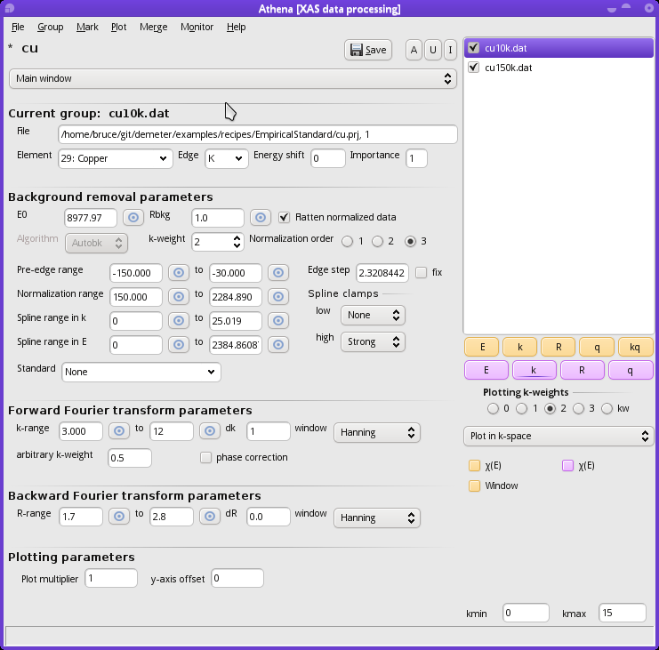
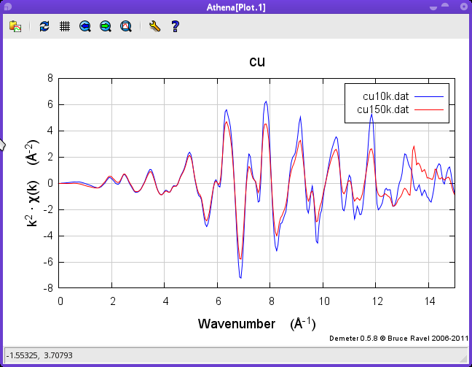
Here is the copper data imported into Athena. Because the 150K data has that wonky bit at 13 A⁻¹, I have made the forward transform range [3:12]. The back transform range is [1.7:2.8], i.e. around the first peak in R. Take care to align your data and to make each data group's E0 the same.
Make sure that the absorber element was identified correctly.

Slide 3
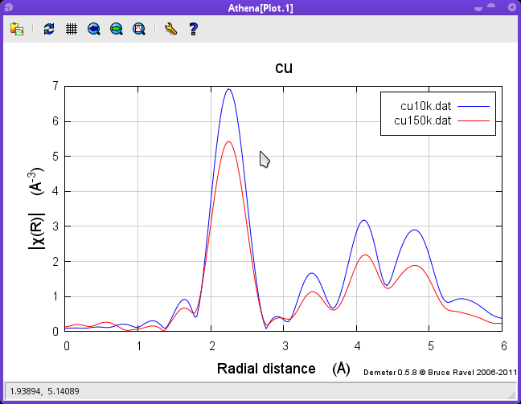
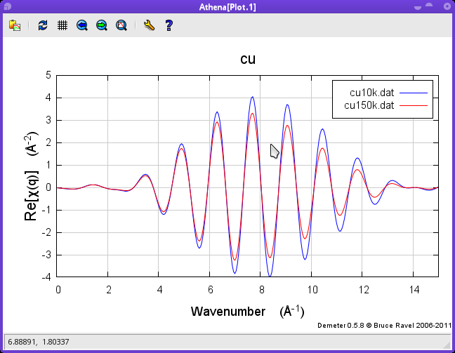
Here are the data plotted in R and q.

Slide 4
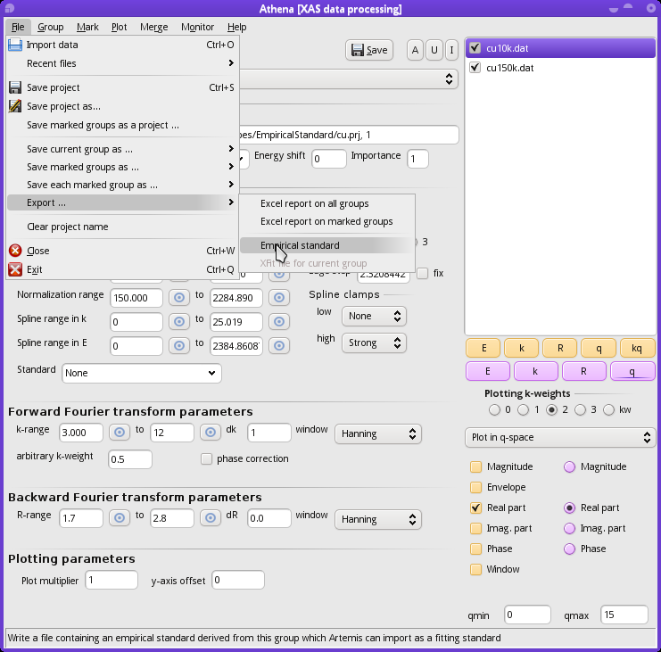
Select the “standard” (in this case, the lower temperature data) in the group list.
Export an empirical standard by digging down through the “File” menu.
This will prompt you for a file name. The default file is the name of the data group with “.es” as the extension.
You will then be prompted....

Slide 5
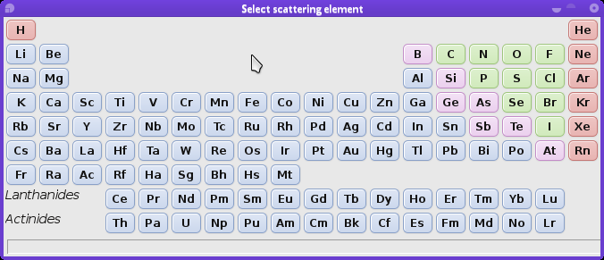
… for the species of the scattering element. Athena has no way of knowing this, so you have to provide this information. In this case, you would click on Cu since this is copper metal.

Slide 6
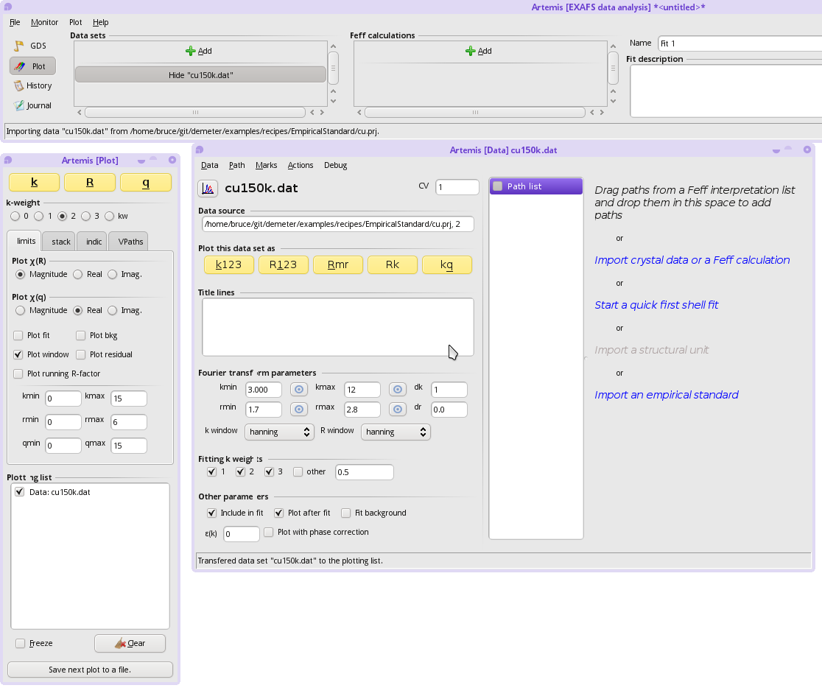
Now fire up Artemis and import the 150K data (i.e. the one that is not the standard). Then click the active text that says “import an empirical standard”. You will be prompted to import the “.es” file you just made with Athena.

Slide 7
Once the empirical standard is imported, it will be displayed just like any path. You can tell it is an empirical standard because its label contains the token “[Emp.]”.
Here I have set up a 4-parameter fit typical for a first shell fit, except that I have set the E0 parameter to 0. The amplitude, σ², and Δr are guess parameters.
In the plot, I show the 150K data in R along with the empirical standard taken from the 10K data. The initial guess of σ²=0.003 is clearly a bit too large.
I am now ready to hit the Fit button.

Slide 8
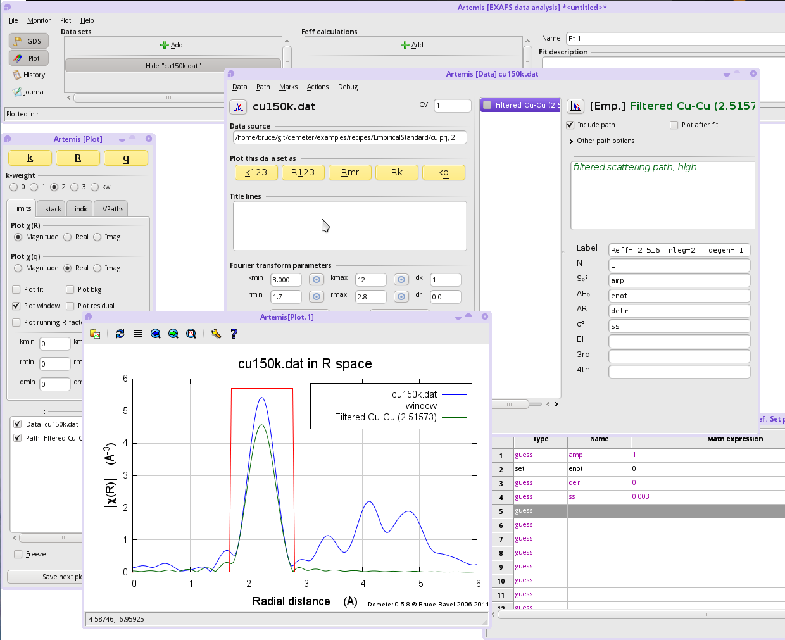

Slide 9
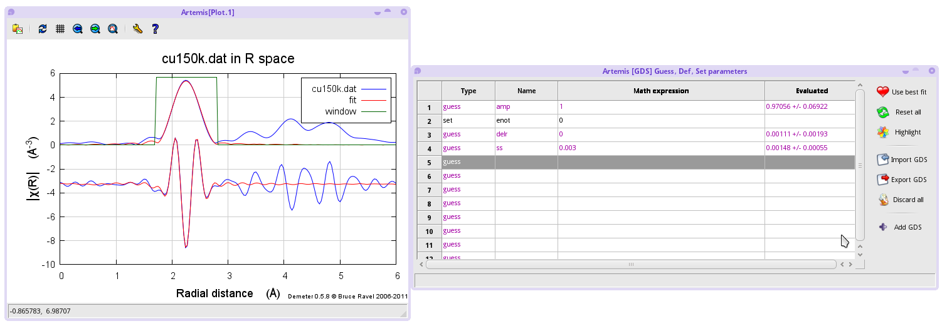
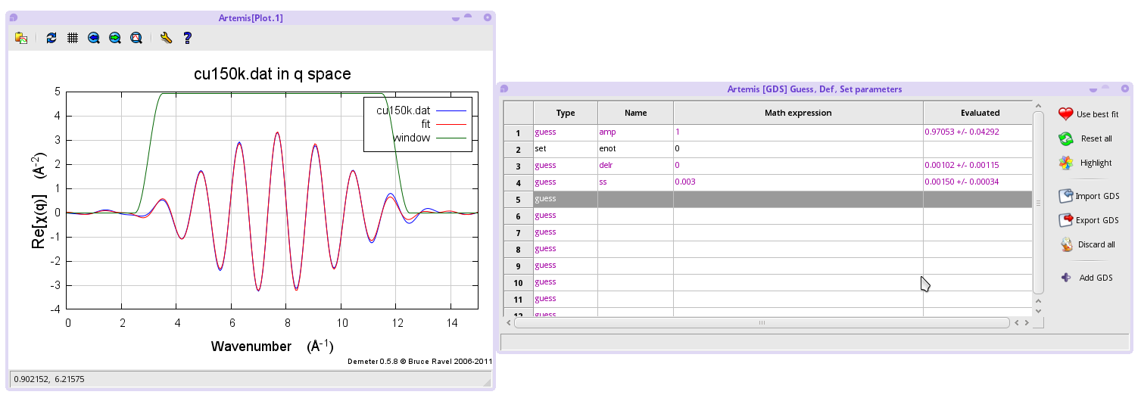
Here is the fit performed in R and plotted in R
Here is the fit performed in q and plotted in q

Slide 10
The results fitting in R or q are pretty similar, which is reassuring.
The value for the amplitude is consistent with and close to 1, which is should be since the copper metal is 12-fold coordinate at both temperatures.
The value for Δσ² is 0.0015(3), which seems reasonable for this temperature range.
The value for ΔR fitted in q space is 0.001(1). Fitted in R space, the uncertainty is 0.002. That's kind of interesting. In either case, the uncertainty in R is smaller than for a Feff-based fit for a number of reasons. Probably the most significant is that both standard and data are of excellent quality. Were the data the sort of marginal data that comes from most research problems on difficult materials, the effects of statistical and systematic noise would be much more dramatic. Also relevant top small uncertainty is that this fitting problem has been contrived (by virtue of careful alignment and choice of E0 back in Athena) to remove ΔE0 from the problem. By removing the parameter most correlated with ΔR, we significantly reduces the uncertainty in ΔR.
I would not interpret all of this to mean that use of empirical standards is superior to the use of Feff. In the specific case where the first coordination shell is of known contents and can be well isolated from higher shells and where you are confident that your unknown is identical to your standard except for small changes in N, R, or σ², then empirical standards are a useful tool for your EXAFS toolbox.

