Slide 1

CS244 Lecture 2
The Design Philosophy of the DARPA
Internet Protocols [Clark 1988]
Sachin Katti
Notes:
Goals of the class
Participation

Slide 2
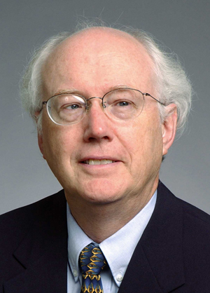
Context: David D. Clark (MIT)
Chief Protocol Architect
for the Internet from 1981.
Continues to be a network
visionary today.
At the time of writing (1987)…
  (Almost) no commercial Internet
  1 yr after Cisco’s 1st product, IETF started
  Number of hosts reaches 10,000
  NSFNET backbone 1 year old; 1.5Mb/s

Slide 3
The Design Philosophy of the DARPA Internet Protocols
[Clark 1988]
Goal 0: An “effective” technique for multiplexed utilization of existing interconnected networks.
“Even at the very dawn of the internet, they were worried about backwards compatibility”
Kevin Rosendahl

Slide 4
The Design Philosophy of the DARPA Internet Protocols
[Clark 1988]
Goal 0: An “effective” technique for multiplexed utilization of existing interconnected networks.
Goal 1: Internet communication must continue despite loss of networks or gateways.
“Even at the very dawn of the internet, they were worried about backwards compatibility”
Kevin Rosendahl

Slide 5
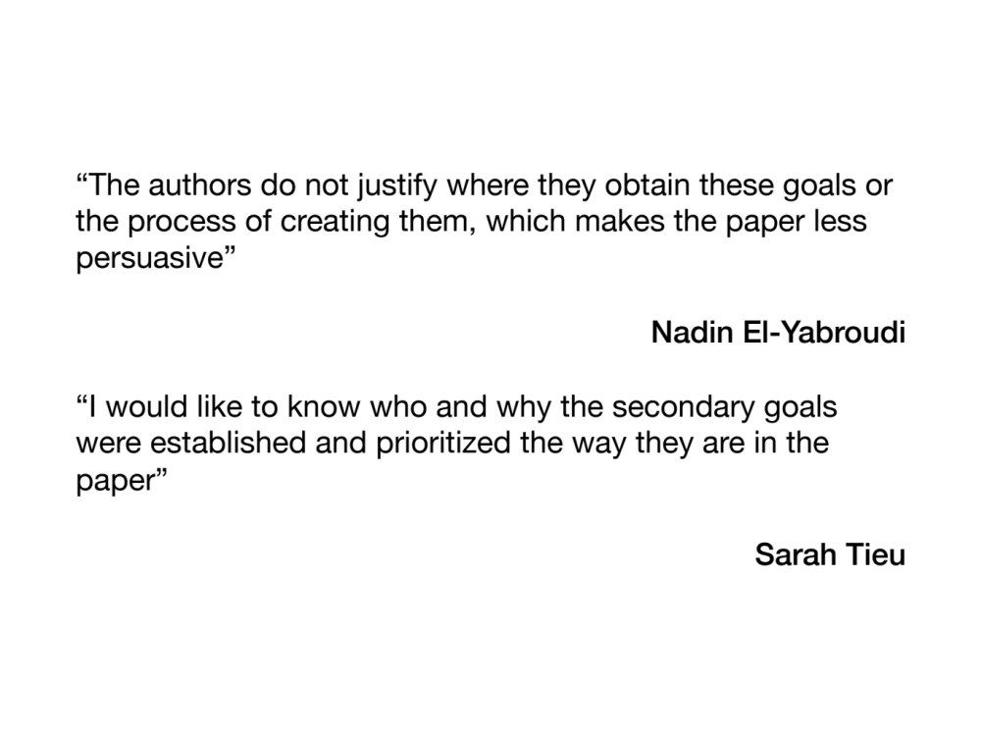

Slide 6
The Design Philosophy of the DARPA Internet Protocols
[Clark 1988]
Goal 0: An “effective” technique for multiplexed utilization of existing interconnected networks.
Goal 1: Internet communication must continue despite loss of networks or gateways.
Goal 2: The Internet must support multiple types of communication service.
Goal 3: The Internet architecture must accommodate a variety of networks.
Goal 4: The Internet architecture must permit distributed management of its resources.
Goal 5: The Internet architecture must be cost effective.
Goal 6: The Internet architecture must permit host attachment with a low level of effort.
Goal 7: The resources used in the internet architecture must be accountable.

Slide 7
Goal 0: An effective technique for multiplexed utilization of existing interconnected networks
Led to: Different networks connected together by packet switched, store-and-forward routers/gateways
Q. Why interconnect existing networks and not design a new overall network from scratch?
Q. Why was packet switching picked for multiplexing? What were the choices?

Slide 8
Goal 1: Internet communication must continue despite loss of networks or gateways.
“Entities should be able to continue communicating without having to re-establish or reset the high level state of their conversation.”
“The architecture [should] mask completely any transient failure.”
Leads to:
“Fate-sharing” model - only lose communication state if the end-host is lost.
Stateless packets switches => datagrams
Q. What alternative design could there be?
Q. How does the Internet do this?
Q. Would a “dedicated” new network have been more reliable?

Slide 9
Other goals
Goal 4: The Internet architecture must permit distributed management of its resources
  Q. Does the Internet accomplish this?
Goal 5: The Internet architecture must be cost effective.
  Q. Is it cost effective?
Goal 7: The resources… must be accountable
Q. What does this mean?
Q. What would such a network look like?

Slide 10
Minimum Assumptions of interconnected networks
Can transport a datagram
…of reasonable size
…with reasonable chance of delivery
Interesting comments:
Reliability and qualities of service were not built in because they would require too much change.
Datagram as a building block, not as a service.

Slide 11
More discussion questions
Originally TCP+IP were joined, but were later split.
Q: Why?
“It proved more difficult than first hoped to provide multiple types of service without explicit support from the underlying network”
Q. Why? What has happened since?

Slide 12
More discussion questions
Interesting comment: “The most important change in the Internet…will probably be the development of a new generation of tools for management of resources...”
Q. Has this happened?

Slide 13
Author’s conclusion
“Datagram” good for most important goals, but poor for the rest of the goals.
Processing packets in isolation, resource management, accountability all hard.
Anticipates flows and “soft-state” for the future.

Slide 14
What you said
“By providing a balanced view of several of the design choices by equally highlighting their strengths and weaknesses, the reader is constantly reminded that there is no fundamentally 'correct' way to design the internet but rather design choices must be made to satisfy overall architectural goals."
- Sandeep Chinchali (2013)

