Slide 1
NuMaker Brick
Training Course
YCHSIEH3@nuvoton.com

Slide 2
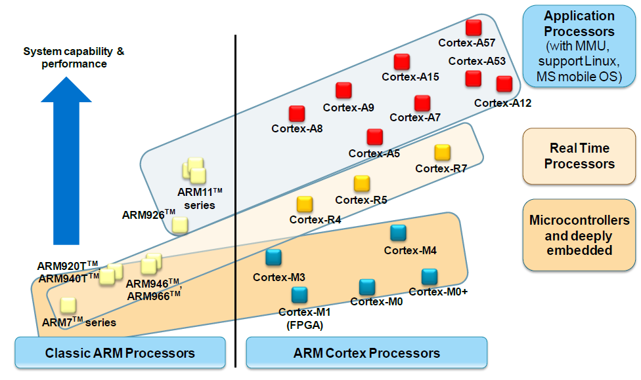
ARM Architecture Road Map
Reference from ARM

Slide 3
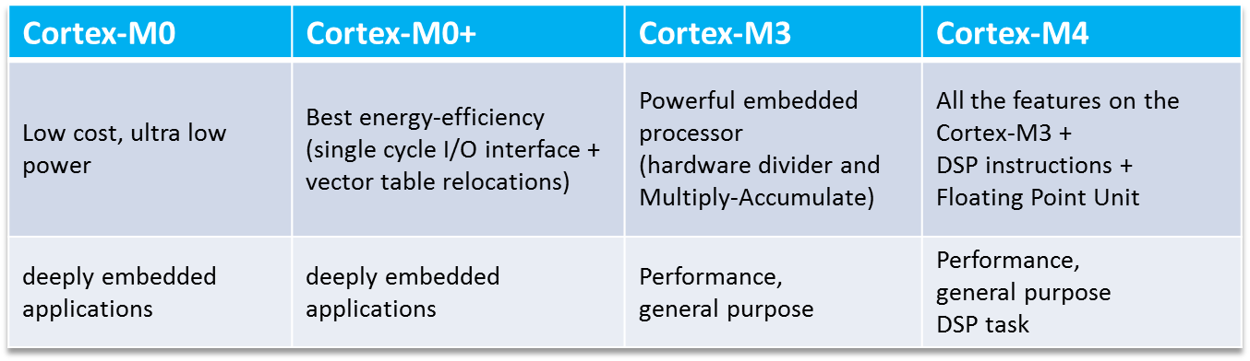
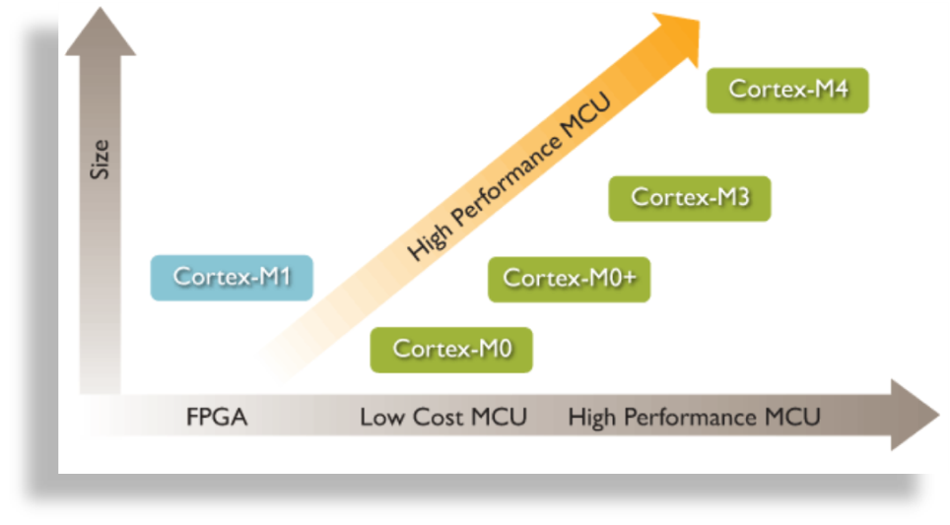
Cortex-M Processor Family
Reference from ARM

Slide 4
M451 Series
Cortex-M4
UART/SPI/I²C/I²S/ISO-7816
M453 CAN Series
EPWM
Up to 256B Flash ROM
Up to 32KB SRAM
16KB Mask ROM
CAN
USB OTG
SPI
I²C
M452 USB Series
I²S
Up to 256KB Flash ROM
Up to 32KB SRAM
16KB Mask ROM
USB OTG
ISO-7816
M451 Base Series
12-bit ADC
Up to 256KB Flash ROM
Up to 32KB SRAM
16KB Mask ROM
Comparators
32-bit Timers
M451M Series (M051 Pin Compatible)
WDT/WWDT
Up to 256KB Flash ROM
Up to 32KB SRAM
16KB Mask ROM
^{＊1} : Denoted without supported
in M451 series
Internal 22MHz RC
Real Time Clock
DMA
GPIO

Slide 5
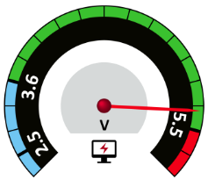
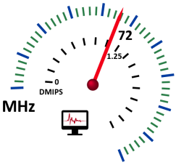
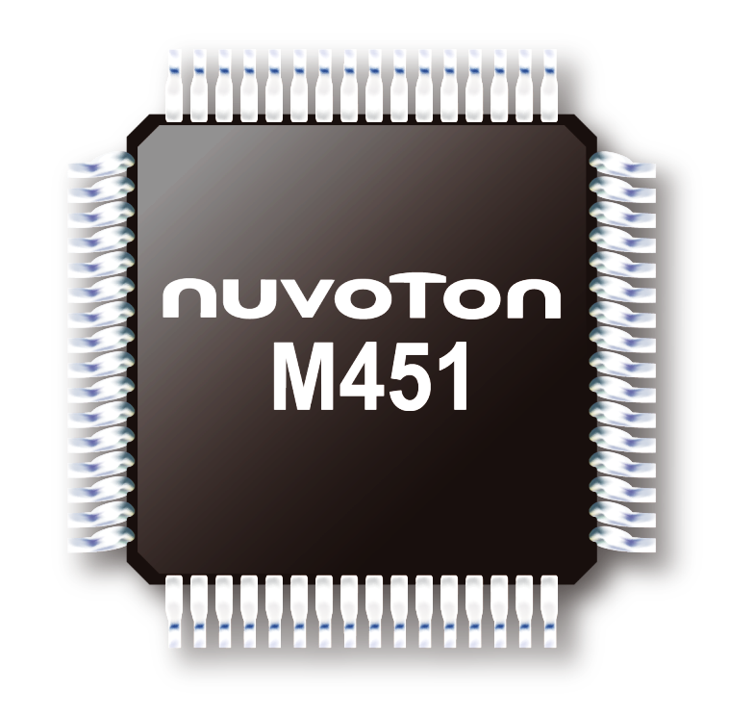





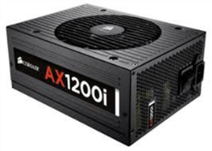



M451 Series Feature
Support 3 sets of SPI
Support 2 sets of I²C
Support 1 set of CAN
Support 4+1 sets of UART
2.5V ~ 5.5V
-40℃ ~ +105 ℃
High precision 22.1184MHz IRC 2%
ESD8KV, EFT 4KV
72MHz /90 DMIPS
Flash 256KB/SRAM 32KB
FPU、DSP、MPU
Support USB 2.0 FS OTG
Support LPM USB 2.0 FS Device
Voltage Adjustable Interface
Clock supervisor
Two watchdogs
RAM parity check
CRC
Supports maximum clock frequency up to 144MHz
Support 16 channels of SADC
Support 1 channel DAC
Support 2 sets of ACMP

Slide 6


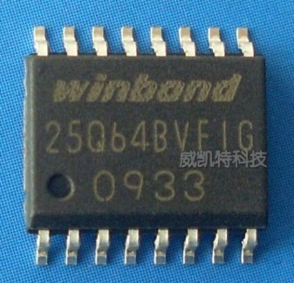


Rich & Flexible Power Domain
Elevator @ 5V
VDD
2.5~5.5V
SPI Flash @ 3.3V
1
2
VDDIO
1.8~5.5V
GPIO x 6
General Device
CAN/I2C/USB/UART
RTC @ 2.5V
VBAT
3
2 ~5.5V
GPIO x 3
VDDIO Peripheral Connection Set
Type1 | Type2 | Type3 | Type4 | Type5 | Type6 | Type7 | Type8
SPI_Dual x 1 UART x 1 | UART x 1 I2C_SMBus x 1 | UART x 1 I2C x 1 | UART_flow x1 I2C x 1 | SPI_Quad x 1 | SPI_Dual x 1 I2C x 1 | I2C x 2 UART x 1 | I2C x1 I2C_SMBus x1

Slide 7
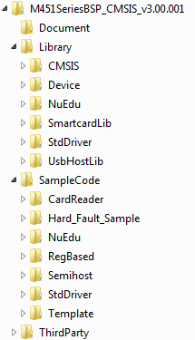
Advantage for M451 BSP
M451SeriesBSP_CMSIS_V3.00.001
Unify API name
Lower barrier for engineer
Rich applications inside
Document
  API description
Library
  CMSIS, MCU initiation
SampleCode
  Sample Code Procedure
ThirdParty
  Third Party Tool (M4 only)

Slide 8
Run 1st Sample Code

Slide 9
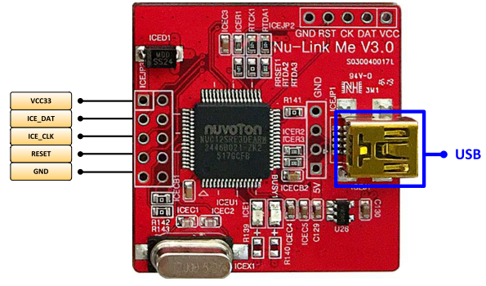
Nu-Link Me
Debugging
Online Programming

Slide 10
Software Requirement
Install Keil IDE
Download & Install M451 BSP
Download & install Nu-Link Driver

Slide 11
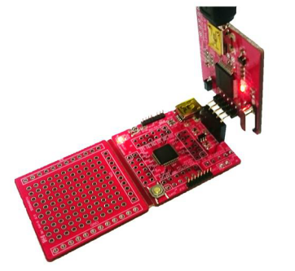
Step 1. Hardware Connection
Connect Nu-Link Me to target board
Connect Nu-Link Me to PC

Slide 12
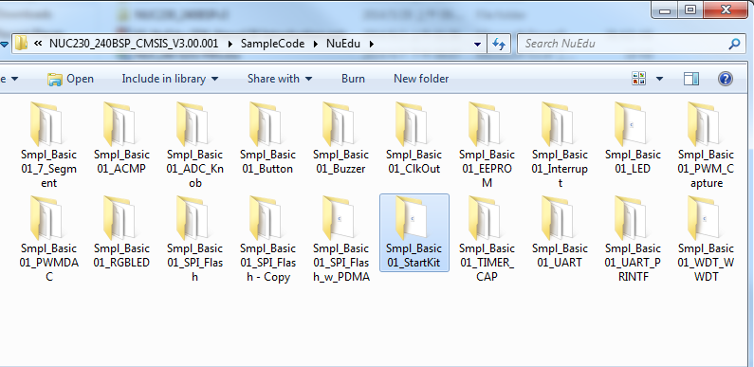
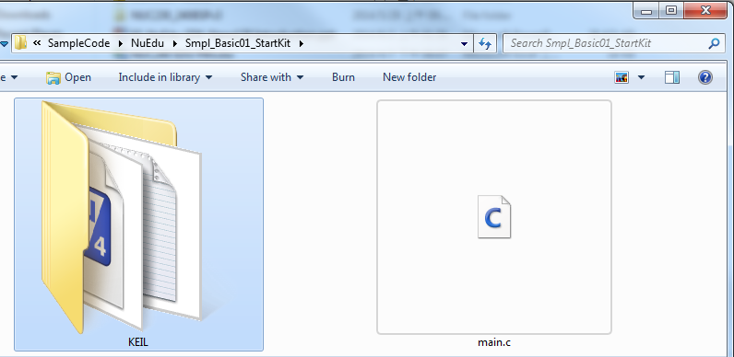
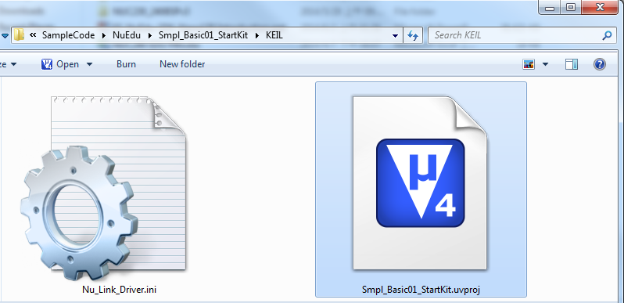
Step 2. Double Click to enter the project

Slide 13
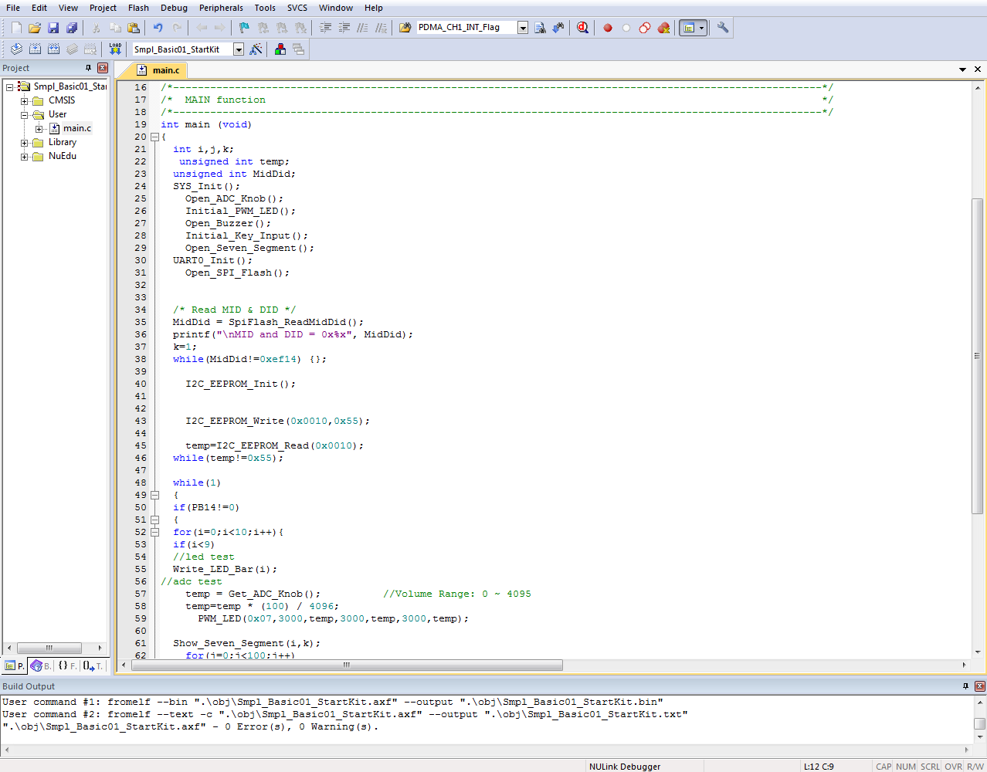
Step 3. Build the Project
Rebuild
Build Output Window

Slide 14
Step 4. To Download & Enter Debug
Start / Stop Debug Session(Ctrl + F5)

Slide 15
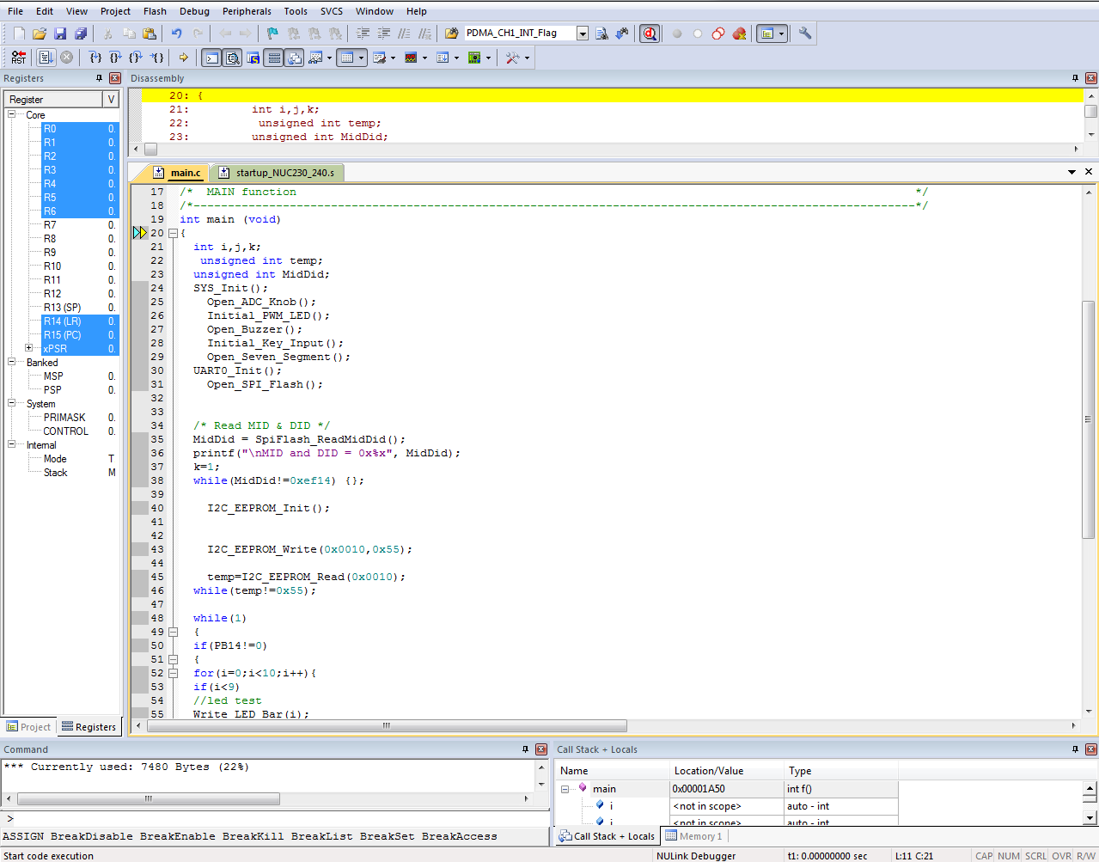
Step 5. Press or “F5” to run the code
Disassembly Window
Run (F5)
Memory, Stack and Watch Window

Slide 16
Q & A
Thank You

