Slide 1
NuMaker Brick
GPIO & UART
YCHSIEH3@nuvoton.com

Slide 2
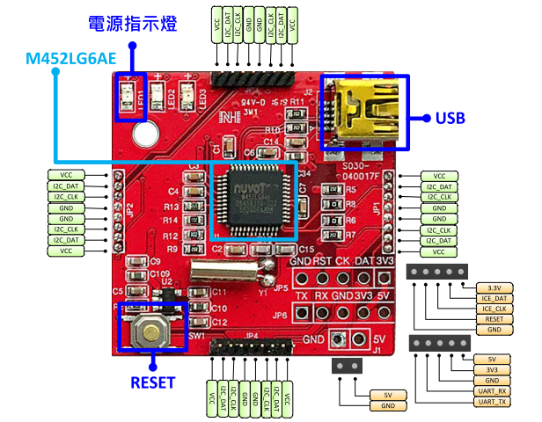
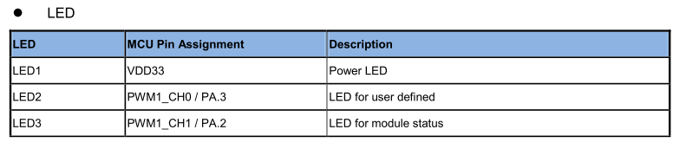
NuMaker Brick Master Module

Slide 3



GPIO Programming Flow
Set Pin Multi-function to GPIO
Set GPIO Mode to Output
Set GPIO to Low

Slide 4
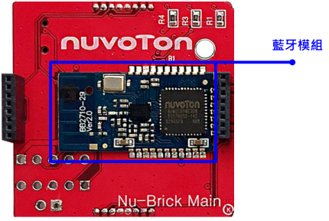
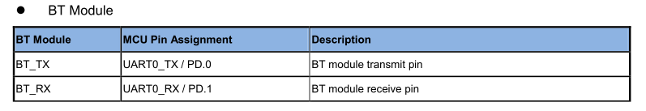
NuMaker Brick Master Module

Slide 5


UART Programming Flow
Enable UART Module Clock
Set UART Module Clock
Set Pin Multi-function to UART
Configure UART

Slide 6
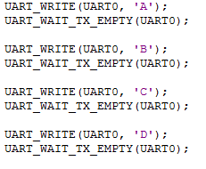
UART Programming Flow
Send UART Data

