Slide 1



The interpretability of Mel-Frequency Cepstral Coefficients: A pilot study using articulatory phonetics
Bruce Xiao Wang¹, Lei He²
¹Department of Chinese and Bilingual studies, Hong Kong Polytechnic University
²Department of Computational Linguistics - Phonetics, University of Zurich
brucex.wang@polyu.edu.hk / lei.he@uzh.ch

Slide 2
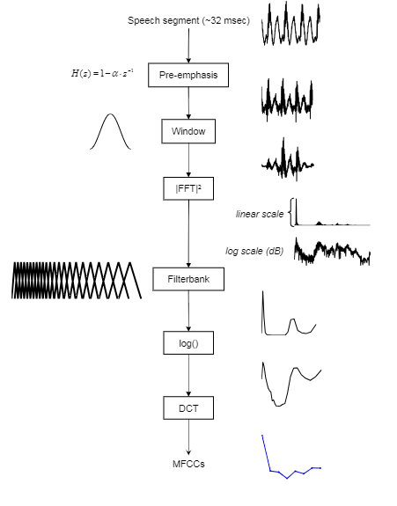
WHAT?
Mel-Frequency Cepstral Coefficients (MFCCs)
Widely used as the input features in automatic systems,
Automatic speech recognition (Prakash & Gangashetty, 2012)
Automatic (semi-) forensic voice comparison (Zhang et al., 2013; Hughes et al., 2017)
Automatic disordered speech recognition (Pellegrini et al., 2014)
Figure 1. MFCCs extraction (Figure 1.2 from Messina 2015, p. 11)

Slide 3
HOWEVER…
Despite its promising performance in automatic systems,
Lack understanding of the underlying principles of MFCCs
No studies have attempted to investigate how MFCCs and vocal tract features, if there are any, are related.
Why MFCCs outperform traditional acoustic features in automatic systems?

Slide 4
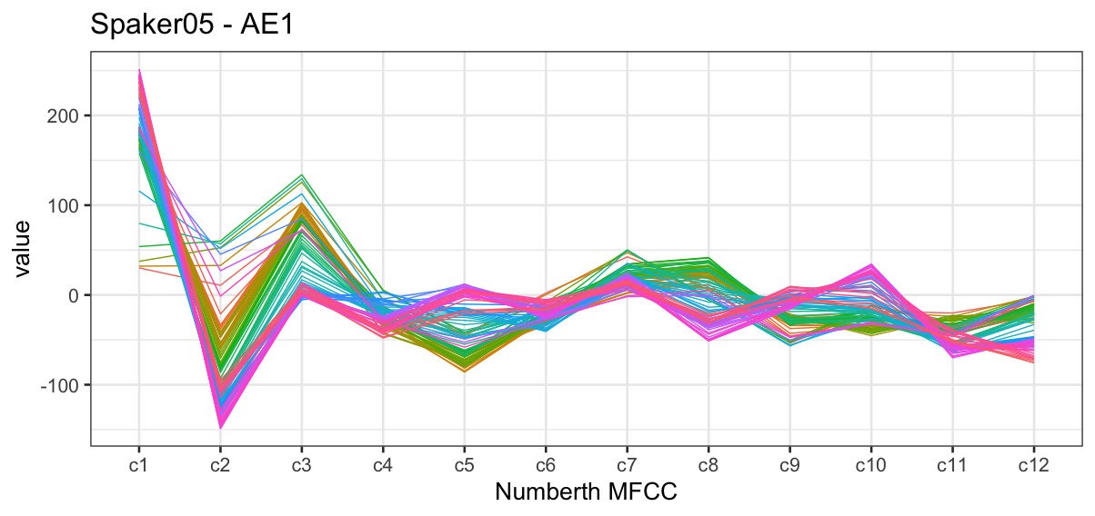
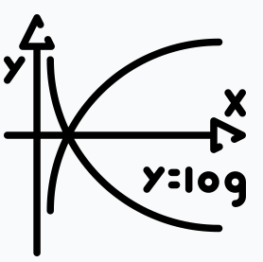
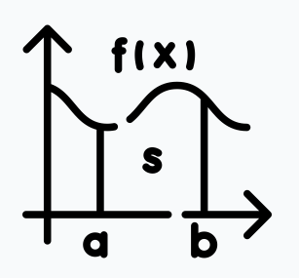


AIM
Mel-Frequency Cepstral Coefficients (MFCCs)
Changes of acoustic signal’s power spectrum across frequencies
Capture the spectral characteristics of speech signal
Spectral characteristics are a function of vocal tract (Fant, 1971), .e.g., articulatory gestures

Slide 5
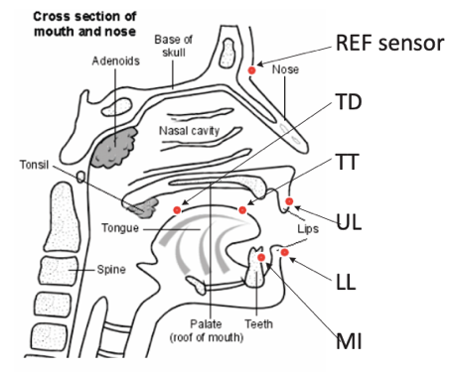
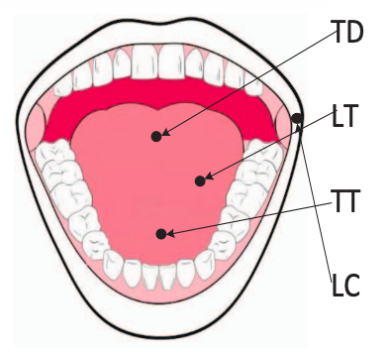
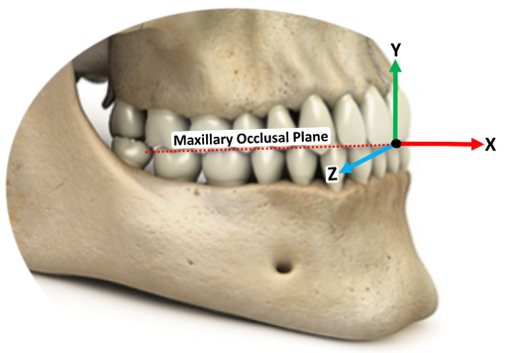
HOW
Corpus
20 Midwestern standard American English speakers (10 male and 10 female; Ji et al. 2014)
330 words in citation form
NDI Wave electromagnetic articulograph
Movement of tongue dorsum (TD), tongue lateral (TL), tongue blade (TB), upper lip (UL), lower lip (LL), lateral lip corner (LC)
Two dimensions, i.e., x: front and back, y:height,
Three corner vowels: FLEECE, TRAP, FOOT

Slide 6
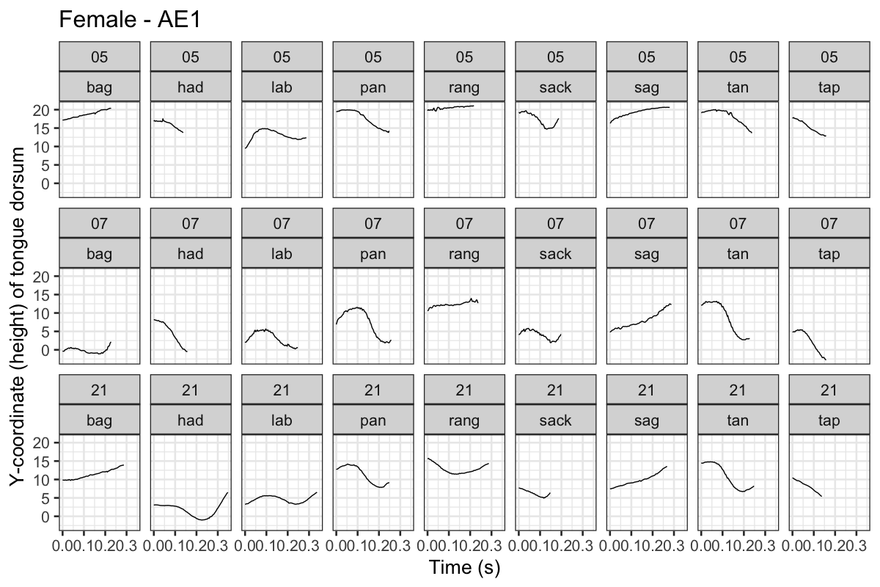
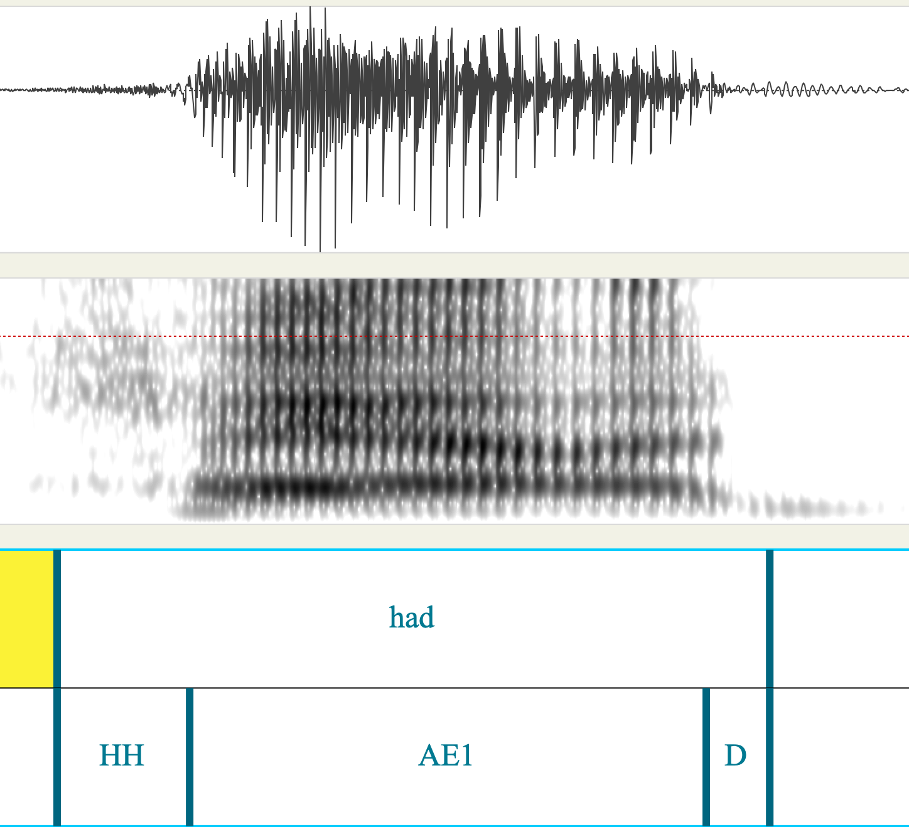
HOW
First 12 MFCCs
12 articulatory kinematics: TD, TL, TB, UL, LL, LC
PCA

Slide 7
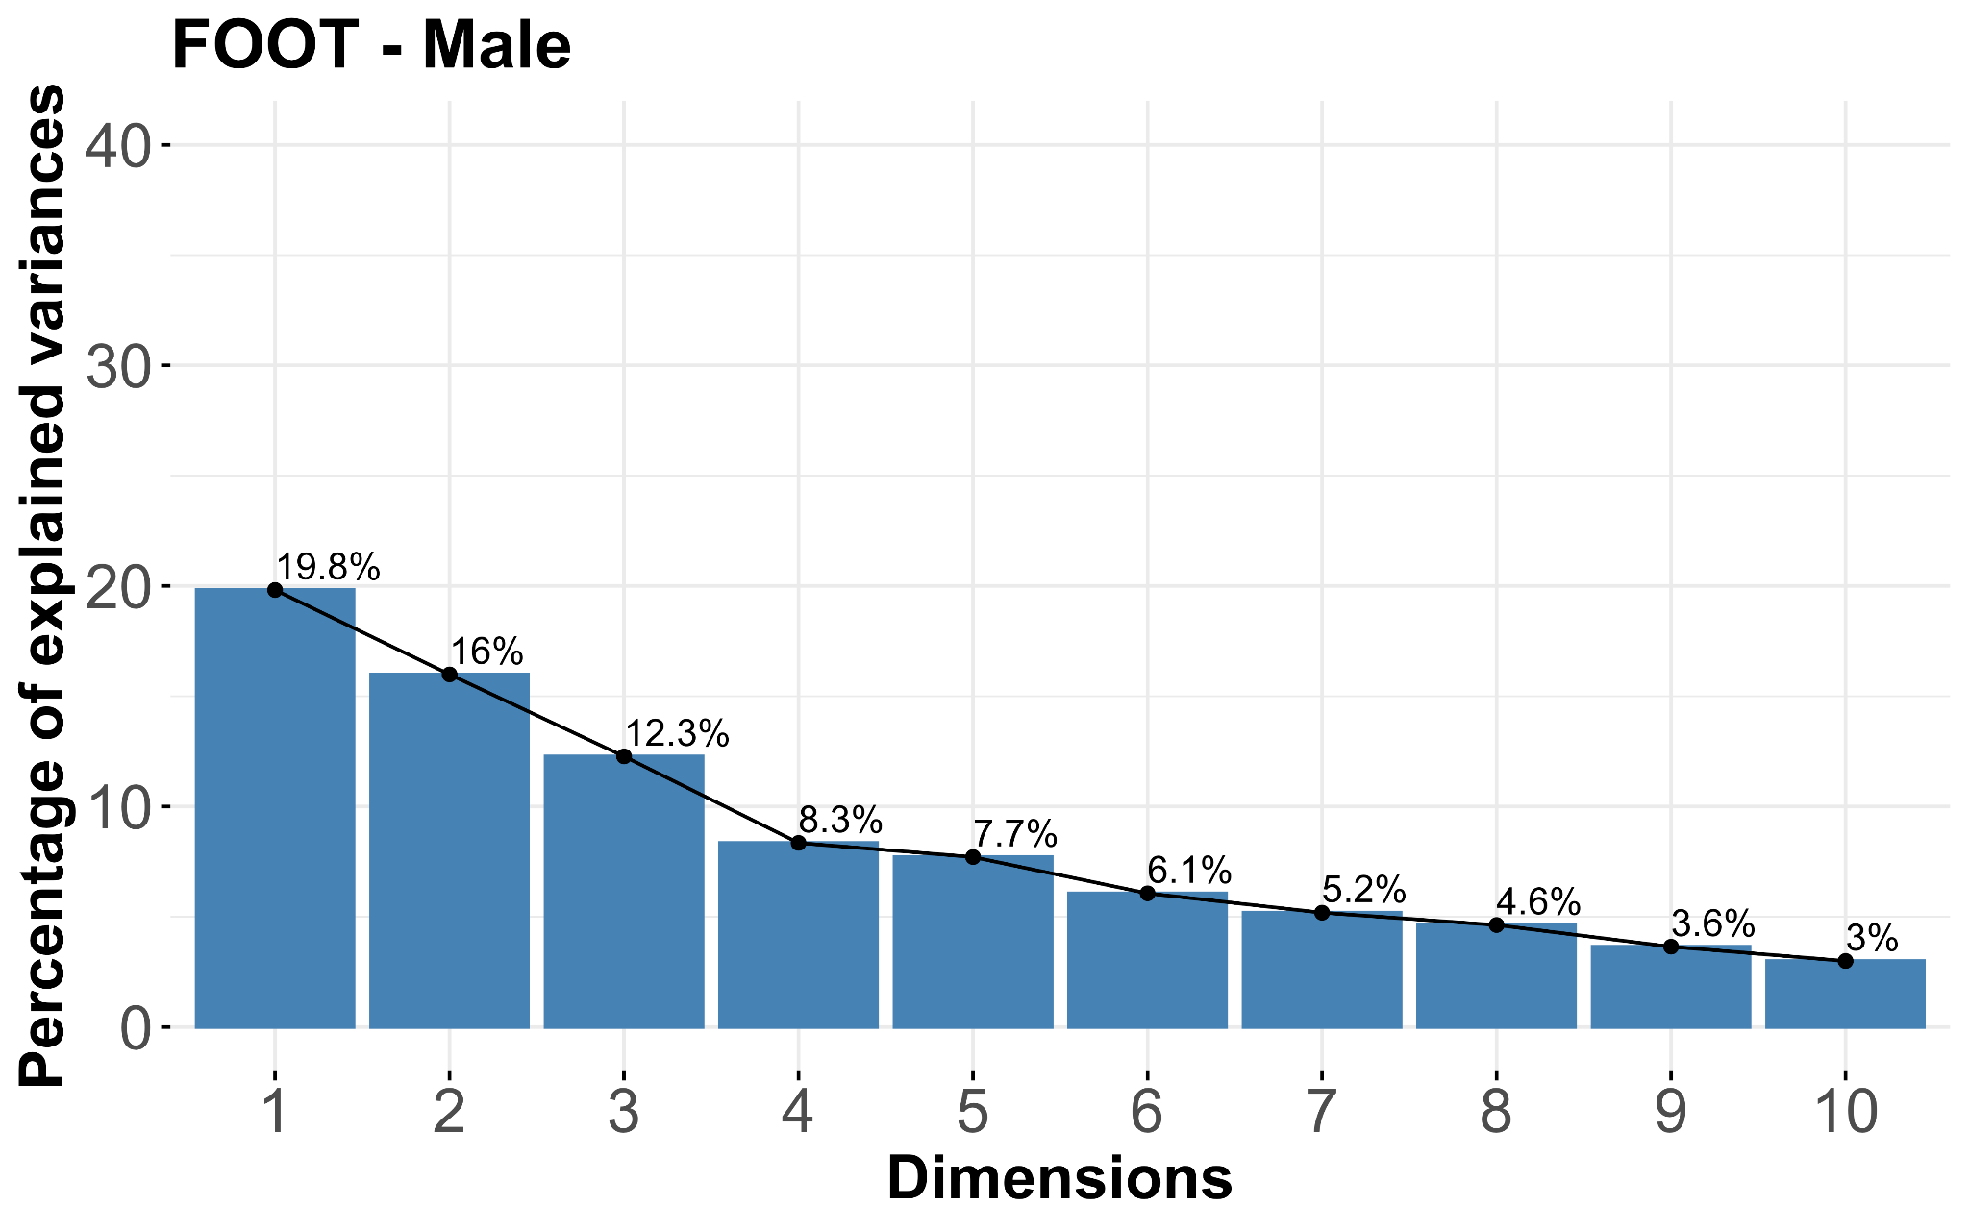
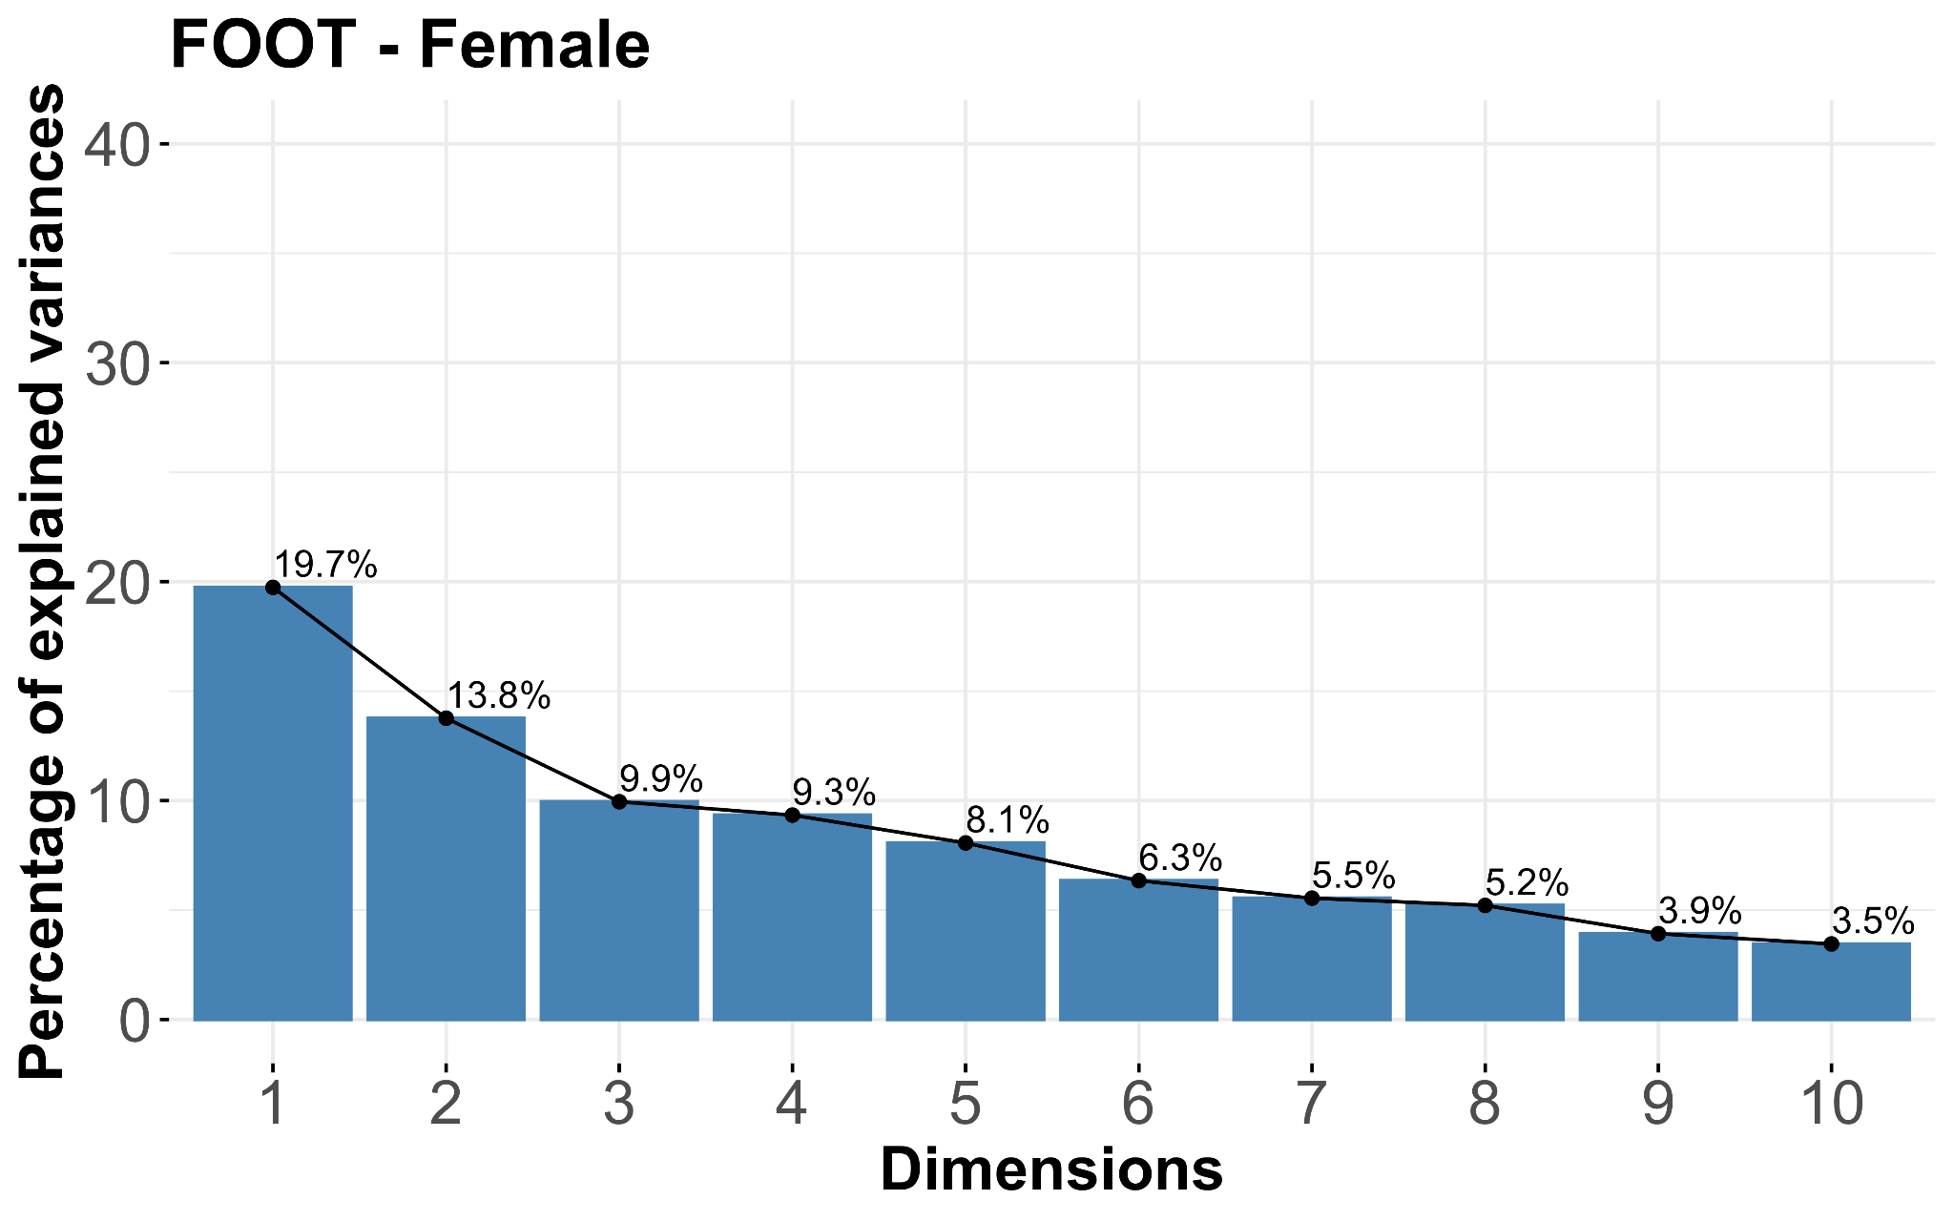
FOR NOW…
First six dimensions account for over 60% of variance explained for male (64.13%) and female (60.85%)

Slide 8
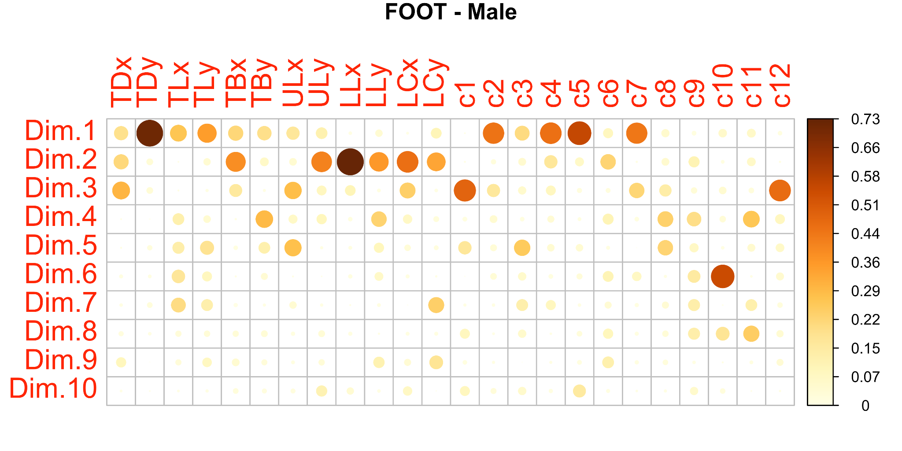
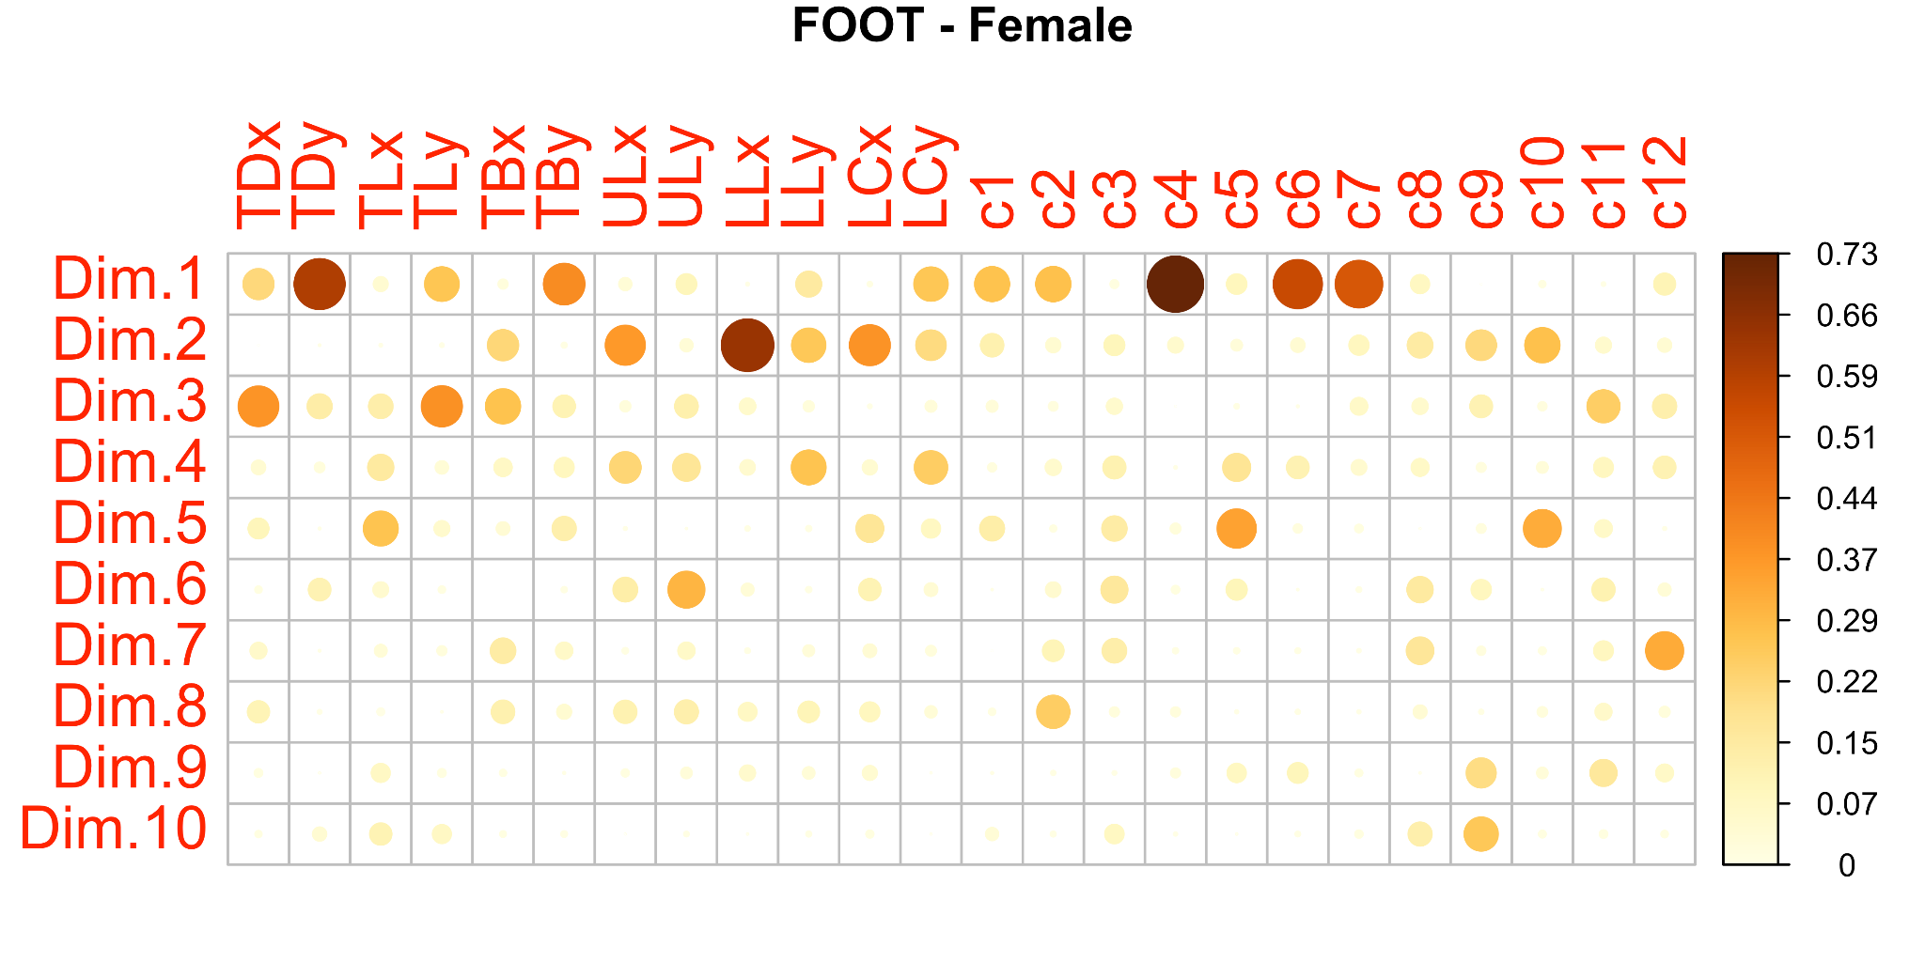
FOR NOW…
Dim. 1 TDy (vertical movement) well represented for both genders
Dim. 2 LLx (front and back ) well represented for both genders
These are sensible similarities between male and female speakers from an articulatory perspective.
Discrepancies in the wellness of the representation of MFCCs
Dim.1
Male: c2, c4, c5, c7
Female: c4, c6, c7

Slide 9
FOR NOW…
Sensible discrepancies in MFCC representation between male and female
MFCCs capture vocal track characteristics & articulatory movement
Articulatory kinematics only captures articulatory movement Biological factor - male generally have longer vocal track and larger larynxes and thicker vocal folds than females (Yule 2010:275).
Follow up questions…
How can we take biological factors into consideration?
More controlled data in terms of participants’ height and weight?
Explore the strength of association between MFCCs and articulatory data
How does the change of articulatory gestures affect the MFCCs values?

Slide 10
谢谢 Thank you
&
Questions?

Slide 11
References
Fant, G. (1971). Acoustic Theory of Speech Production: With Calculations Based on X-Ray Studies of Russian Articulations. Walter
de Gruyter.
Hosom, J.-P. (2003). Speech Recognition. In H. Bidgoli (Ed.), Encyclopedia of Information Systems (pp. 155–169).
Elsevier. https://doi.org/10.1016/B0-12- 227240-4/00164-7
Hughes, V., Harrison, P., Foulkes, P., French, P., Kavanagh, C., & Segundo, E. S. (2017). Mapping Across Feature Spaces in Forensic Voice Comparison: The
Contribution of Auditory-Based Voice Quality to (Semi-)Automatic System Testing. Interspeech 2017, 3892–3896. https://doi.org/10.21437/Interspeech.2017-
1508
Ji, A., Berry, J. J., & Johnson, M. T. (2014, May). The Electromagnetic Articulography Mandarin Accented English (EMA-MAE) corpus of acoustic and 3D
articulatory kinematic data. In 2014 IEEE International Conference on Acoustics, Speech and Signal Processing (ICASSP) (pp. 7719-7723). IEEE.
Pellegrini, T., Fontan, L., Mauclair, J., Farinas, J., & Robert, M. (2014). The goodness of pronunciation algorithm applied to disordered speech. Interspeech
2014, 1463–1467. https://doi.org/10.21437/Interspeech.2014-357
Prakash, C., & Gangashetty, S. V. (2012). Fourier-Bessel cepstral coefficients for robust speech recognition. 2012 International Conference on Signal
Processing and Communications (SPCOM), 1–5. https://doi.org/10.1109/SPCOM.2012.6290031
Yule, G. (2010). The Study of Language. 4th ed. Cambridge: Cambridge University Press.
Zhang, C., Morrison, G. S., Enzinger, E., & Ochoa, F. (2013). Effects of telephone transmission on the performance of formant-trajectory-based forensic voice
comparison – Female voices. Speech Communication, 55(6), 796–813. https://doi.org/10.1016/j.specom.2013.01.011

