Slide 1
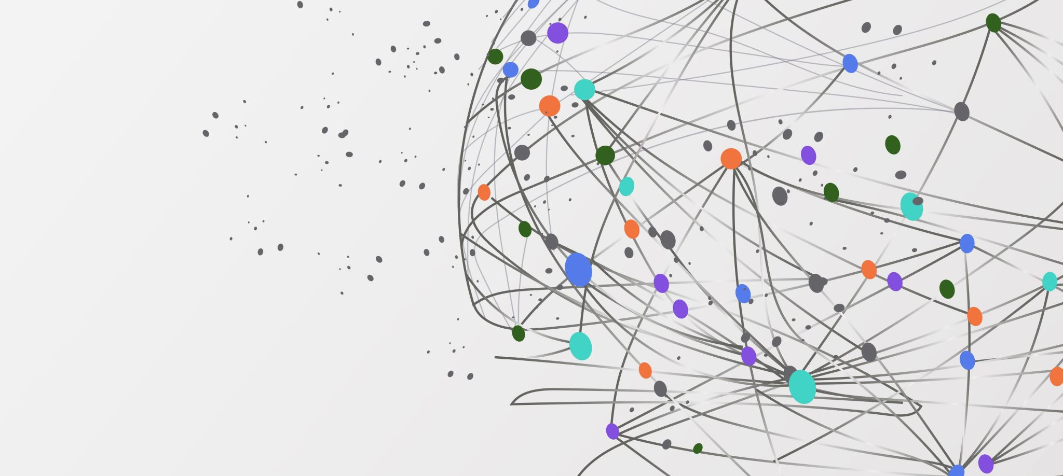
TALKER NORMALISATION OF PROSODIC CUES IN NON-NATIVE SPEAKERS
Bei Li, Bruce Xiao Wang, Si Chen, Caicai Zhang, Puiyin Lau & Yike Yang
The Hong Kong Polytechnic University

Slide 2
Background
Speech Normalization
Lack of invariance problem (Liberman, 1967)
Perceptual normalization provides relational invariance (e.g., Bauer & Benedict, 1997; Stilp & Theodore, 2020)
Theories on Speech Normalization
Abstract theories of phonological representations (Hyman,1970; Idemaru & Holt, 2011)
Episodic theories of phonological representations (Wang, 1976; Wade & Möbius, 2010)
Parametric Representations (Pierrehumbert, 2016)

Slide 3
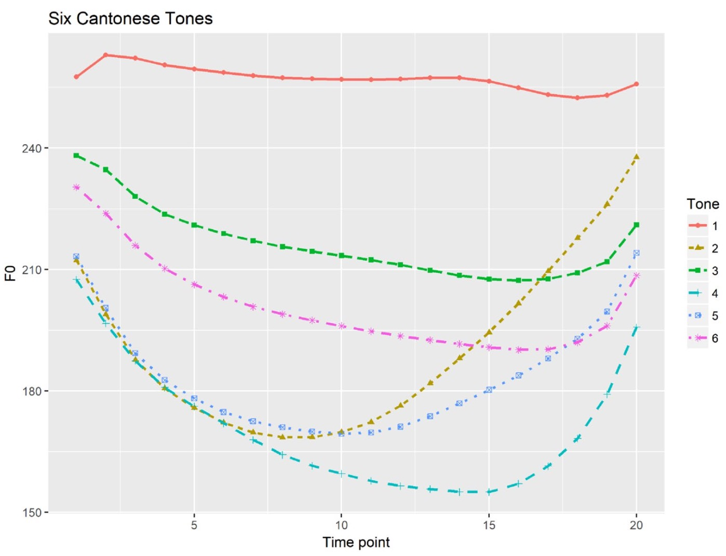
Background
Cantonese Tonal System
Three level tones: High tone T1(55/53), mid tone T3(33) and low tone T6(22)
Context Effects
Cantonese listeners may identify the mid tone as a low tone by shifting the F₀ of the preceding context two semitones upward (Wong & Diehl, 2003; Francis et al.,2015).
Chen et al. (2022)

Slide 4
Background
Probabilistic Parametric Representation (PPR)
(Chen et al., 2022)
Mental representations in isolation
Mental representations vs. Contextual information
Is the phenomenon of PPR exclusive to native speakers? If non-native speakers adopt a similar approach for normalizing Cantonese level tones？

Slide 5
Research Questions
Can Mandarin speakers establish and exploit the mental representations of F₀ distributions to identify Cantonese level tones?
Can Mandarin speakers still detect such representations when the parameters are deviated from the estimated population distributions?
Does the contextual information affect the tonal normalization of Cantonese level tones in Mandarin speakers?

Slide 6
Method
Identification task
Participants: Native Mandarin speakers
Materials: The target /ji/ with Cantonese level tones; and /si/ as fillers
Natural Tone Identification in Isolation
Experiment 1
Synthesized Tone Identification in Isolation
Experiment 2
Tone Identification in Contexts
Experiment 3

Slide 7
Method
Participants
14 native Mandarin speakers (7F; 7M; Mean age ± SD: 19.29± 0.91 yrs)
Stimuli
34 native Hong Kong Cantonese speakers
Target syllable /ji/ & filler /si/
Three level tones (T1, T3, T6) → “聽聽 /thiŋ thiŋ/ (Listen to) ____”
Extracted syllables (T3) in isolation (34 speakers * 2 syllables * 10 repetitions)
Experiment 1
Natural Tone Identification in Isolation

Slide 8

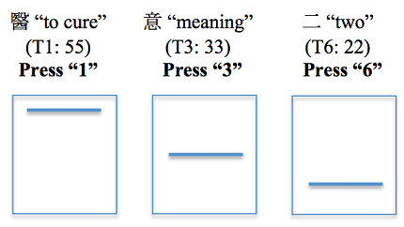
Method
Procedure
Isolated syllable
Identify
blocked by gender

Slide 9
Statistical analysis
Distribution fitting
Extracted F₀ values of the voiced portion of /ji/
Fitted skew-normal (SN) distributions to each of the 34 speakers’production and obtained three parameters:
location (ξ), scale (ω), and shape (α)
Multinomial mixed effects model
SN distributions ~ Judgments (T1, T3, T6)
mixcat (Hartzel et al., 2001) package in R

Slide 10
Results
Multinomial mixed effects model
Location and shape contribute to tone identification
 |  | Location P value | Scale P value | Shape P value
Baseline T6 | T1 | <0.001* | 0.94 | <0.001*
 | T3 | <0.001* | 0.17 | <0.001*
Baseline T1 | T3 | <0.001* | 0.196 | <0.001*
 | T6 | <0.001* | 0.608 | <0.001*

Slide 11
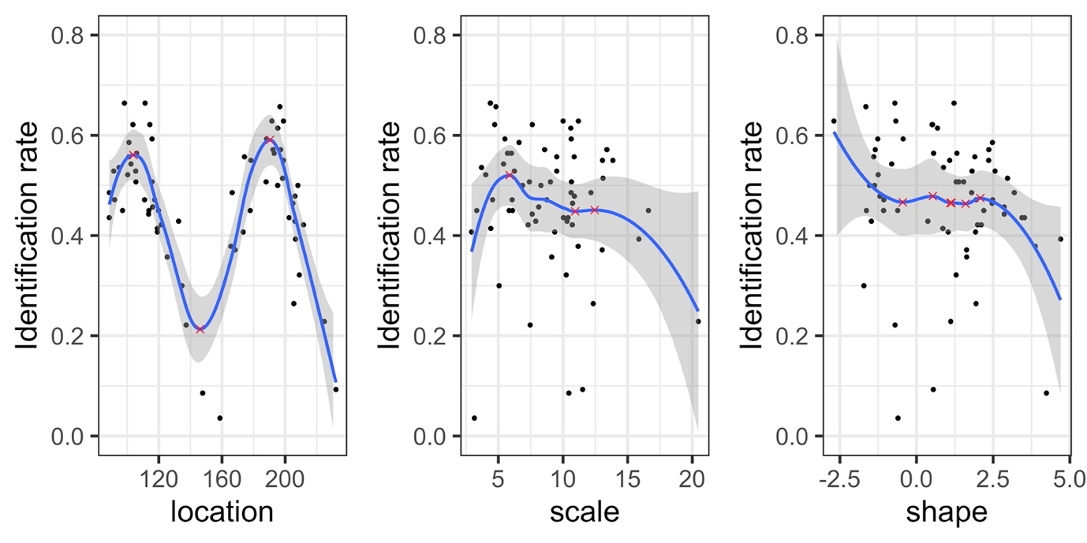
Results
Locally Weighted Scatterplot Smoothing (LOESS) Curves
Two peaks of Location: Identify T3 spoken by male and female speakers
One peak of Scale: Identify T3 production with variability

Slide 12
Method
Experiment 2: Synthesized Tone Identification in Isolation
Stimuli
The CUSENT Corpus
(Lee, n.d.)
3400 utterances with syllables carrying T1, T3 and T6 produced by 68 native Hong Kong Cantonese speakers
Estimation of SN distributions
Fitted SN distributions to F₀ values and obtained three parameters (ξ, ω, and α) of each tone by gender
Simulation
Varied each parameter respectively, and fixed other two
F₀ manipulation
Pitch Synchronous Overlap Add (PSOLA) method (Moulines & Laroche)

Slide 13
Method
Semitone distance | T1 vs. T3 | T1 vs. T6 | T3 vs. T6
Male | 2.64 | 3.56 | 0.93
Female | 3.01 | 3.90 | 0.88
Participants:
The 14 native Mandarin speakers in Experiment 1
Stimuli:
Two carrier sentences:
High tones T1(55):
聽聽 /thiŋ thiŋ/____ (Listen to ____ )
Low tones T6(22):
就係/thsɐu hɐi/_____ (This is just ____ )
Experiment 3
Tone Identification in Contexts

Slide 14
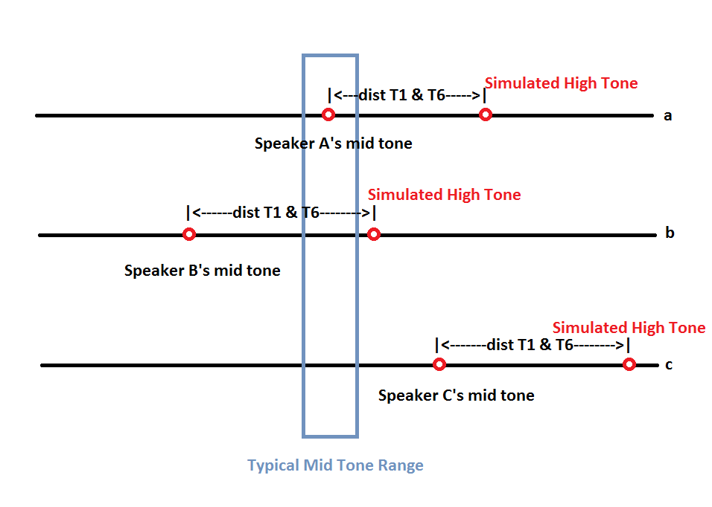
Simulated high tones (T1) treating mid tones (T3) as low tones (T6)
T3 ⇠ Tonal distributions
T6 ⇠ Context
T6 ⇠ Tonal distributions/ Context
T1 ⇠ Tonal distributions
T6 ⇠ Context

Slide 15
Results
T1 as the baseline | Simulated low tone |  |  | Simulated high tone
 | Estimate | p-value |  | Estimate | p-value
Indicator 3 | 0.53 | < 0.001 | Indicator 3 | 0.49 | < 0.001
Indicator 6 | -0.61 | < 0.001 | Indicator 6 | -0.69 | < 0.001
tt 3 | 0.46 | < 0.001 | zh 3 | 0.10 | 0.413
tt 6 | 1.38 | < 0.001 | zh 6 | 0.90 | < 0.001
T6 as the baseline | Simulated low tones |  |  | Simulated high tones
 | Estimate | p-value |  | Estimate | p-value
Indicator 1 | 0.61 | < 0.001 | Indicator 1 | 0.69 | < 0.001
Indicator 3 | 1.14 | < 0.001 | Indicator 3 | 1.18 | < 0.001
tt 1 | -1.38 | < 0.001 | zh 1 | -0.90 | < 0.001
tt 3 | -0.92 | < 0.001 | zh 3 | -0.80 | < 0.001

Slide 16
Discussions
Non-native natural/synthesized tone identification in isolation:
Distribution parameters significantly contribute to the normalization of Cantonese level tones in Mandarin speakers.
Akin to the findings among native Cantonese speakers (Chen et a., 2022).
However, Mandarin speakers display a reduced sensitivity compared to Cantonese speakers reported in Chen et al. (2022).
Mandarin speakers may not have established mental representations of non-native tones as parametrically as their native counterparts.

Slide 17
Discussions
Non-native tone identification in contexts:
Both mentally stored representations and contextual information contribute to the identification of non-native lexical tones.
However, the effect of contextual information is weaker than mentally stored parameters under certain conditions.
Mentally stored distributional parameters remain accessible even in the presence of contextual information.

Slide 18
References
Bauer, R. S. & Benedict, P. K. Modern Cantonese phonology. De Gruyter (1997).
Si, C., Zhang, C., Lau, P. et al. Modelling representations in speech normalization of prosodic cues. Sci Rep 12, 14635. https://doi.org/10.1038/s41598-022-18838-w (2022).
Francis, A. L., Ciocca, V. & Ng, B. K. C. On the (non) categorical perception of lexical tones. Percept. Psychophys. 65(7), 1029–1044. https://doi.org/10.3758/BF03194832 (2015).
Hyman, L. How concrete is phonology? Language. 46(1), 58-76. https://doi.org/10.2307/412407(1970).
Idemaru, K. & Holt, L. L. Word recognition reflects dimension-based statistical learning. J. Exp. Psychol. Hum. Percept. Perform. 37(6), 1939–1956. https://doi.org/10.1037/a0025641 (2011).
Liberman, A. M., Cooper, F. S., Shankweiler, D. P. & Studdert-Kennedy, M. Perception of the speech code. Psychol. Rev. 74(6), 431–461. https://doi.org/10.1037/h0020279 (1967).
McMurray, B. & Jongman, A. What information is necessary for speech categorization? Harnessing variability in the speech signal by integrating cues computed relative to expectations. Psychol. Rev. 118(2), 219–246. https://doi.org/10.1037/a0022325 (2011).
Moulines, E. & Laroche, J. Nonparametric techniques for pitch-scale and time scale modification of speech. Speech Commun. 16, 175–205 (1995).
Pierrehumbert, J. B. Phonological representation: Beyond abstract versus episodic. Ann. Rev. Linguist. 2(1), 33–52. https://doi.org/10.1146/annurev-linguistics-030514-125050 (2016).
Stilp, C. E. & Theodore, R. M. Talker normalization is mediated by structured indexical information. Atten. Percept. Psychophys. 82(5), 2237–2243. https://doi.org/10.3758/s13414-020-01971-x (2020).
Wade, T. & Möbius, B. Detailed phonetic memory for multi-word and part-word sequences. Lab. Phonol. 1(2), 283–294. https://doi.org/10.1515/labphon.2010.014 (2010).
Wang, W. S. Y. Language change. Ann. N. Y. Acad. Sci. 280(1), 61–72. https://doi.org/10.1111/j.1749-6632.1976.tb25472.x(1976).
Wong, P. & Diehl, R. L. Perceptual normalization for inter- and intratalker variation in Cantonese level tones. J. Speech Lang. Hearing Res. JSLHR 46(2), 413–421. https://doi.org/10.1044/1092-4388(2003/034) (2003).

Slide 19
Thank you!

