Slide 1
Group 5
Tianqi Yang
Jiupeng Zhang
Yu Zhang

Slide 2
Requirement Specification

Slide 3
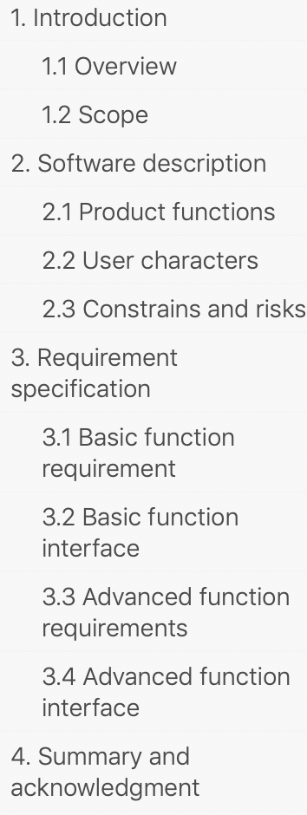
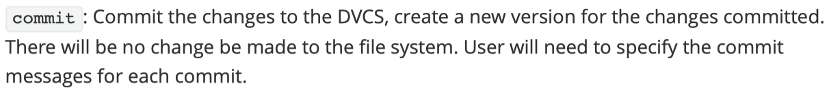
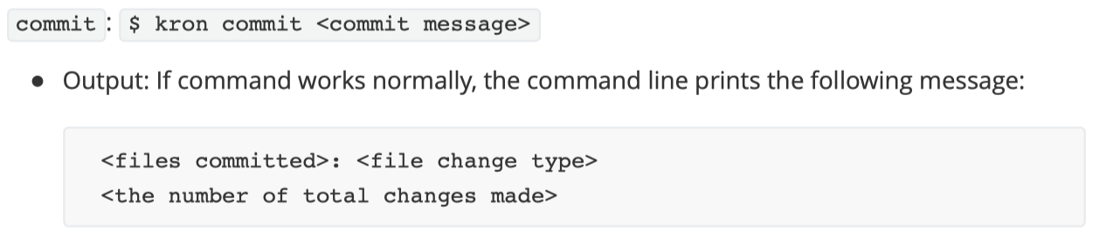
Requirement Specification
General functionality
Notes:
The document structure I put it on the right side. There are mainly four parts of the document. The main parts are part 2 and 3.
In part 2 I briefly put the description of each functional part, the characters user need to have, like being able to use command line. And some risks we can perceive currently
In part3 I give the detailed description of behavior of each command. And defined the interfaces of each command. Aka input and output.
The detailed requirements are from the previous assignment requirement write up which should be originally come from customers and negotiate with customers for many rounds.

Slide 4
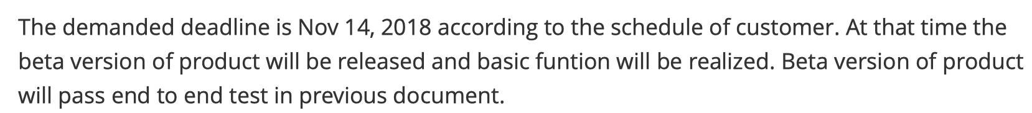
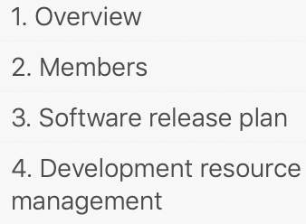
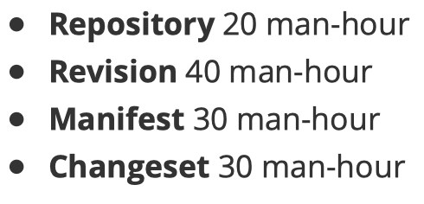
Management Plan
Notes:
In the management plan we listed our members. And the deadline and what the product should look like at deadline.
Estimated each the resource cost of each module.

Slide 5
Module Design

Slide 6
Mercurial v0.1
Repository
the interface to process the user commands
Revision
representing a single snapshot
Changelog
keep track of a commit record and file modifications
Manifest
a snapshot of a specific revision of work directory

Slide 7
Core Modules
Repository
an abstraction of a version-controlled project
Revision
maintains the changes and structure of versioned files
Changeset
keeps track of the commit record and file modifications
Manifest
a mapping list of a specific revision of objects

Slide 8
USE Hierarchy
#2 Revision
#1 Repository
#2 Revision B
#2 Revision A
history
#3 Changeset
#4 Manifest
#3 Changeset B
#4 Manifest B
#3 Changeset A
#4 Manifest A

Slide 9

Mercurial 0.1
Our Design
00Changelog.i
1
changesets/A
00Changelog.d
2
changesets/B
#3 Changeset
changelog.i
manifest.i
rev
#4 Manifest
00Manifest.i
1
manifests/A
00Manifest.d
2
manifests/B
more I/O but neat and extendable
no redundancy on graph structure

Slide 10

File Structure
.kron
A.txt
index
changeset/
manifest/
objects/
A
A
blk#1
stage
B
B
blk#2
heads
Working
Directory
rev
…
Notes:
the appended folder versionizing this repository

Slide 11
More details

Slide 12
File Structure
A.txt
index
changeset/
manifest/
objects/
A
A
blk#1
stage
B
B
blk#2
heads
Working
Directory
rev
…

Slide 13
A.txt ac882f6e899f616e9cf445d2613b1fe3
index
Notes:
The index file record the names of files in tracking list and its hash.

Slide 14
(index of parent) (index of self) (hash of self)
0 1 (hash of 1)
2 (hash of 2)
3 (hash of 3)
0 4 (hash of 4)
3,4 5 (hash of 5)
rev
Notes:
The rev file will store the whole revision tree like this.

Slide 15
+ A.txt
+ B.txt
stage
Notes:
The stage file will record which file to add

Slide 16
Head : aaf44dbe3ca6492f7272e8b207c912929e0aa170
Master : (latest revision of master)
Branch1: (latest revision of branch1)
Branch2: (latest revision of branch2)
heads
Notes:
The heads file will record which node the head is in. and the latest revision of every branch

Slide 17


objects
ac
ac882f6e899f616e9cf445d2613b1fe3
acXXXXXXXXXXXXXXXXXXXXXXXXXXXX
bc
bc882f6e899f616e9cf445d2613b1fe3
Notes:
This file has the same contents with A.txt. The name of this file is its hash obviously. And based on first two characters of its hash , they will be stored in different folder.

Slide 18
changeset
aaf44dbe3ca6492f7272e8b207c912929e0aa170
cf445d3b207c911feac88207c912f6e899f616e9
bc882f6e899f207c91616e9cf4d45d261c3b1fe3
Notes:
The changeset folder will store changeset of every revision. The name of file is hash of a revision.

Slide 19
manifests
aaf44dbe3ca6492f7272e8b207c912929e0aa170
cf445d3b207c911feac88207c912f6e899f616e9
bc882f6e899f207c91616e9cf4d45d261c3b1fe3
Notes:
The manifests folder will store manifest of every revision. The name of file is hash of a revision. And we can find what files are in give revision and their hash. According to their hash we can find the files in object folder.
This is all file structure in our design.

Slide 20
Thank you!

