Slide 1

TrackYourCatchCO
Benjamin Bruffey

Slide 2
Application Overview
The TrackYourCatchCO application is designed to help anglers record fishing trips and the fish they catch on them. More importantly, it utilizes geolocation to save the latitude and longitude of a given catch. A user is able to register an account for the site by creating their account in Okta. Once the account is created, the user is able to login. Following this, they will then be on the main page of the application where their trips are displayed. The user can then add/update/view/delete these trips. Catches can be added to trips, and then these catches can be geolocated.

Slide 3
Application Features
Key Features:
User Registration/Login/Authentication (via Okta)
Adding Fishing Trips
CRUD functionality
Adding Catches to Trips
CRUD functionality
Geolocation of a catch
Alternative is manual entry of latitude/longitude
Displaying a map with a pin for the geolocated catch

Slide 4
Technology Used
MEAN Stack Application (MongoDB, Express, Angular, Node)
Okta
Google Maps API
HTML5 Geolocation API
Bootstrap

Slide 5
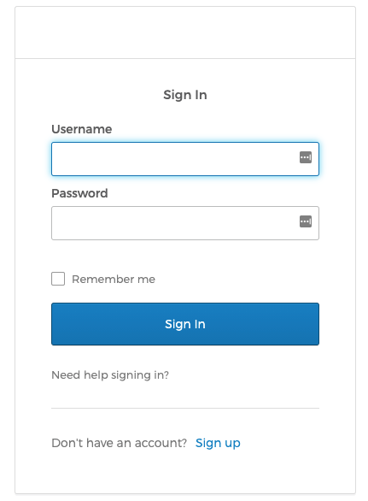
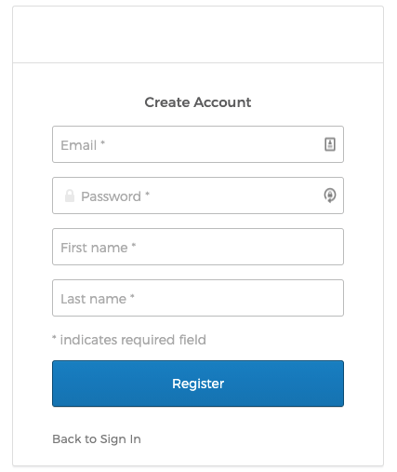
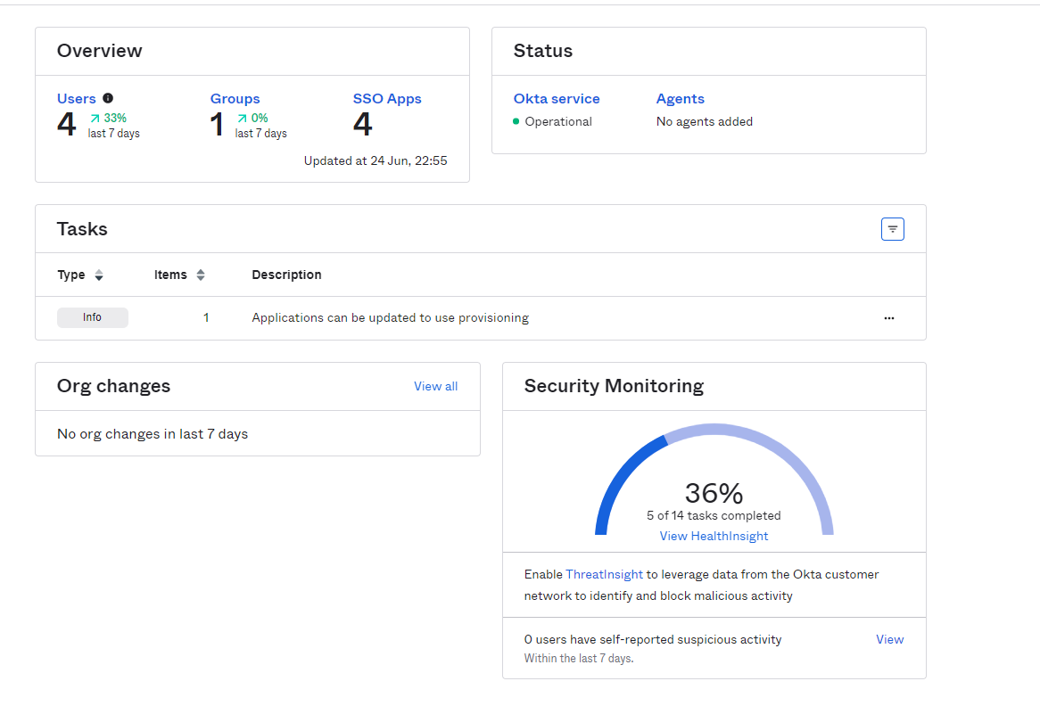
Authentication
Okta is an authentication provider that I've utilized for my application. Users are able to create and manage their users in Okta, and they are then able to login to the application. The application also utilizes okta's signin widget, which reduces confusion as the user stays inside of the TrackYourCatchCO application the entire time.

Slide 6
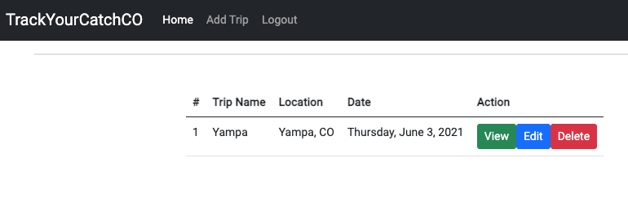
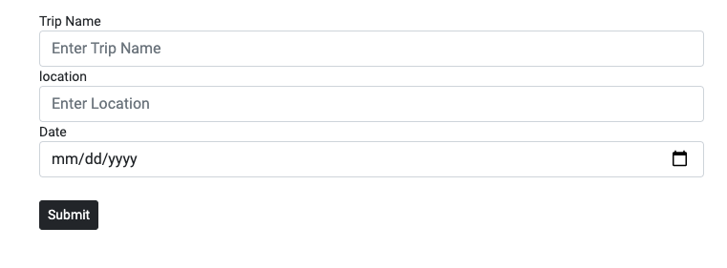
Trips
Trips can be created, read, updated, and deleted (CRUD)
A trip has a name, location, and date

Slide 7
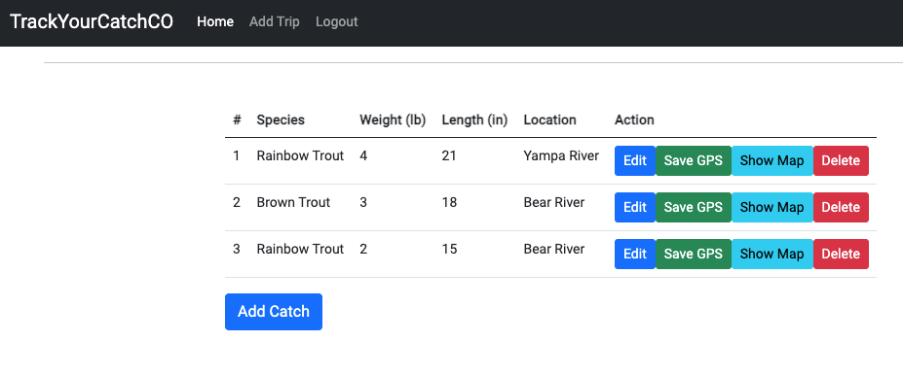
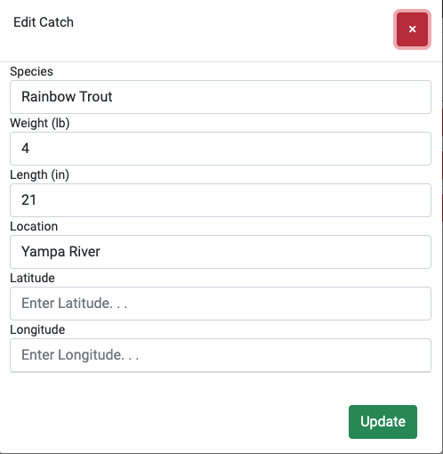
Catches
Catches are added to a trip (once you've clicked to view a trip)
You can add the species, weight, length, location (if you want to give a general name to wear you caught the fish), and the latitude and longitude.
If you do not wish to manually add the GPS coordinate, you can use the "Save GPS" functionality to use geolocation to get your current latitude and longitude and save it to the catch.

Slide 8
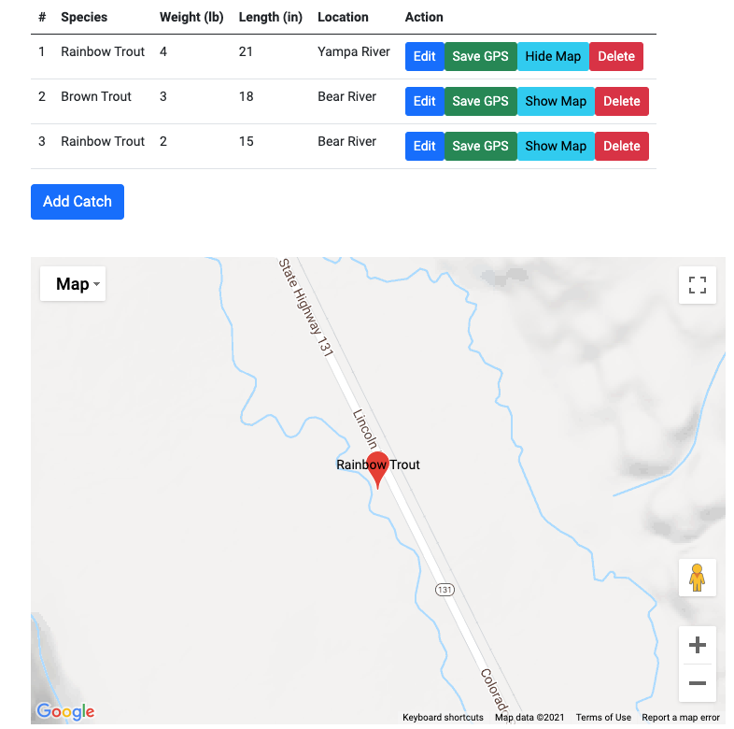
CATCH - GEOLOCATION
Once a trip has been added, and either had the GPS coordinate manually entered or it has been geolocated, a map can be displayed to show the location of the catch.

Slide 9
Future Feature Considerations
Some features that I'd like to add to this application outside of the scope of this course are:
Ability to search all users catches and see the location (pending an angler has made the catch location visible)
Search a specific body of water for the catches that haven been caught there
Add more detailed notes to a catch (such as what lure was used, weather, water/ice conditions, etc)
Taking/Uploading a photo of the catch

