Slide 1
Part 1/3: Top down

Slide 2

Surprise will be assessed by a 3-items instrument;
Responses are to be collected on 5-points Likert scales
5
high level of reported surprise
4
3
2
low level of reported surprise
1
Notes:
Premise 1:

Slide 3



Candidate items (in decreasing similarity to user profile vector)
Relevant
Surprising
:
:
Reported Surprise

Slide 4
Part 2/3: Bottom up

Slide 5






Conventions
What is popularity? Vargas and Castells, 2011:
This is an estimator of the probability of an item being known to an arbitrary user, namely
$$pop\left(i, R, U\right)= \frac{\#\left\{r_{ui}∈R \right| r_{ui}≠0\}}{\#U}$$
$$p\left(i∈E_{u} | u\right)$$
What is surprise? Kaminskas and Bridge, 2014:
Top 200 tracks in Brazil, 2017-18
(board position and #streams)
1,106 distinct tracks
~587k tracks
15 audio features
$\hat{S}\left(i, E_{u}\right)=\min_{j∈E_{u}} dist(v(i), v(j))$
Using Euclidean distance
Spotify D2
Spotify D1
A theoretical link between popularity and surprise
Assume P3: Every user has at least one highly popular item in their profile.
The expected surprise of an item to an arbitrary user is:
$$E\left[\hat{S}\left(i, E_{u}\right)\right]=p\left(i∈E_{u}|u\right) E[\hat{S}\left(i∈E_{u}, E_{u}\right)]+p\left(i∉E_{u}|u\right) E[\hat{S}\left(i∉E_{u}, E_{u}\right)]$$
$$=\left(1−p\left(i∈E_{u}|u\right)\right) E[\hat{S}\left(i∉E_{u}, E_{u}\right)]$$
Let P be the set of vertices of the convex hull that envelops all highly popular items.
Then, given an arbitrary item, it must be the case that (1) it is interior or (2) exterior to the hull. In both cases, the surprise of the item has an upper bound given by:
$${\hat{S}}_{ub}\left(i, E_{u}\right)=\max_{j∈P} dist\left(v\left(i\right), v\left(j\right)\right)$$
This is the upper bound of the surprise of an item to an arbitrary user, given that P3 is true
Thus, the expected surprise of an item is also bounded:
$$\hat{S}\left(i, E_{u}\right)≤{\hat{S}}_{ub}\left(i, E_{u}\right)⇒E\left[\hat{S}\left(i, E_{u}\right)\right]≤{\hat{S}}_{ub}\left(i, E_{u}\right)$$

Slide 6
Conventions
What is popularity? Vargas and Castells, 2011:
This is an estimator of the probability of an item being known to an arbitrary user, namely
$$pop\left(i, R, U\right)= \frac{\#\left\{r_{ui}∈R \right| r_{ui}≠0\}}{\#U}$$
$$p\left(i∈E_{u} | u\right)$$
What is surprise? Kaminskas and Bridge, 2014:
Top 200 tracks in Brazil, 2017-18
(board position and #streams)
1,106 distinct tracks
796 mappings
(310 unlinked tracks)
~587k tracks
15 audio features
$\hat{S}\left(i, E_{u}\right)=\min_{j∈E_{u}} dist(v(i), v(j))$
Using Euclidean distance
Spotify D2
Spotify D1
A theoretical link between popularity and surprise
Assume P3: Every user has at least one highly popular item in their profile.
The expected surprise of an item to an arbitrary user is:
$$E\left[\hat{S}\left(i, E_{u}\right)\right]=p\left(i∈E_{u}|u\right) E[\hat{S}\left(i∈E_{u}, E_{u}\right)]+p\left(i∉E_{u}|u\right) E[\hat{S}\left(i∉E_{u}, E_{u}\right)]$$
$$=\left(1−p\left(i∈E_{u}|u\right)\right) E[\hat{S}\left(i∉E_{u}, E_{u}\right)]$$
Let P be the set of vertices of the convex hull that envelops all highly popular items.
Then, given an arbitrary item, it must be the case that (1) it is interior or (2) exterior to the hull. In both cases, the surprise of the item has an upper bound given by:
$${\hat{S}}_{ub}\left(i, E_{u}\right)=\max_{j∈P} dist\left(v\left(i\right), v\left(j\right)\right)$$
This is the upper bound of the surprise of an item to an arbitrary user, given that P3 is true
Thus, the expected surprise of an item is also bounded:
$$\hat{S}\left(i, E_{u}\right)≤{\hat{S}}_{ub}\left(i, E_{u}\right)⇒E\left[\hat{S}\left(i, E_{u}\right)\right]≤{\hat{S}}_{ub}\left(i, E_{u}\right)$$

Slide 7
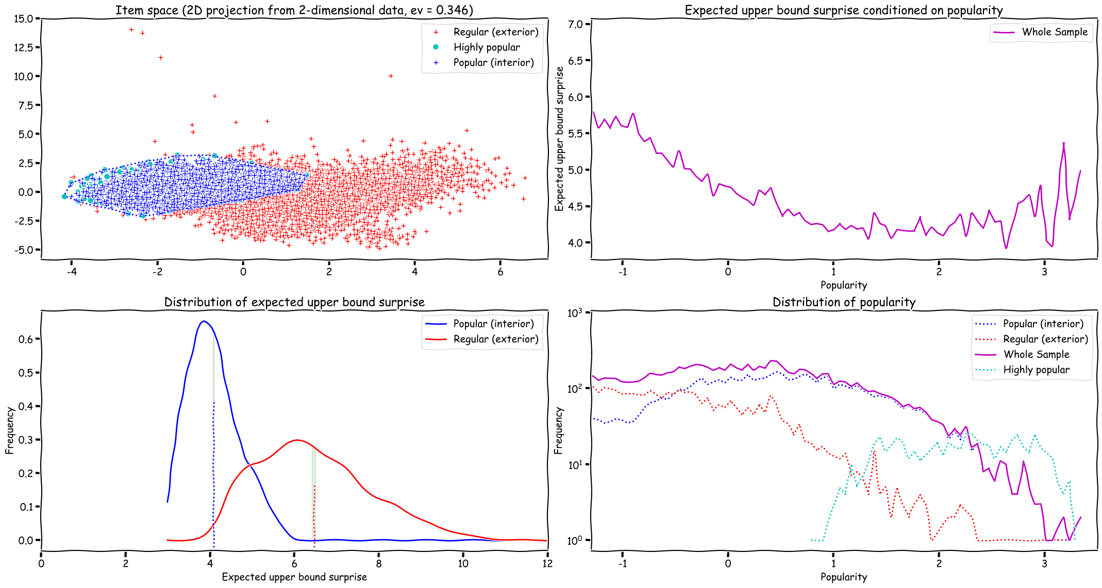
Conventions
What is popularity? Vargas and Castells, 2011:
This is an estimator of the probability of an item being known to an arbitrary user, namely
$$pop\left(i, R, U\right)= \frac{\#\left\{r_{ui}∈R \right| r_{ui}≠0\}}{\#U}$$
$$p\left(i∈E_{u} | u\right)$$
What is surprise? Kaminskas and Bridge, 2014:
Top 200 tracks in Brazil, 2017-18
(board position and #streams)
1,106 distinct tracks
796 mappings
(310 unlinked tracks)
~587k tracks
15 audio features
$\hat{S}\left(i, E_{u}\right)=\min_{j∈E_{u}} dist(v(i), v(j))$
Using Euclidean distance
Spotify D2
Spotify D1
A theoretical link between popularity and surprise
Assume P3: Every user has at least one highly popular item in their profile.
The expected surprise of an item to an arbitrary user is:
$$E\left[\hat{S}\left(i, E_{u}\right)\right]=p\left(i∈E_{u}|u\right) E[\hat{S}\left(i∈E_{u}, E_{u}\right)]+p\left(i∉E_{u}|u\right) E[\hat{S}\left(i∉E_{u}, E_{u}\right)]$$
$$=\left(1−p\left(i∈E_{u}|u\right)\right) E[\hat{S}\left(i∉E_{u}, E_{u}\right)]$$
Let P be the set of vertices of the convex hull that envelops all highly popular items.
Then, given an arbitrary item, it must be the case that (1) it is interior or (2) exterior to the hull. In both cases, the surprise of the item has an upper bound given by:
Convex hull enveloping all highly popular items
$${\hat{S}}_{ub}\left(i, E_{u}\right)=\max_{j∈P} dist\left(v\left(i\right), v\left(j\right)\right)$$
This is the upper bound of the surprise of an item to an arbitrary user, given that P3 is true
Thus, the expected surprise of an item is also bounded:
$$\hat{S}\left(i, E_{u}\right)≤{\hat{S}}_{ub}\left(i, E_{u}\right)⇒E\left[\hat{S}\left(i, E_{u}\right)\right]≤{\hat{S}}_{ub}\left(i, E_{u}\right)$$

Slide 8
Conventions
What is popularity? Vargas and Castells, 2011:
This is an estimator of the probability of an item being known to an arbitrary user, namely
The dataset has an estimate of the popularity of every item
$$pop\left(i, R, U\right)= \frac{\#\left\{r_{ui}∈R \right| r_{ui}≠0\}}{\#U}$$
$$p\left(i∈E_{u} | u\right)$$
What is surprise? Kaminskas and Bridge, 2014:
Top 200 tracks in Brazil, 2017-18
(board position and #streams)
1,106 distinct tracks
796 mappings
(310 unlinked tracks)
~587k tracks
15 audio features
$\hat{S}\left(i, E_{u}\right)=\min_{j∈E_{u}} dist(v(i), v(j))$
Using Euclidean distance
Spotify D2
Spotify D1
A theoretical link between popularity and surprise
Assume P3: Every user has at least one highly popular item in their profile.
The expected surprise of an item to an arbitrary user is:
$$E\left[\hat{S}\left(i, E_{u}\right)\right]=p\left(i∈E_{u}|u\right) E[\hat{S}\left(i∈E_{u}, E_{u}\right)]+p\left(i∉E_{u}|u\right) E[\hat{S}\left(i∉E_{u}, E_{u}\right)]$$
$$=\left(1−p\left(i∈E_{u}|u\right)\right) E[\hat{S}\left(i∉E_{u}, E_{u}\right)]$$
Let P be the set of vertices of the convex hull that envelops all highly popular items.
Then, given an arbitrary item, it must be the case that (1) it is interior or (2) exterior to the hull. In both cases, the surprise of the item has an upper bound given by:
Convex hull enveloping all highly popular items
$${\hat{S}}_{ub}\left(i, E_{u}\right)=\max_{j∈P} dist\left(v\left(i\right), v\left(j\right)\right)$$
This is the upper bound of the surprise of an item to an arbitrary user, given that P3 is true
Thus, the expected surprise of an item is also bounded:
$$\hat{S}\left(i, E_{u}\right)≤{\hat{S}}_{ub}\left(i, E_{u}\right)⇒E\left[\hat{S}\left(i, E_{u}\right)\right]≤{\hat{S}}_{ub}\left(i, E_{u}\right)$$

Slide 9

Conventions
What is popularity? Vargas and Castells, 2011:
This is an estimator of the probability of an item being known to an arbitrary user, namely
The dataset has an estimate of the popularity of every item
$$pop\left(i, R, U\right)= \frac{\#\left\{r_{ui}∈R \right| r_{ui}≠0\}}{\#U}$$
$$p\left(i∈E_{u} | u\right)$$
What is surprise? Kaminskas and Bridge, 2014:
Top 200 tracks in Brazil, 2017-18
(board position and #streams)
1,106 distinct tracks
796 mappings
(310 unlinked tracks)
~587k tracks
15 audio features
$\hat{S}\left(i, E_{u}\right)=\min_{j∈E_{u}} dist(v(i), v(j))$
Using Euclidean distance
Spotify D2
Spotify D1
A theoretical link between popularity and surprise
Assume P3: Every user has at least one highly popular item in their profile.
The expected surprise of an item to an arbitrary user is:
$$E\left[\hat{S}\left(i, E_{u}\right)\right]=p\left(i∈E_{u}|u\right) E[\hat{S}\left(i∈E_{u}, E_{u}\right)]+p\left(i∉E_{u}|u\right) E[\hat{S}\left(i∉E_{u}, E_{u}\right)]$$
$$=\left(1−p\left(i∈E_{u}|u\right)\right) E[\hat{S}\left(i∉E_{u}, E_{u}\right)]$$
Let P be the set of vertices of the convex hull that envelops all highly popular items.
Then, given an arbitrary item, it must be the case that (1) it is interior or (2) exterior to the hull. In both cases, the surprise of the item has an upper bound given by:
Convex hull enveloping all highly popular items
$${\hat{S}}_{ub}\left(i, E_{u}\right)=\max_{j∈P} dist\left(v\left(i\right), v\left(j\right)\right)$$
This is the upper bound of the surprise of an item to an arbitrary user, given that P3 is true
Thus, the expected surprise of an item is also bounded:
$$\hat{S}\left(i, E_{u}\right)≤{\hat{S}}_{ub}\left(i, E_{u}\right)⇒E\left[\hat{S}\left(i, E_{u}\right)\right]≤{\hat{S}}_{ub}\left(i, E_{u}\right)$$

Slide 10

Conventions
What is popularity? Vargas and Castells, 2011:
This is an estimator of the probability of an item being known to an arbitrary user, namely
The dataset has an estimate of the popularity of every item
$$pop\left(i, R, U\right)= \frac{\#\left\{r_{ui}∈R \right| r_{ui}≠0\}}{\#U}$$
$$p\left(i∈E_{u} | u\right)$$
What is surprise? Kaminskas and Bridge, 2014:
Top 200 tracks in Brazil, 2017-18
(board position and #streams)
1,106 distinct tracks
796 mappings
(310 unlinked tracks)
~587k tracks
15 audio features
$\hat{S}\left(i, E_{u}\right)=\min_{j∈E_{u}} dist(v(i), v(j))$
Using Euclidean distance
Spotify D2
Spotify D1
A theoretical link between popularity and surprise
Assume P3: Every user has at least one highly popular item in their profile.
The expected surprise of an item to an arbitrary user is:
$$E\left[\hat{S}\left(i, E_{u}\right)\right]=p\left(i∈E_{u}|u\right) E[\hat{S}\left(i∈E_{u}, E_{u}\right)]+p\left(i∉E_{u}|u\right) E[\hat{S}\left(i∉E_{u}, E_{u}\right)]$$
$$=\left(1−p\left(i∈E_{u}|u\right)\right) E[\hat{S}\left(i∉E_{u}, E_{u}\right)]$$
Let P be the set of vertices of the convex hull that envelops all highly popular items.
Then, given an arbitrary item, it must be the case that (1) it is interior or (2) exterior to the hull. In both cases, the surprise of the item has an upper bound given by:
Convex hull enveloping all highly popular items
$${\hat{S}}_{ub}\left(i, E_{u}\right)=\max_{j∈P} dist\left(v\left(i\right), v\left(j\right)\right)$$
This is the upper bound of the surprise of an item to an arbitrary user, given that P3 is true
Thus, the expected surprise of an item is also bounded:
$$\hat{S}\left(i, E_{u}\right)≤{\hat{S}}_{ub}\left(i, E_{u}\right)⇒E\left[\hat{S}\left(i, E_{u}\right)\right]≤{\hat{S}}_{ub}\left(i, E_{u}\right)$$

Slide 11
Conventions
What is popularity? Vargas and Castells, 2011:
This is an estimator of the probability of an item being known to an arbitrary user, namely
The dataset has an estimate of the popularity of every item
$$pop\left(i, R, U\right)= \frac{\#\left\{r_{ui}∈R \right| r_{ui}≠0\}}{\#U}$$
$$p\left(i∈E_{u} | u\right)$$
What is surprise? Kaminskas and Bridge, 2014:
Top 200 tracks in Brazil, 2017-18
(board position and #streams)
1,106 distinct tracks
796 mappings
(310 unlinked tracks)
~587k tracks
15 audio features
$\hat{S}\left(i, E_{u}\right)=\min_{j∈E_{u}} dist(v(i), v(j))$
Using Euclidean distance
Spotify D2
Spotify D1
A theoretical link between popularity and surprise
Assume P3: Every user has at least one highly popular item in their profile.
The expected surprise of an item to an arbitrary user is:
$$E\left[\hat{S}\left(i, E_{u}\right)\right]=p\left(i∈E_{u}|u\right) E[\hat{S}\left(i∈E_{u}, E_{u}\right)]+p\left(i∉E_{u}|u\right) E[\hat{S}\left(i∉E_{u}, E_{u}\right)]$$
$$=\left(1−p\left(i∈E_{u}|u\right)\right) E[\hat{S}\left(i∉E_{u}, E_{u}\right)]$$
Let P be the set of vertices of the convex hull that envelops all highly popular items.
Then, given an arbitrary item, it must be the case that (1) it is interior or (2) exterior to the hull. In both cases, the surprise of the item has an upper bound given by:
Convex hull enveloping all highly popular items
$${\hat{S}}_{ub}\left(i, E_{u}\right)=\max_{j∈P} dist\left(v\left(i\right), v\left(j\right)\right)$$
This is the upper bound of the surprise of an item to an arbitrary user, given that P3 is true
Thus, the expected surprise of an item is also bounded:
$$\hat{S}\left(i, E_{u}\right)≤{\hat{S}}_{ub}\left(i, E_{u}\right)⇒E\left[\hat{S}\left(i, E_{u}\right)\right]≤{\hat{S}}_{ub}\left(i, E_{u}\right)$$

Slide 12
Conventions
What is popularity? Vargas and Castells, 2011:
This is an estimator of the probability of an item being known to an arbitrary user, namely
The dataset has an estimate of the popularity of every item
$$pop\left(i, R, U\right)= \frac{\#\left\{r_{ui}∈R \right| r_{ui}≠0\}}{\#U}$$
$$p\left(i∈E_{u} | u\right)$$
What is surprise? Kaminskas and Bridge, 2014:
Top 200 tracks in Brazil, 2017-18
(board position and #streams)
1,106 distinct tracks
793 mappings
(313 unlinked tracks)
~587k tracks
15 audio features
$\hat{S}\left(i, E_{u}\right)=\min_{j∈E_{u}} dist(v(i), v(j))$
Using Euclidean distance
Spotify D2
Spotify D1
A theoretical link between popularity and surprise
Assume P3: Every user has at least one highly popular item in their profile.
The expected surprise of an item to an arbitrary user is:
$$E\left[\hat{S}\left(i, E_{u}\right)\right]=p\left(i∈E_{u}|u\right) E[\hat{S}\left(i∈E_{u}, E_{u}\right)]+p\left(i∉E_{u}|u\right) E[\hat{S}\left(i∉E_{u}, E_{u}\right)]$$
$$=\left(1−p\left(i∈E_{u}|u\right)\right) E[\hat{S}\left(i∉E_{u}, E_{u}\right)]$$
Let P be the set of vertices of the convex hull that envelops all highly popular items.
Then, given an arbitrary item, it must be the case that (1) it is interior or (2) exterior to the hull. In both cases, the surprise of the item has an upper bound given by:
Convex hull enveloping all highly popular items
$${\hat{S}}_{ub}\left(i, E_{u}\right)=\max_{j∈P} dist\left(v\left(i\right), v\left(j\right)\right)$$
This is the upper bound of the surprise of an item to an arbitrary user, given that P3 is true
Thus, the expected surprise of an item is also bounded:
$$\hat{S}\left(i, E_{u}\right)≤{\hat{S}}_{ub}\left(i, E_{u}\right)⇒E\left[\hat{S}\left(i, E_{u}\right)\right]≤{\hat{S}}_{ub}\left(i, E_{u}\right)$$

Slide 13
Conventions
What is popularity? Vargas and Castells, 2011:
This is an estimator of the probability of an item being known to an arbitrary user, namely
The dataset has an estimate of the popularity of every item
$$pop\left(i, R, U\right)= \frac{\#\left\{r_{ui}∈R \right| r_{ui}≠0\}}{\#U}$$
$$p\left(i∈E_{u} | u\right)$$
What is surprise? Kaminskas and Bridge, 2014:
Top 200 tracks in Brazil, 2017-18
(board position and #streams)
1,106 distinct tracks
793 mappings
(313 unlinked tracks)
~587k tracks
15 audio features
$\hat{S}\left(i, E_{u}\right)=\min_{j∈E_{u}} dist(v(i), v(j))$
Using Euclidean distance
Spotify D2
Spotify D1
A theoretical link between popularity and surprise
Assume P3: Every user has at least one highly popular item in their profile.
The expected surprise of an item to an arbitrary user is:
$$E\left[\hat{S}\left(i, E_{u}\right)\right]=p\left(i∈E_{u}|u\right) E[\hat{S}\left(i∈E_{u}, E_{u}\right)]+p\left(i∉E_{u}|u\right) E[\hat{S}\left(i∉E_{u}, E_{u}\right)]$$
$$=\left(1−p\left(i∈E_{u}|u\right)\right) E[\hat{S}\left(i∉E_{u}, E_{u}\right)]$$
Let P be the set of vertices of the convex hull that envelops all highly popular items.
Then, given an arbitrary item, it must be the case that (1) it is interior or (2) exterior to the hull. In both cases, the surprise of the item has an upper bound given by:
Convex hull enveloping all highly popular items
$${\hat{S}}_{ub}\left(i, E_{u}\right)=\max_{j∈P} dist\left(v\left(i\right), v\left(j\right)\right)$$
This is the upper bound of the surprise of an item to an arbitrary user, given that P3 is true
Thus, the expected surprise of an item is also bounded:
$$\hat{S}\left(i, E_{u}\right)≤{\hat{S}}_{ub}\left(i, E_{u}\right)⇒E\left[\hat{S}\left(i, E_{u}\right)\right]≤{\hat{S}}_{ub}\left(i, E_{u}\right)$$

Slide 14
Conventions
What is popularity? Vargas and Castells, 2011:
This is an estimator of the probability of an item being known to an arbitrary user, namely
The dataset has an estimate of the popularity of every item
$$pop\left(i, R, U\right)= \frac{\#\left\{r_{ui}∈R \right| r_{ui}≠0\}}{\#U}$$
$$p\left(i∈E_{u} | u\right)$$
What is surprise? Kaminskas and Bridge, 2014:
Top 200 tracks in Brazil, 2017-18
(board position and #streams)
1,106 distinct tracks
793 mappings
(313 unlinked tracks)
~587k tracks
15 audio features
$\hat{S}\left(i, E_{u}\right)=\min_{j∈E_{u}} dist(v(i), v(j))$
Using Euclidean distance
Spotify D2
Spotify D1
A theoretical link between popularity and surprise
Assume P3: Every user has at least one highly popular item in their profile.
The expected surprise of an item to an arbitrary user is:
$$E\left[\hat{S}\left(i, E_{u}\right)\right]=p\left(i∈E_{u}|u\right) E[\hat{S}\left(i∈E_{u}, E_{u}\right)]+p\left(i∉E_{u}|u\right) E[\hat{S}\left(i∉E_{u}, E_{u}\right)]$$
$$=\left(1−p\left(i∈E_{u}|u\right)\right) E[\hat{S}\left(i∉E_{u}, E_{u}\right)]$$
Let P be the set of vertices of the convex hull that envelops all highly popular items.
Then, given an arbitrary item, it must be the case that (1) it is interior or (2) exterior to the hull. In both cases, the surprise of the item has an upper bound given by:
Convex hull enveloping all highly popular items
$${\hat{S}}_{ub}\left(i, E_{u}\right)=\max_{j∈P} dist\left(v\left(i\right), v\left(j\right)\right)$$
This is the upper bound of the surprise of an item to an arbitrary user, given that P3 is true
Thus, the expected surprise of an item is also bounded:
$$\hat{S}\left(i, E_{u}\right)≤{\hat{S}}_{ub}\left(i, E_{u}\right)⇒E\left[\hat{S}\left(i, E_{u}\right)\right]≤{\hat{S}}_{ub}\left(i, E_{u}\right)$$

Slide 15
Conventions
What is popularity? Vargas and Castells, 2011:
This is an estimator of the probability of an item being known to an arbitrary user, namely
The dataset has an estimate of the popularity of every item
$$pop\left(i, R, U\right)= \frac{\#\left\{r_{ui}∈R \right| r_{ui}≠0\}}{\#U}$$
$$p\left(i∈E_{u} | u\right)$$
What is surprise? Kaminskas and Bridge, 2014:
Top 200 tracks in Brazil, 2017-18
(board position and #streams)
1,106 distinct tracks
793 mappings
(313 unlinked tracks)
~587k tracks
15 audio features
$\hat{S}\left(i, E_{u}\right)=\min_{j∈E_{u}} dist(v(i), v(j))$
Using Euclidean distance
Spotify D2
Spotify D1
A theoretical link between popularity and surprise
Assume P3: Every user has at least one highly popular item in their profile.
The expected surprise of an item to an arbitrary user is:
$$E\left[\hat{S}\left(i, E_{u}\right)\right]=p\left(i∈E_{u}|u\right) E[\hat{S}\left(i∈E_{u}, E_{u}\right)]+p\left(i∉E_{u}|u\right) E[\hat{S}\left(i∉E_{u}, E_{u}\right)]$$
$$=\left(1−p\left(i∈E_{u}|u\right)\right) E[\hat{S}\left(i∉E_{u}, E_{u}\right)]$$
Let P be the set of vertices of the convex hull that envelops all highly popular items.
Then, given an arbitrary item, it must be the case that (1) it is interior or (2) exterior to the hull. In both cases, the surprise of the item has an upper bound given by:
Convex hull enveloping all highly popular items
$${\hat{S}}_{ub}\left(i, E_{u}\right)=\max_{j∈P} dist\left(v\left(i\right), v\left(j\right)\right)$$
This is the upper bound of the surprise of an item to an arbitrary user, given that P3 is true
Thus, the expected surprise of an item is also bounded:
$$\hat{S}\left(i, E_{u}\right)≤{\hat{S}}_{ub}\left(i, E_{u}\right)⇒E\left[\hat{S}\left(i, E_{u}\right)\right]≤{\hat{S}}_{ub}\left(i, E_{u}\right)$$

Slide 16
Part 3/3: Connecting the ideas

Slide 17



Candidate items (in decreasing similarity to user profile vector)
Relevant
Surprising
:
:
Reported Surprise
Conventions
$$pop\left(i, R, U\right)= \frac{\#\left\{r_{ui}∈R \right| r_{ui}≠0\}}{\#U}$$
Vargas and Castells, 2011
$\hat{S}\left(i, E_{u}\right)=\min_{j∈E_{u}} dist(v(i), v(j))$
Kaminskas and Bridge, 2014
$${\hat{S}}_{ub}\left(i, E_{u}\right)=\max_{j∈P} dist\left(v\left(i\right), v\left(j\right)\right)$$
Assumptions
P0: Popularity scales are homomorphic
P1: Surprise is assessed by a unidimensional instrument
P2: Surprise scales are homomorphic
P3: Every user has at least one highly popular item in their profile

Slide 18

Candidate items (in decreasing similarity to user profile vector)
Relevant
Surprising
:
:
Estimated Surprise
Reported Surprise
$$\hat{S}\left(i, E_{u}\right)$$
Conventions
$$pop\left(i, R, U\right)= \frac{\#\left\{r_{ui}∈R \right| r_{ui}≠0\}}{\#U}$$
Vargas and Castells, 2011
$\hat{S}\left(i, E_{u}\right)=\min_{j∈E_{u}} dist(v(i), v(j))$
Kaminskas and Bridge, 2014
$${\hat{S}}_{ub}\left(i, E_{u}\right)=\max_{j∈P} dist\left(v\left(i\right), v\left(j\right)\right)$$
Assumptions
P0: Popularity scales are homomorphic
P1: Surprise is assessed by a unidimensional instrument
P2: Surprise scales are homomorphic
P3: Every user has at least one highly popular item in their profile

Slide 19
Candidate items (in decreasing similarity to user profile vector)
Relevant
Surprising
:
:
Estimated Surprise
Reported Surprise
$$\hat{S}\left(i, E_{u}\right)$$
Conventions
$$pop\left(i, R, U\right)= \frac{\#\left\{r_{ui}∈R \right| r_{ui}≠0\}}{\#U}$$
Vargas and Castells, 2011
Convex hull enveloping all highly popular items
$\hat{S}\left(i, E_{u}\right)=\min_{j∈E_{u}} dist(v(i), v(j))$
Kaminskas and Bridge, 2014
$${\hat{S}}_{ub}\left(i, E_{u}\right)=\max_{j∈P} dist\left(v\left(i\right), v\left(j\right)\right)$$
Assumptions
P0: Popularity scales are homomorphic
P1: Surprise is assessed by a unidimensional instrument
P2: Surprise scales are homomorphic
P3: Every user has at least one highly popular item in their profile

Slide 20
Candidate items (in decreasing similarity to user profile vector)
Relevant
Surprising
:
:
Estimated Surprise
Reported Surprise
$$\hat{S}\left(i, E_{u}\right)$$
Conventions
$$pop\left(i, R, U\right)= \frac{\#\left\{r_{ui}∈R \right| r_{ui}≠0\}}{\#U}$$
Vargas and Castells, 2011
Convex hull enveloping all highly popular items
$\hat{S}\left(i, E_{u}\right)=\min_{j∈E_{u}} dist(v(i), v(j))$
Kaminskas and Bridge, 2014
$${\hat{S}}_{ub}\left(i, E_{u}\right)=\max_{j∈P} dist\left(v\left(i\right), v\left(j\right)\right)$$
Assumptions
P0: Popularity scales are homomorphic
P1: Surprise is assessed by a unidimensional instrument
P2: Surprise scales are homomorphic
P3: Every user has at least one highly popular item in their profile

Slide 21
Candidate items (in decreasing similarity to user profile vector)
Relevant
Surprising
Items of average popularity do not attain surprise higher than this.
:
:
Estimated Surprise
Reported Surprise
$$\hat{S}\left(i, E_{u}\right)$$
Conventions
$$pop\left(i, R, U\right)= \frac{\#\left\{r_{ui}∈R \right| r_{ui}≠0\}}{\#U}$$
Vargas and Castells, 2011
Convex hull enveloping all highly popular items
$\hat{S}\left(i, E_{u}\right)=\min_{j∈E_{u}} dist(v(i), v(j))$
Kaminskas and Bridge, 2014
$${\hat{S}}_{ub}\left(i, E_{u}\right)=\max_{j∈P} dist\left(v\left(i\right), v\left(j\right)\right)$$
Assumptions
P0: Popularity scales are homomorphic
P1: Surprise is assessed by a unidimensional instrument
P2: Surprise scales are homomorphic
P3: Every user has at least one highly popular item in their profile

Slide 22

Candidate items (in decreasing similarity to user profile vector)
Critical
region
Relevant
Surprising
:
:
Estimated Surprise
Threshold
Reported Surprise
$$\hat{S}\left(i, E_{u}\right)$$
$$θ$$
Conventions
$$pop\left(i, R, U\right)= \frac{\#\left\{r_{ui}∈R \right| r_{ui}≠0\}}{\#U}$$
Vargas and Castells, 2011
Convex hull enveloping all highly popular items
$\hat{S}\left(i, E_{u}\right)=\min_{j∈E_{u}} dist(v(i), v(j))$
Kaminskas and Bridge, 2014
$${\hat{S}}_{ub}\left(i, E_{u}\right)=\max_{j∈P} dist\left(v\left(i\right), v\left(j\right)\right)$$
Assumptions
P0: Popularity scales are homomorphic
P1: Surprise is assessed by a unidimensional instrument
P2: Surprise scales are homomorphic
P3: Every user has at least one highly popular item in their profile

Slide 23
Calibration

Slide 25
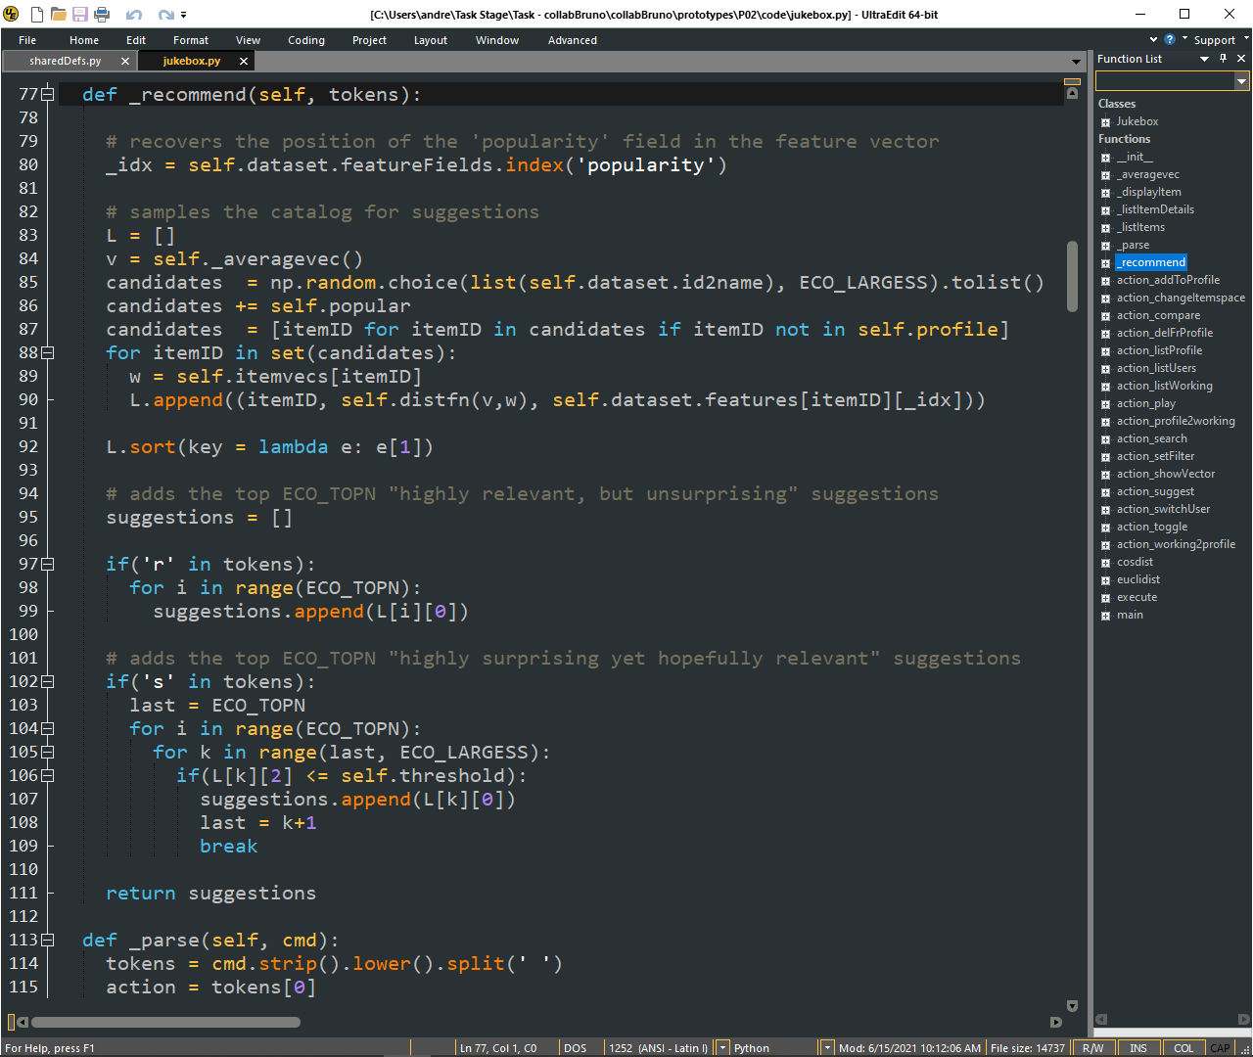
Candidate items (in decreasing similarity to user profile vector)
Relevant
Surprising

