Slide 1
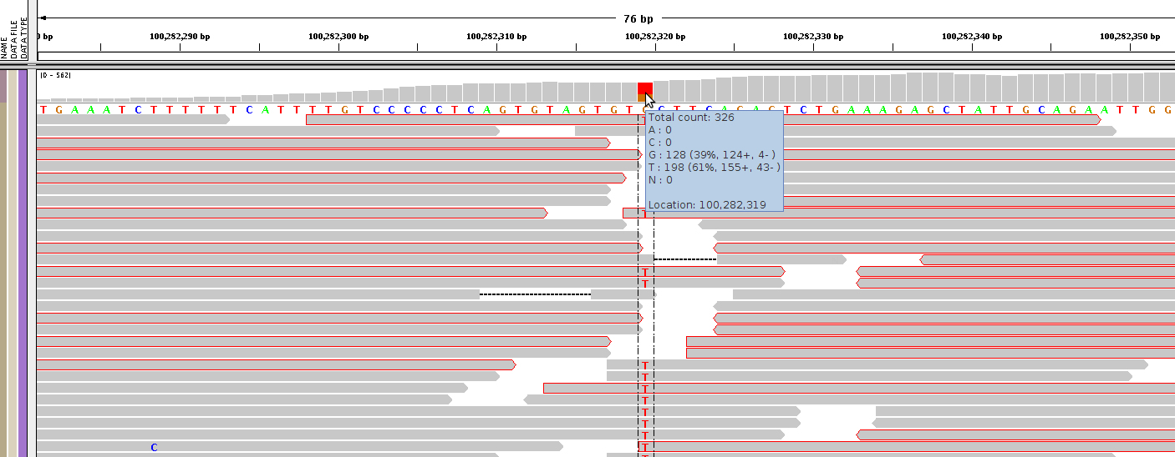
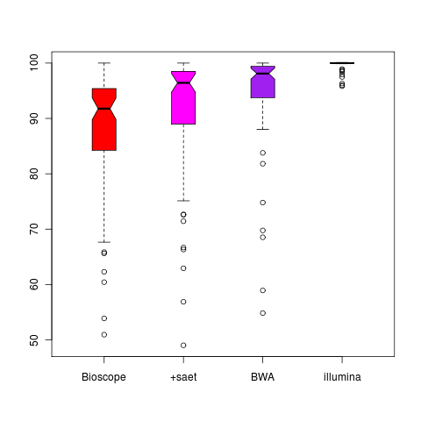
Alleles SNP splits (should be 100 %)
For 80 known snps, the base splits was extracted. As these are hemizygous SNPs they should all be 100% different from the reference
Solid: 80 hemizygous known SNPs, illumina: 80 random selected SNPs

Slide 2
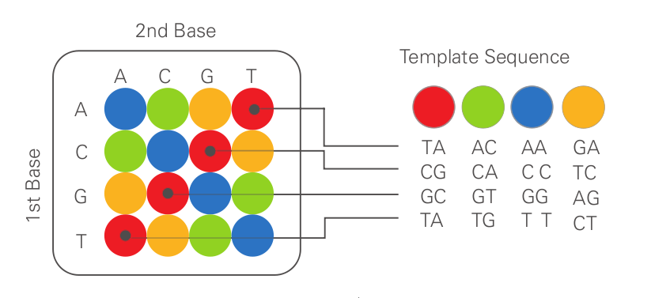
Colour space error rates
This is how the colour error rates as determined, both for clipped and unclipped Bioscope reads.
This method was used for getting the colour error rate, which of cause differs from the base error rate.
92.7%
0.3%
clipped reads
5.2%
1.6%
A A T C A A T C T G
78.8%
0.9%
unclipped reads
18.0%
2.1%

Slide 3
Bioscope | 59%/41%
+saet | 88%/12%
BWA | 70%/30%
For each SNP it was further investigated
how many of the reads where being
changed into the reference base.
Bases that was corrected to the reference
base incorrectly is what we refer to as:
reference leakage
As these SNPs are hemizygous there
should not be any reference bases in at
any of the SNPs
Colour 2
4.0%
0.0%
0.0%
0.0%
SNP
0.0%
0.0%
0.8%
0.0%
Colour 1
65.5%
0.0%
28.8%
0.0%
Reference leakage
0.8%
0.0%
0.0%
0.0%
Error
C A G G A G C
Reference
C A G A A G C
SNP

Slide 4
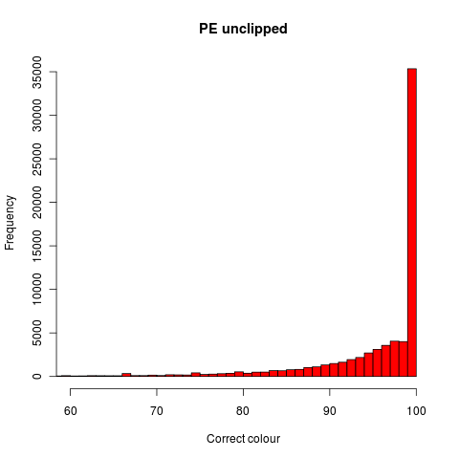
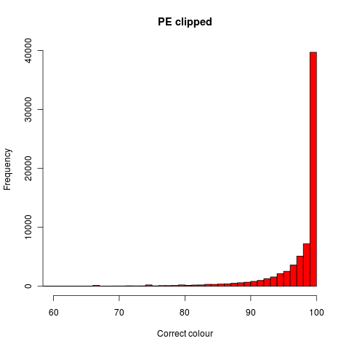
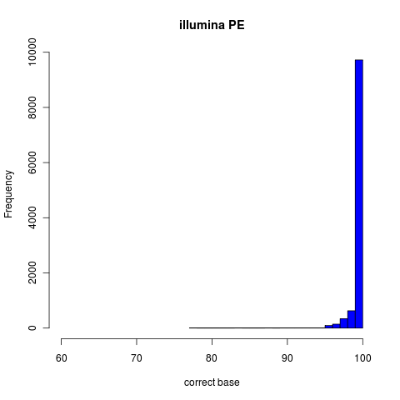
Comparison of colour error rates and illumina error rates. The rates are determined as
% bases/colours at a given position agreeing with the reference. SNPs was removed.
Median | 98.59%
Mean | 94.00%
Median | 99.58%
Mean | 97.00%
Median | 100 %
Mean | 99.72%

Slide 5
#reads: 409380
single colour error: 531894
double colour errors: 32080
+triple colour errors: 4761
Avg mapping length: ~40
Avg error rate/read: ~1.5 ==> 3.75% overall colour error rate
Implications of this:
~7.5% leakage towards reference at snps (as observed)
~0.04% false positives (wrong bases)
Expected Illumina false positives: 0.1% (wrong base)
Simple statistics based on the error rate we found. The error rate was established
In three different ways and the basis error rate is comparable.

Slide 6
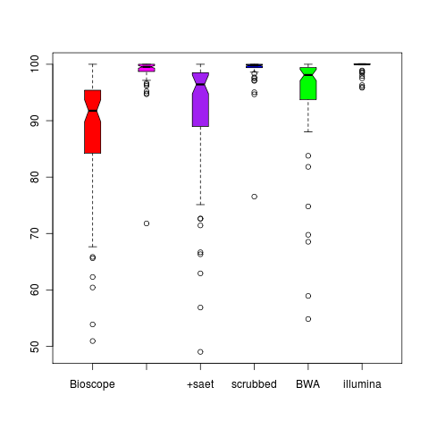
Prototype cleaning of reference leakage

Slide 7
 | Bioscope | BWA
F3 (50bp) | 68.29% | 39.64%
F3 unique | 56.14% | 34.06%
F5 (35bp) | 36.49% | 20.32%
F5 unique | 29.68% | NA
F3 PE | 69.00% | 39.64%
F3 PE unique | 54.56% | 34.14%
F5 PE | 45.77% | 20.32%
F5 PE unique | 37.79% | 18.39%
No mapping benefit in PE sequencing

