Slide 1
Kickstart Linux Kernel Contribution by Fixing Coverity Issue
Robertus Diawan Chris
Yogyakarta | October, 2026

Slide 2
Who am I?
- Used to work as web developer (mostly backend)
- On career break
- Sometimes doing programming live stream on youtube
- Resources available on
github.com/bruhtus/opensuse-asia-summit-2026

Slide 3
Where do we start?

Slide 4
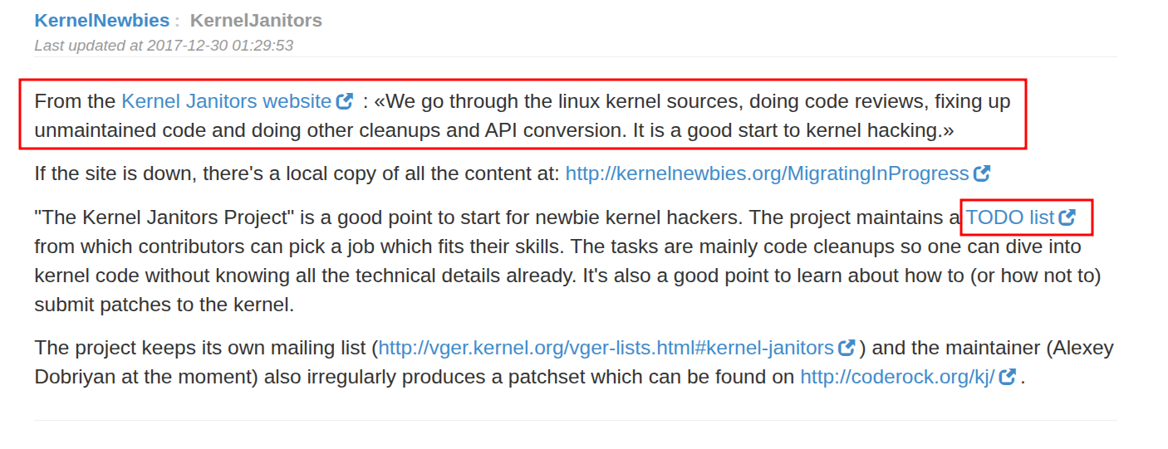

Slide 5
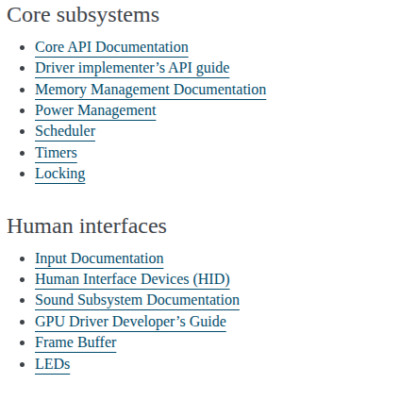
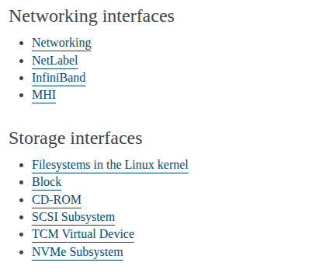
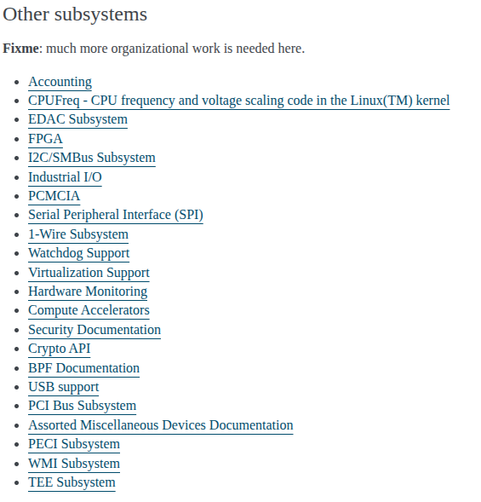

Slide 6
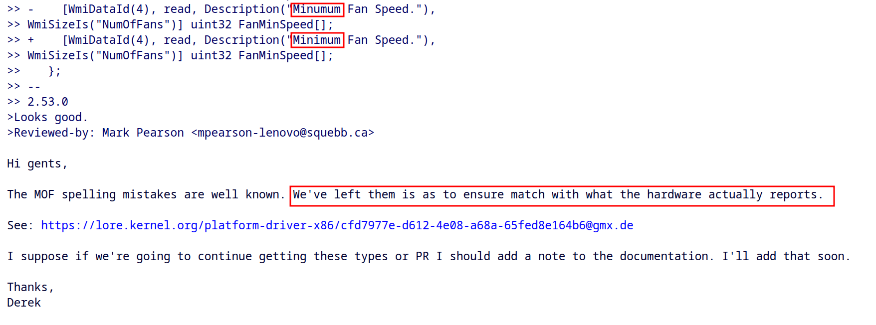

Slide 7
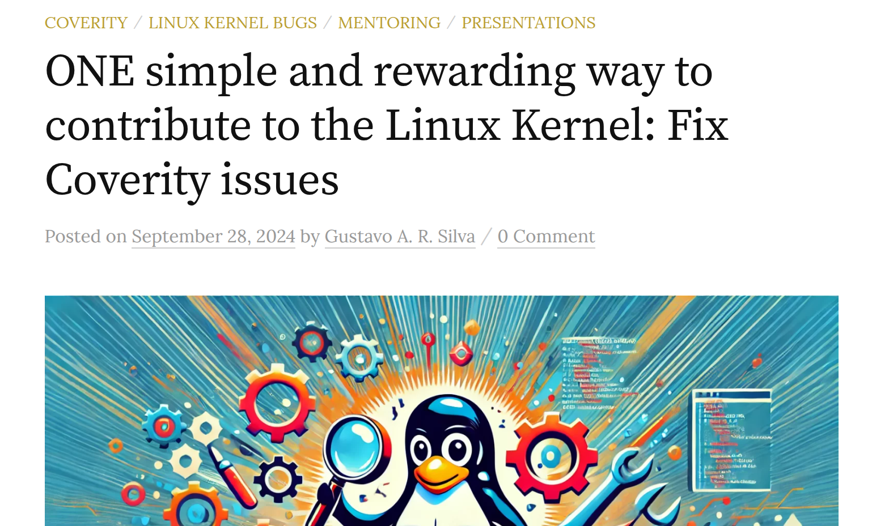

Slide 8
Analysis Tool Type
- Static Analysis (before the program run)
- Dynamic Analysis (when the program run)

Slide 9
Example of Analysis Tool
- Coverity Scan (static analysis)
- Sparse (static analysis)
- Coccinelle (static analysis)
- Smatch (static analysis)
- Syzkaller (dynamic analysis)

Slide 10

https://scan.coverity.com/

Slide 11
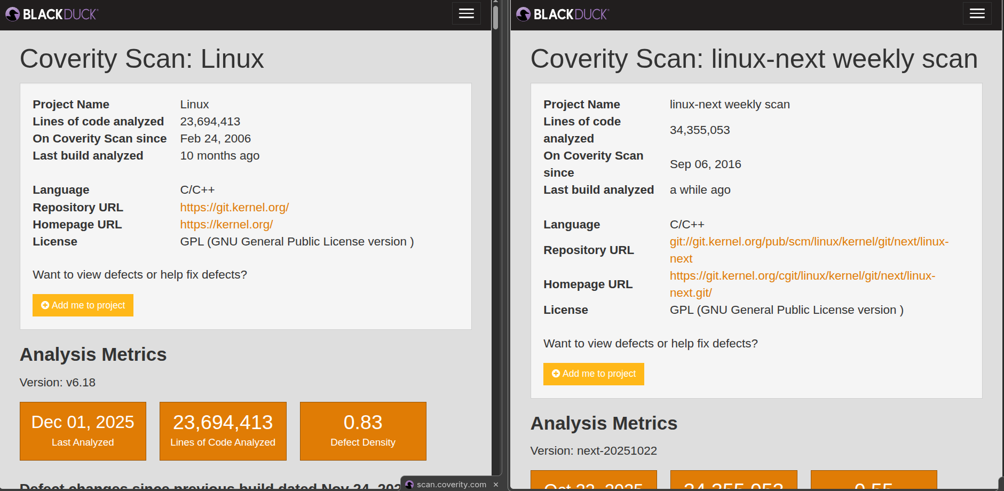

Slide 12
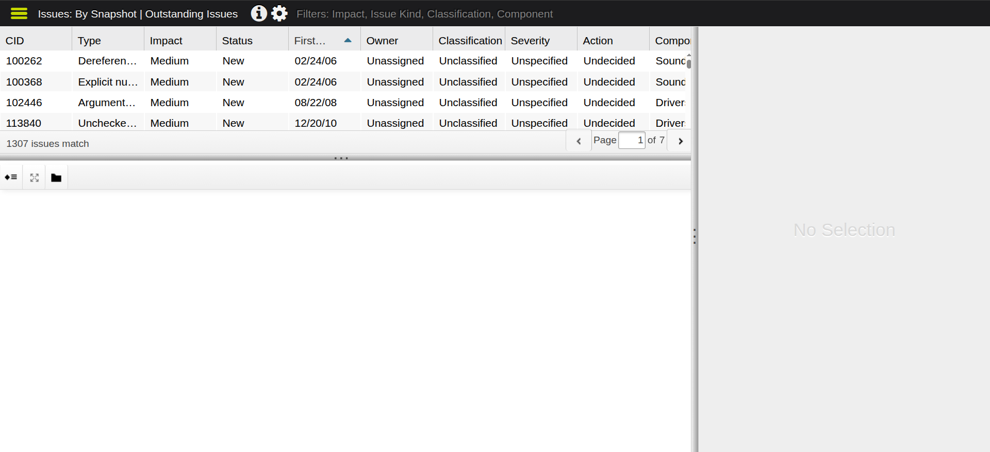

Slide 13
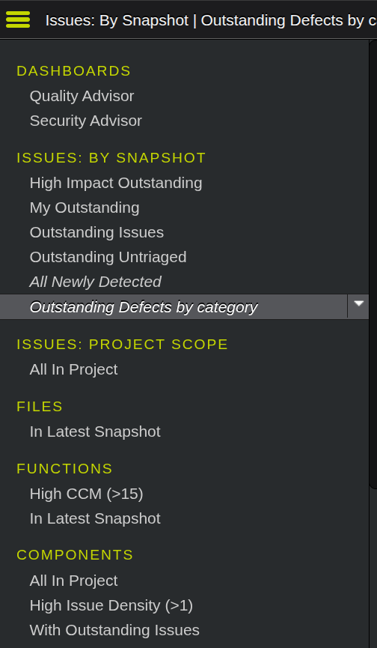
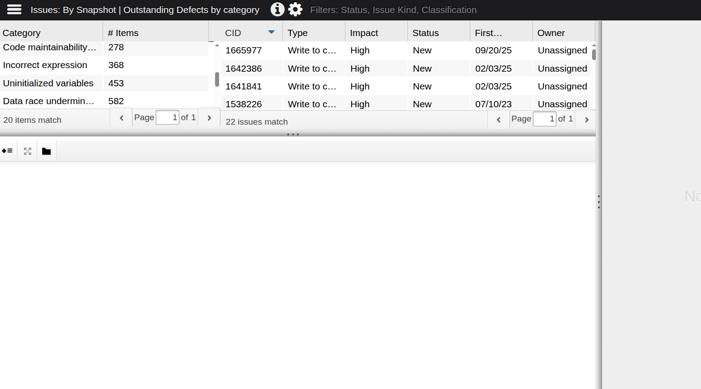

Slide 14
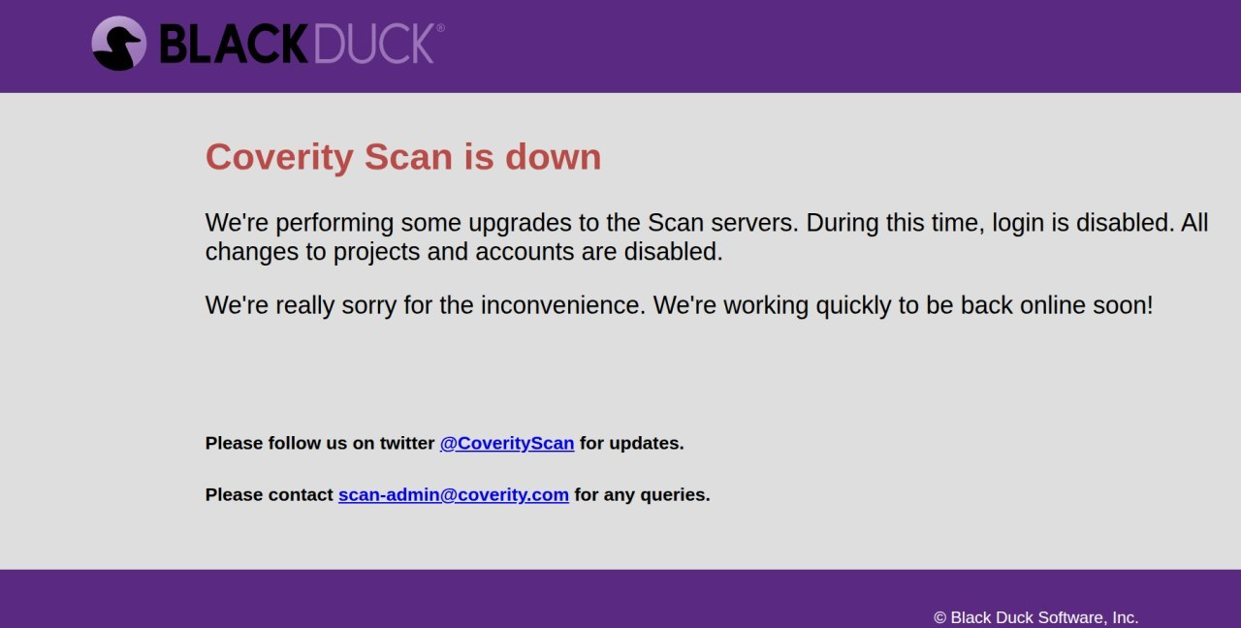

Slide 15
False Positive

Slide 16
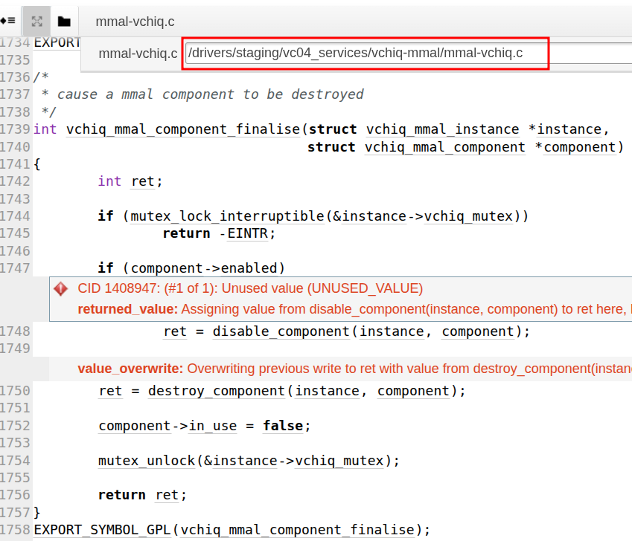
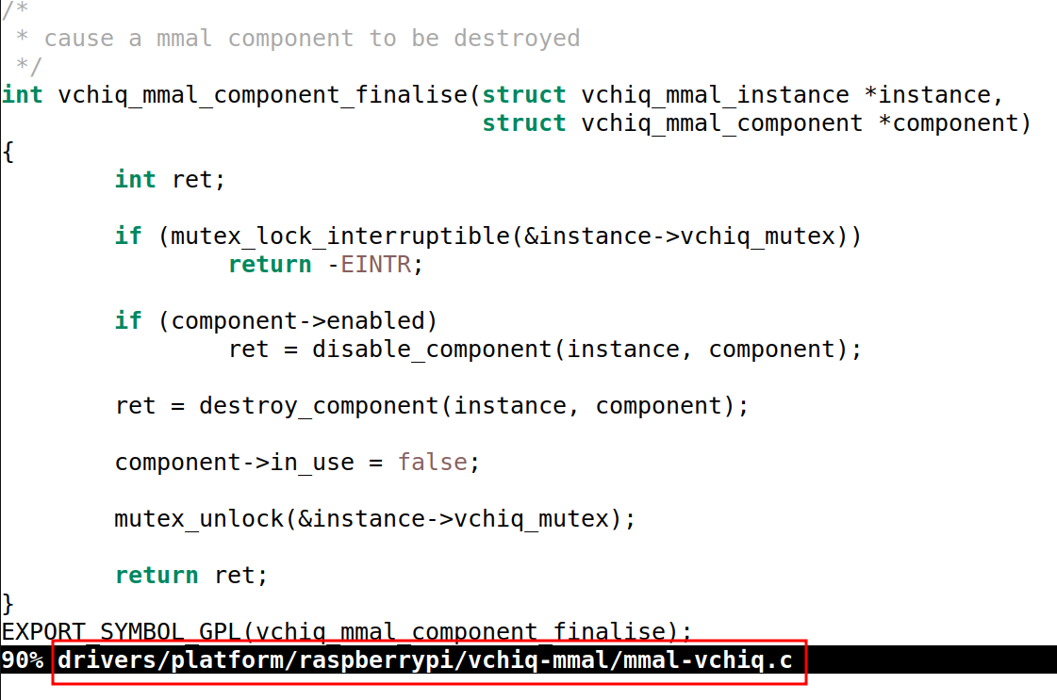

Slide 17
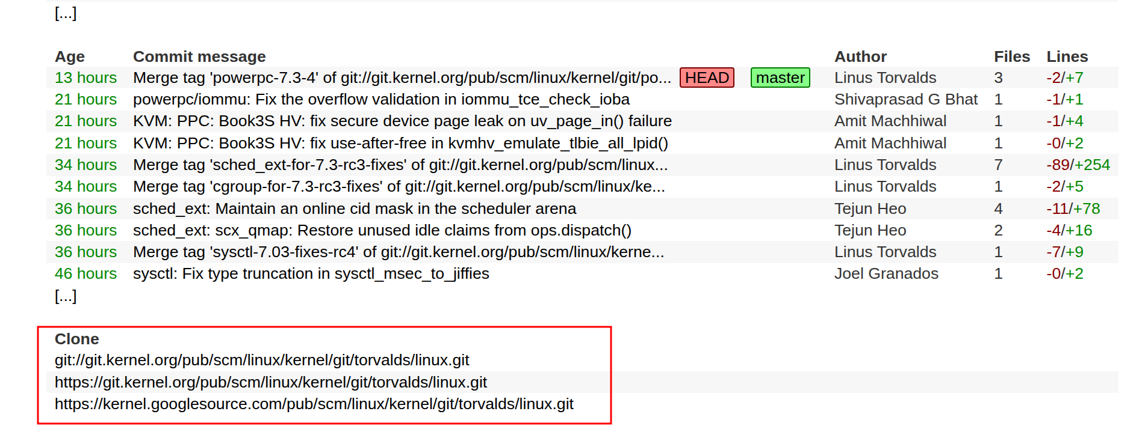

Slide 18
https://git.kernel.org/pub/scm/linux/kernel

Slide 19

https://flusp.ime.usp.br/kernel/Kernel-compilation-and-installation/

Slide 20
Simplified Patch Preparation
- git commit -s
- git format-patch -1 --base=v7.3-rc3 [--rfc=-RFT] [-v2] <commit>
- ./scripts/get_maintainer.pl <patch-file | source-code-file>
- git send-email [--dry-run] \
--to=’m1@example.com, m2@example.com, r1@example.com’ \
--cc=’linux-kernel@vger.kernel.org, mailing-list@example.com’ \
<patch-file>

Slide 21
https://git-send-email.io/

Slide 22
Documentation/process/submitting-patches.rst

Slide 23
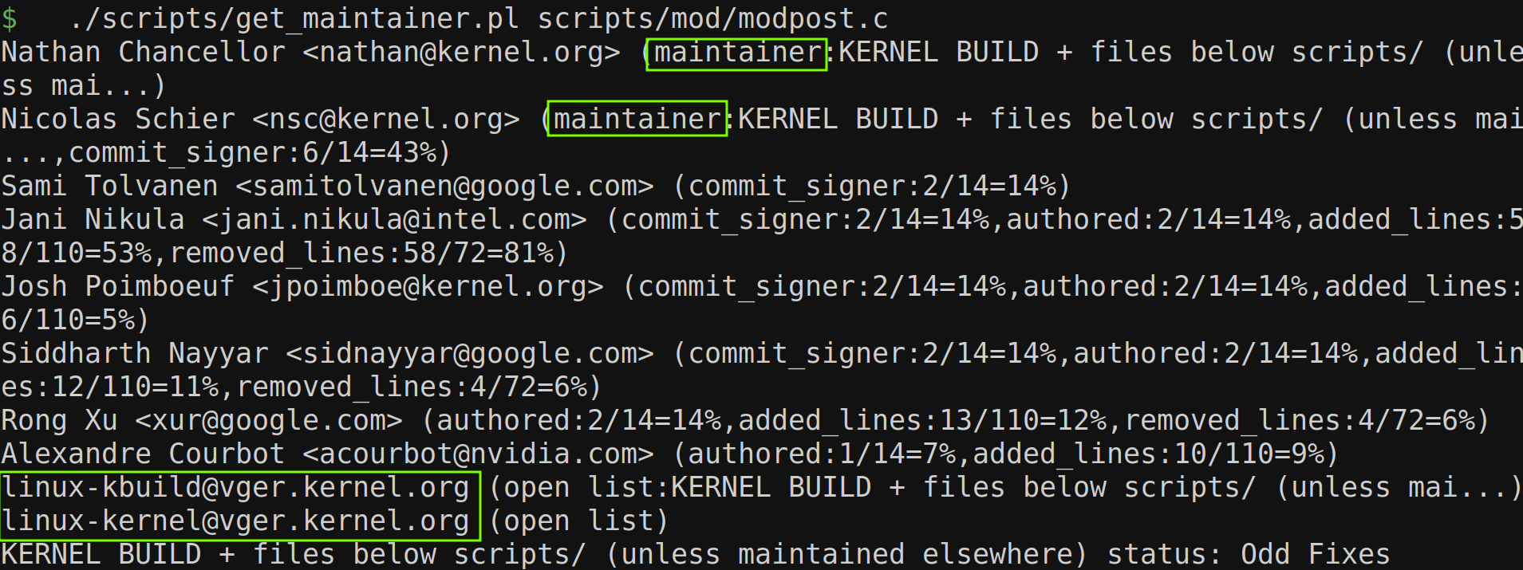

Slide 24
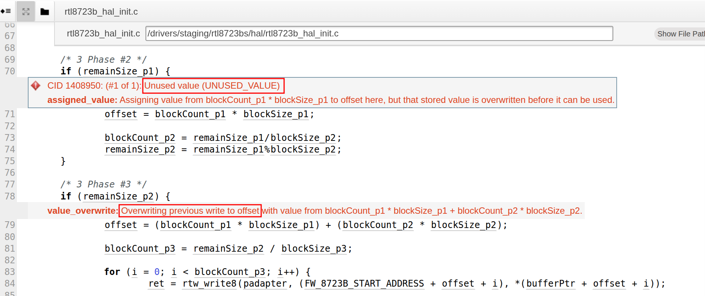
_BlockWrite()

Slide 25
Check the Changes History
- git log \
-L :_BlockWrite:drivers/staging/rtl8723bs/hal/rtl8723b_hal_init.c \
a6f242ad1e2b
- git log \
-L 76,81:drivers/staging/rtl8723bs/hal/rtl8723b_hal_init.c \
a6f242ad1e2b

Slide 26
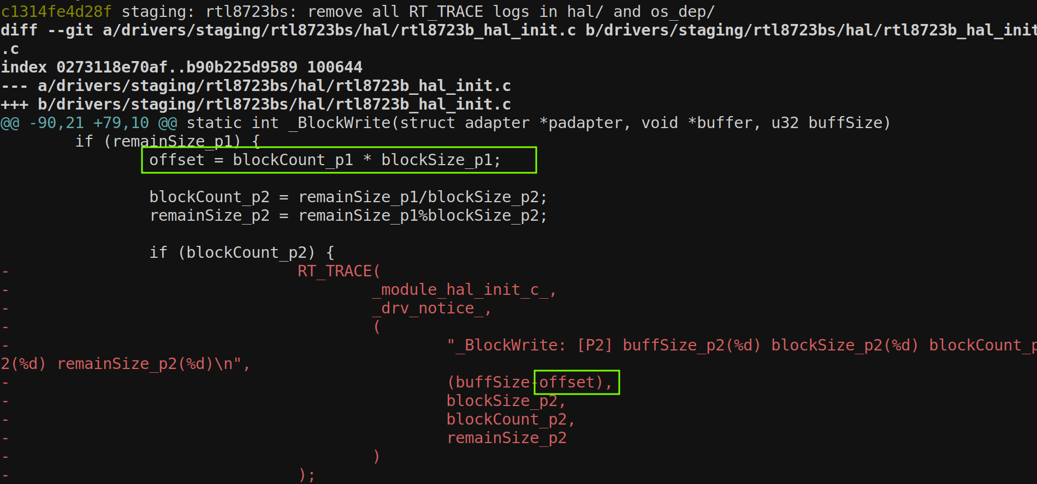
On commit c1314fe4d28 (“staging: rtl8723bs: remove all RT_TRACE logs in hal/ and os_dep/”)

Slide 27
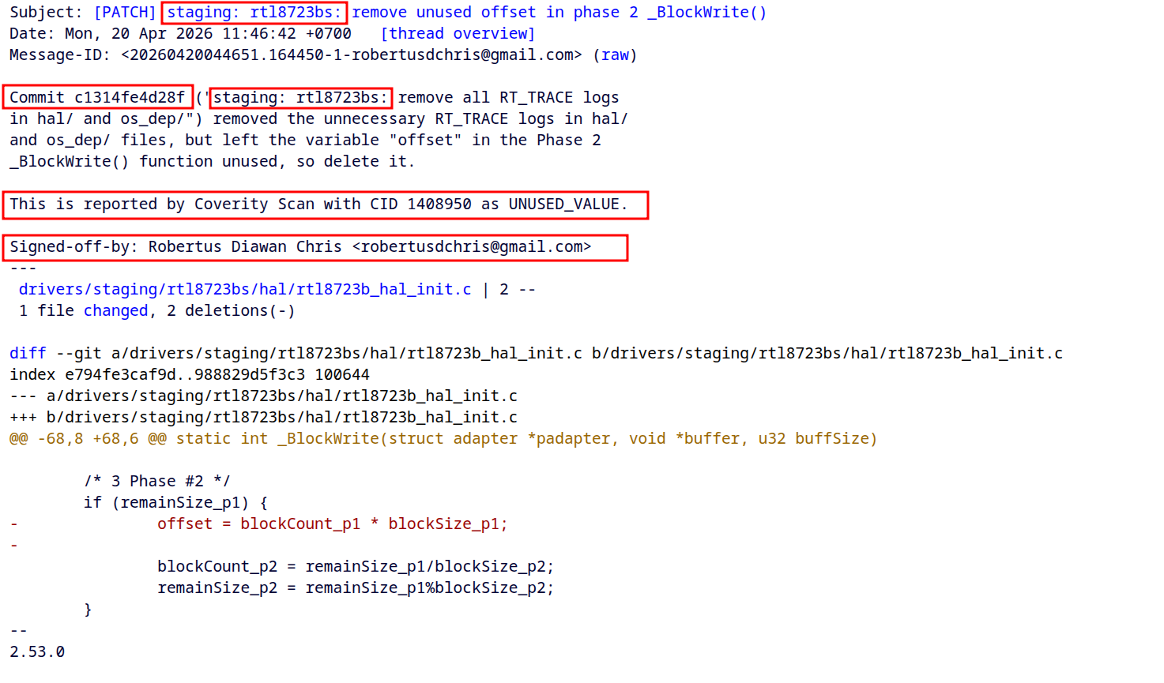

Slide 28
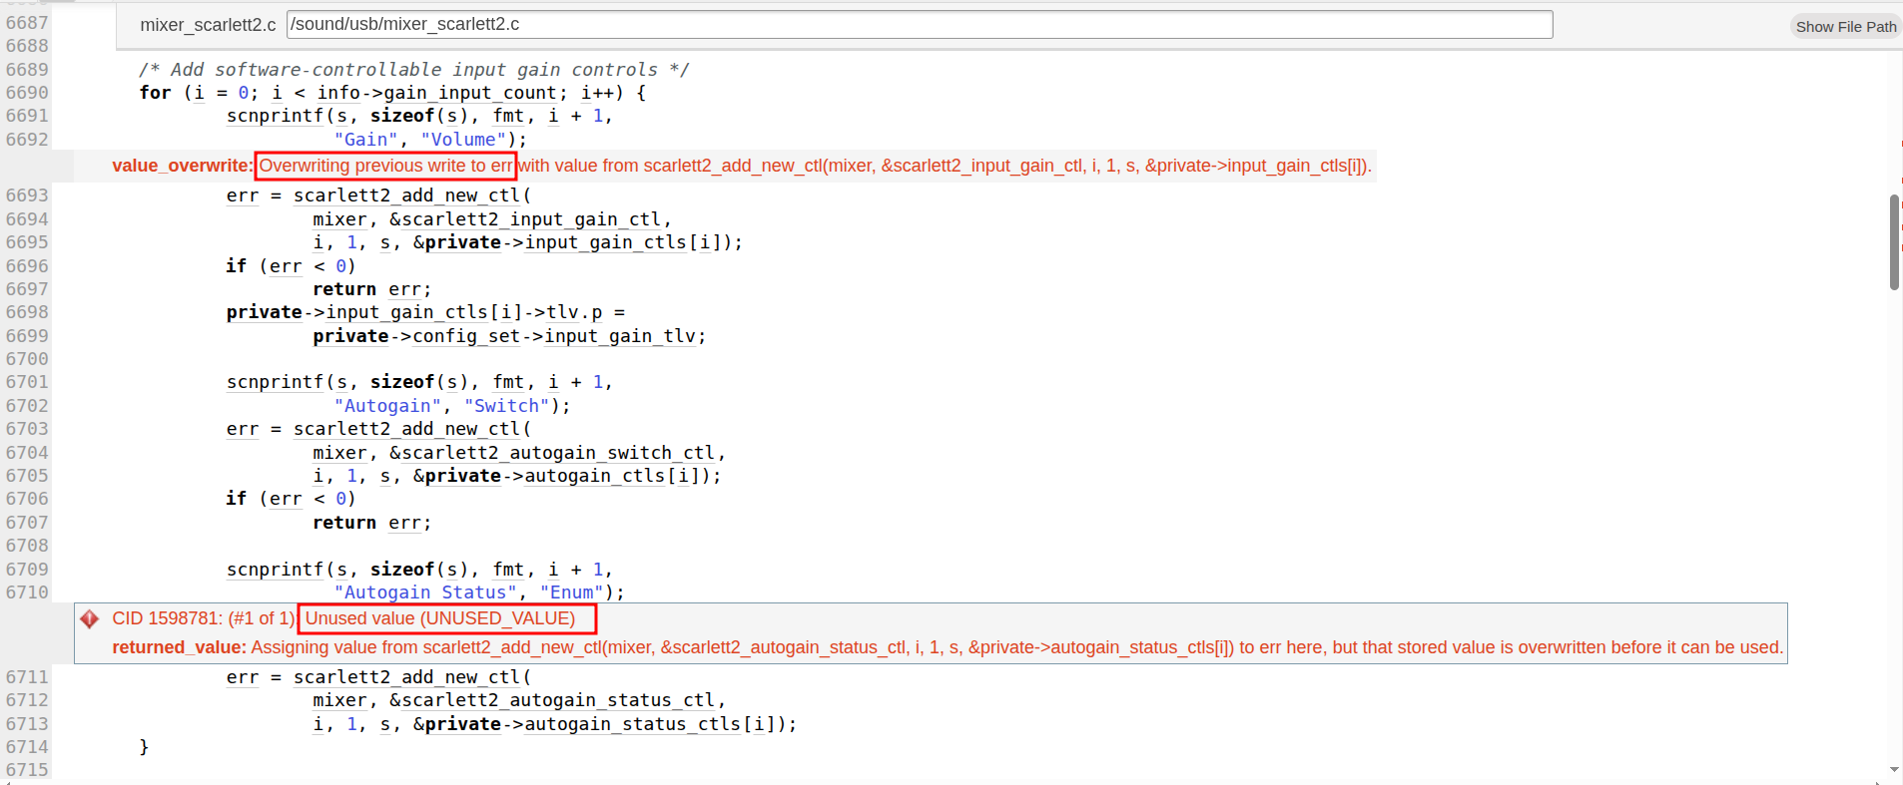
scarlett2_add_line_in_ctls()

Slide 29
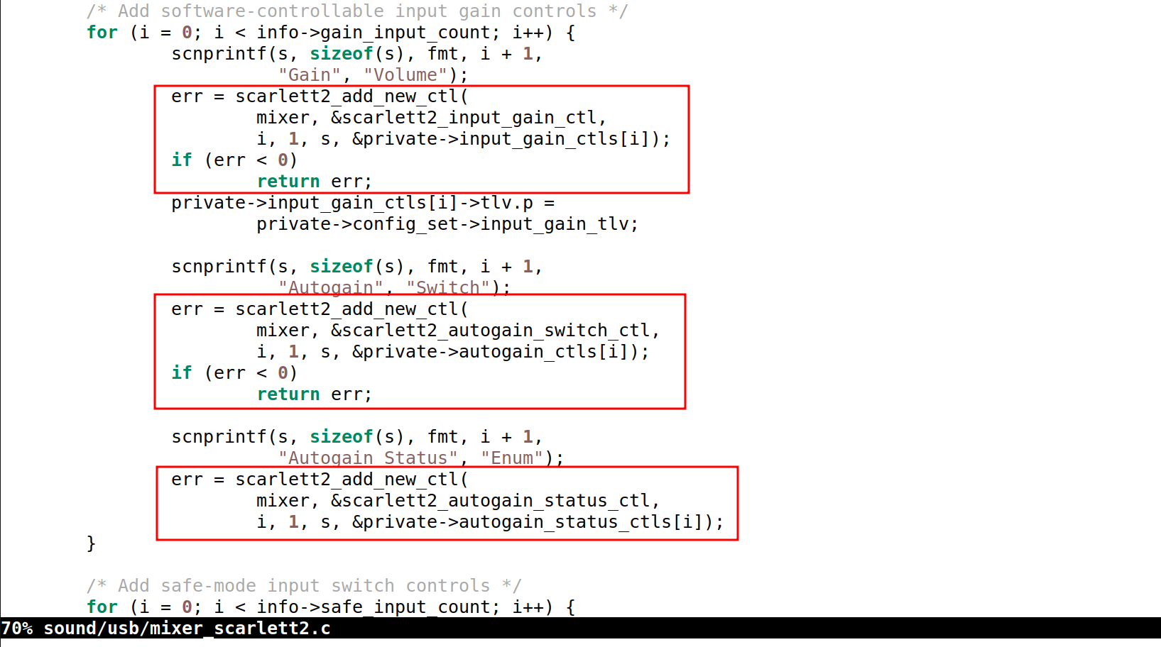
On commit 87b73d48a583 (“ALSA: scarlett2: Define the maximum preamp input gain per-config-set”)

Slide 30
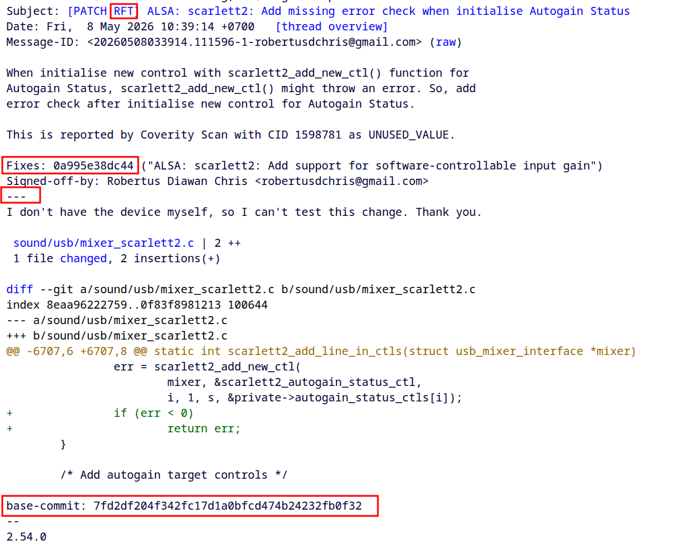
git format-patch --base=v7.1-rc2 --rfc=-RFT ...

Slide 31
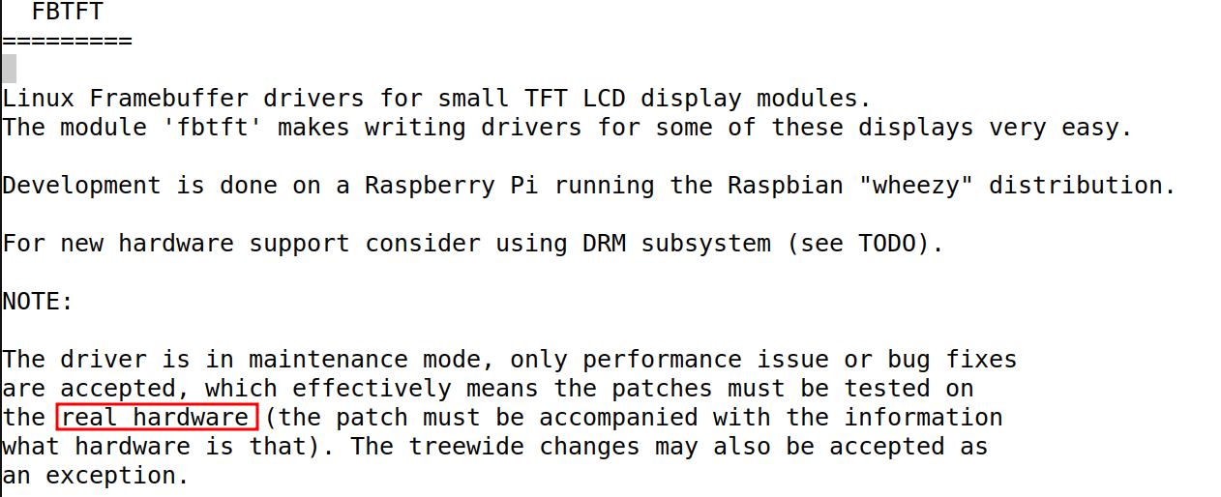
drivers/staging/fbtft/README

Slide 32
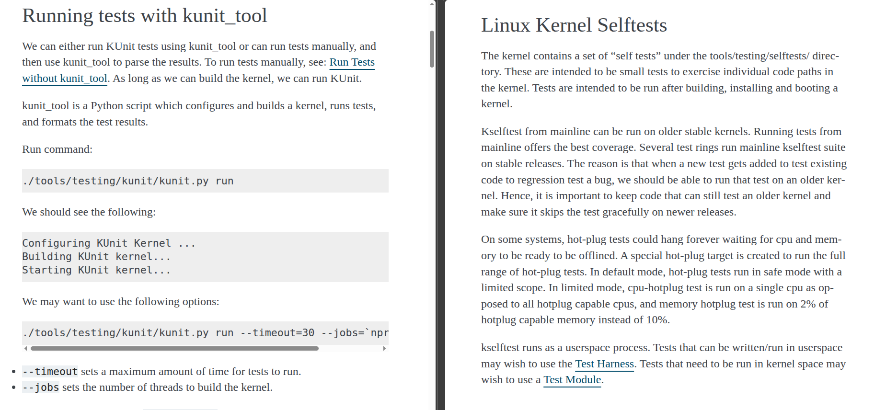

Slide 33
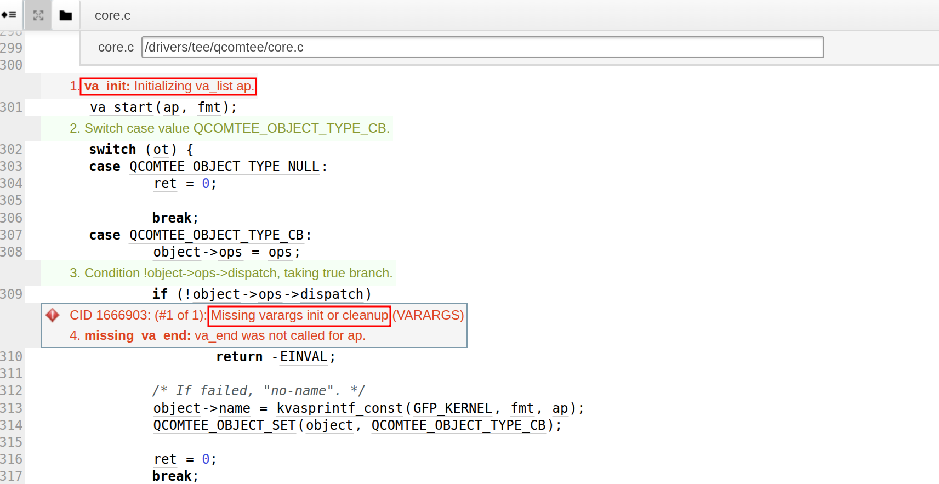
qcomtee_object_user_init()

Slide 34
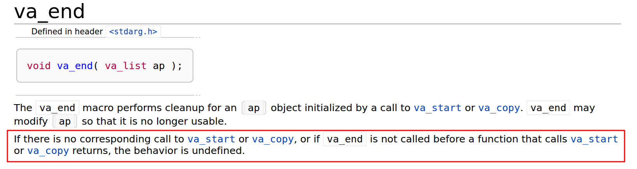

Slide 35
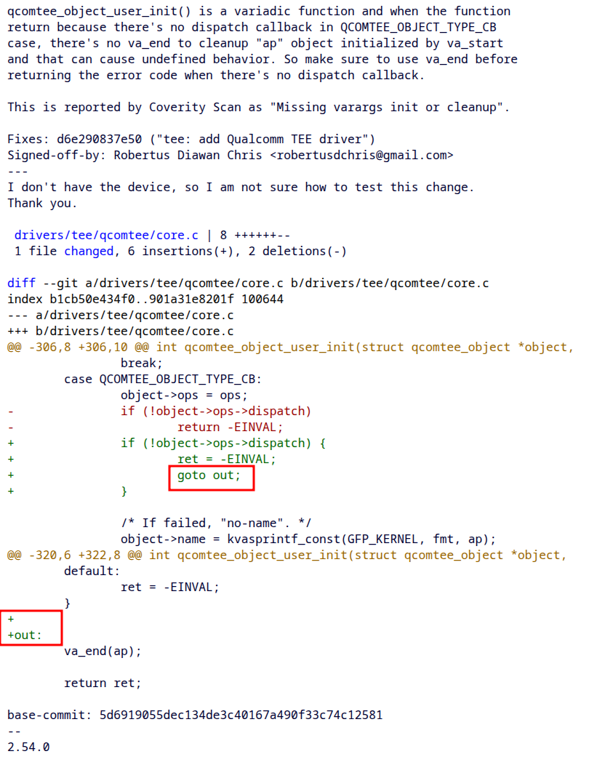

Slide 36
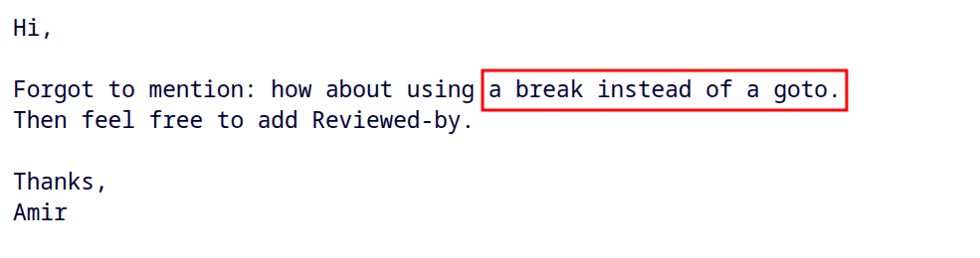

Slide 37
Send Next Version of Patch
- Send the next version of the patch as new email
- Put the changelogs in the next version patch
- Wait a few days (or even weeks) before sending next version of patch

Slide 38
Scenario Send Next Version of Patch Too Fast
- Maintainer 1 give feedback to the patch (version 1’s thread)
- Send version 2 immediately
- Maintainer 2 didn’t agree with Maintainer 1’s approach, and give different approach (version 2’s thread)
- Send version 3 immediately
- Maintainer 1 pointed out the downside of Maintainer 2’s approach (version 3’s thread)

Slide 39
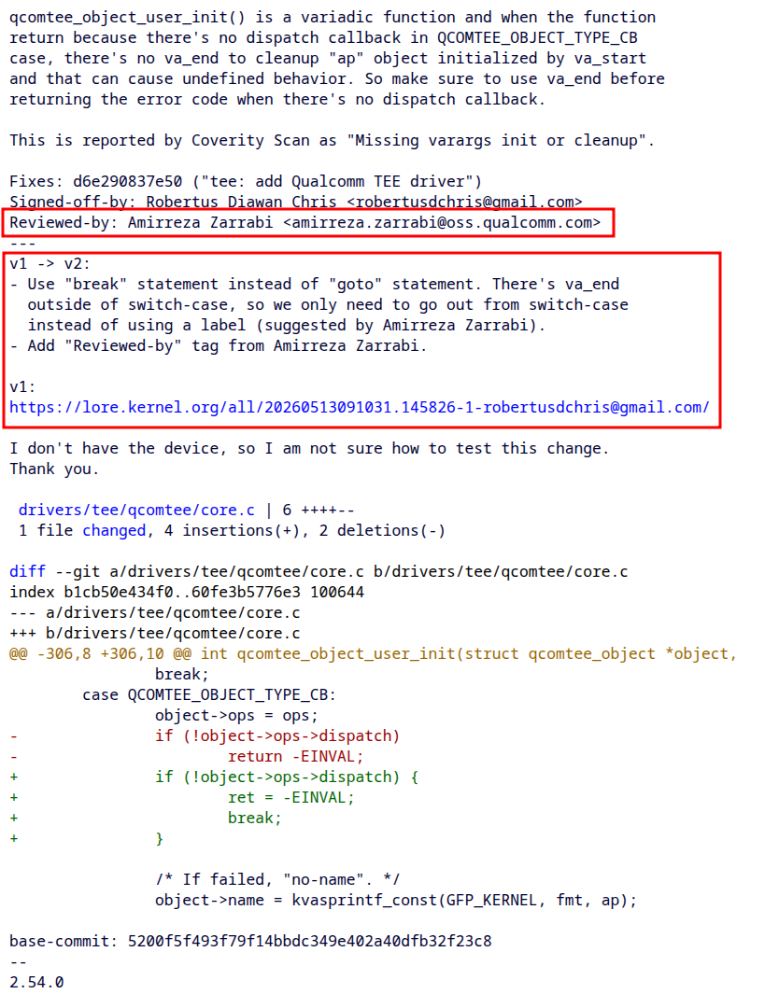

Slide 40
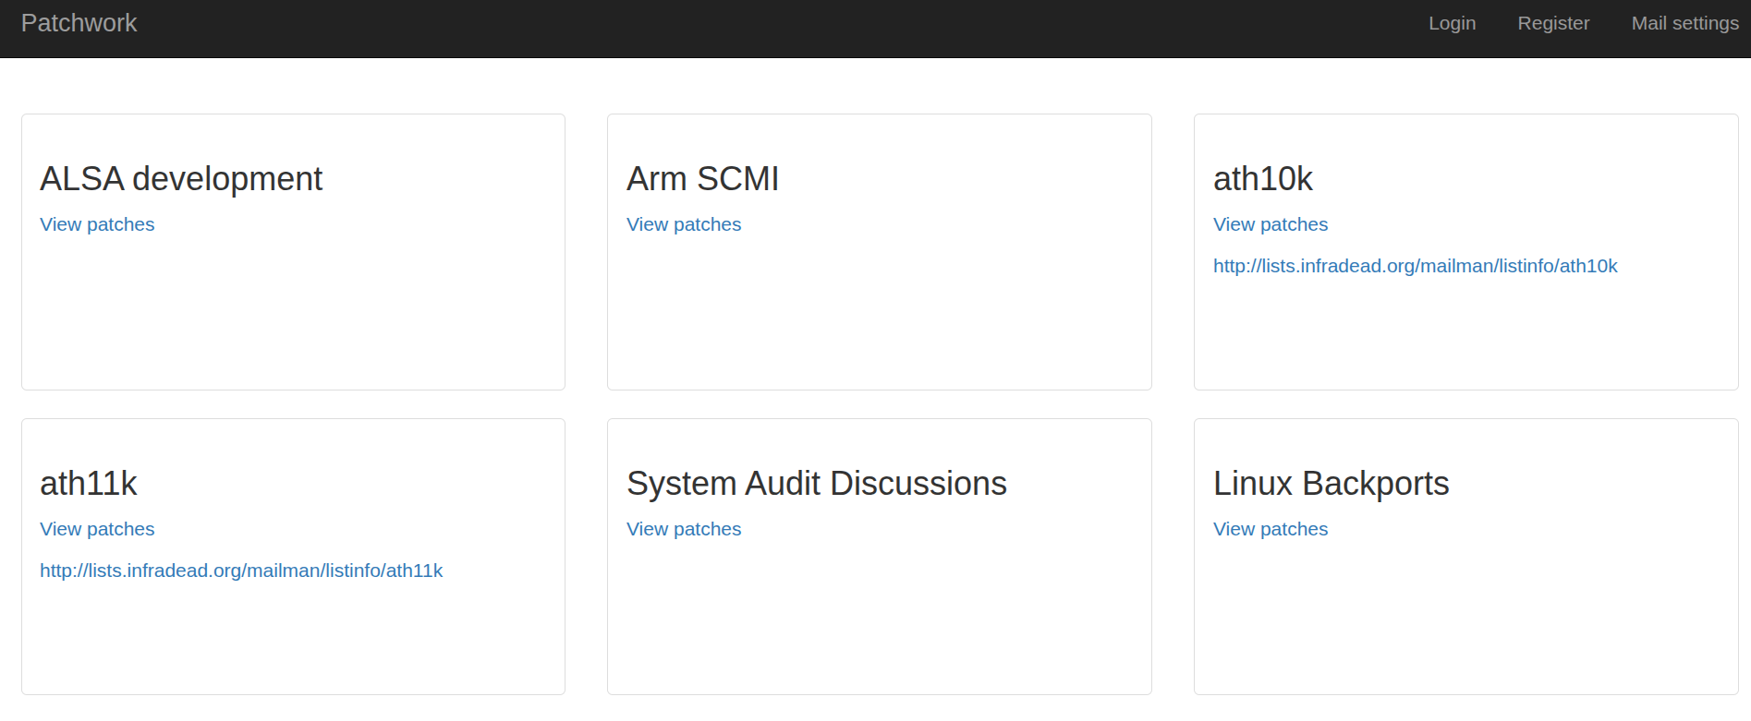
https://patchwork.kernel.org/

Slide 41
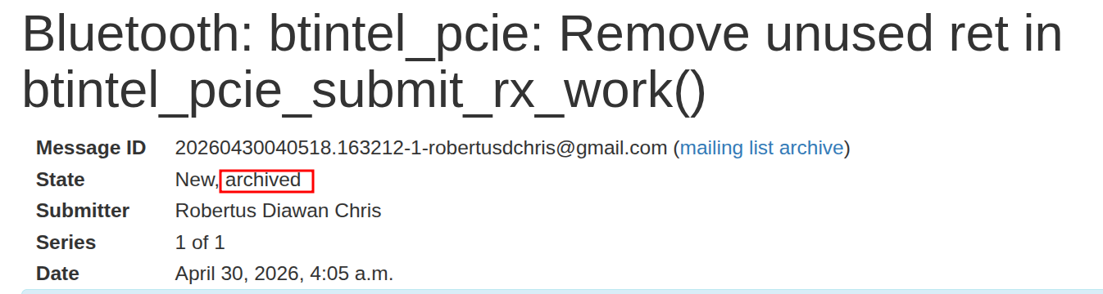

Slide 42
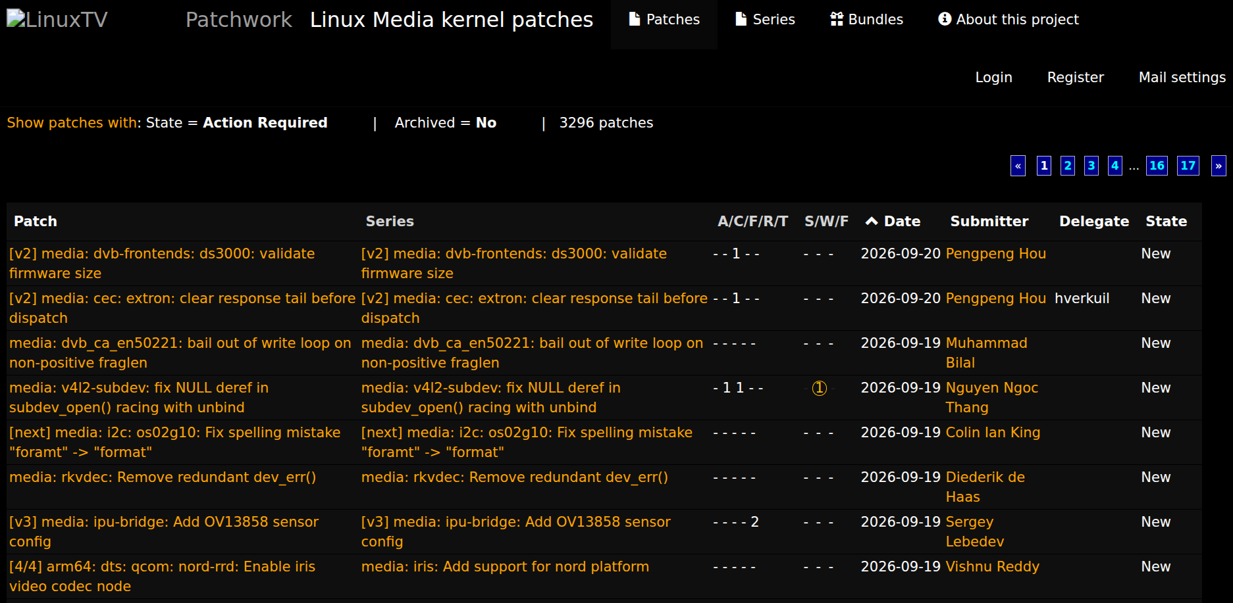
https://patchwork.linuxtv.org/project/linux-media/list/

Slide 43
“The beginning is not for proving yourself, it is for learning the craft.”

Slide 44

Thank You

