Slide 1

Lessons Learned from Single-Pass Electron Cooling Simulations
David Bruhwiler
1348 Redwood Ave.
Boulder, Colorado 80304
USA
MEIC Collaboration Meeting
31 March 2015 – Jefferson Lab
Preparation of this presentation was supported by RadiaSoft LLC. Previous work on electron cooling physics was supported by the US Department of Energy, Office of Science, Office of Nuclear Physics, through the SBIR program.

Slide 2

RadiaSoft Vision
world class computational scientists and engineers
near-term: beams, plasma and radiation
work with and contribute to community codes
WARP (LBL, beams and plasmas, Linux)
Synergia (Fermilab, beams, Linux)
Elegant (ANL, beams, cross platform)
SRW (BNL, synchrotron radiation & X-ray optics, cross platform)
Genesis (PSI, free electron lasers, cross platform)
commitment to open source software
scientific software should be open for inspection
enables collaborative development with other scientists
eliminates expensive, time-consuming IP discussions
scientific cloud computing services
market is large & independent of any particular field
accelerator technology can provide initial users
success will bring significant value to our community

Slide 3
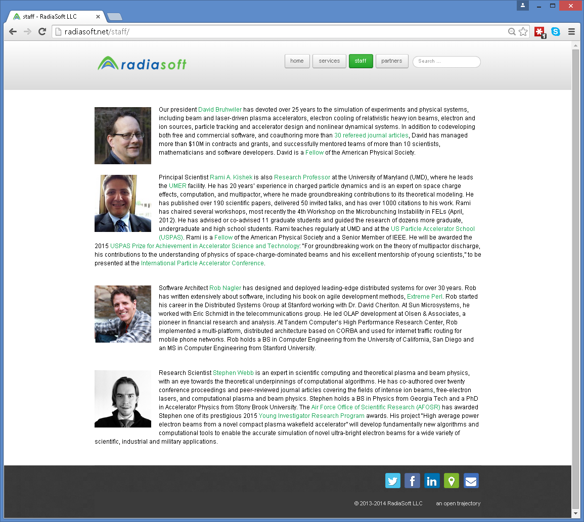
The RadiaSoft Team

Slide 4
RadiaSoft Projects
Nonlinear integrable optics (collaboration w/ Fermilab)
DOE/HEP Phase I highlights (Phase II begins April 6, 2015)
chromaticity doesn't break integrability, if horiz. & vert. are equal
space charge does break the integrability, unless its perfectly linear
interesting dynamics in the statistical distribution of the two invariants
distribution quickly evolves to a Vlasov quasi-equilibrium
these equilibria appear to evolve over longer time scales
added magnetic fields from Danilov and Nagaitsev to Synergia
Software for X-ray optics (collaboration w/ BNL)
DOE/BES Phase I highlights (Phase II begins April 6, 2015)
improvements to SRW code by O. Chubar
IPython, JavaScript interfaces to SRW
containerization of SRW, security for IPython as web service
AFOSR Young Investigator Award (Stephen Webb)
development of novel, symplectic EM-PIC algorithms

Slide 5
Our Vision for Scientific Cloud Computing
Containerized computing – put your simulation in a box
remove the pain of installing scientific codes
we install codes in a Linux container with all dependencies & tools
compilation and development can be restricted to one flavor of Linux
you can run the code directly on your PC or Mac, or in the cloud
open source technologies: Docker, Vagrant, virtual machines (VM)
Docker and Vagrant enable rapid distribution of app’s to the cloud
headless VMs enable execution on Mac and Windows with low overhead
archive your simulation in the cloud, then grab it weeks later
user input files, output files, etc. are saved in the container
version control can be used to recover previous state of files
share the container with a collaborator, students, etc.
The browser is the UI – never install software again
near term: implement X in the browser
many codes run on Linux, with X-based post-processing and graphics
we will enable immediate capture of existing code capabilities in the cloud
existing open source projects are close to having this working
in the longer term, anything is possible with JavaScript
Seamless legacy – you won’t realize you’re in the cloud
option to run codes locally (e.g. laptop on the airplane)
switch from local to cloud computing will be seamless

Slide 6
Dynamical friction in relativistic electron coolers
Lessons learned over 8 years of work
Diffusive kicks must be suppressed for single-pass studies
friction wins over millions of turns, but not in a single pass
quiet start with correlated electron-positron pairs
use more macroparticles than there are physical electrons
Semi-analytic models are required for design studies
using codes like BETACOOL
single-pass results help to improve these models
Relativistic cooling very different from standard regime
friction force scales like 1/γ² (Lorentz contraction, time dilation)
time dilation (& other considerations) → short interaction times
violates the assumptions of introductory beam & plasma texts
often, our physical intuition can be wrong
D.L. Bruhwiler, “Simulating single-pass dynamics for relativistic electron cooling,” in ICFA Beam Dynamics Newsletter 65, Beam Cooling II; http://icfa-usa.jlab.org/archive/newsletter.shtml

Slide 7
As of 2000, there were competing models
Ya. S. Derbenev and A.N. Skrinsky, “The Effect of an Accompanying Magnetic Field on Electron Cooling,” Part. Accel. 8 (1978), 235.
Ya. S. Derbenev and A.N. Skrinskii, “Magnetization effects in electron cooling,” Fiz. Plazmy 4 (1978), p. 492; Sov. J. Plasma Phys. 4 (1978), 273.
I. Meshkov, “Electron Cooling; Status and Perspectives,” Phys. Part. Nucl. 25 (1994), 631.
V.V. Parkhomchuk, “New insights in the theory of electron cooling,” Nucl. Instr. Meth. in Phys. Res. A 441 (2000), p. 9.

Slide 8

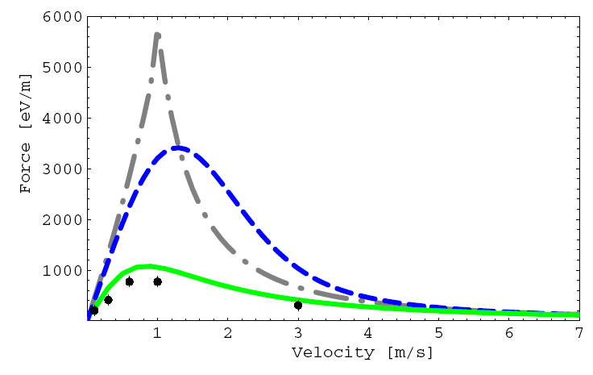
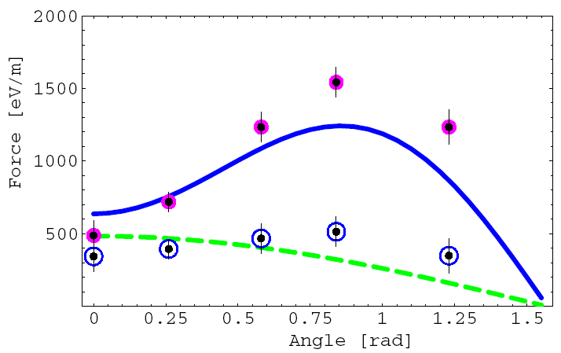
VORPAL modeling of binary collisions clarified differences in formulae for magnetized friction
green – Parkhomchuk
blue – D&S integral
gray – D&S asymptotics
A.V. Fedotov, D.L. Bruhwiler, A.O. Sidorin, D.T. Abell, I. Ben-Zvi, R. Busby, J. R. Cary and V.N. Litvinenko, “Numerical study of the magnetized friction force,” Phys. Rev. ST/AB 9, 074401 (2006)
pink – VORPAL, cold e-
blue – VORPAL, warm e-
D&S algorithm is accurate for cold electrons – not for warm
Parkhomchuk formula is approximately correct for typical parameters, but not always
3D quadrature of standard formula with modified ρ_{min} is better for idealized solenoidal field
In general, direct simulation is required

Slide 9
Replacing SC solenoid with a conventional wiggler offers lower cost & technical risk
Why look for alternatives to solenoid design?
solenoid design & beam requirements for RHIC are challenging
80 m, 5 T, superconducting, field errors <10⁻⁵
Advantages of a wiggler
like a solenoid, it provides focusing & suppresses recombination
modest fields (~10 Gauss) effectively reduce recombination via ‘wiggle’ motion of electrons:
e- bunch is easier: less charge and un-magnetized
lower construction costs; less technical risk
What’s the effect of ‘wiggle’ motion on cooling?
independent suggestion of V. Litvinenko & Ya. Derbenev
increases ρ_{min} of Coulomb logarithm:
strong need for simulations

Slide 10
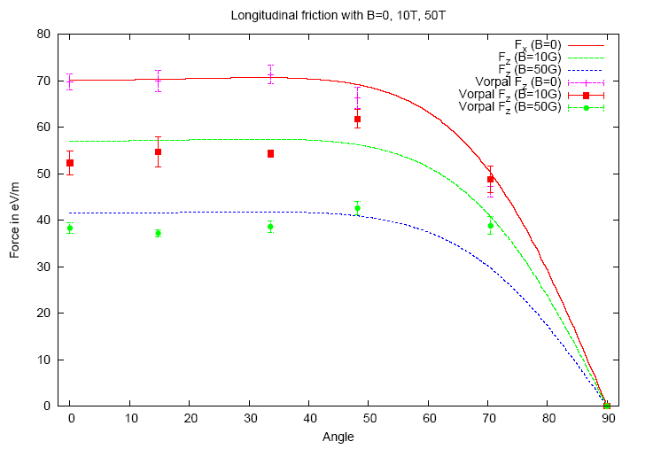
VORPAL simulations support decision to use conventional wiggler for e- cooling of 100 GeV/n Au+79
Culmination of years of work, beginning in 2002
A.V. Fedotov, D.L. Bruhwiler, A. Sidorin, D. Abell, I. Ben-Zvi, R. Busby, J.R. Cary, and V.N. Litvinenko, "Numerical study of the magnetized friction force," Phys. Rev. ST Accel. Beams 9, 074401 (2006).
A.V. Fedotov, I. Ben-Zvi, D.L. Bruhwiler, V.N. Litvinenko and A.O. Sidorin, "High-energy electron cooling in a collider," New J. Phys. 8 (2006), p. 283.
G.I. Bell, D.L. Bruhwiler, A. Fedotov, A.V. Sobol, R. Busby, P. Stoltz, D.T. Abell, P. Messmer, I. Ben-Zvi and V.N. Litvinenko, “Simulating the dynamical friction force on ions due to a briefly co-propagating electron beam”, J. Comp. Phys. 227 (2008), p. 8714.
Conventional wiggler could replace expensive solenoid
friction force is reduced only logarithmically

Slide 11
Acknowledgments
Preparation of this talk was supported by RadiaSoft LLC.
Much of the work discussed here was supported by the US Department of Energy, Office of Science, Office of Nuclear Physics, in part through the SBIR program.
I gratefully acknowledge the contributions made by all my coauthors, with special thanks to the following scientists for key contributions:
George Bell, Ilan Ben-Zvi, Michael Blaskiewicz, Alexey Burov,
Yaroslav Derbenev, Alexei Fedotov, Vladimir Litvinenko,
Sergei Nagaitsev, Gregg Penn, Ilya Pogorelov, Sven Reiche,
Brian Schwartz, Andrey Sobol, Peter Stoltz, Gang Wang
Most of the simulations discussed here were conducted using the parallel VORPAL framework (now known as VSim) [1,2,3], including the implementation of several algorithms (Hermite, BCC, δf-PIC, Vlasov/Poisson), and I acknowledge the important contributions of John Cary and all members of the VORPAL development team at Tech-X Corp.
[1] C. Nieter and J.R. Cary, “VORPAL: a versatile plasma simulation code,” J. Comput. Phys.196, 448 (2004)
[2] G.I. Bell, D.L. Bruhwiler, A. Fedotov, A. Sobol, R.S. Busby, P. Stoltz, D.T. Abell, P. Messmer, I. Ben-Zvi and V. Litvinenko, “Simulating the dynamical friction force on ions due to a briefly co-propagating electron beam,” J. Comput. Phys. 227, 8714 (2008).
[3] The VSim website; http://www.txcorp.com/home/vsim/vsim-overview

