Slide 2
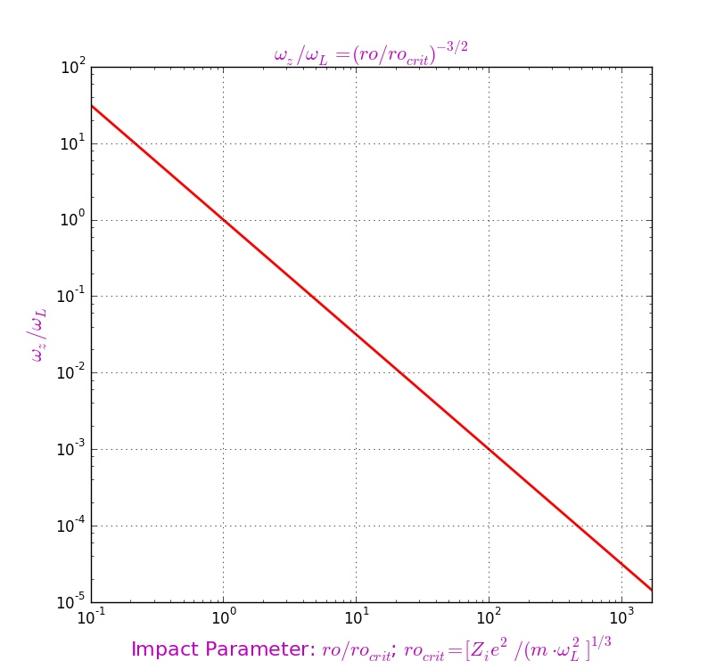
”Magnetization” Area

Slide 3
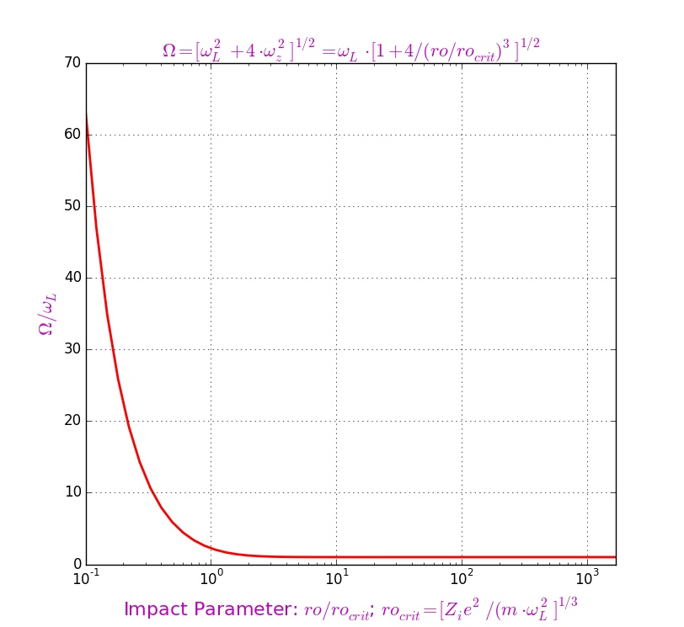
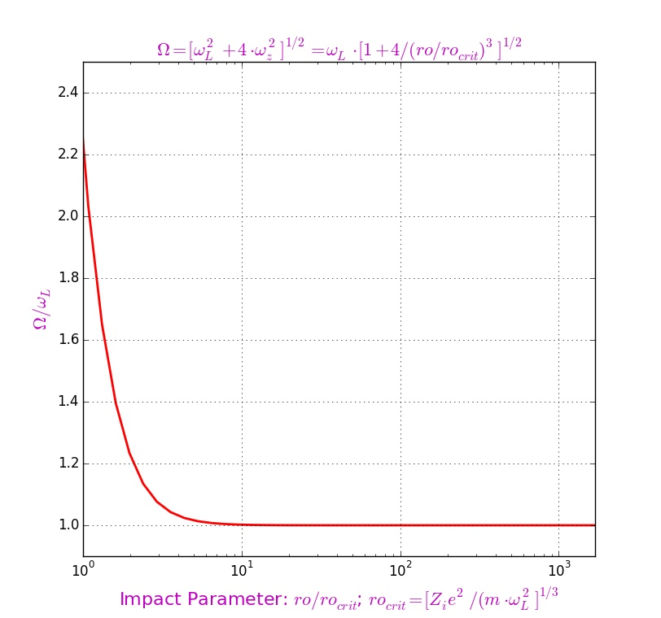

Slide 4
For each ion with velocity cycles over electrons
Cycle over transversal velocity with the step
Cycle over impact parameter with the step
Cycle over longitudinal velocity with the step
Cycle over time with the step
“Pull” electron with step in the magnetic field;
“Pull” ion with step in the drift gap;
“Pull” electron with step in the interaction area;
“Pull” ion with step in the interaction area;
“Pull” electron with step in the magnetic field;
“Pull” ion with step in the drift gap;
Change in the ion momentum for this step over ;
Increment of the ion momentum for this step over ;
Increment of the ion momentum for this step over ;
Increment of the ion momentum for this step over ;
Friction force

Slide 5
Loop for value in range with steps
Loop for value in range with steps
Solution of the cubic equation for value for selected values of
Calculation of the initial parameters
for found value of
Preparation of data for a loop along each track with
“Pull” each track for approach-1
See further
“Pull” each track for approach-2
Writing of the results to output files for later visualization and processing

Slide 6
“Pull” each track for approach-1 (Larmor rotation):
“Pull” each track for approach-2 (“guiding center” system; gcs):
For each time step:
“Pull” electron with the time step in the magnetic field;
“Pull” ion with the time step in the drift gap;
Calculation of distance between electron and ion;
Calculation of the changing of momenta for ion and electron for the time step ;
Change in the ion and electron momenta for this time step.
For each time step:
“Pull” electron with the time step in the gcs;
“Pull” ion with the time step in the drift gap;
Calculation of the changing of momenta for ion and electron for the time step in the gcs;
Change in the ion and electron momenta for this time step;
“Pull” electron with the time step in the gcs;
“Pull” ion with the time step in the drift gap.

