Slide 1

Data Visualisation Project Student Name: Bruna Minhos Student ID: K00278559
Microsoft Power BI

Slide 2
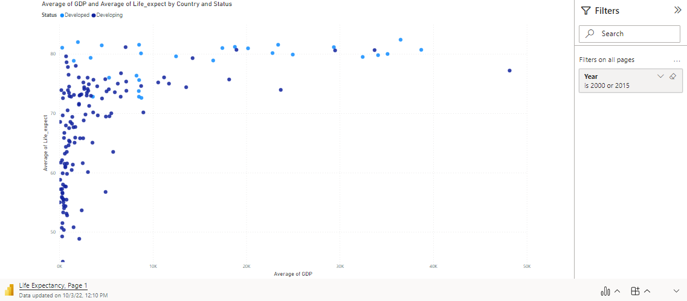
Average of GDP and Average of Life Expectancy By Country

Slide 3
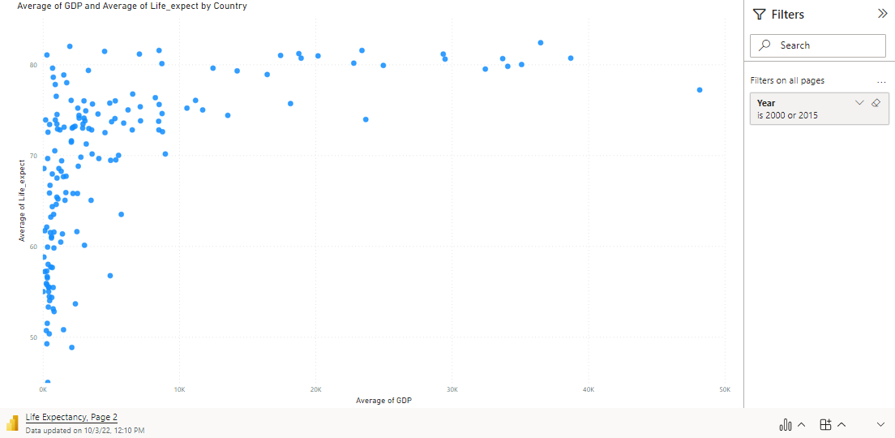
Average of GDP and Average of Life Expect by Country

Slide 4
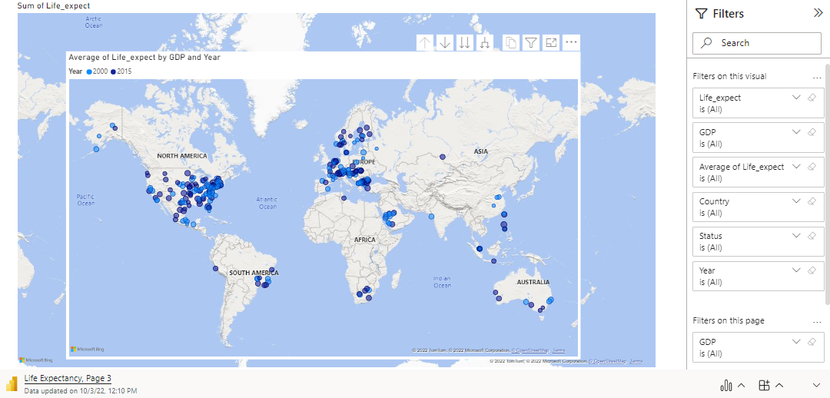
Average of Life Expect by GDP and Year

