Slide 1
Operating Systems, Security and Networks 207SE
Introduction – Connecting to Server Anywhere

Slide 2
Linux Server
The activities on the 207SE you do not need to use the Linux server you can install Linux on your PC, laptop or chromebook.
If you do use the Linux server, simply follow the instructions on these slides and the associated video

Slide 3
Linux Server
Carrying out the practical work (including for portfolio we will use linux server)
ITS have set up a server for us called os-207se, which they refer to as “the UNIX server”.
It’s an virtual machine running Linux, we can add cores as we wish so it’s pretty fast in comparison to the typical desktop.

Slide 4
Installing Software

Slide 5
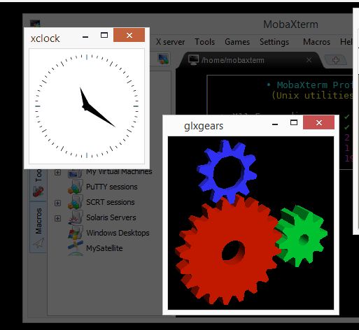
Download and install ssh
Must be using own PC, laptop etc
See slides and video on connect in E and C
Download MobaXterm and install (the free one) http://mobaxterm.mobatek.net/download.html

Slide 6
Install VPN
To connect from anywhere on your computer you need to install a VPN.
On Moodle there is ITS document on how to do this.
To install the Coventry university VPN go to
https://anyconnect.coventry.ac.uk/

Slide 7
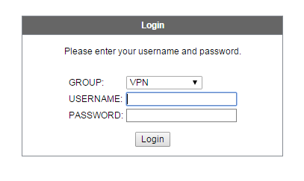
Install VPN
Login in with your university login details

Slide 8
Install VPN
Click on download to install the VPN

Slide 9
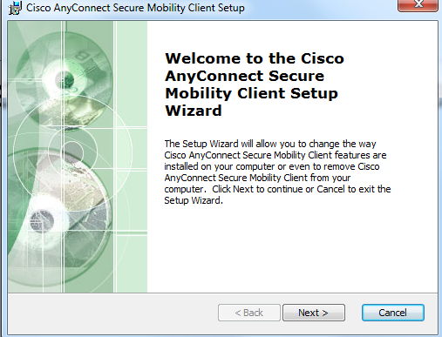
Install VPN
Install the VPN using the .exe file

Slide 10
Connecting to Server
Must be done each time link to server

Slide 11
Connecting to Linux Server
Run Cisco anyconnect Server Mobile Client from start button
In the window that opens type anyconnect.coventry.ac.uk

Slide 12
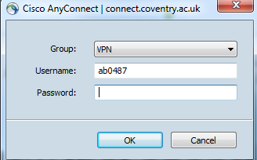
Connect to Linux Server
Log on to connect
Run you ssh (MobaXterm)

Slide 13
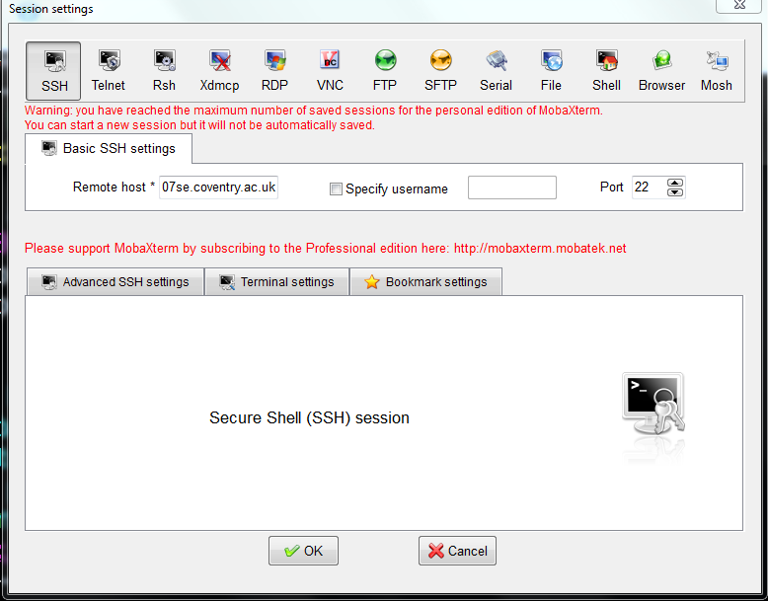
Connect to Linux Server
Click session -> SSH
In remote host type os-207se.coventry.ac.uk

Slide 14
Connect to Linux Server
Login to the server
NB: To link to the server the VPN connect must be there

