Slide 1

GIT PRESENTATION
PRESENTED BY PRASAD YADAV

Slide 2
Git Cheatsheet
This cheatsheet covers essential Git commands, their examples, and usage explanations, along with a diagram illustrating common Git workflows.
Table of Contents
Configuration
Repository Management
Working with Files
Committing Changes
Branching
Merging and Rebasing
Remote Repositories
Inspecting History
Undoing Changes
Git Workflow Diagram

Slide 3
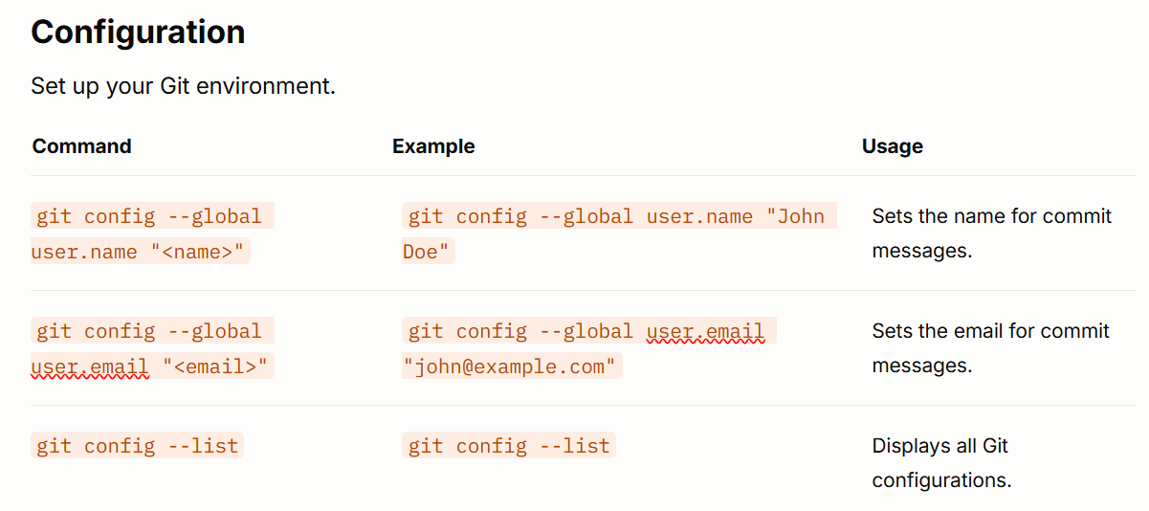

Slide 4
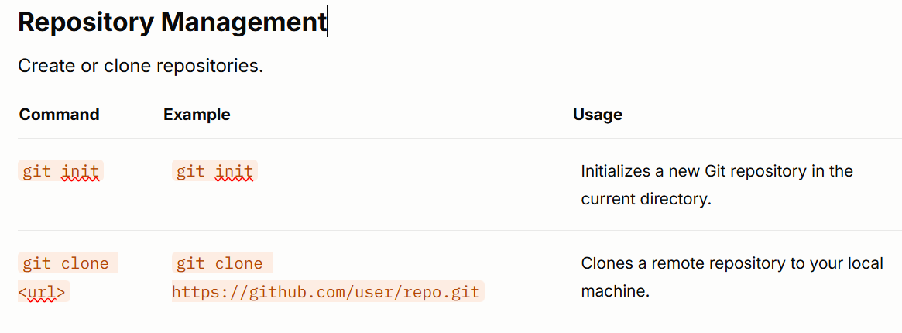

Slide 5
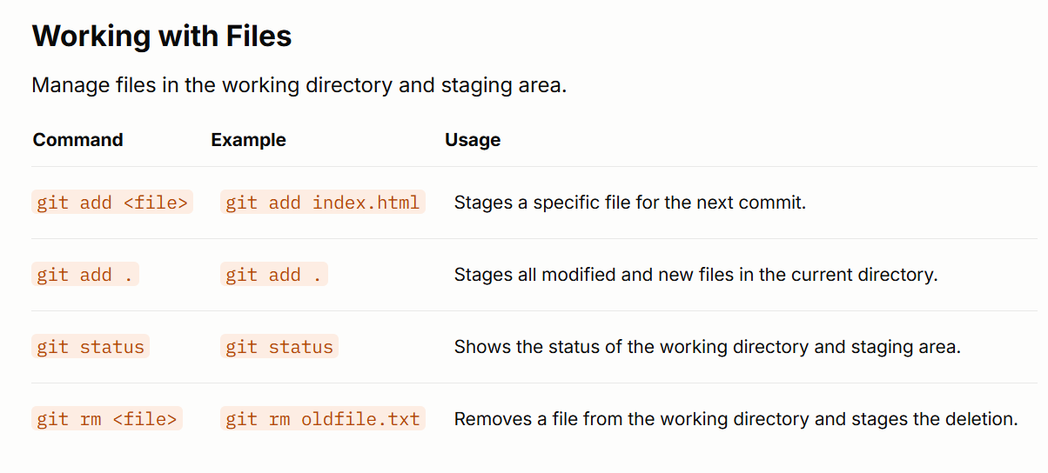

Slide 6
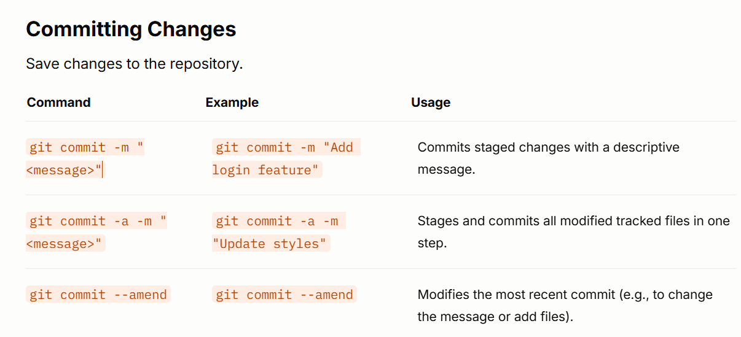

Slide 7
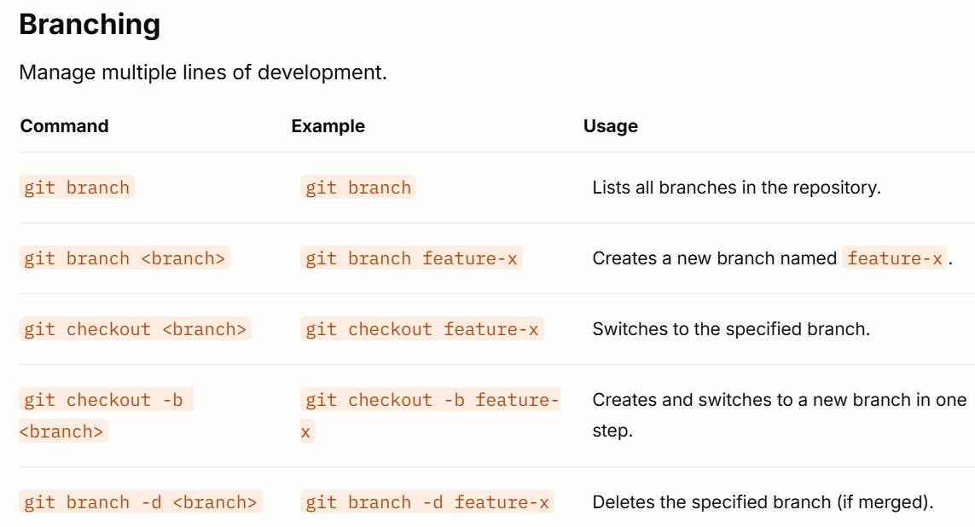

Slide 8
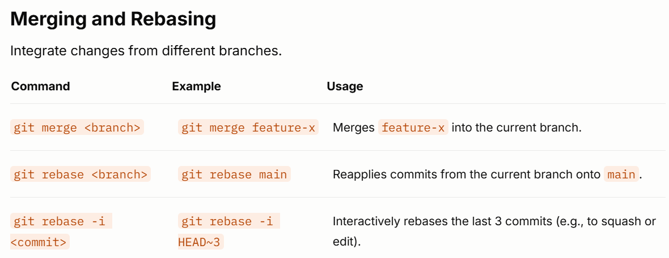

Slide 9
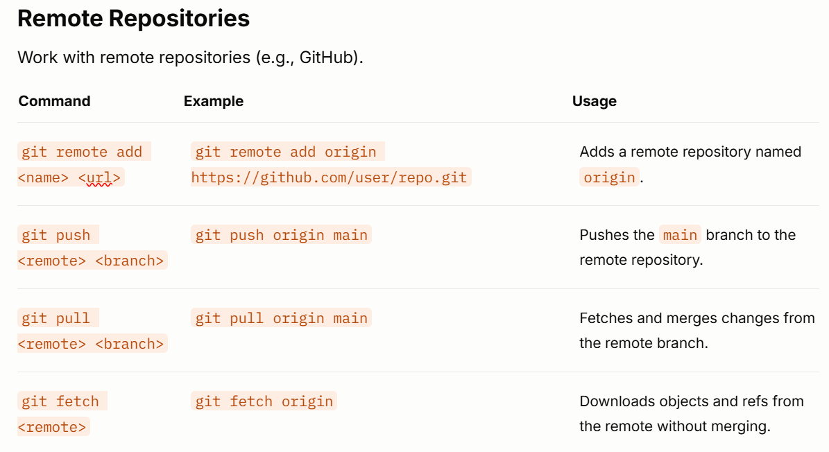

Slide 10
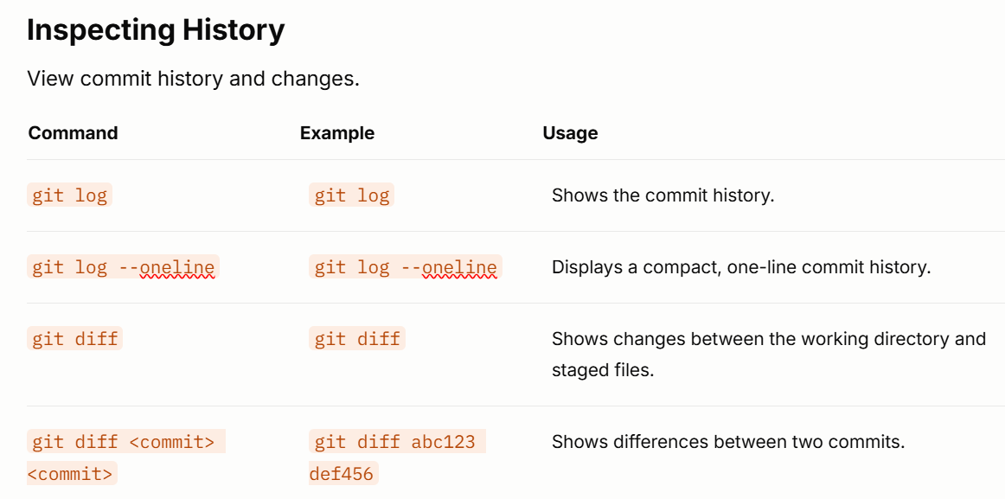

Slide 11
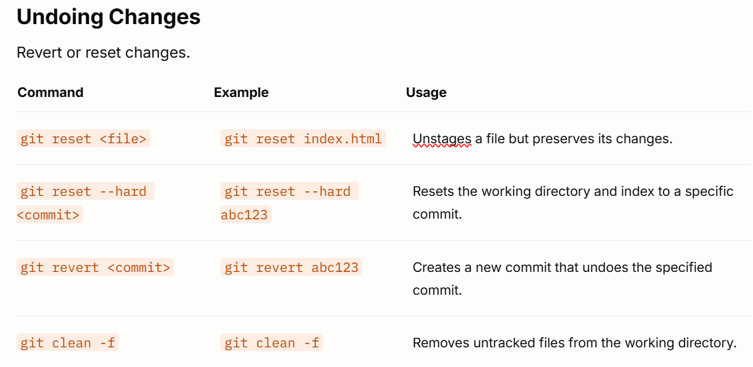

Slide 12
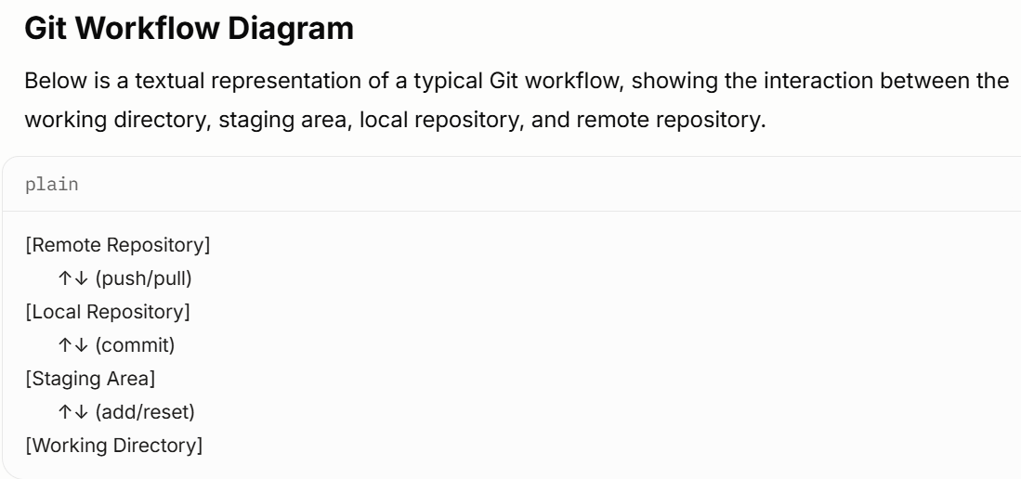

Slide 13
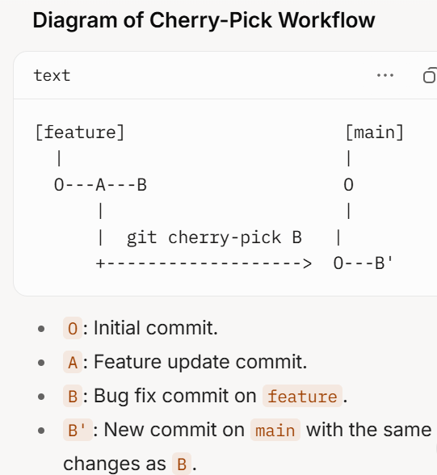
Git Cherry-Pick: Explanation and Usage
git cherry-pick is a Git command that allows you to apply a specific commit from one branch to another. It "picks" a single commit (or multiple commits) and applies its changes to the current branch, creating a new commit with the same changes but a different commit hash. This is useful when you want to incorporate specific changes from another branch without merging the entire branch.

Slide 14
Thank you very much!
PRESENTED BY PRASAD YADAV

