Slide 1



Project Title: Task Scheduler with Priority Management
Course Details: CSL2020,DSA,Suchetana Chakraborty
Mentor TA: Shreya Pandey
Team members:
Brundha Devi . A (B23CH1015)
Tirupathi Yashaswini (B23CI1039)
Aakarshana A (B23ME1002)
Vallimpula Niveditha (B23MT1044)

Slide 2
PROBLEM STATEMENT
📌 Problem Overview: Managing multiple tasks efficiently is a crucial skill in both professional and personal environments. With increasing workloads, tight deadlines, and varying priorities, individuals and teams often struggle to stay organized and meet their objectives on time. The problem becomes more complex when task urgency (due dates) and importance (priority) overlap.Our goal is to develop a Task Scheduler with Priority Management—a smart system that automatically organizes and ranks tasks based on urgency and importance, allowing users to focus on what matters most.
Domain / Use Case Mapping:
Domain: Personal and professional task management.
Use Case: Individuals, teams, and project managers with varying deadlines, priorities, and dependencies.
Scope of solution:
Priorities (1-10 scale).
Deadlines (due dates & work dates).
Dependencies (blocking tasks)
Time constraints (duration, start/end times).
Why Is It an Important Problem?
Stress & Burnout.
Business Impact.
Prevents missed deadlines (89% professionals struggle with this).
Optimizes daily productivity (saves ~4 hours/week).
Personal Goals.
Why Is It Challenging?
Task Dependencies.
Dynamic priorities (tasks change urgency).
Human biases (underestimating time,
overcommitting).
Time Constraints.
Why a Data-Driven Solution Looks Promising?
Objective Decision-Making
Efficient Time Allocation.
Scalability for Teams.
Conflict detection (avoids double-booking time)
Dependency tracking.
Adaptive scheduling (learns from past behavior).

Slide 3

current status
Research Links: https://github.com/Rutvik1711/Task-Scheduler
https://github.com/urvesh254/Daily-Task-Scheduler
EXISTING APPROACHES
LIMITATIONS
Stores tasks with descriptions, activities (1-4)
Add new tasks with
Complete highest task
View current highest task
View next task
Display all pending tasks.
Basic heap operations (shift Up, shift Down)
No due dates.
No dependency tracking between tasks.
Only considers time for scheduling.
No conflict detection for overlapping times.
Priority Queue.
No undo functionality.
Topological sorting .
No circular dependency detection.
Lack of Real-Time Adaptability.

Slide 4


COMPARATIVE ANALYSIS
Feature | Existing code | Our code
Priority System | Fixed 4 levels (Teaching = 4 to Administrative = 1) | Flexible 1–10 scale with conflict resolution
Time Management | None | Detailed time tracking with duration validation
Date Handling | None | Due dates with timezone support and countdowns
Conflict Detection | None | Time conflict detection and resolution
Undo Functionality | None | Has undo capability
User Interface | Basic text | Enhanced with emojis and visual feedback
Data Structure | Array-based max-heap | List-based min-heap with additional stacks
Task Editing | Not possible | Has edit capability

Slide 5

IDEA
Github link:
https://github.com/brundhaiitj/Task_Management.git
RESULT HIGHLIGHTS:
Core Features & Results:
Task Creation & Management
Priority-Based Scheduling
Dependency Handling
Conflict Resolution
Undo Functionality
User Interaction Highlights:
Smart Date/Time Handling
Priority Management
Task Visualization
IMPROVEMENTS:
Topological Sort (for Dependency Resolution)
Priority Queue/Min-Heap
Conflict Detection Algorithm
Multi-Criteria Sorting
Undo/Redo Mechanism
Circular Dependency Detection
Time Calculations

Slide 6
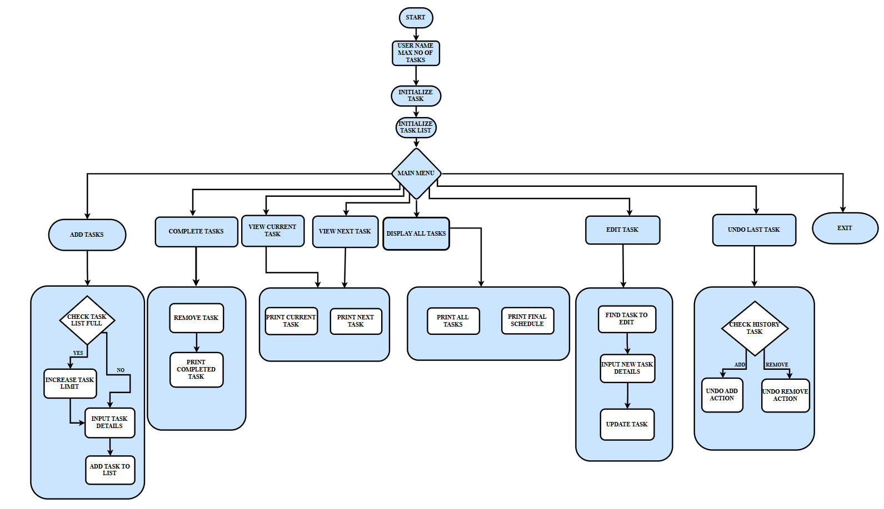
flow chart

Slide 7

TIME COMPLEXITY ANALYSIS
Component | Method | Time Complexity | Cost | Benefit
Task Class | input_task() | O(n) | Linear scans for dependencies | Simple, ensures correctness
 | check_circular_dependencies() | O(V + E) | DFS traversal overhead | Prevents deadlocks
 | print_task() | O(1) | Constant time | Instant Display
TaskList Class | add_task() | O(n + log n) | Conflict checks (O(n)) | Priority heap efficient
 | remove_task() | O(n + log n) | Dependency validation (O(n)) | Safe removal
 | get_sorted_tasks() | O(n log n + V + E) | Expensive sorting | Correct task order
 | print_tasks() | O(n) | None (pre-sorted) | Fast display
 | edit_task() | O(n) | Linear search | Simple
 | undo_last_action() | O(n + log n) | Search + heap insert | User-friendly
Main Program | User Loop | O(m × (n log n + e)) | m = user ops, n = tasks, e = dependencies | Always up-to-date
Final time complexity | Worst-case | O(m × (n log n + e)) | Quadratic for large n | Simple design

Slide 8
Conclusion
Priority-Based Scheduling is Essential
Dependency Management Requires Graph Algorithms
Time Conflict Handling is Critical
Undo/Redo Functionality
Enhances Usability
Robust Input Validation
Prevents Errors
Calendar Integration
Machine Learning for Auto-Prioritization
Team Collaboration
AI-Powered Suggestions
Mobile App + Notifications
Hybrid Sorting Algorithm.
Time-Aware Scheduling (for conflict-free planning).
User-Friendly Features (undo/redo, input validation).
Key Findings
Future Extensions
Innovation SummAry

Slide 9
INDIVIDUAL CONTRIBUTION
Brundha Devi . A
Priority
Add more task
Edit task option
Undo option
PPT
Created github
Niveditha
Time required
Flow chart
PPT
Time conflict
Date conflict
Aakarshana A
Date validity
Time validity
PPT
Flow chart
Cost Benefit
Yashaswini Tirupathi
Dependency
Final Sorted Schedule
Current Priority Task Option (scheduled)
PPT
Time complexity analysis

Slide 10


THANK YOU

