Slide 1
Prepping 1: Google Colab

Slide 2
Search for Google Colab on Google Create notebook and save on google drive or upload a notebook.ipynb into the Colab Notebooks folder in your Google drive For our course, upload the course folder into Google Colab folder in your Google drive
Make sure you have a Google account

Slide 3
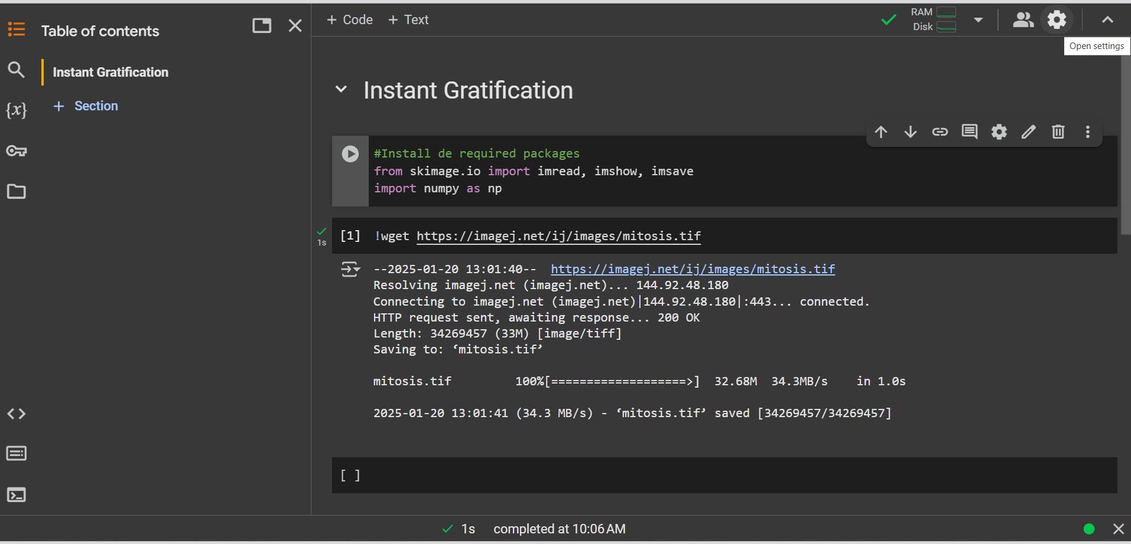
Getting started

Slide 4
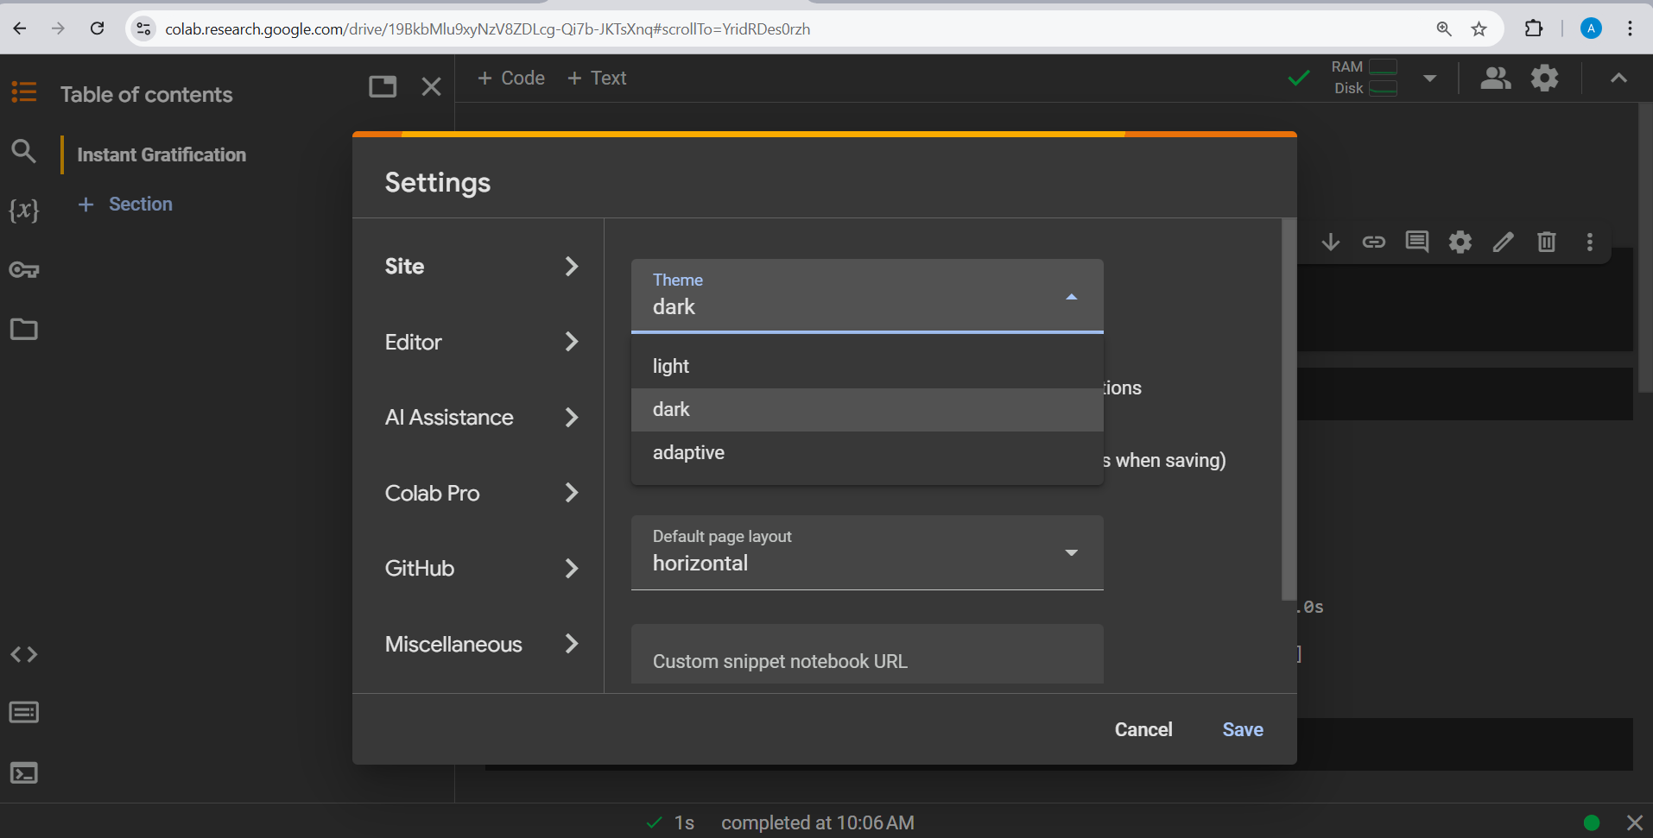

Change layout as desired. I like my theme dark!!

Slide 5
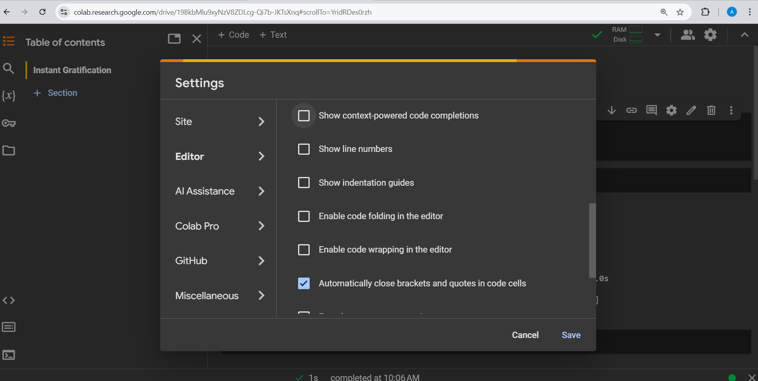
Uncheck show context-powered code completions and enter key suggestions

Slide 6
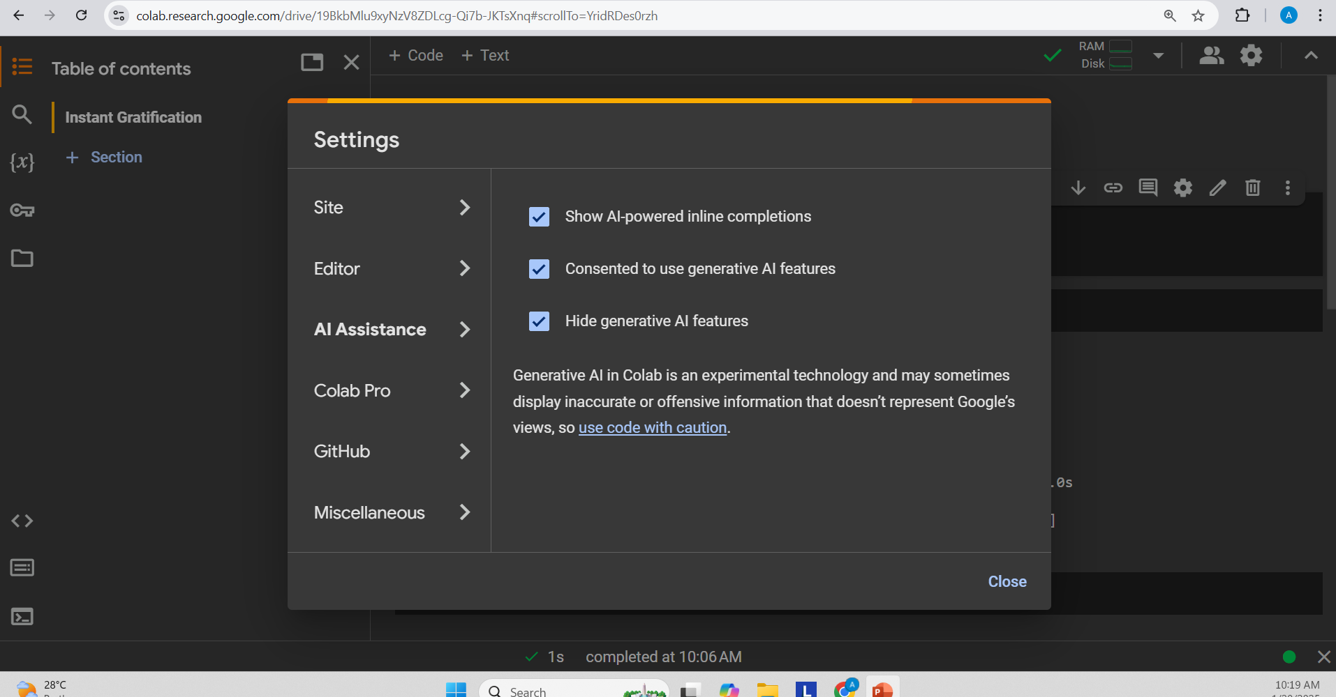
Check Hide generative AI features

Slide 7
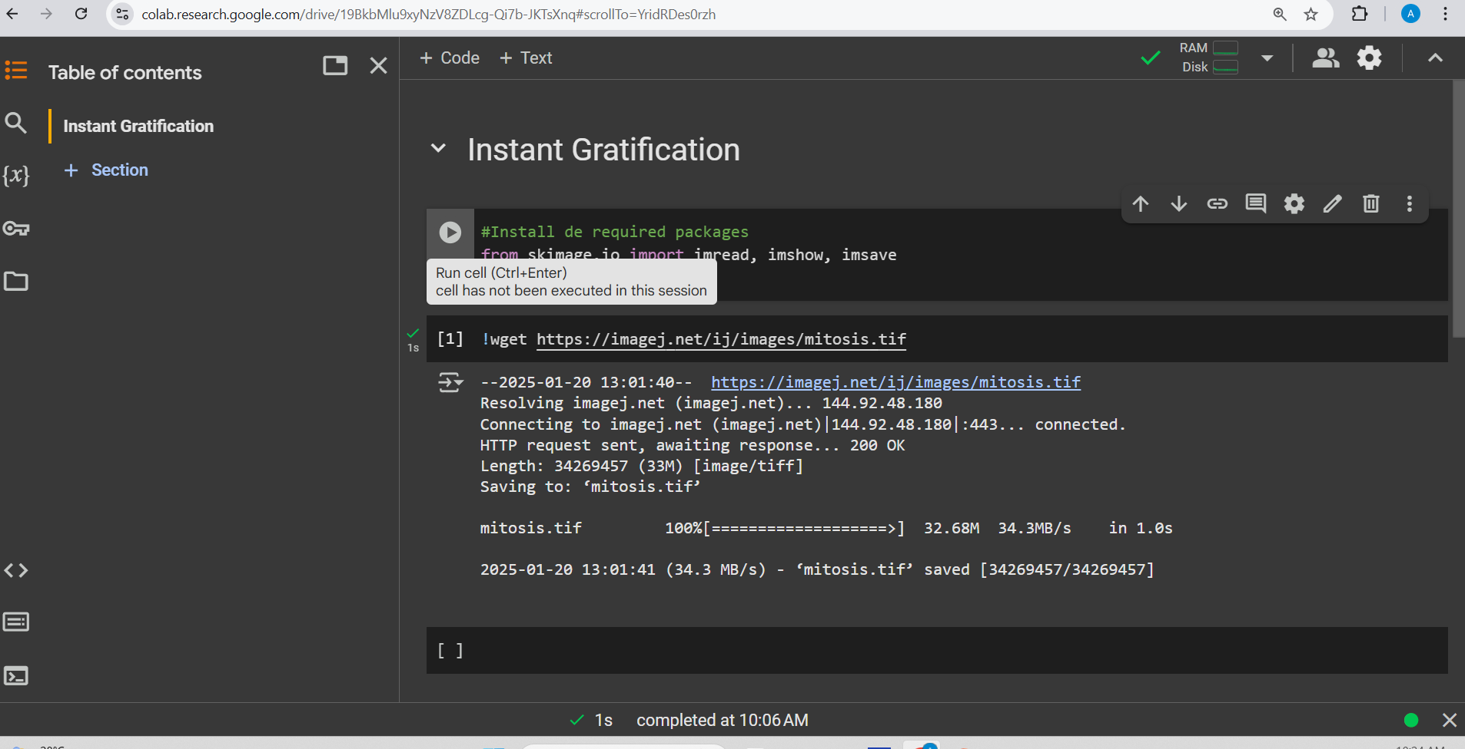
Ctrl + Shift executes the current cell and also create na cell below

Slide 8
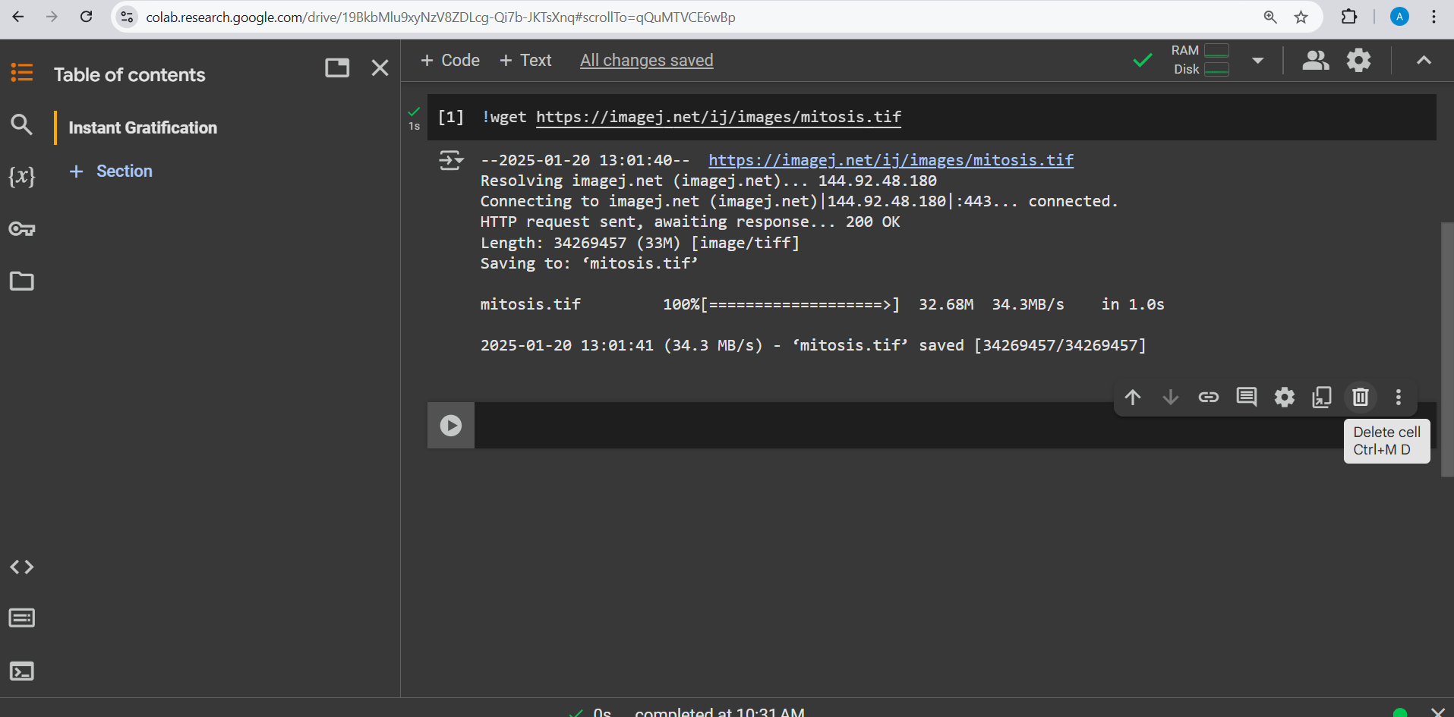
To delele a cell, click on the trash icon or type Ctrl+M +D with your cursor inside the cell

Slide 9
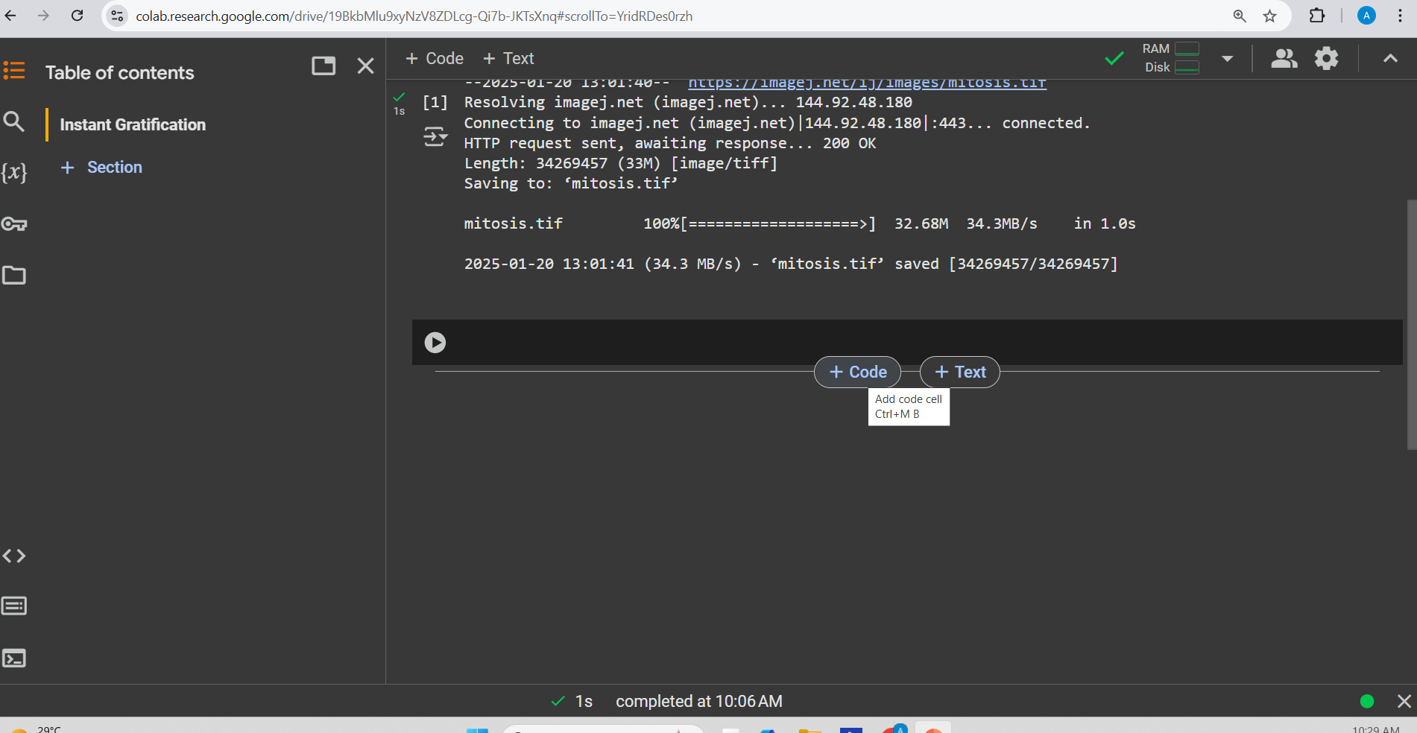
The boxes are called cell. To add one box click on + Code or + Text (if you want a markdown text). Or with your cursor just outside the cell (to the left) type A to create a cell above and B to create a cell below.

Slide 10
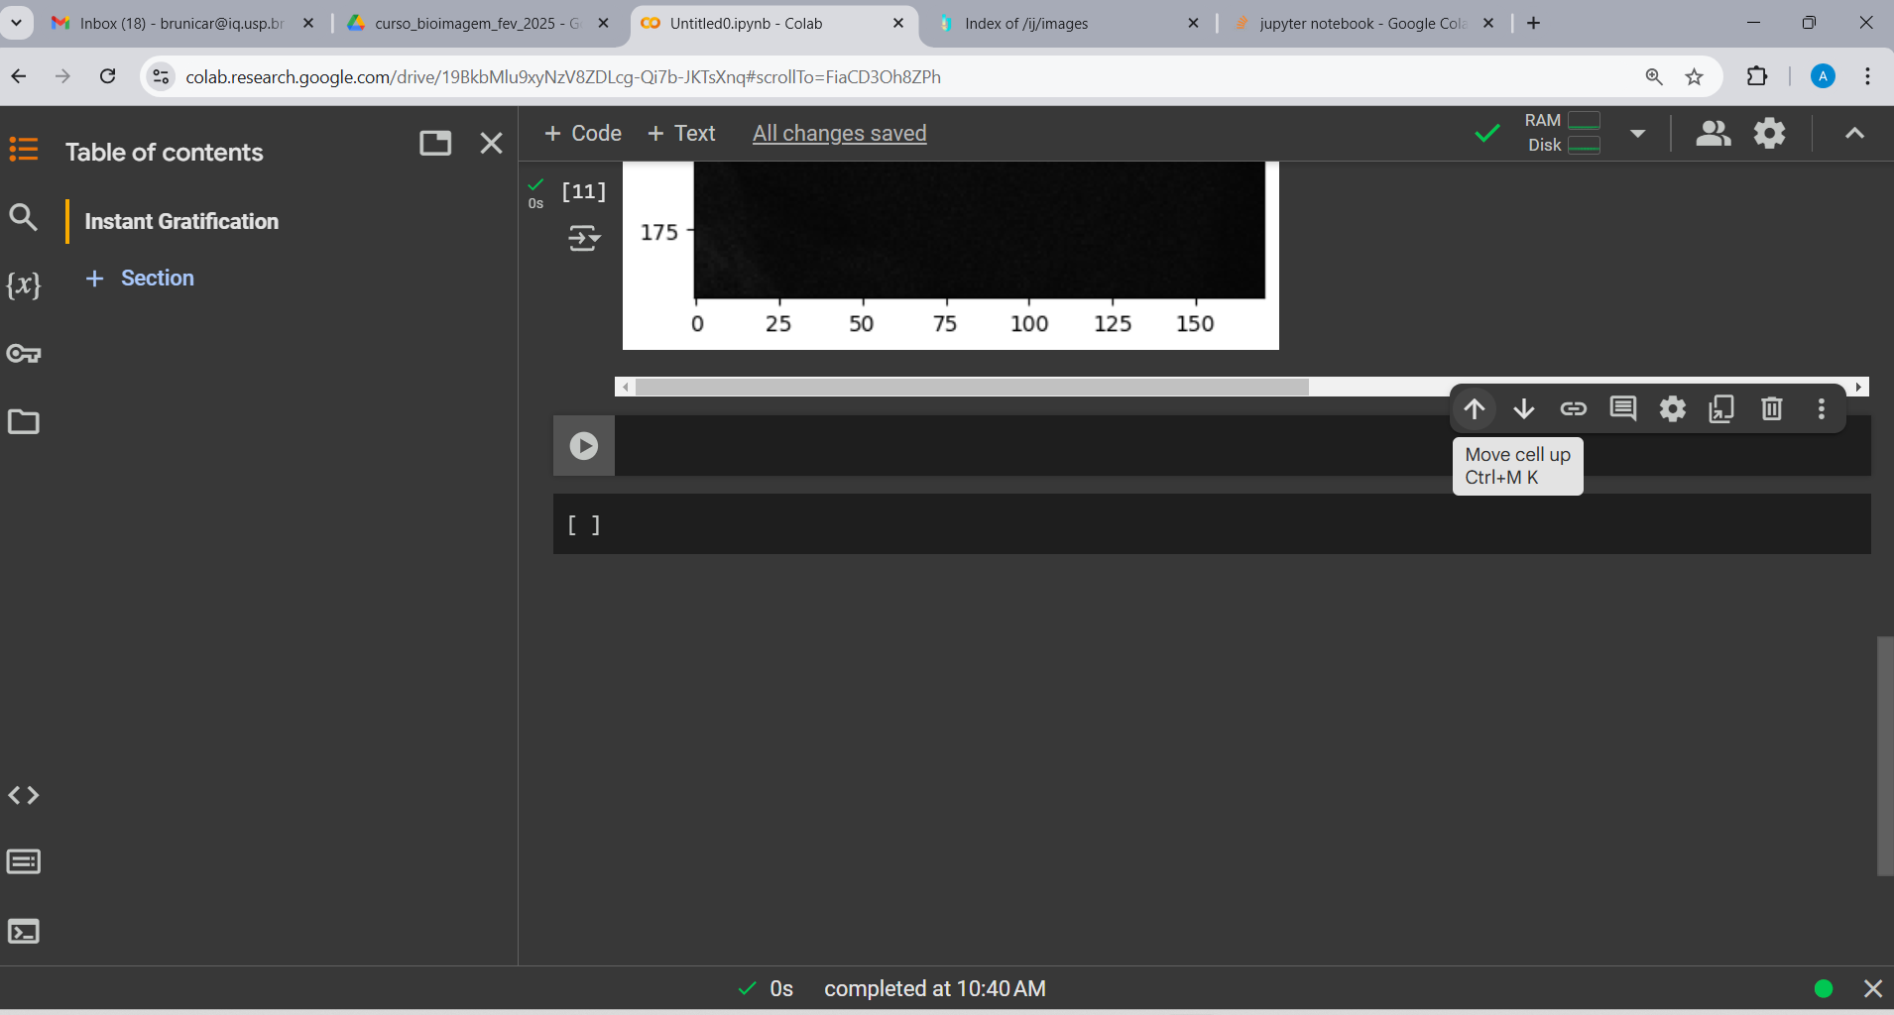
Use the arrows to move cell up or down

