Slide 1
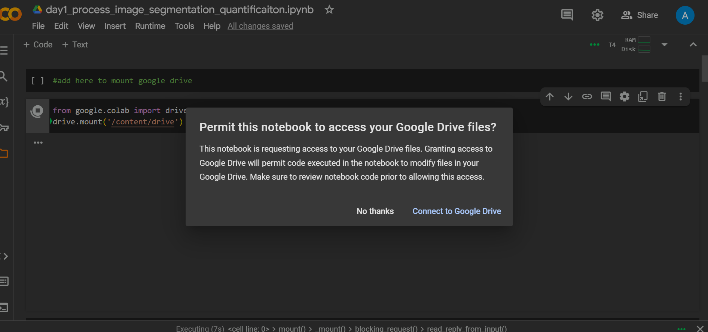
To allow Google Colab to access your Google Drive files

Slide 2
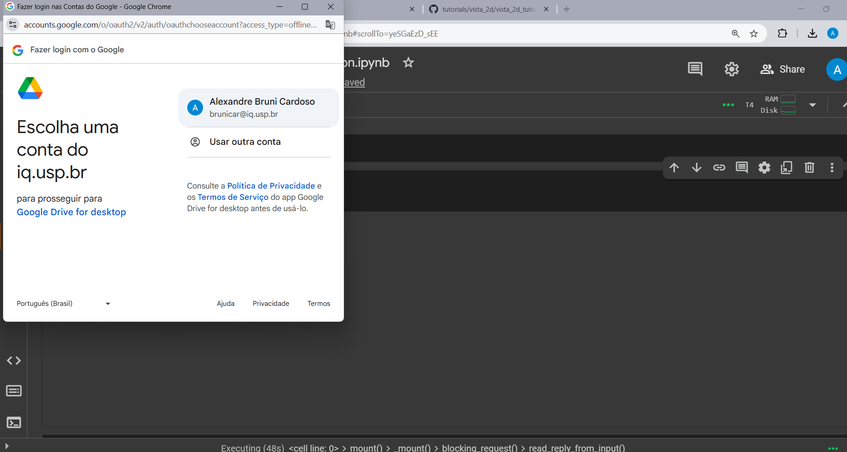
Choose your usp.br, iq.usp.br or google email account

Slide 3
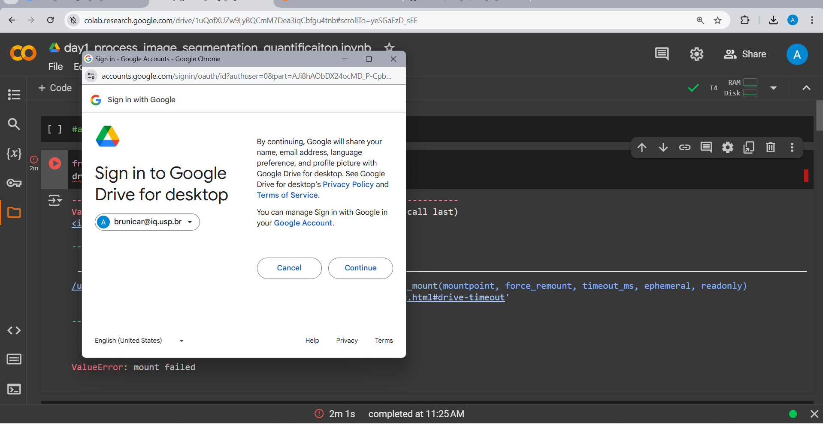
Press continue

Slide 4
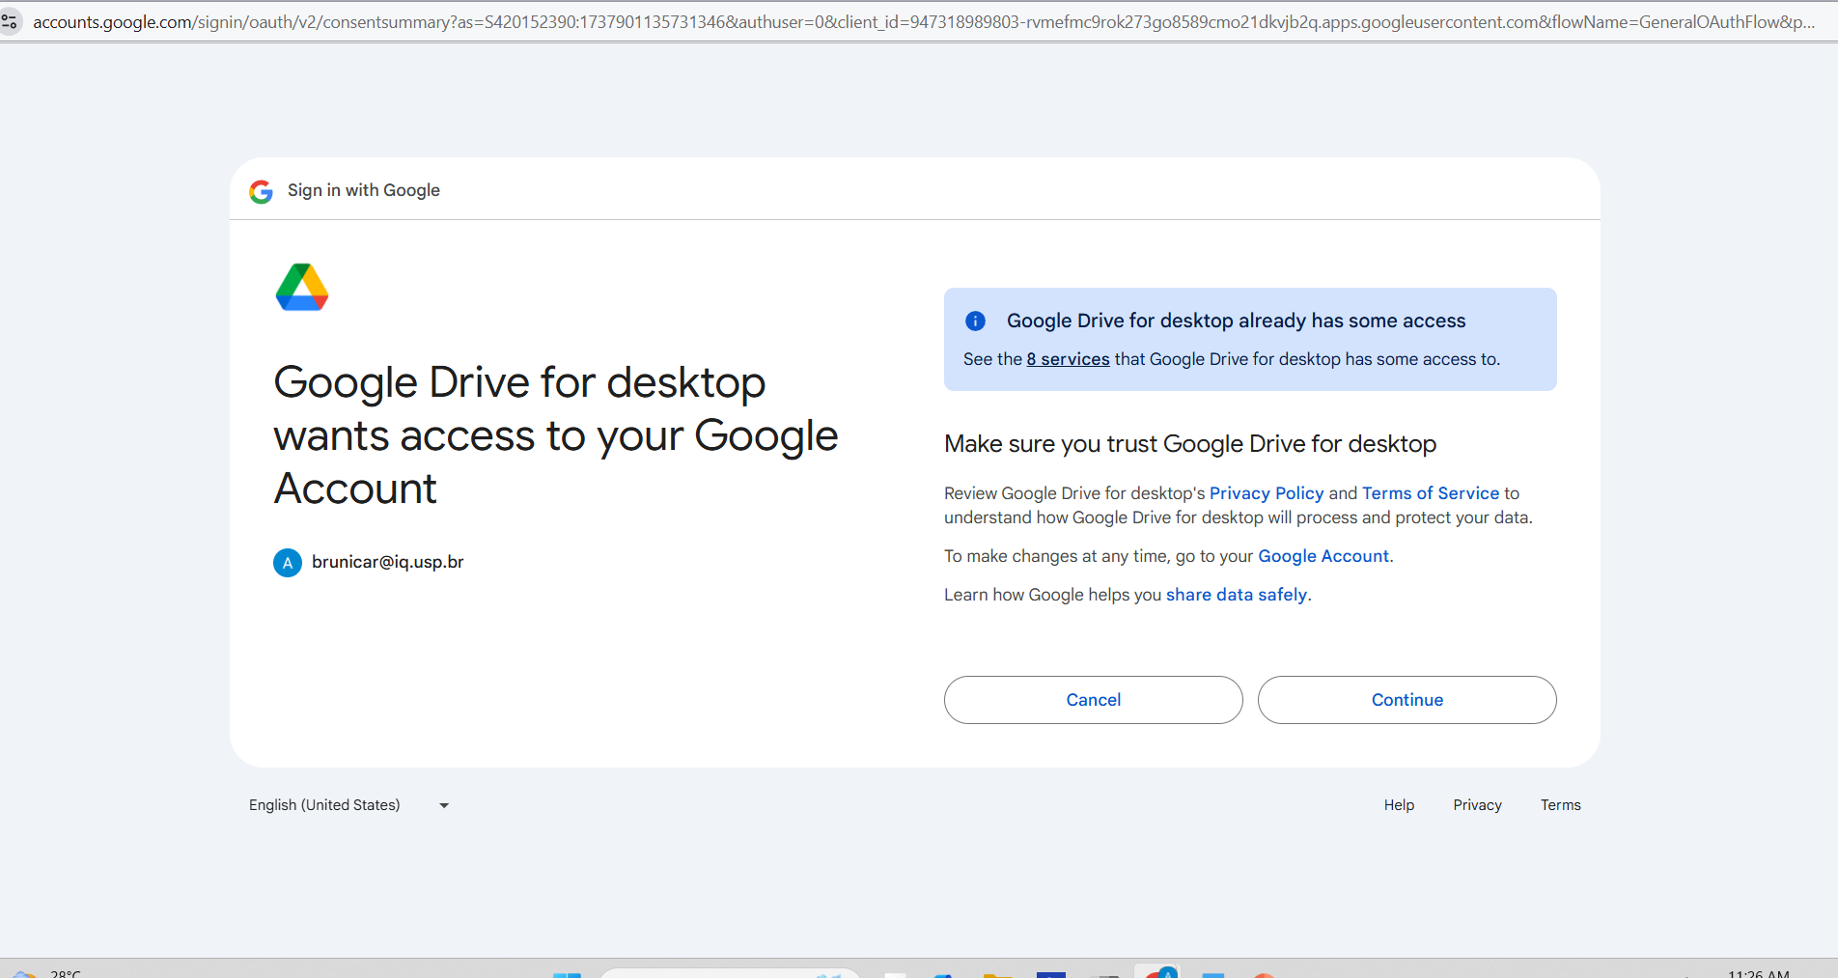
Press continue again

