Slide 1
Running Python locally
(Anaconda and environment management)

Slide 2
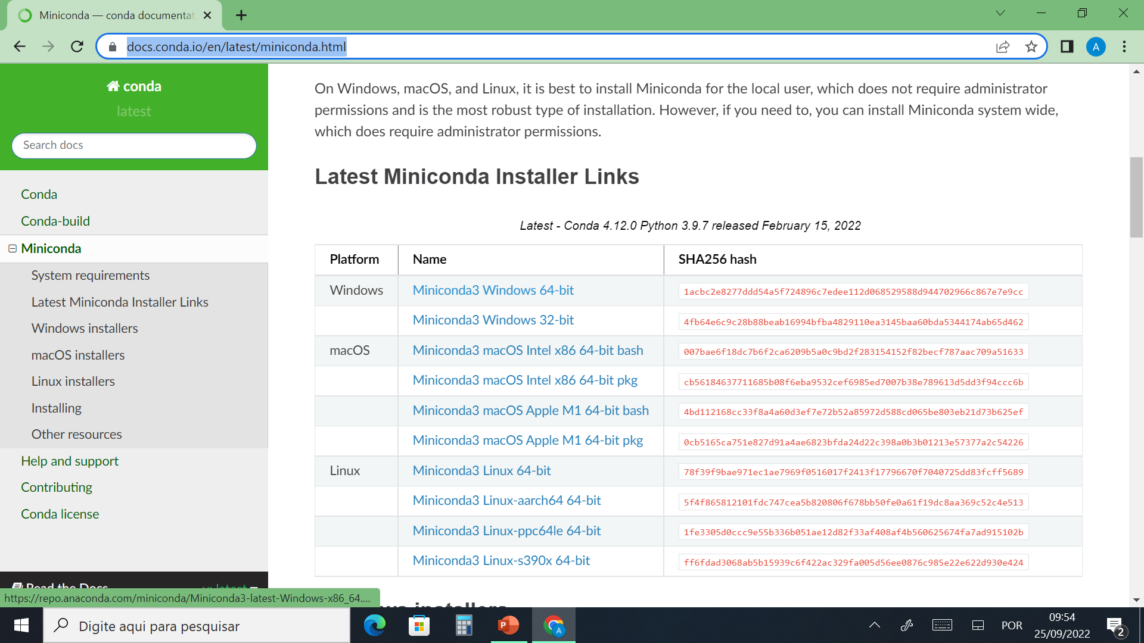
Installing Miniconda and Jupyter notebook
Installing miniconda
Anaconda or Miniconda helps you organize Python environment avoiding conflicts between package versions. Although Anaconda has a graphical interface, it is too large and frequently crashes. I recommend using Miniconda.
Before installing Miniconda, I recommend removing any Python versions that you have in your computer. If you are already using Python for a project, you could keep it, but you might have some glitches.
Download it from https://docs.conda.io/en/latest/miniconda.html
Choose a version that matches your OS (e.g. Windows, Mac or Linux).
Click on the .exe file to launch installation. Follow all instructions on the pop-up windows and use the recommended default options.
IMPORTANT: Install it in your user->yourname folder. Miniconda does not like spaces and accents in the folder name (e.g. andré silva). If that is your case, create a new user (e.g andresilva)

Slide 3
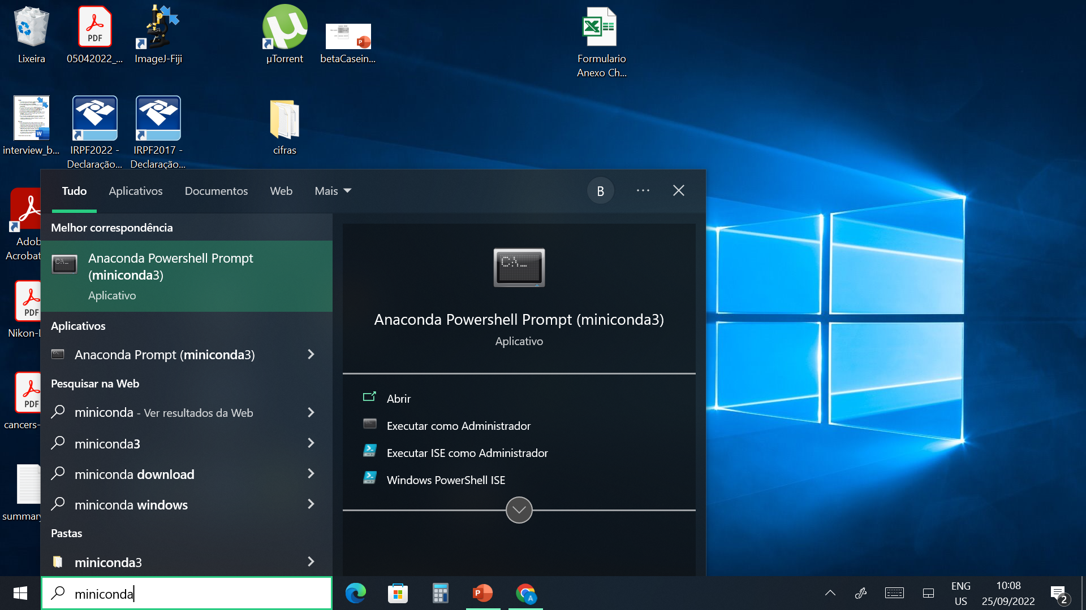
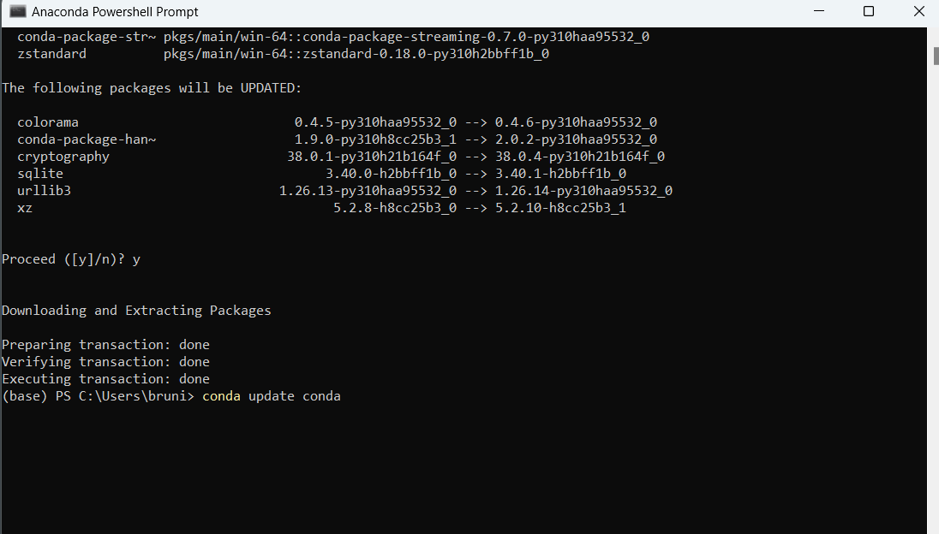
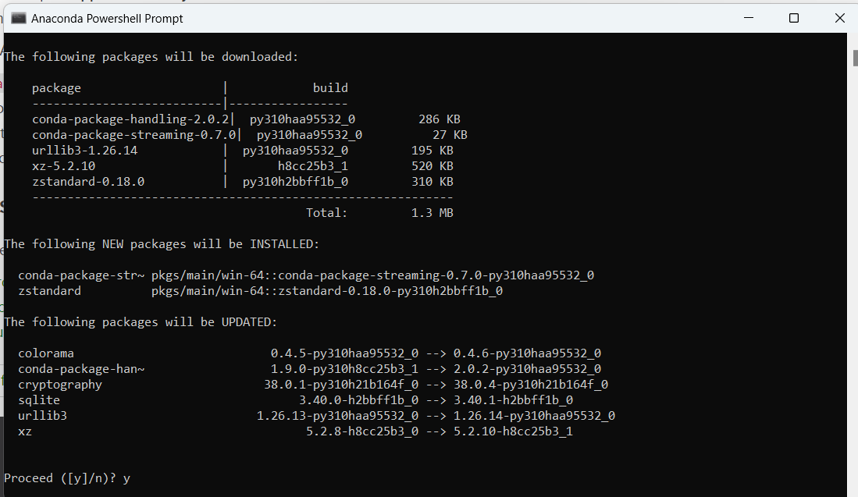
2. Create a conda environment named bioimage
For each project, it is recommended to create an environment to avoid conlficts between packages and to allow reproducibility.
Open the anaconda prompt or anaconda powershell prompt. There are many way to open the anaconda prompt. For Windows, one way is typing miniconda on the search field. For MacOS: Use Cmd+Space to open Spotlight Search and type “Navigator” to open the program.
It is good practice to keep conda updated. Type conda update conda and click enter (always click enter to execute a command line). Type y to proceed download.

Slide 4
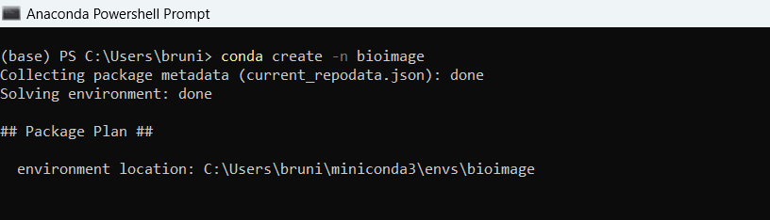
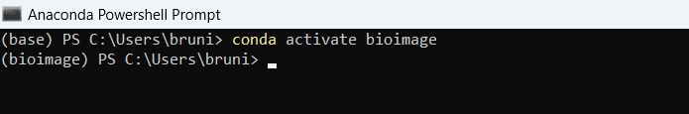
To create an environment named bioimage type conda create –n bioimage . Type y
In this link you will find a cheatsheet for all conda commands
https://docs.conda.io/projects/conda/en/4.6.0/_downloads/52a95608c49671267e40c689e0bc00ca/conda-cheatsheet.pdf
3. Activate the bioimage environment
To use a specific environment, you need to activate it. Type conda activate bioimage
(Note that the environment “(base)” (the default environment) has changed to “(bioimage)”. Do not install packages in the base environment.
4. You can either download packages via conda install or pip install commands. Check package documentation for recommendations of installation.
Pip https://pypi.org/ and conda https://anaconda.org/anaconda/repo host repositories of packages. Pip does not come with miniconda. Download pip by typing conda install pip

Slide 5
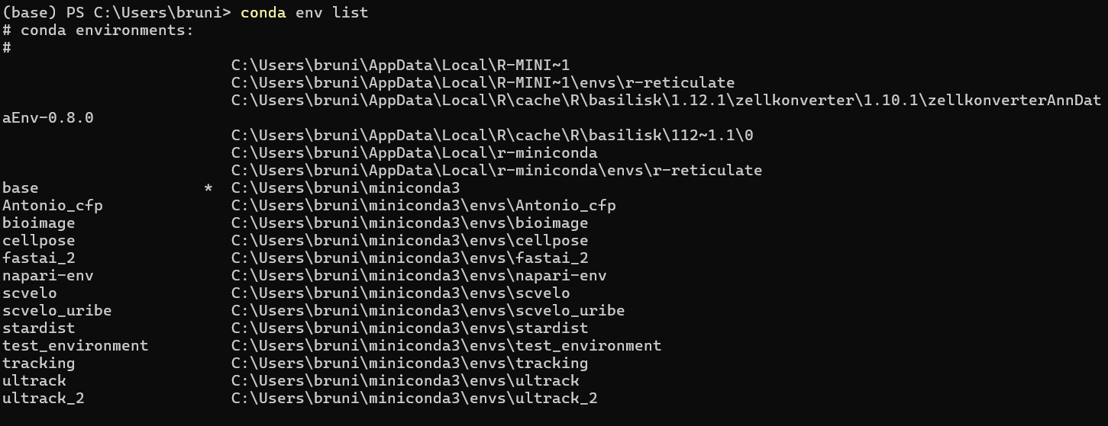
To deactivate an environment
If necessary, you can create a conda environment with a specific Python version. For example:
In the base environment, you can check for your environments by using the conda env list command

Slide 6
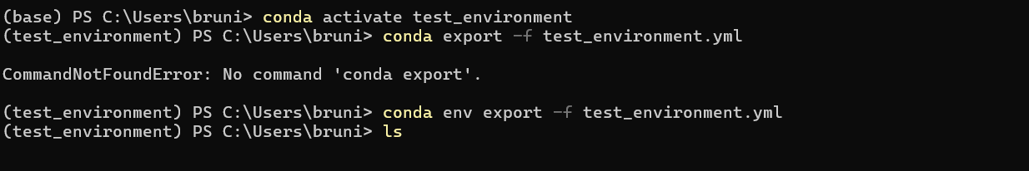
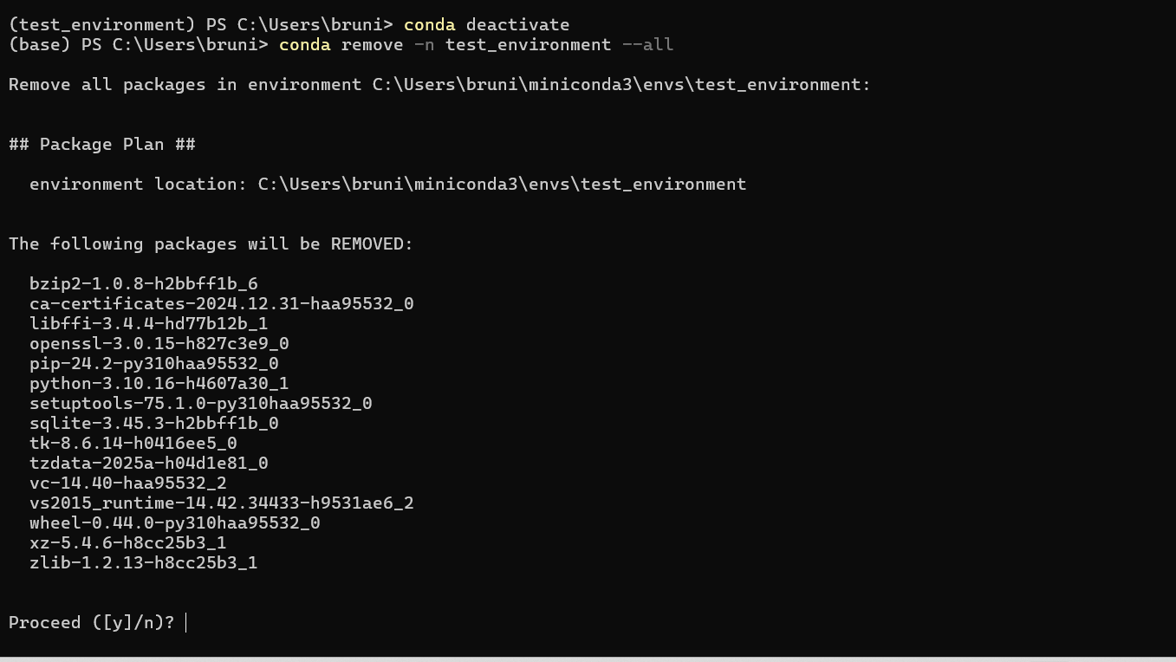
If you need to free storage space, but need to reproduce your environment later, save first a .yml file (a text file containing all the information of packages in your environment) and then remove the environment from miniconda.
1. Activate the environment you want to obtain the .yml file and export the file executing the command below
2. Run the ls command to confirm that your test_environment.yml file is there
3. To remove the environment, first deactivate environment and make sure you are on the base environment and execute conda remove –n environment_name --all as below. Press y to confirm.
4. Run conda env list to confirm the environment was removed

Slide 7
Create an environment from a .yml file
Make sure the .yml file is in the active folder and run the command below (remember to replace test_environment.yml by your actual file name.

Slide 8
Now we are going to create a comprehensive Bioimage Analyst environment

Slide 9

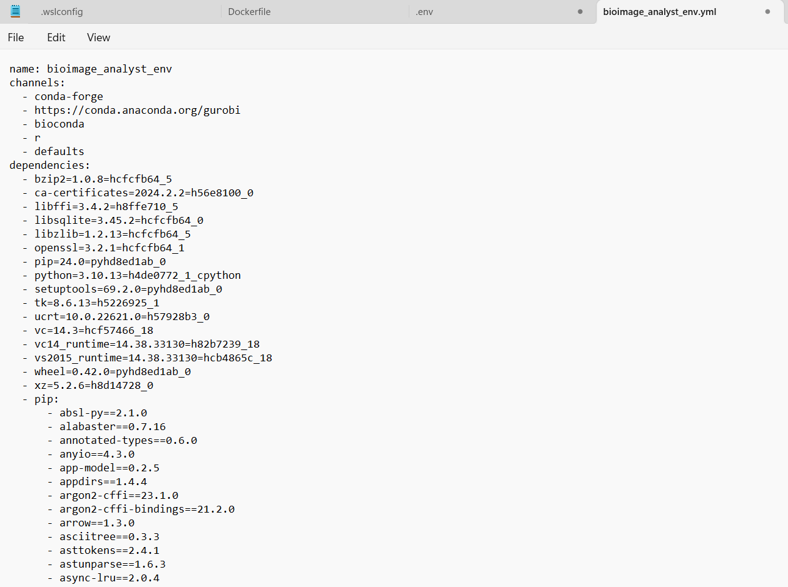
Add the file bioimage_analyst_env.yml in the same folder that you installed miniconda. (If you add it in a diffent folder, you will need to point conda to that folder path)
Open the file using the app Notepad
3. Finally, create environment from the bioimage_analyst_env.yml file
4. Activate bioimage_analyst_env

Slide 10
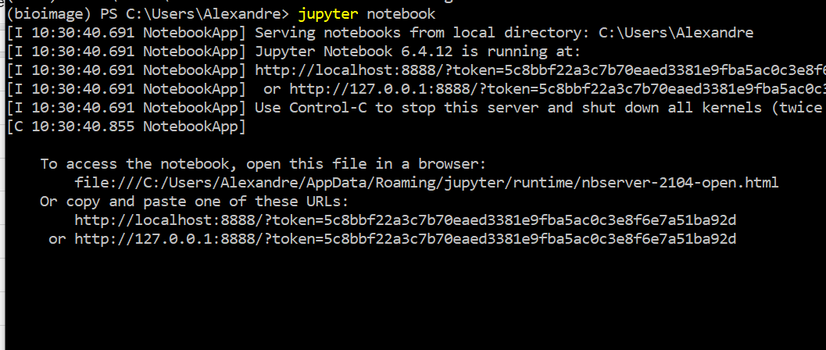
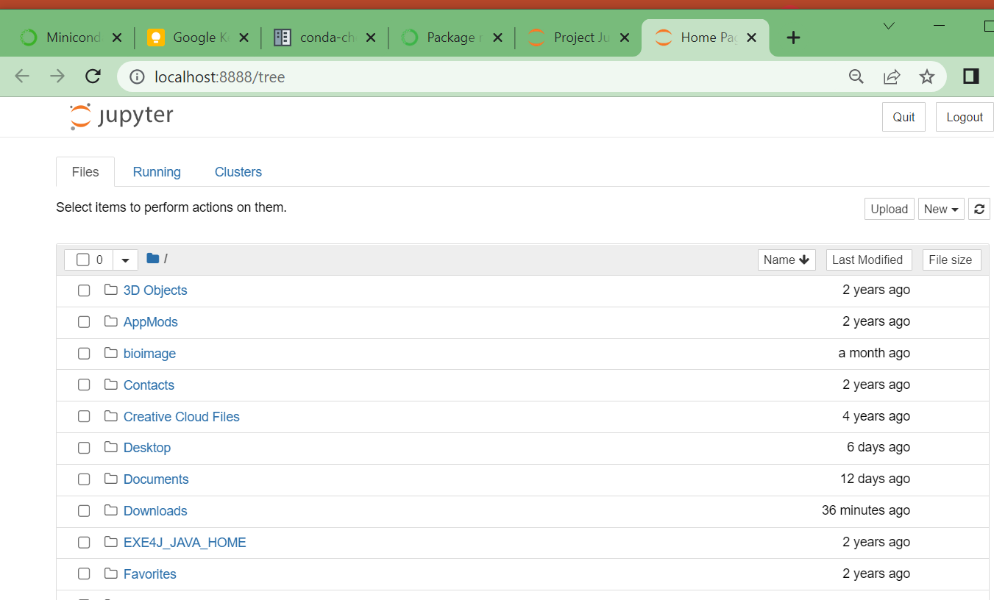
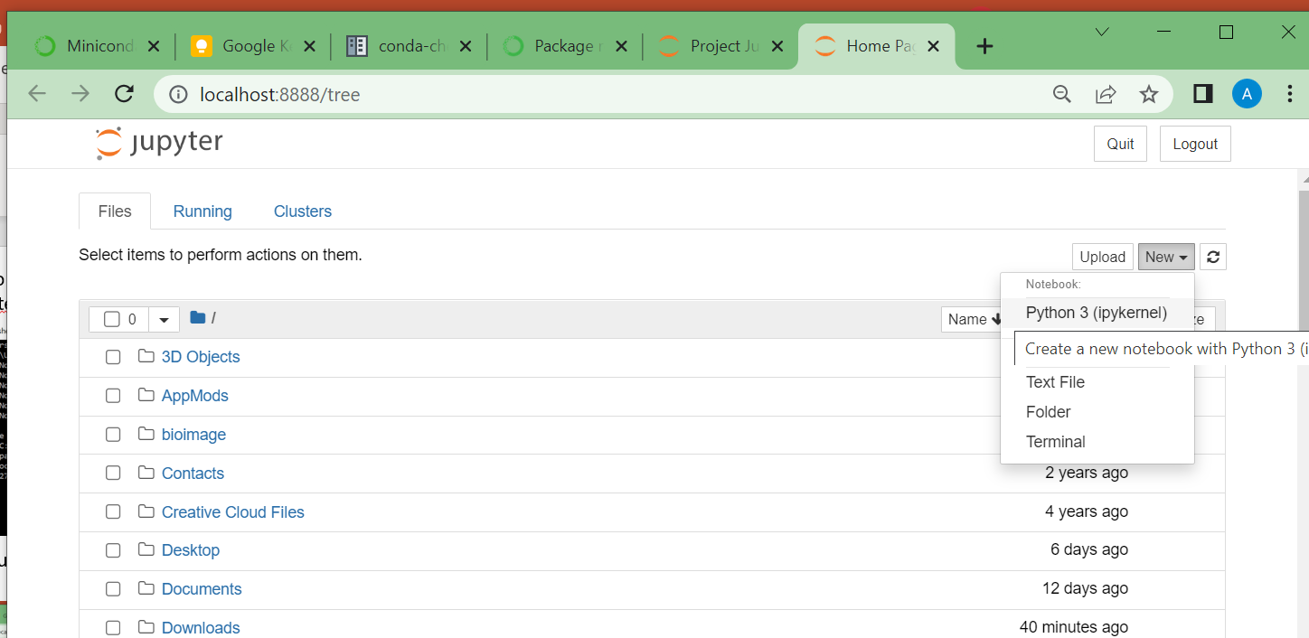
5. Jupyter notebook (https://jupyter.org/ )
There are many ways to work with Python. I found Jupyter notebooks the easiest way for biologists. Also, it is great to organize your analysis workflow (from image to plot) in a single document and for reproducibility of your analysis
To open a notebook, type Jupyter notebook on the prompt. You can also use the more complete interface Jupyter lab by executing jupyter lab with or environment active
*The window below (bottom left) will automatically appear on your screen. If that does not happen, copy and paste the link that appears on the prompt.
Click on new and on Python 3 (pykernel)

Slide 11
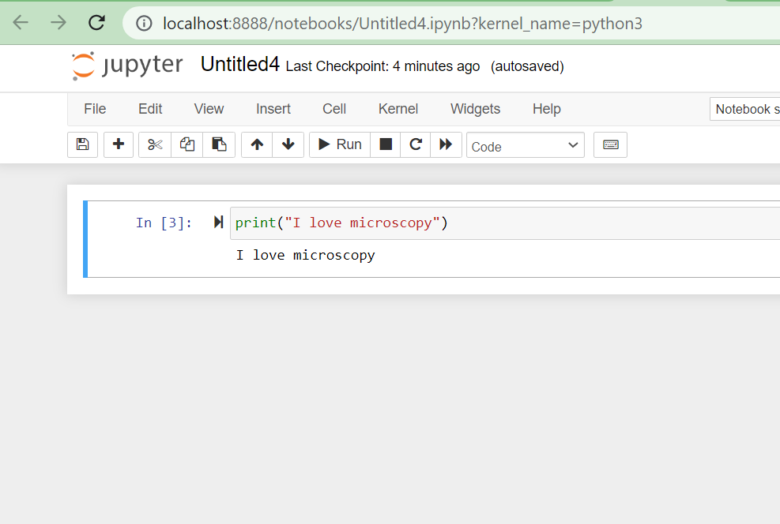
6. Execute your first Python program and feel the power flowing through your veins ☺
Type print(“I love microscopy”) and shift+enter or click on the play button indicated below. Try typing I love microscpy within single quotation marks (‘I love microscopy’) or without one or any quotation marks. What happens?

