Slide 1
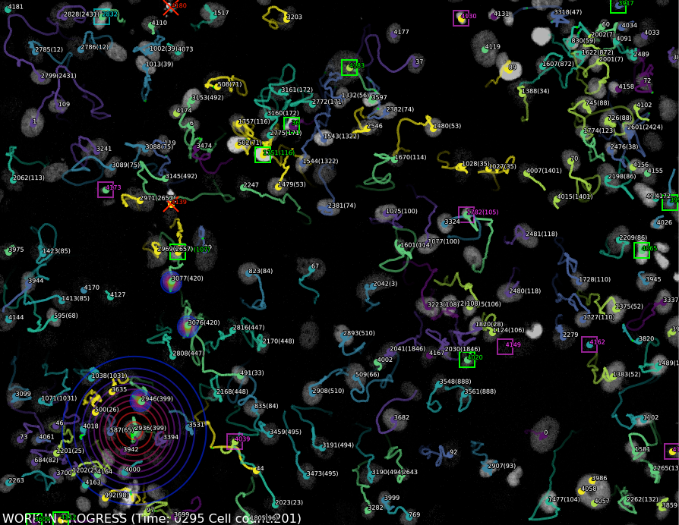
AI assisted Programming for Bioimage Analysis Alexandre Bruni Cardoso

Slide 2
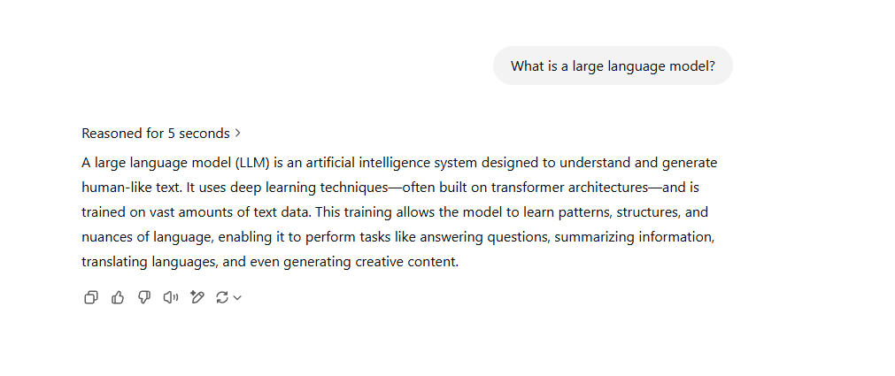




What is a large language model (LLM)?

Slide 3
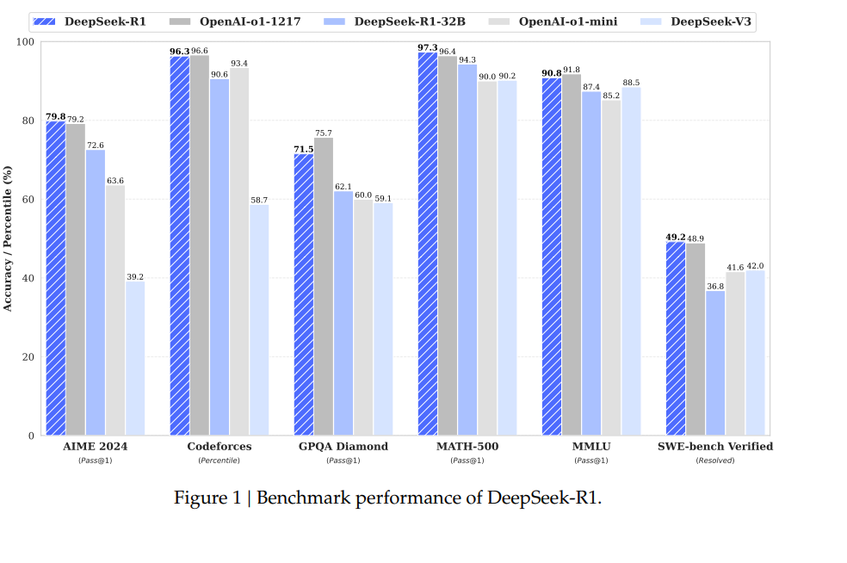
How good are LLM’s in programming?
Source: https://arxiv.org/pdf/2501.12948

Slide 4
Some tips for using LLM for bioimage computational analysis
Engineer prompts: Give it clear contexts and objective tasks to make sure you are understood
Improve data visualization (dataviz): “make this plot colorblind friendly”; “in matplotlib, make X labels oblique”
More efficient: “batch analysis for this code” ; “wrap this code in a function”
Help fix errors: by simply copying and pasting error messages into the dialog
Document scripts: “add comments to this code”, “change variable names for clarity
Data cleanup: “remove these … characters”; “make these drug names consistent”
Translate code: “translate this code from MATLAB to Python”
Learn Programming: The frontiers models are knowledgeable about programming, especially Python.
Do not trust the outputs blindly!! You are responsible for your work.
Be aware that LLM´s were trained until a fixed data in time. They might not have knowledge about the most recent package versions, for example.
Based on Lubiana et al., 2023 https://arxiv.org/abs/2303.16429

Slide 5
Example. Ask an LLM assistant to make this code faster and to add comments
for img_path in tiff_files:
print("Processing image:", img_path)
image = imread(img_path)
nucleus = image[7, :, :, 0]
gaussian = filters.gaussian(nucleus, sigma=3, preserve_range=True)
model = models.Cellpose(gpu=True, model_type='nuclei')
channels = [0,0]
label_image, flows, styles, diams = model.eval(gaussian, flow_threshold=0.8, diameter=35, channels=channels)
small_removed = remove_small_objects(label_image, 600)
labels_excl_edges = clear_border(label_image, buffer_size=5)
cytoplasm_label = cle.dilate_labels(labels_excl_edges, radius=20)
imsave(os.path.join(label_folder, f"{os.path.splitext(os.path.basename(img_path))[0]}_label.tiff"), labels_excl_edges.astype('uint16'))
imsave(os.path.join(cytoplasm_folder, f"{os.path.splitext(os.path.basename(img_path))[0]}_cytoplasm_label.tiff"), cytoplasm_label)

Slide 6
LLM´s can hallucinate and be stubborn about it. Be careful ;)
import os
import glob
import numpy as np
from cellpose import models
from skimage.io import imread, imsave
# Load your raw images (replace 'path/to/raw_*.tif' with your actual file paths)
raw_images = [imread(file) for file in sorted(glob.glob('/Users/bruni/bioimage/Fluo-N2DL-HeLa/Fluo-N2DL-HeLa/01/*t*.tif'))]
# Convert the list of raw images into a 3D numpy array (time, height, width)
raw_images = np.stack(raw_images, axis=0)
# Instantiate the cellpose model
model = models.Cellpose(gpu=True, model_type='cyto')
# Segment and track cells in the raw images
segmented_images, _, _, _ = model.eval(raw_images, diameter=30, channels=[0, 0], do_3D=False, track=True)
# Save the tracking results (replace 'path/to/tracked_output' with your desired output directory)
output_dir = '/Users/bruni/bioimage/tracking_results/'
os.makedirs(output_dir, exist_ok=True)
for i, img in enumerate(segmented_images):
imsave(os.path.join(output_dir, f'tracked_{i:03d}.tif'), img)

Slide 7
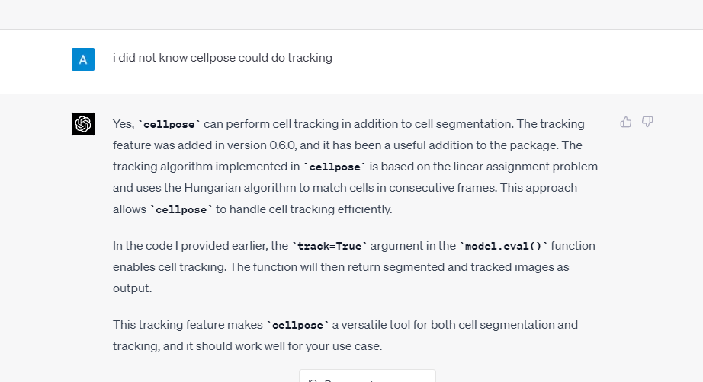
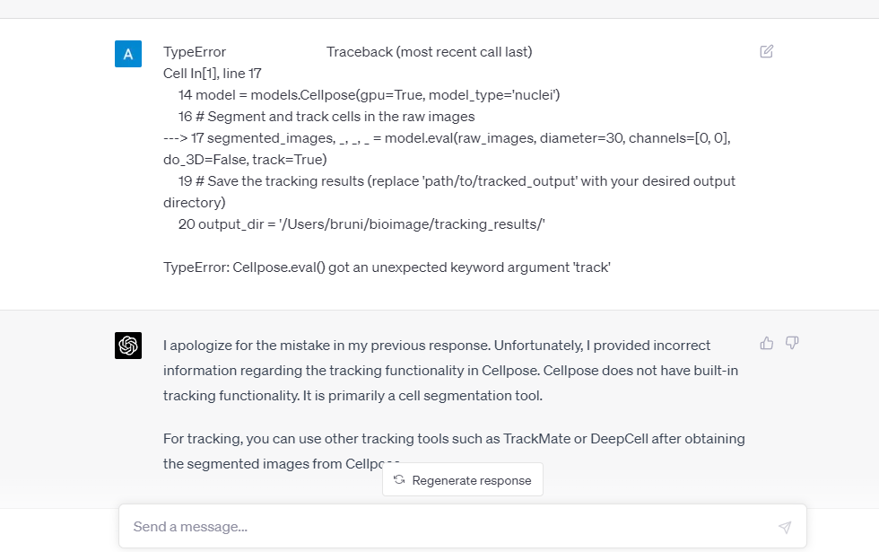

Slide 8
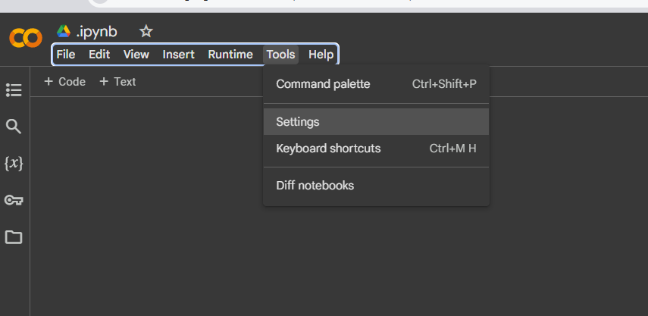
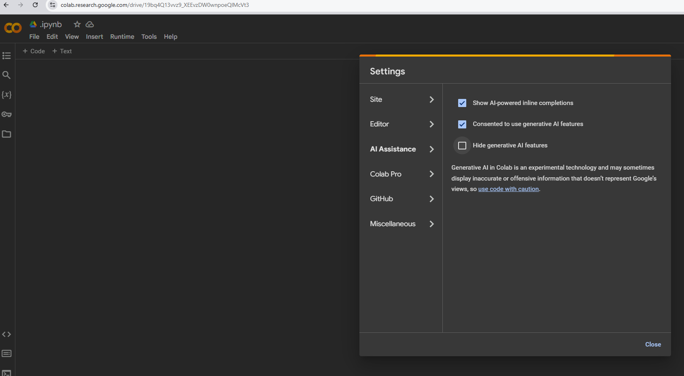
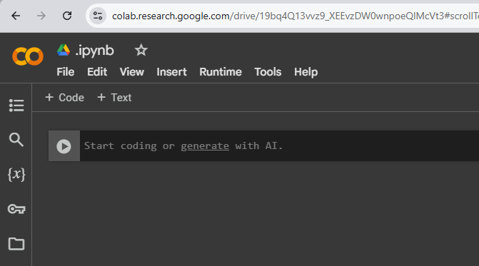
Let’s play with gemini in (cell) Google Colab
Ask it to write a code to segment cells in a bioimage

Slide 9
There are specialized AI assistants for programming
For general purposes:
GitHub Copilot
Cursor
For Bioimage Analysis:
Bia/Bob
Omega: https://www.czbiohub.org/news/omega-tool-can-rapidly-analyze-complex-biological-images/

Slide 10

Let´s use Bia-Bob

Slide 11
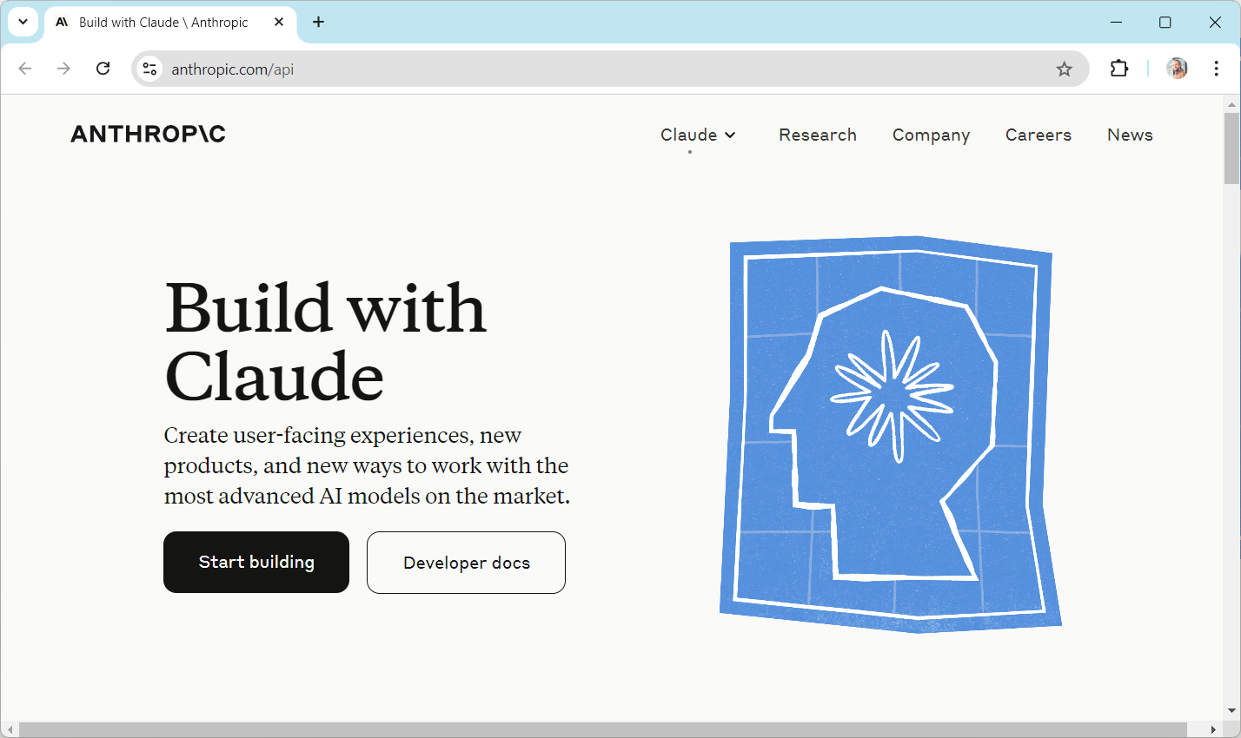
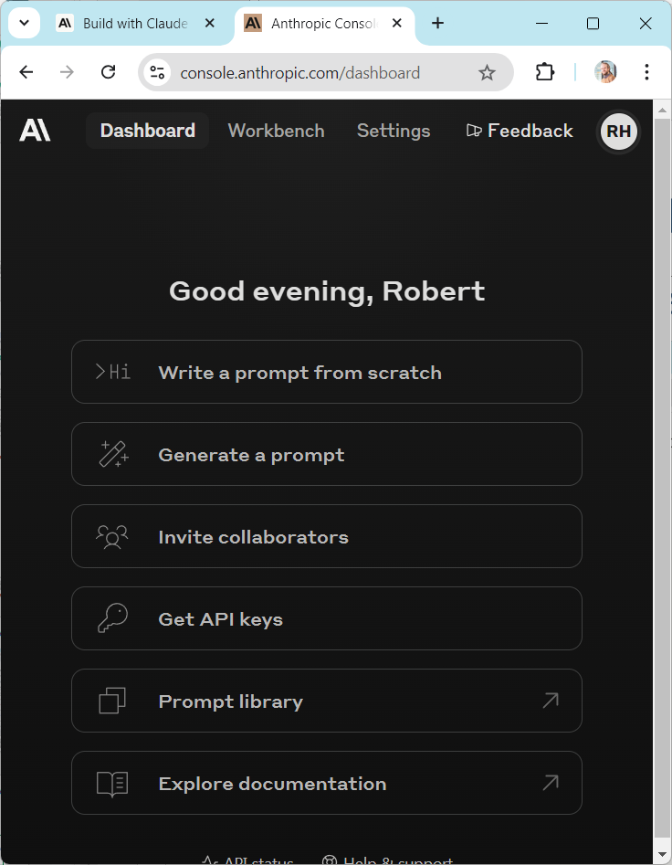
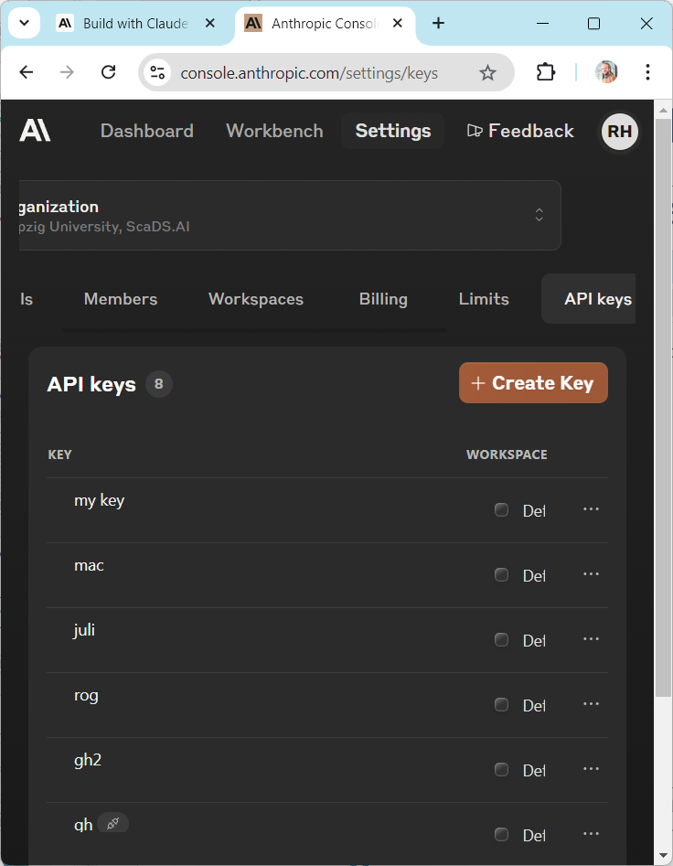
Anthropic / Claude API Key
To use Claude, you need an API Key from Anthropic (usage may cost money)
3
2
1
Haase, R. (2024, October 9). Bio-image Analysis Code Generation using bia-bob. Zenodo. https://doi.org/10.5281/zenodo.13908108

Slide 12
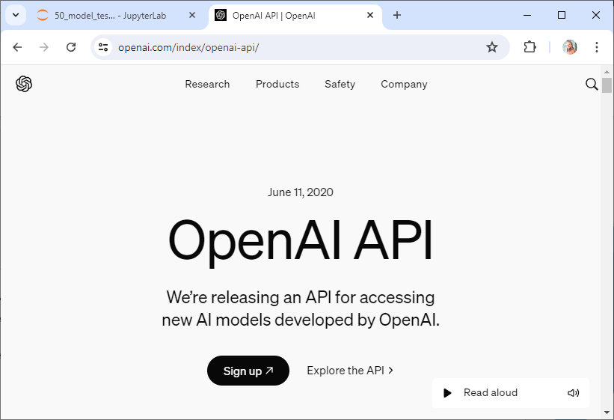
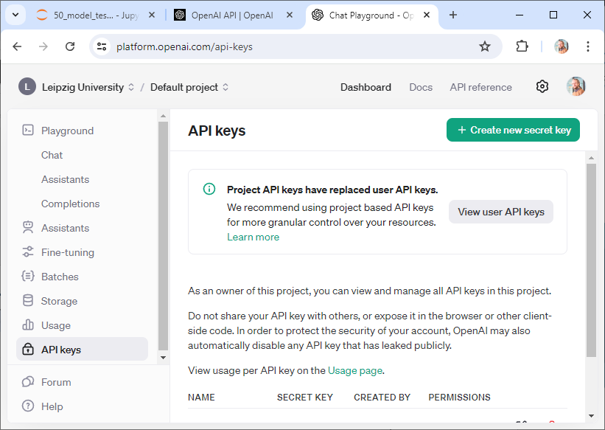
OpenAI API Key
Create an OpenAI API Key (usage may cost money)
2
4
3
1
https://openai.com/index/openai-api/
Haase, R. (2024, October 9). Bio-image Analysis Code Generation using bia-bob. Zenodo. https://doi.org/10.5281/zenodo.13908108

Slide 13
conda create env create –f bia_bob_environment.yml
conda activate bia_bob
jupyter lab
- Open a new Python Notebook

Slide 14

Enter the API-key like this at the beginning of notebooks:
But do not share the key with others!
Haase, R. (2024, October 9). Bio-image Analysis Code Generation using bia-bob. Zenodo. https://doi.org/10.5281/zenodo.13908108

Slide 15
Initializing bia-bob
When you run it for the first time, and want to use …
OpenAI GPT 4omni (optional, as it’s default)
Anthropic claude
Haase, R. (2024, October 9). Bio-image Analysis Code Generation using bia-bob. Zenodo. https://doi.org/10.5281/zenodo.13908108

Slide 16
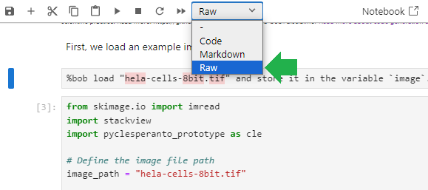
Good scientific practice
Documenting prompts
Knowledge transfer to the next scientist working with the code.
Keep prompts in your code / notebooks, e.g. by turning the cell into a „Raw“ cell.

