Slide 1
Your journey in computational bioimage analysis just got started

Slide 2
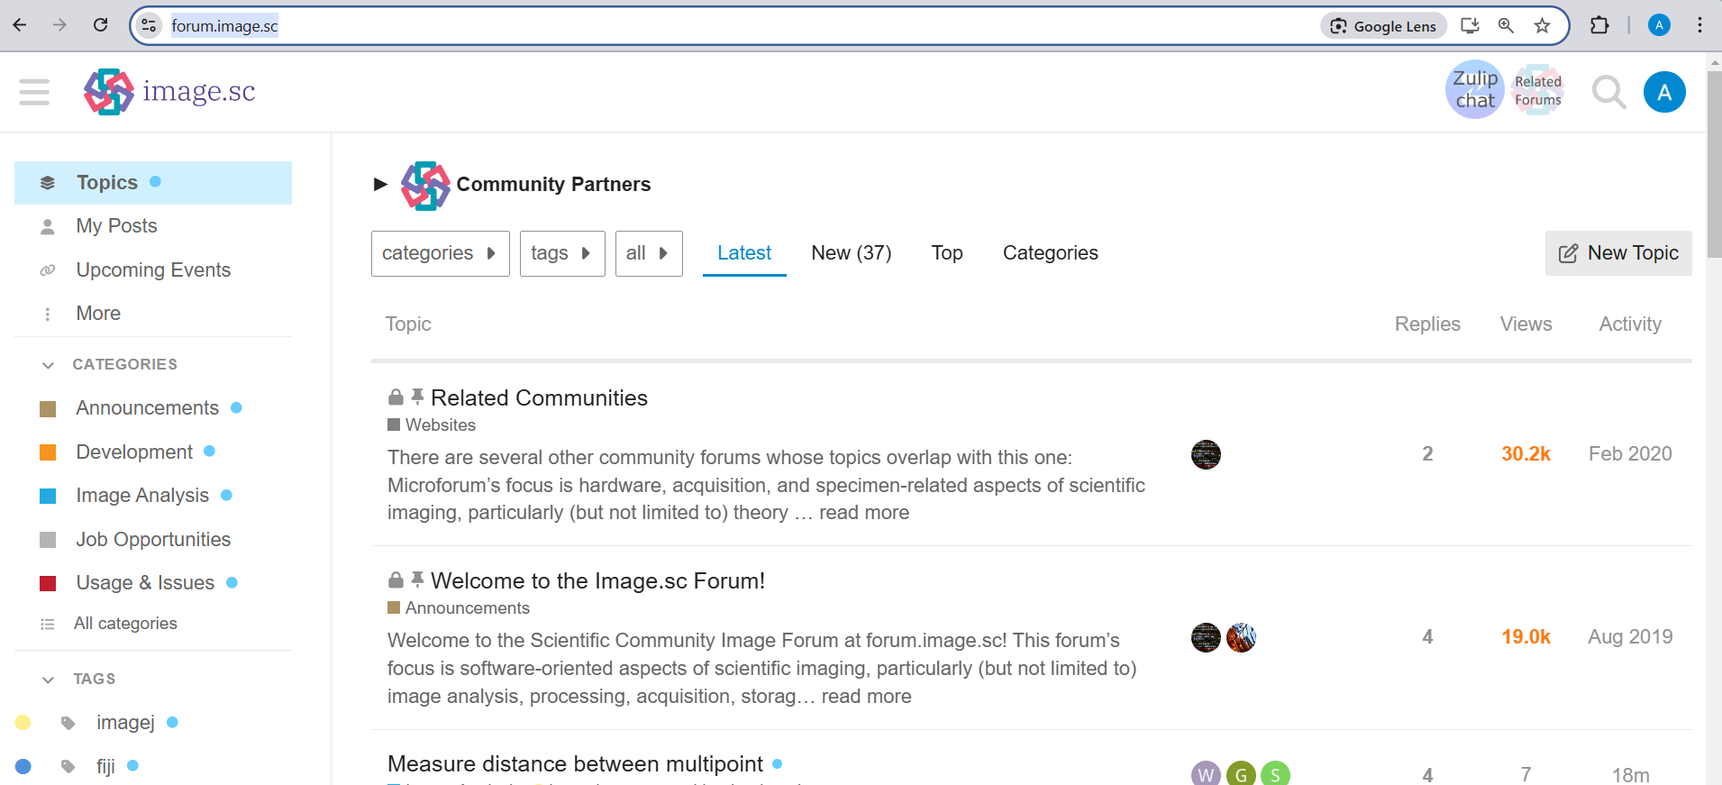

Slide 3
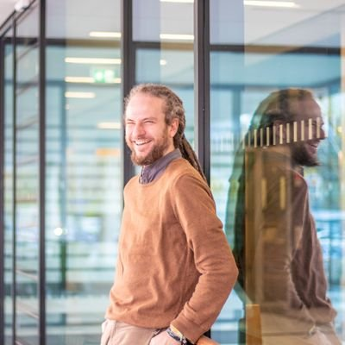
https://bioimagebook.github.io/index.html
Pete Bankhead
https://haesleinhuepf.github.io/BioImageAnalysisNotebooks/intro.html
Robert Haase
https://github.com/haesleinhuepf

Slide 4

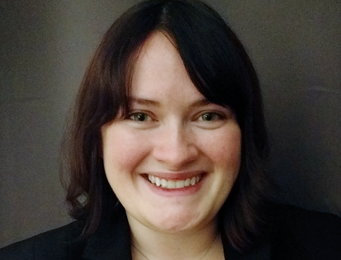
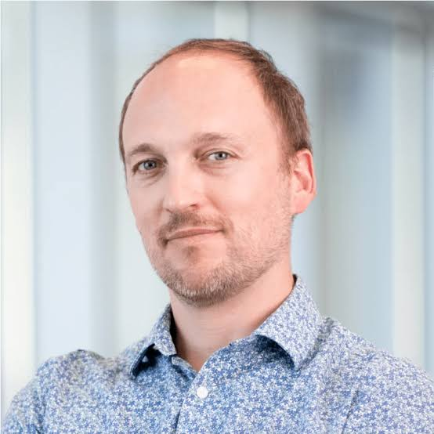

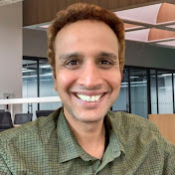
Amazing people to follow and learn from
Anne Carpenter
https://www.broadinstitute.org/bios/anne-e-carpenter
Beth Cimini
https://www.broadinstitute.org/bios/beth-cimini
Loïc A Royer
https://www.czbiohub.org/sf/person/loic-royer/
Guillaume Witz
https://github.com/guiwitz?tab=repositories
Sreenivas B.
https://www.youtube.com/@DigitalSreeni

Slide 5
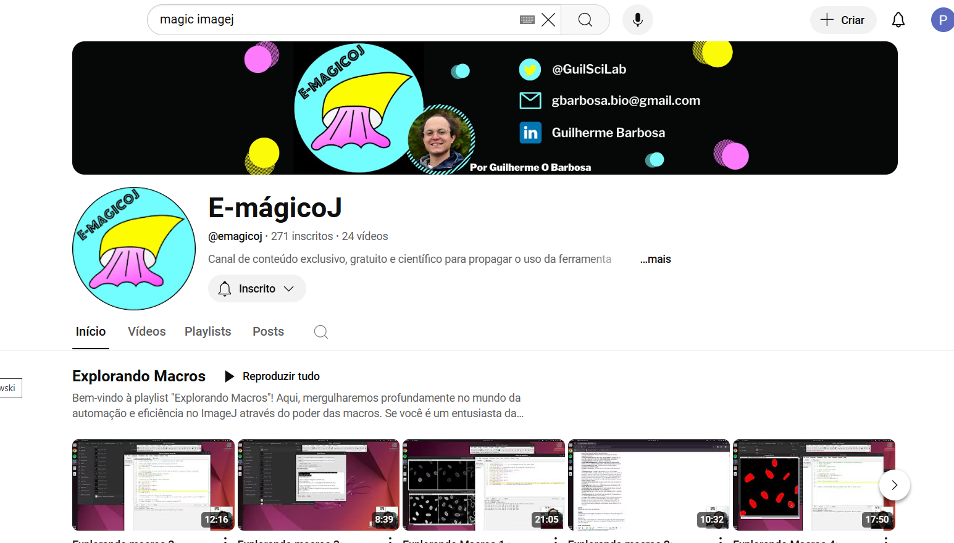

Slide 6
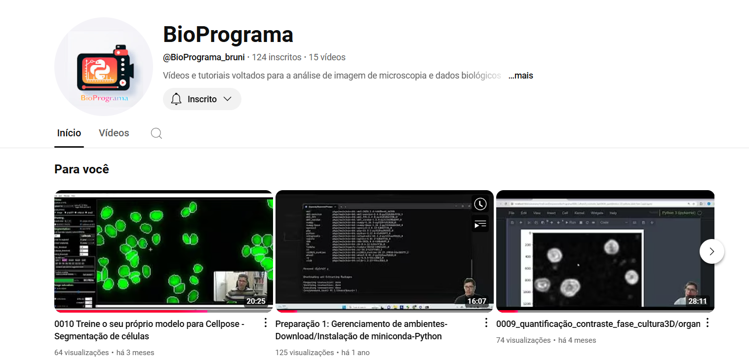

Slide 7
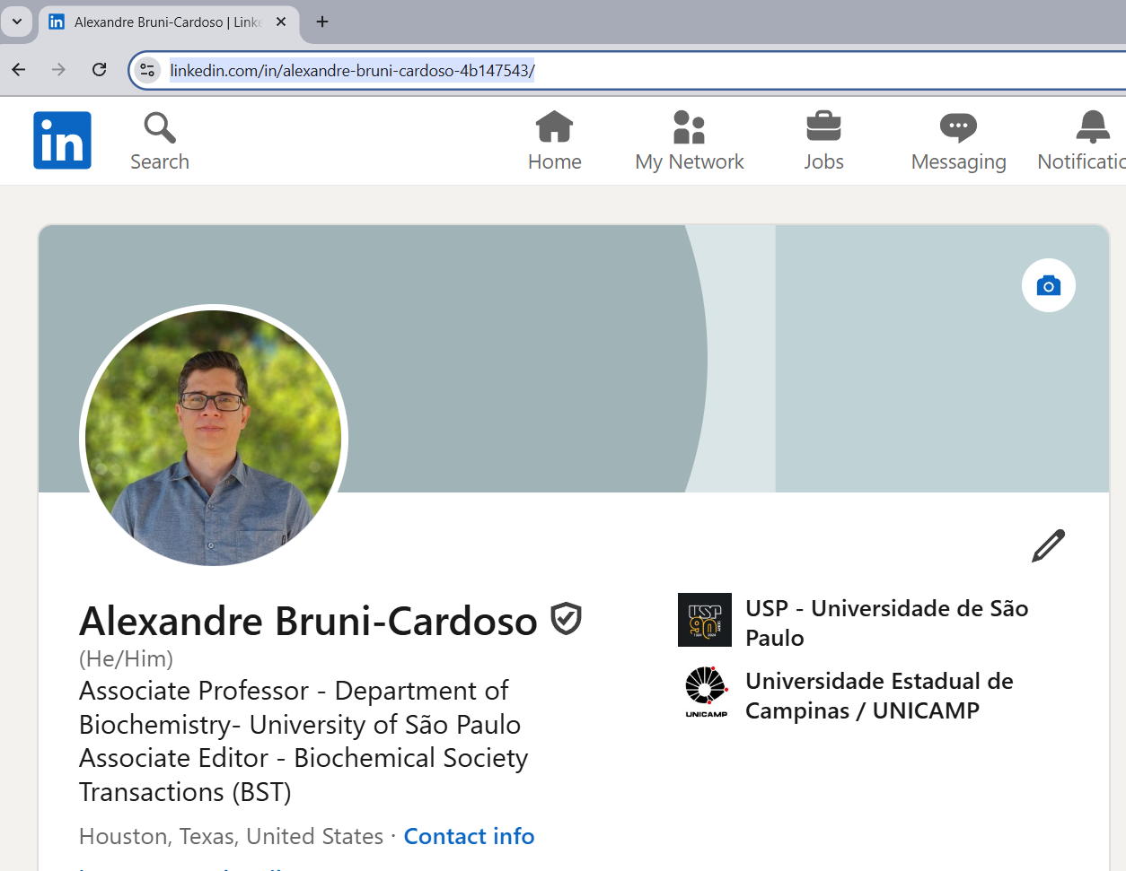
Contact
brunicar@iq.usp.br

