Slide 1
Exploratory data visualization
Lauren Hallett

Slide 2
Why visualize data?: The Datasaurus Dozen

Slide 3
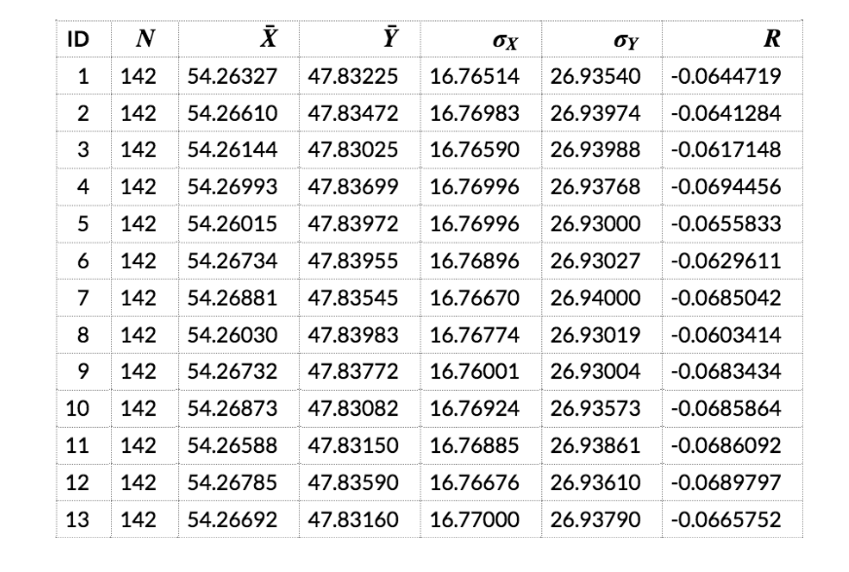

Slide 4
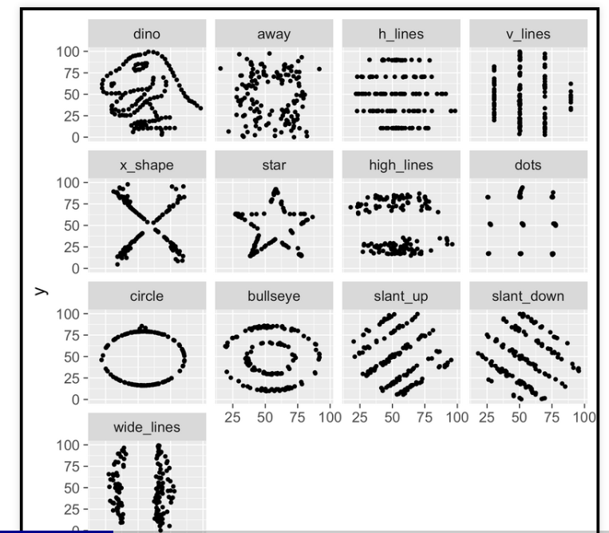

Slide 5
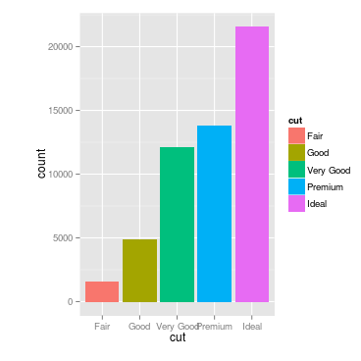
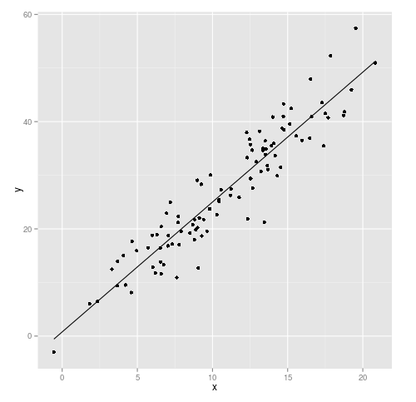
What makes an effective graph?
Facilitate comparisons
Reveal trends
Creating more effective graphs by Robbins
ggplot2 by Wickham

Slide 6
ggplot2: A layered grammar of graphics

Slide 7
What is this?:
VAR 2
VAR 1

Slide 8
What is this?:

Slide 9
What is this?: A coordinate system

Slide 10
What is this?: A coordinate system AND data and aesthetics
VAR 2
VAR 1

Slide 11
What is this?: A coordinate system, data and aesthetics AND geometric objects
VAR 2
VAR 1

Slide 12
What is this?: A coordinate system data and aesthetics and geometric objects AND scale
100
VAR 2
10
1
1
10
100
VAR 1

Slide 13
What is this?: A coordinate system data and aesthetics and geometric objects and scale AND statistical transformations
100
VAR 2
10
1
1
10
100
VAR 1

Slide 14
What is this?: A coordinate system data and aesthetics and geometric objects and scale and statistical transformations AND Faceting
GROUP 1
GROUP 2
100
VAR 2
10
1
1
10
100
1
10
100
VAR 1

Slide 15
Format for this ggplot2 object:
ggplot(Data, aes(x=Var1, y=Var2)) + geom_point() +
geom_smooth() +
scale_x_log10() + scale_y_log10() +
facet_wrap(~Group)

Slide 16
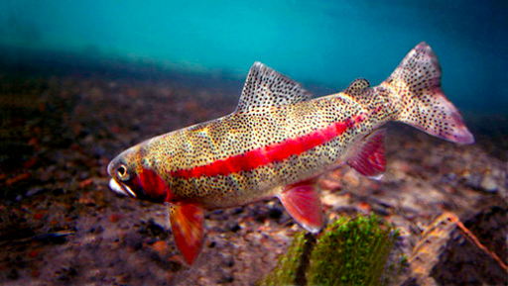
Redband trout
Notes:
Primitive form of rainbow trout

Slide 17
Looking ahead to the final project:
By Monday identify a topic area
My goal is to get enough information about your interests to guide you to an appropriate dataset
If you have a dataset you would like to work with, give me as much information as you get when you use str() on your data (i.e., how many variables, what types are they, how many rows, etc)

