Slide 1

Cardano Incentives
Enabling a Fair Decentralized System

Slide 2

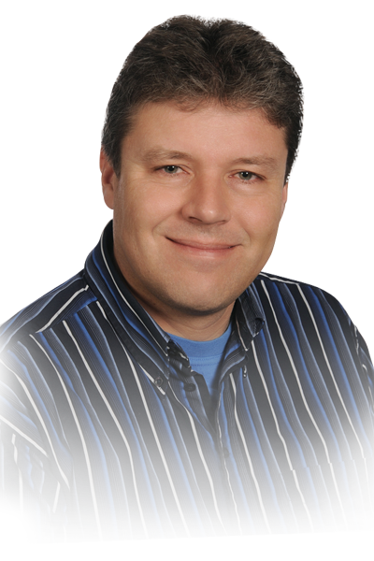
About myself
PhD in Pure Mathematics from Regensburg University (Germany).
Postdoc at Cambridge University (UK).
Ten years working in Software Development prior to joining IOG.
Haskell enthusiast for more than 15 years.
Joined IOG November 2016.
Director of Education at IOHK.
Led the ”Incentives” workstream.

Slide 3
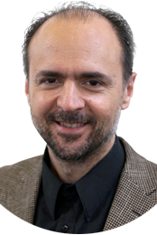
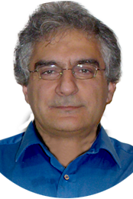

Doing the Hard Work
Prof. Dr. Aggelos Kiayias
Prof. Dr. Elias Koutsoupias
Chief Scientist
Senior Research Fellow
Aikaterini-Panagiota Stouka
Researcher

Slide 4
What are Incentives?
Incentives in the context of a cryptocurrency are ways of encouraging people to participate in the protocol and to follow it faithfully.
In the case of Cardano:
  Being online and creating a block when having been elected slot leader.
  Providing necessary network infrastructure.

Slide 5
Incentive Types
In this talk, when we talk about incentives, we mean monetary incentives in the form of ADA.
There are other types of incentives as well: things like idealism and morality and the general desire to ”do the right thing”.
Design goal for Cardano incentives: Monetary and moral incentives should align perfectly.

Slide 6
Danger of Misalignment
In 2014, the mining pool GHash.io controlled more than 51% of the Bitcoin mining power for several days.
Eventually, GHash.io voluntarily reduced its mining power and promised not to exceed 40% in the future.
There was a real conflict between the financial interests of the miners and the security of the network.

Slide 7
Desired Configuration
A solid majority of stake (ca. 80%) should be delegated to a number of k stake pools (k ∼ 100 seems to be reasonable).
The stake pools should be online when needed, and they should provide additional network infrastructure (”relay nodes”).

Slide 8
Incentive Sources
Transaction fees.
Non-refundable deposits.
Monetary expansion.

Slide 9
Incentives Distribution
In Cardano, time is divided into epochs and slots.
A slot lasts 20 seconds, an epoch contains 21,600 slots and lasts ﬁve days.
Incentives are distributed on an epoch by epoch base: Transaction fees, deposits and monetary expansion are collected into a virtual rewards pool; then this pool is distributed amongst the stakeholders.

Slide 10
Basic Idea of Distribution
The rewards pool from one epoch is distributed amongst stake pools (and individual protocol participants) according to their stake.

Slide 11
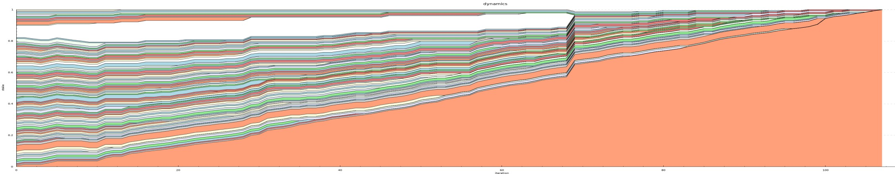
Problem with the Basic Idea
The basic idea is a good guideline, but too naive: The fewer pools there are, the lower total costs will be, the higher everybody’s rewards will be.
So the system will tend towards a single dictatorial pool that everybody else delegates to.

Slide 12
First refinement: Large Pools
The maximal proportion of the rewards pool that a stake pool can receive will be limited by 1/k, where k is the number of desired pools (k ∼ 100).

Slide 13
Second refinement: Being Online
Stake pools should be penalized for not following the protocol and not being online when it is their turn.
Rewards will be proportional to performance.
In a protocol without public leader schedule like Ouroboros Praos, performance has to be estimated.

Slide 14
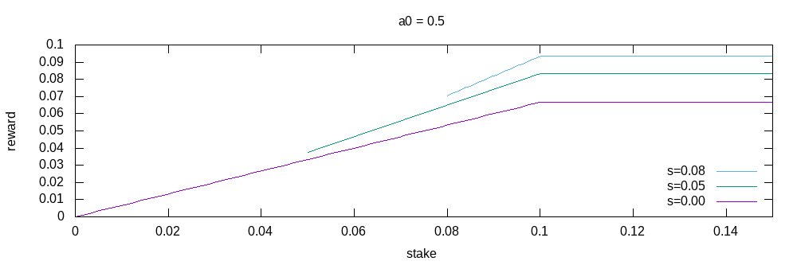
Third refinement: Sybil Prevention
An attacker could create hundreds of ”attractive” pools and have more than 50% of people delegating to one of them.
Handled by making pool operators ”pledge” some stake to their pools and make pool rewards depend on the pledged amount.

Slide 15
Undistributed Rewards
These reﬁnements can lead to a situation where not all funds contained in the rewards pool will be distributed.
This, however, is a feature, not a bug, because the remaining funds can instead be put to use in the treasury.

Slide 16
Distribution to Pool Members
The pool leader herself should be compensated for her costs (computing power, online time) and rewarded for her efforts.
Pool members should be rewarded proportional to the stake they delegated to the pool.

Slide 17
Not Being Short Sighted
It might seems proﬁtable for a pool operator to change his strategy and increase his margin.
In reality, of course, pool operators will know that people will leave their pools if they do that.
So expected rewards displayed in the wallet will ”look ahead” and take into account that only the k most attractive pools will actually have members.

Slide 18
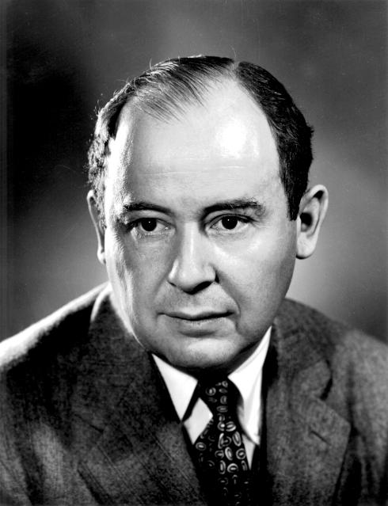
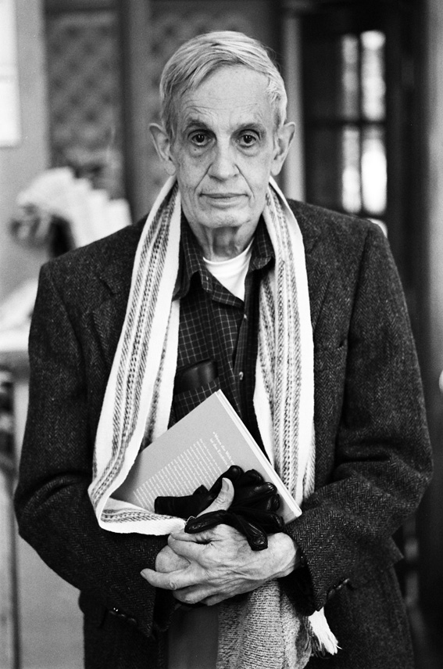
Game Theory
.John Forbes Nash Jr. (June 13, 1928 – May 23, 2015)
By Peter Badge / Typos1 - submission by way of Jimmy Wales, CC BY-SA 3.0, https://commons.wikimedia.org/w/index.php?curid=6977799
.John von Neumann (Los Alamos).
By LANL - http://www.lanl.gov/history/atomicbomb/images/NeumannL.GIF (archive copy at the Wayback Machine), Attribution, https://commons.wikimedia.org/w/index.php?curid=3429594

Slide 19
Nash Equilibria
In game theory, Nash's concept of a Nash Equilibrium is of central importance.
A Nash Equilibrium is a situation where no player can improve his payoff by unilaterally changing his strategy.
So if all other players stick to their strategies, it would be irrational for any player to change his own strategy.

Slide 20
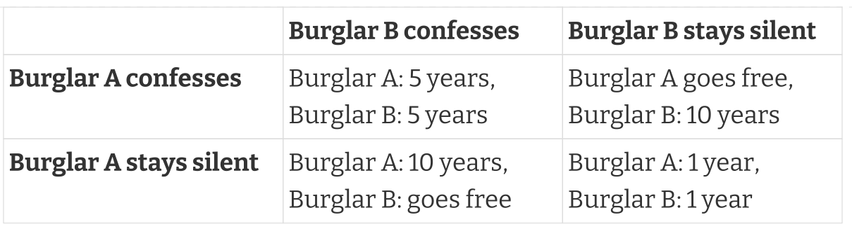
Prisoner’s Dilemma
This game has exactly one Nash Equilibrium: Both burglars confess and spend five years in prison.

Slide 21
The Staking Game
In a 2022 research paper, game theory was applied to the Cardano incentives mechanism.
It was shown that if the reward distribution follows the rules explained above, then each Nash Equilibrium of the "staking game" will have k stake pools of the same size.

Slide 22
Thank you!

