Slide 1
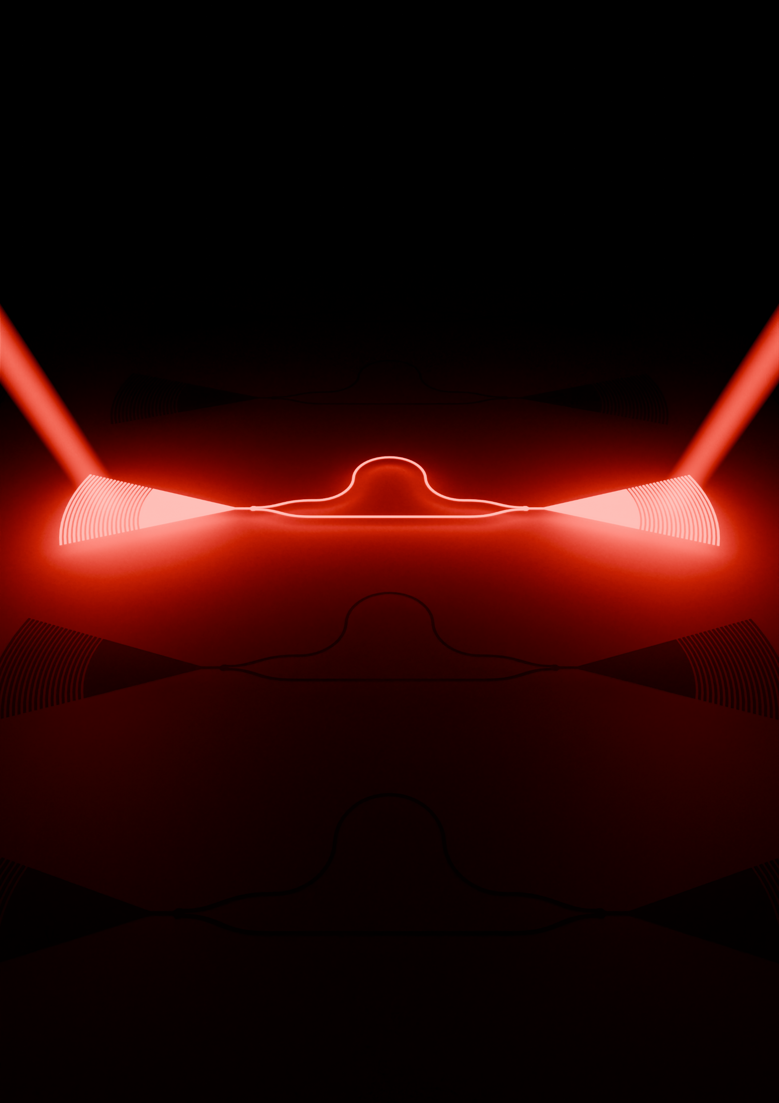

Silicon Photonics
Design, Fabrication and Data Analysis
Bruno Fernando Abreu de Melo
ETH Zürich
2025

