Slide 1

Predictive Analytics

Slide 2
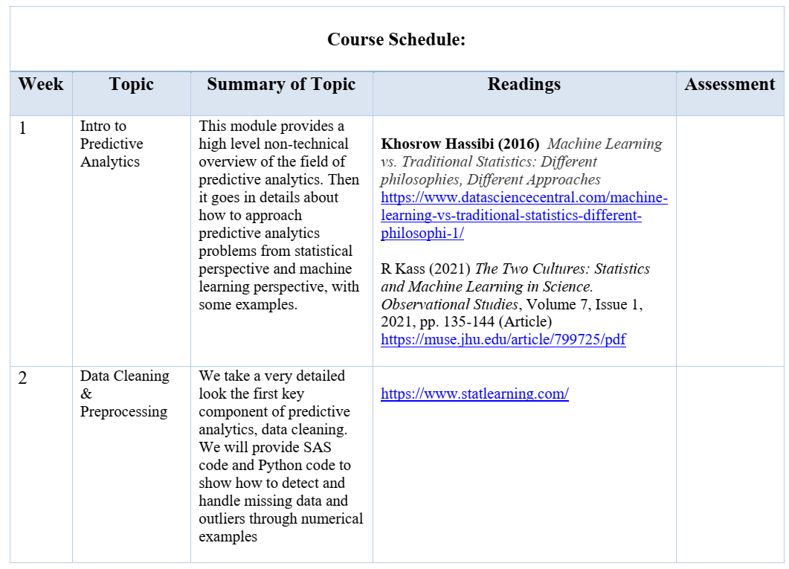

Slide 3
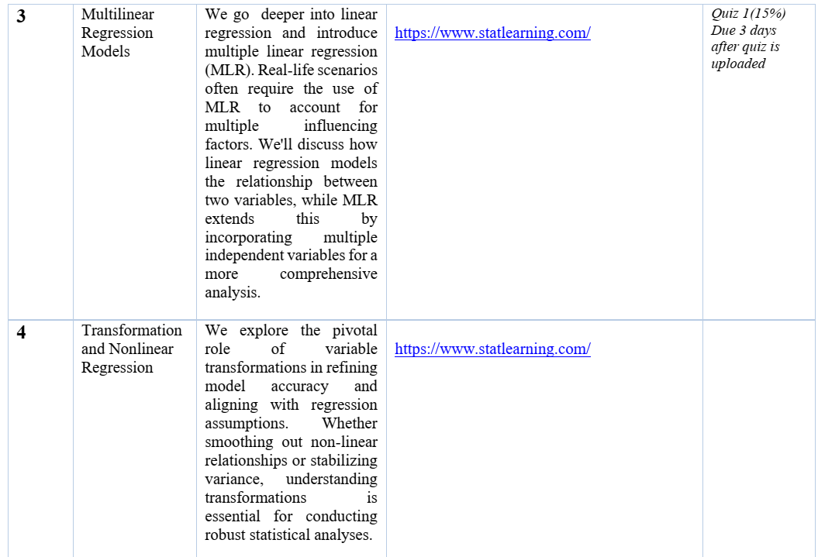

Slide 4
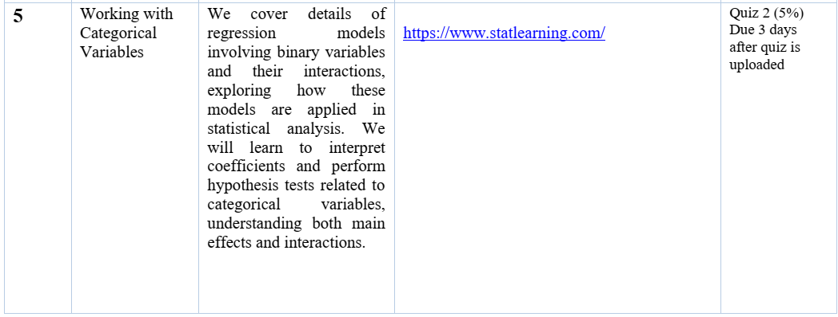
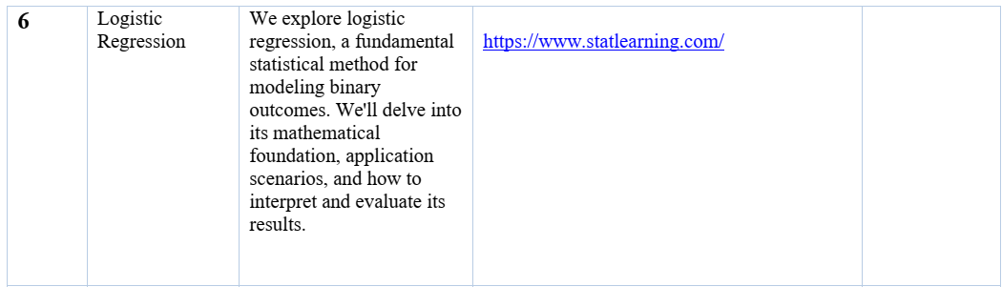

Slide 5
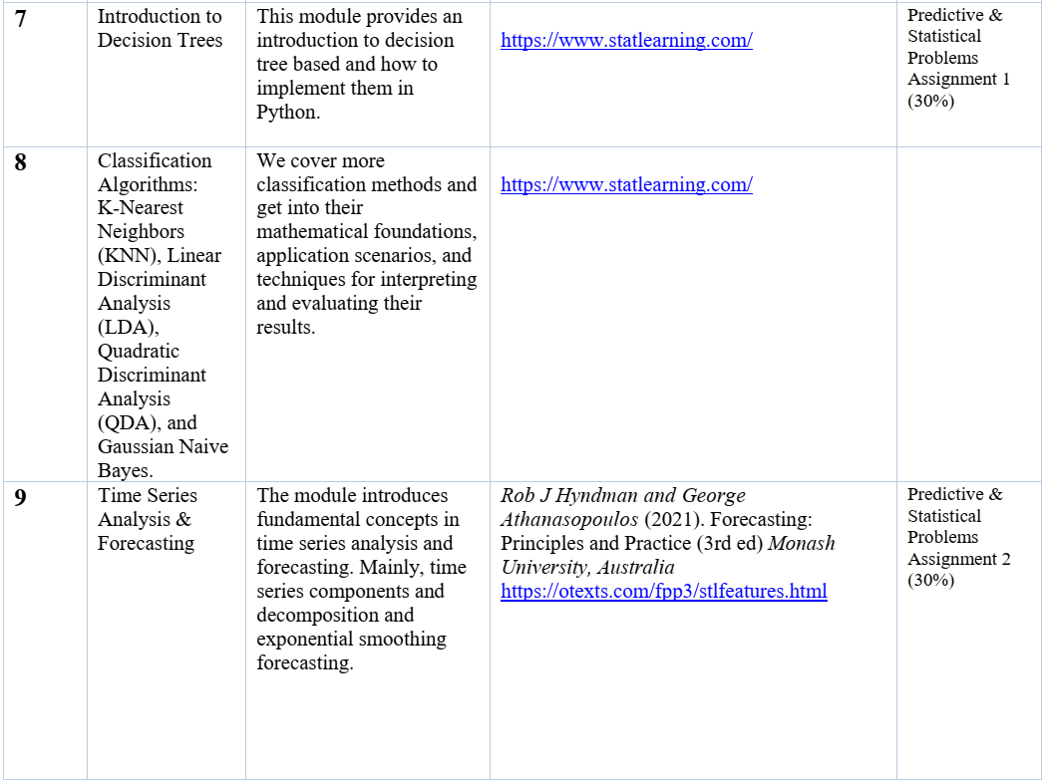

Slide 6
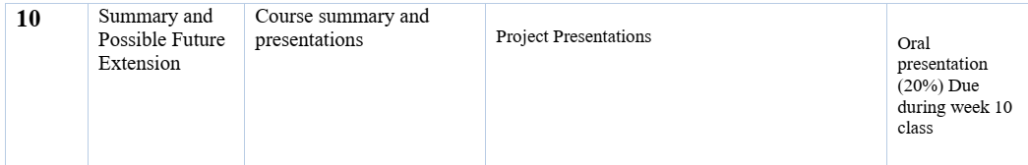

Slide 7
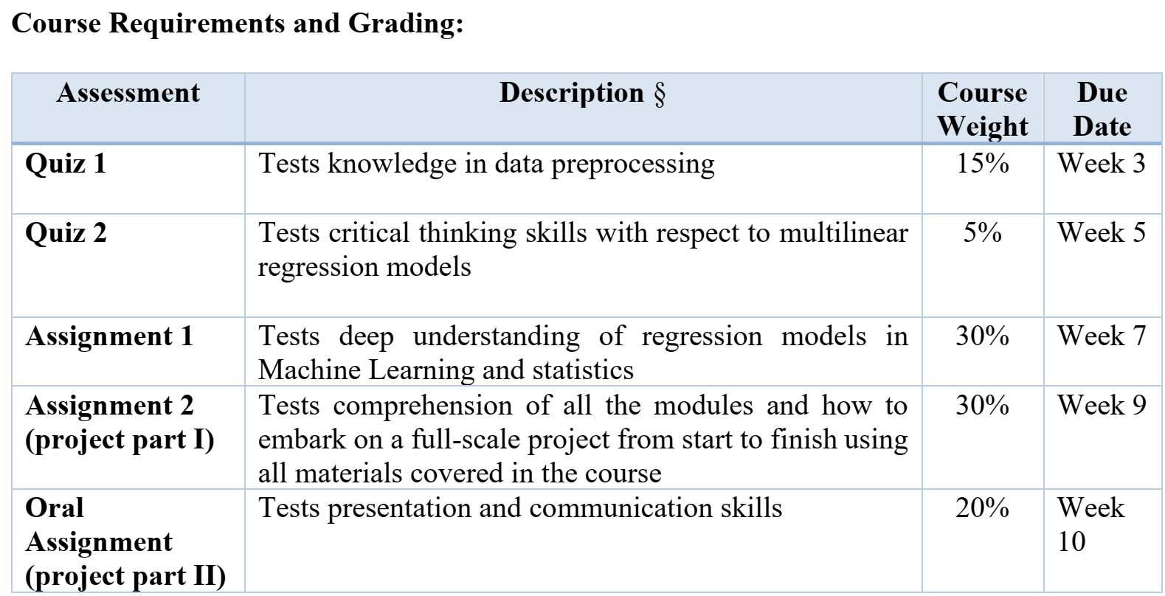

Slide 8
Academic Integrity

Slide 9
Student Preparation and Participation

Slide 10
Attendance

Slide 11




COURSE REPRESENTATION
With Student Success

Slide 12



WHAT IS COURSE REPRESENTATION?
Centralizes formative feedback in developing a learning community.
Encourages collaboration between students and instructors.
Creates a safe structure for student feedback.
Enhances communication and provides professional development for students.

Slide 13

ROLE OF THE COURSE REPRESENTATIVE
Attends mandatory Student Leaders Training in Week 4.
Make their role known to peers.
Acts as a liaison between the class and the instructor.
Gathers and communicates feedback from peers.
Ensures regular information sharing and collaborative decision-making.
Engage with the Course Representative community on Teams.

Slide 14

BENEFITS OF COURSE REPRESENTATION
Student Voice = Superpower
Addresses issues proactively during the term (real-time problem solving).
Engages student voices and maintains focus on student learning (your voice, center stage).
Utilizes student body to address concerns collaboratively (collaboration = progress).
Integrates feedback into a holistic course evaluation approach (better feedback = better courses).

Slide 15


Slide 16

For more information: Bhanu.shree@unfc.ca
LET'S WORK TOGETHER

