Slide 1
Case study 3 Module 1: Foundations of Course
Tools, Techniques, & Terminology

Slide 2
Course Overview
This module uses Python and Tableau.
Focuses on fundamental financial concepts such as returns and dividends.
Lays the groundwork for practical case studies in financial analysis.

Slide 3
Learning Objectives
Set up Python and Tableau environments.
Understand simple, annualized, and compound returns.
Analyze continuous compounding and dividend effects.
Interpret excess returns for investment evaluation.

Slide 4
Tool Setup
Install Python: Refer to CPSC 610 documentation.
Install Tableau: Refer to CPSC 600 documentation.
Verify tools before proceeding with analysis.

Slide 5
Financial Data Overview
Includes Apple, Facebook, IBM, Microsoft, Tesla stock data.
Key features: Open, Close, High, Low, Adjusted Close, Volume.
Used throughout course for real-world case studies.

Slide 6
What are Prices?
Prices represent market value of an asset.
Determined by supply and demand.
Essential for return and performance calculation.

Slide 7
Why Use Returns?
Returns are scale-free performance indicators.
Statistically more stable than price data.
Enable comparison across different assets.

Slide 8
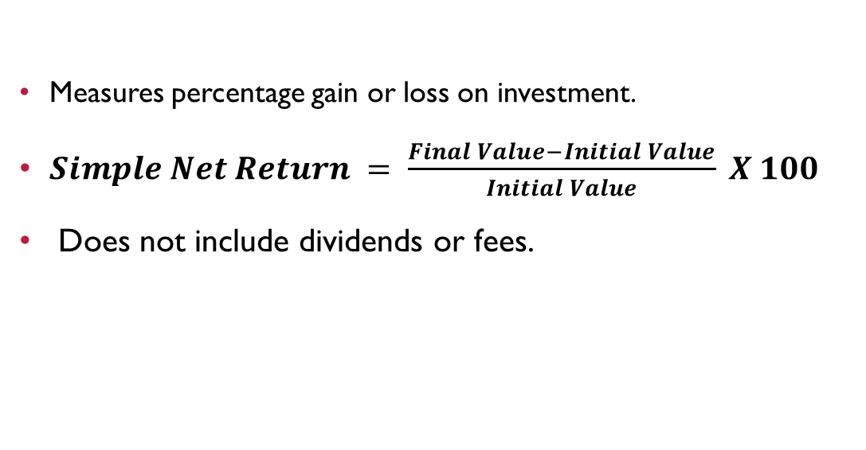
Simple Net Return
Measures percentage gain or loss on investment.
$Simple Net Return = \frac{Final Value−Initial Value}{Initial Value} X 100$
Does not include dividends or fees.
If the value is positive → the asset appreciated (profit)
If the value is negative → the asset depreciated (loss)

Slide 9
Example: Simple Net Return
Investment grows from $1,000 to $1,350 in 3 years.
Simple Return = (1350 - 1000) / 1000 = 35%
Provides total gain but not per-year growth.

Slide 10
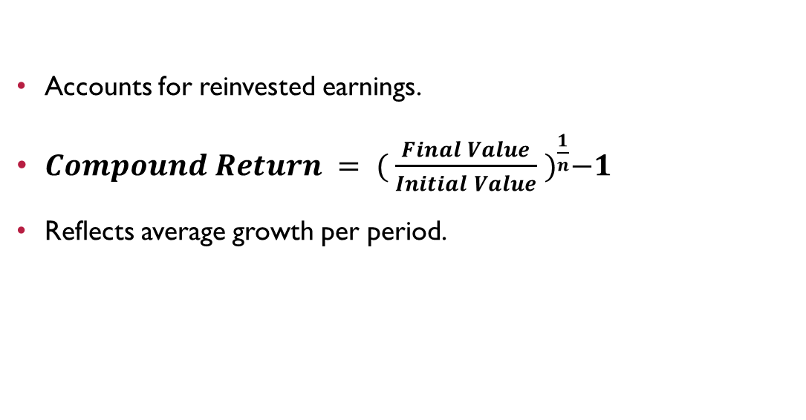
Compound Return
Accounts for reinvested earnings.
$Compound Return = {( \frac{Final Value}{Initial Value} )}^{\frac{1}{n}}−1$
Reflects average growth per period.

Slide 11
Example: Compound Return
Initial = $1,000; Final = $1,350 over 3 years.
Compound Return = (1350 / 1000)^(1/3) - 1 ≈ 10.37%
More realistic view of annual performance.
Year | Investment Value ($) | Simple Net Return | Compound Return
0 | 1,000 | - | -
1 | 1,100 | 10% | 10%
2 | 1,200 | 20% | 9.54%
3 | 1,350 | 35% | 10.37%

Slide 12
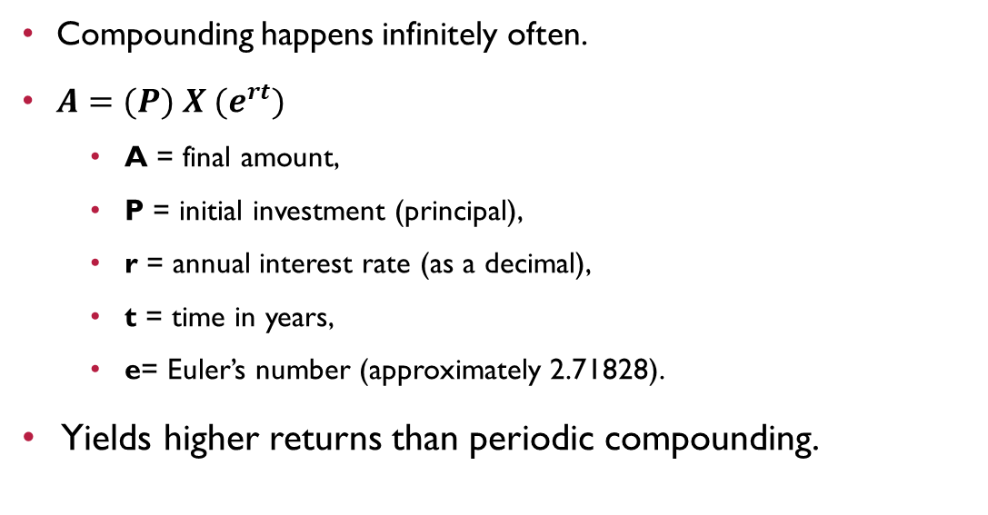
Continuous Compounding
Compounding happens infinitely often.
$A=(P) X {(e}^{rt})$
A = final amount,
P = initial investment (principal),
r = annual interest rate (as a decimal),
t = time in years,
e= Euler’s number (approximately 2.71828).
Yields higher returns than periodic compounding.

Slide 13
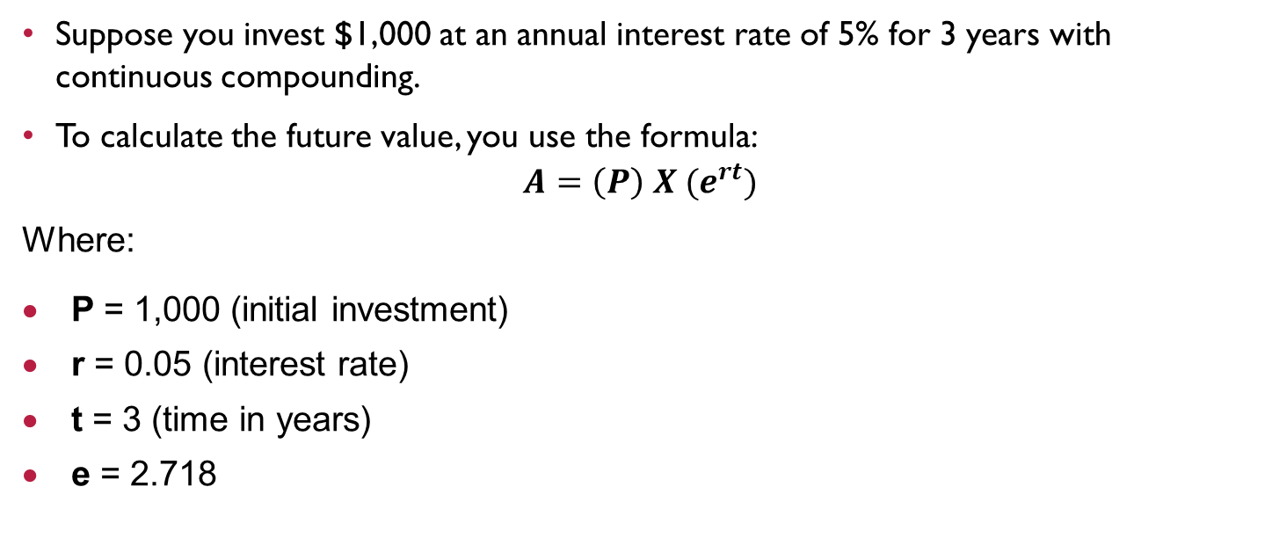
Example: Continuous Compounding
Suppose you invest $1,000 at an annual interest rate of 5% for 3 years with continuous compounding.
To calculate the future value, you use the formula:
$$A=\left(P\right) X (e^{rt})$$
Where:
P = 1,000 (initial investment)
r = 0.05 (interest rate)
t = 3 (time in years)
e = 2.718

Slide 14
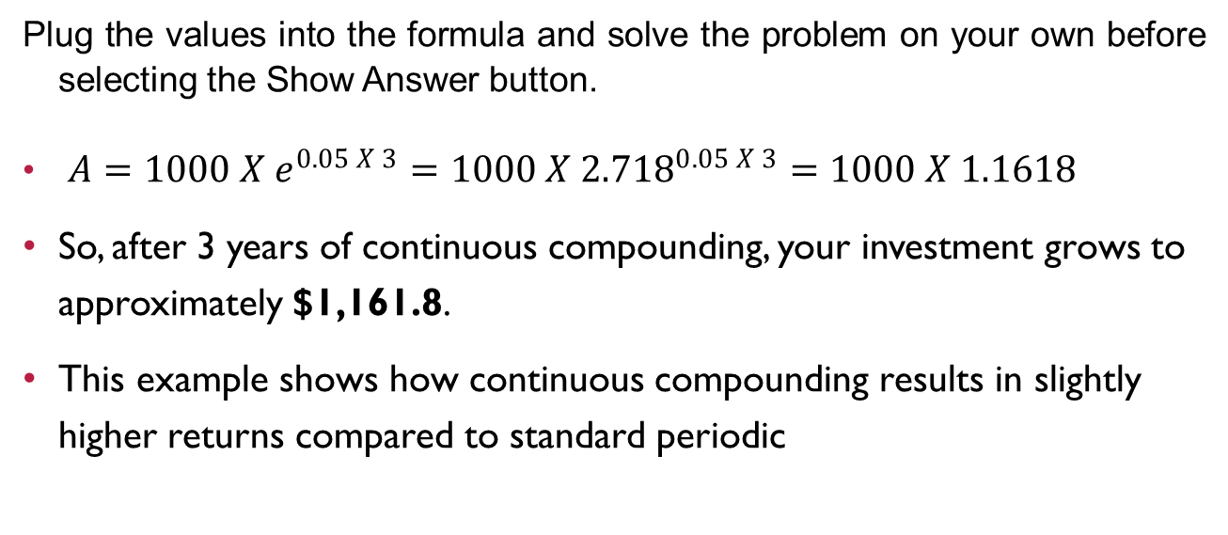
Plug the values into the formula and solve the problem on your own before selecting the Show Answer button.
$A=1000 X e^{0.05 X 3}=1000 X {2.718}^{0.05 X 3}=1000 X 1.1618$
So, after 3 years of continuous compounding, your investment grows to approximately $1,161.8.
This example shows how continuous compounding results in slightly higher returns compared to standard periodic

Slide 15
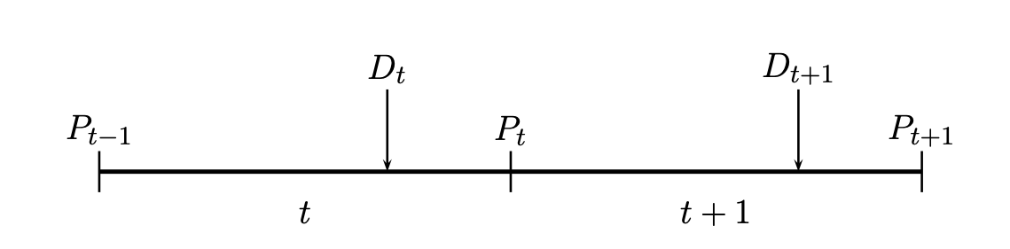
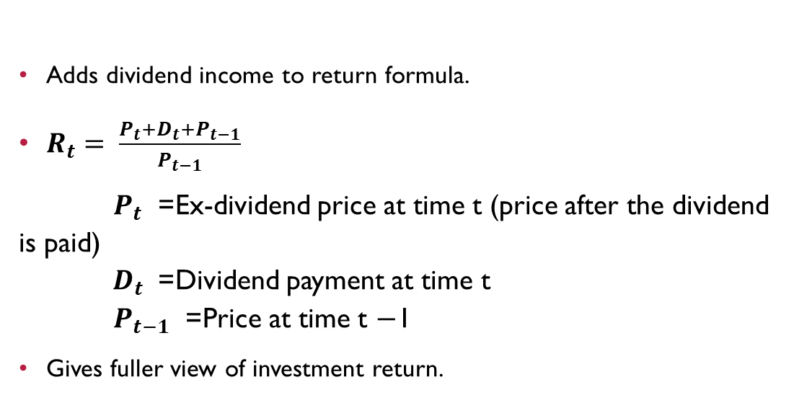
Simple Return with Dividends
Adds dividend income to return formula.
$R_{t}= \frac{P_{t}+D_{t}+P_{t−1}}{P_{t−1}}$
$P_{t}$ = Ex-dividend price at time t (price after the dividend is paid) ${ D}_{t}$ = Dividend payment at time t $P_{t−1}$ = Price at time t −1
Gives fuller view of investment return.

Slide 16
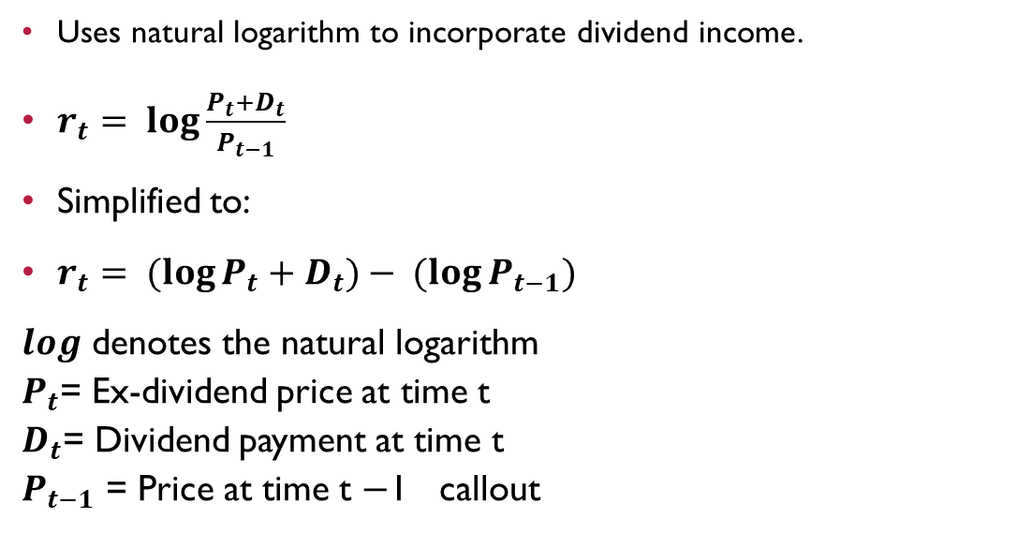
Continuous Return with Dividends
Uses natural logarithm to incorporate dividend income.
$r_{t}= \log{\frac{P_{t}+D_{t}}{P_{t−1}}}$
Simplified to:
$r_{t}= (log{P_{t}}+D_{t})− (log{P_{t−1}})$
$log$ denotes the natural logarithm $P_{t}$= Ex-dividend price at time t $D_{t}$= Dividend payment at time t $P_{t−1}$ = Price at time t −1 callout

Slide 17
Understanding Excess Returns
Difference between asset return and risk-free rate.
Evaluates investment performance above market average.
Used in both simple and continuous formats.

Slide 18
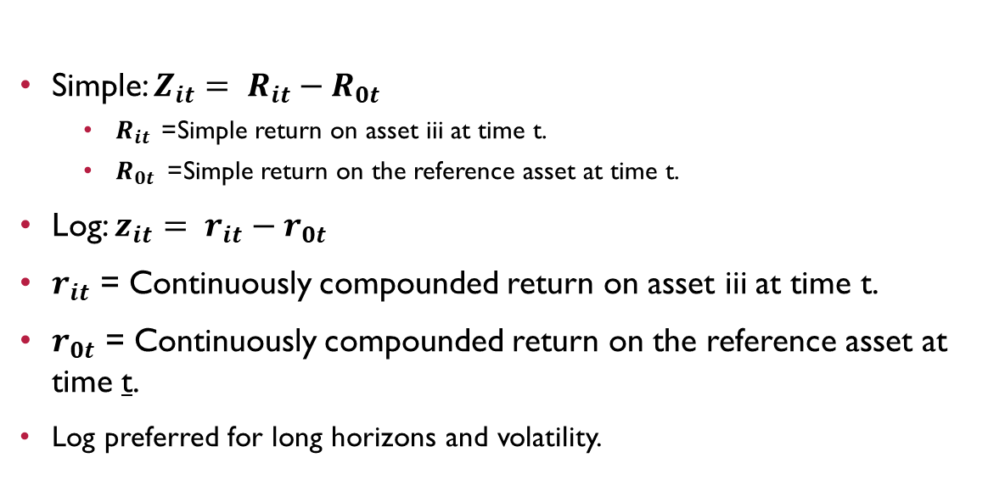
Simple vs. Log Excess Return
Simple: $Z_{it}= R_{it}−R_{0t}$
$R_{it }$= Simple return on asset iii at time t.
$R_{0t}$= Simple return on the reference asset at time t.
Log: $z_{it}= r_{it}−r_{0t}$
$r_{it}$ = Continuously compounded return on asset iii at time t.
$r_{0t}$ = Continuously compounded return on the reference asset at time t.
Log preferred for long horizons and volatility.

Slide 19
Simple Excess Return and Log Excess Return
Simple excess return is calculated by subtracting the reference asset's return from the asset's simple return, and it's straightforward for short-term or discrete periods. | In contrast, log excess return is used when dealing with continuously compounded returns, providing a more accurate measure for long-term investments. Log excess returns are preferred for better handling of compound growth, especially in volatile markets or for longer time horizons.

Slide 20
Module Summary
Set up tools and reviewed sample datasets.
Explored returns: simple, compound, continuous.
Analyzed dividends and excess return concepts.
Prepared for practical financial analysis.

Slide 21
Practice Exercise
Calculate simple, compound, and continuous return:
Investment: $2,000 → $2,640 in 4 years.
Try including a $50 dividend in the final year.

Slide 22
What’s Next – Module 2
Explore Python syntax and financial programming.
Manipulate data using Pandas DataFrames.
Visualize financial trends with Matplotlib.
Build your first trading strategy.

