Slide 1

Bruno Simões - Data Engineer Bosch Challenge

Slide 2


Intro – How to run the python scripts
List of Python Scripts:
Script-VehicleComplaints.ipynb
Script-VehicleFuelEconomy.ipynb
Script-AlternativeFuelStations.ipynb
Script-LoadingDataintoHypotheticalDataStorageSystem (*). ipynb
How to run them:
You will need an environment where you have Python (version 3.xx) installed to run these scripts. In my case, I have Python installed on my local computer and I use Anaconda to launch JupyterNotebook where I can run the code. But you can use your own way of running Python scripts of the format . ipynb
Since I used the “display” command to visualize the datasets multiple times (instead of the “print”) you should run it in JupyterNotebook or Databricks with Python, since this “display” command might not be supported in other environments.
What each Script does:
Each one of these scripts has the full code for the Data Acquisition, Data Processing, and Data Transformation steps requested for each dataset. With exception to the “Script-LoadingDataintoHypotheticalDataStorageSystem”. This one is only a DEMO code as asked in Step 4 (Data Loading) of this Challenge

Slide 3
Intro – How to run the python scripts
List of Files that should be created in your current directory after running the Python Scripts shared on github:
AlternativeFuelStations_Transformed.csv
VehicleFuelEconomy_Transformed.csv
VehicleComplaints_Transformed.csv
brands_with_most_complaints_recorded.csv
complaints_factual.csv
complaints_type_dimension.csv
location_dimension.csv
vehicle_dimension.csv
Downloaded Dataset files :
alternative_fuel_stations.csv
vehicleFuelEconomy.csv
vehicleComplaints.csv
FLAT_CMPL.zip
FLAT_CMPL.txt
FLAT_CMPL.csv

Slide 4
Intro – PowerPoint structure
In this PowerPoint I will go through the Python Scripts, explaining why some decisions were made. I tried to have different approaches for each dataset, in terms of data processing and data transformation, in a way to test new ways of doing things and not be repetitive. The Structure of this presentation is the following:
Data Acquisition – (For each dataset/script)
Data Processing - (For each dataset/script)
Data Transformation – (For each dataset/script)
Data Loading – (In general, since the process is independent of the dataset/script)
Automation Suggestion

Slide 5
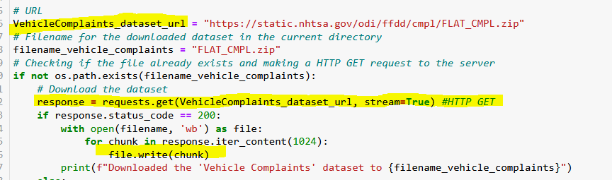
1. Data Acquisition- Vehicle Complaints Dataset
Using the HTTP GET method to download the dataset:
Since we downloaded a ZIP file (that contains a .txt), we need to extract it to be able to use it and convert it to CSV:
By making a HTTP GET request we are able to safetly comunicate with the API and request its data. It will also allow us to automate this request, later on.

Slide 6
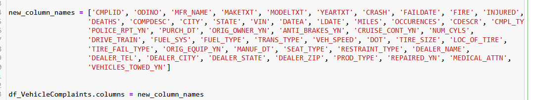
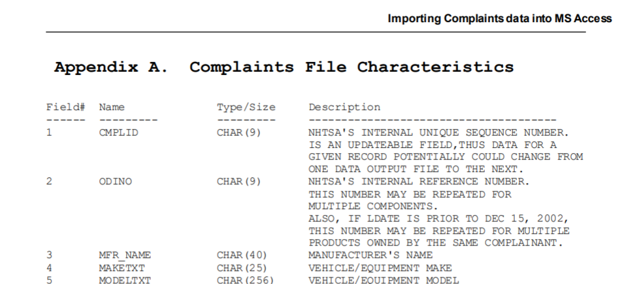
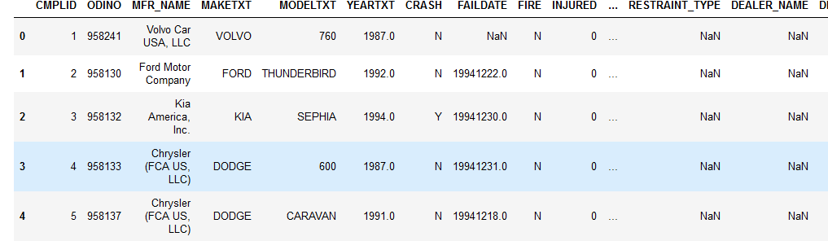
1. Data Acquisition - Vehicle Complaints Dataset
The Vehicle Complaints dataset comes with empty column names by deflaut, so we manually added them, taking into account the dataset documentation:
Link to the documentation: https://static.nhtsa.gov/odi/ffdd/cmpl/Import_Instructions_Access.pdf
Dataset Visualization:

Slide 7
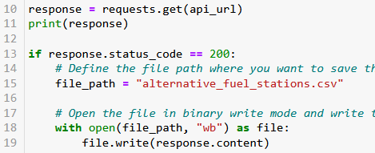
1. Data Acquisition - Alternative Fuel Stations Dataset
In this case, the GET method must contain an API key. This key was given to me via email by the NREL when I registered myself on their website as a Developer.
If the request is successfull, we save the file:

Slide 8
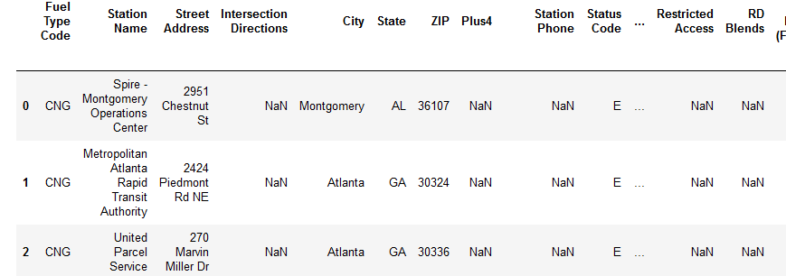
1. Data Acquisition - Alternative Fuel Stations Dataset
Loading the dataset and showing it:
Dataset Visualization:
Note: The Vehicle Fuel Consumption Dataset follows the same pattern for downloading it, so I’ll not repeat the explanation for it

Slide 9
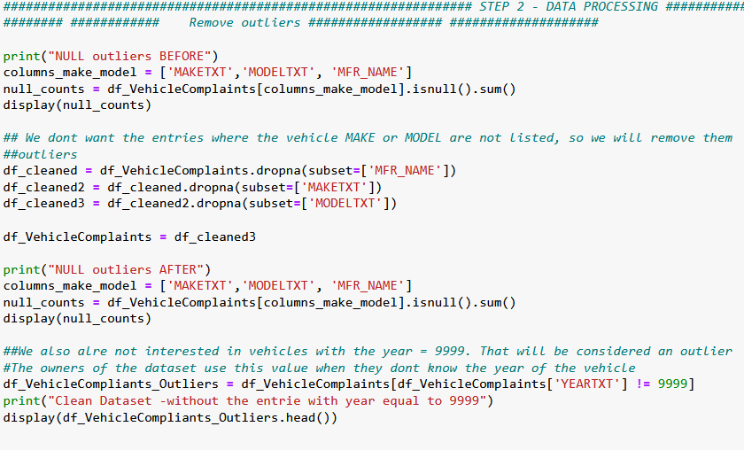
2. & 3. - Data Processing and Data Transformation – Vehicle complaints
Outliers:
By removing the entries that have a NULL value on the Manufacture Name or Model of the Vehicle, we are able to prepare the data from a more reliable analysis later on, as it is important for us to identify the Vehicle Model and Make because we are an automotive supplier, interested in understanding the broader trends in the automotive industry.
We also dropped the rows where the vehicle’s year is 9999 as this value was defined by the dataset owners when the Year of the Vehicle was unknown. This could disturb our analysis for example when trying to look for the mean age of vehicles, etc...
Source:

Slide 10
2. & 3. - Data Processing and Data Transformation – Alternative Fuel Stations
Outliers:
For the Alternative Fuel Stations dataset, my approach to find outliers was the following:
We know, from the dataset documentation that the list of countries that the column “Country” can be set to is US and CA. So, to potentially remove outliers we can drop all the entries where the country is neither the United States nor Canada

Slide 11
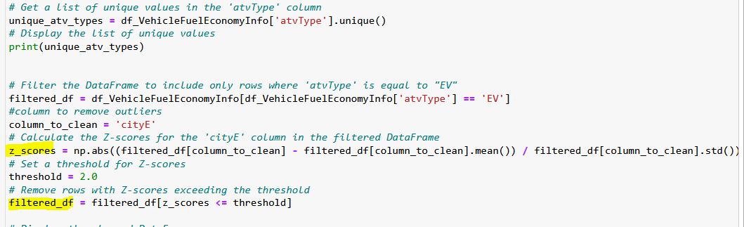
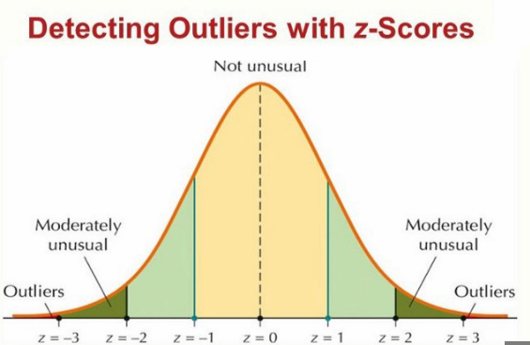
2. & 3. - Data Processing and Data Transformation – Vehicle Fuel ECONOMY Info
Outliers:
In the Vehicle Fuel Economy dataset, my approach to finding outliers was a bit different. I selected only the EVs (electric vehicles) and then I used their Energy consumption in the city (cityE) to determine what rows could have outliers. We don’t want the rows with very low or very high numbers of city consumption… That probably means their data were wrongly introduced in the dataset.. So we are removing them. The way to do this was to apply the Z-Scores method

Slide 12
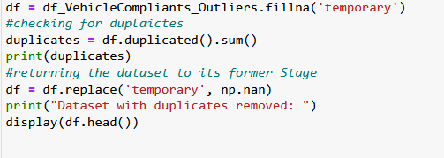
2. & 3. - Data Processing and Data Transformation – Vehicle complaints
Duplicates:
We used the Pandas function duplicated() to check if there are duplicates in our dataset. There are no duplicates found with this method. But since NaN == NaN returns false, we transformed the NULLs values to ‘temporary’ and checked the duplicates again. But no duplicates were found once again, so we returned the dataset to its original state, replacing ‘temporary’ with NaN value again.
Note: This verification was done for all 3 datasets. Other techiques tested to remove duplicates are presented next.

Slide 13
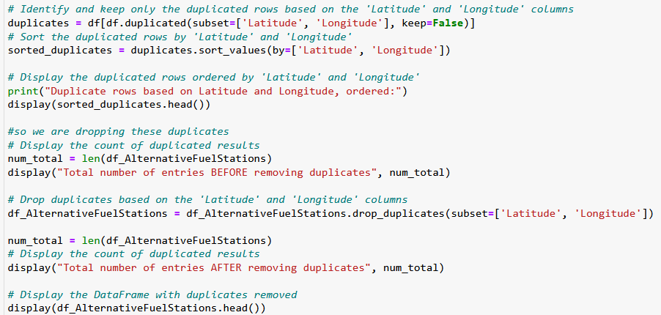
2. & 3. - Data Processing and Data Transformation – Alternative Fuel Stations
Duplicates:
In the Alternative Fuel Stations Dataset, my approach to finding duplicates was the following:
- The duplicated() Pandas function was not finding any duplicates
- But we know that it is physically impossible for 2 Fuel Stations to be in the exact same spot
- This location is given by the Latitude and Longitude columns of the dataset
- So, if there are multiple entries where the key pair (Latitude, Longitude) is equal, I will consider it as a duplicate and remove the repeated entries.

Slide 14
2. & 3. - Data Processing and Data Transformation (in general)
Handling NULL values
The Python Pandas library is treating our NULL values as NaNs (Not a Number). This allows mathematical operations such as mean() in a given column with a mix of Numbers (integers, floats,..) and NULL values. So I decided we would keep them as they are.
Another option could be to replace the NaNs with None datatype in Pandas, only for the columns that are not Integers or Floats, such as the “object” data type.
What else could be done? We could, for example, replace the NULL values with zero (0), but this would contaminate data on columns where we need to perform metrics such as the mean. So I didn’t take this approach. This could be done if we evaluated each column 1 by 1 to see if it was possible. But some datasets have 50 columns and it would take too long.
Also, a more drastic solution would be to drop all rows that contain NULL values.
Note: this applies to the 3 datasets we are working on

Slide 15
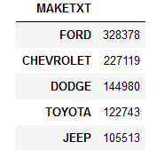
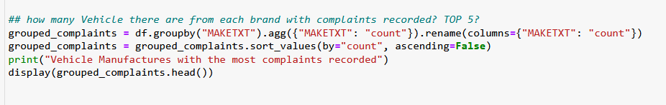
2. & 3. - Data Processing and Data Transformation – Vehicle complaints
Vehicle Manufacturers with the most complaints recorded
Since we are trying to understand the trends in the automotive industry it will help us if we recognize which manufacturers have the most complaints

Slide 16
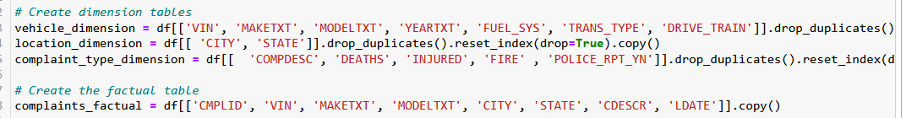
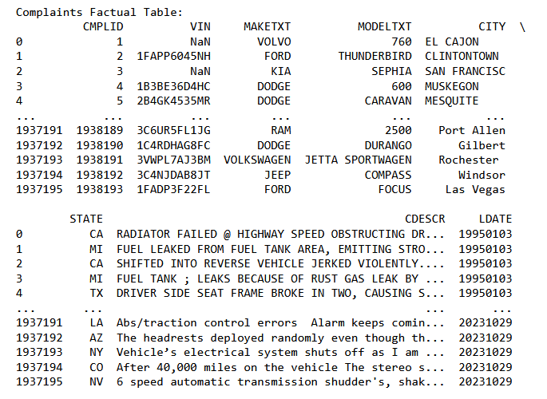
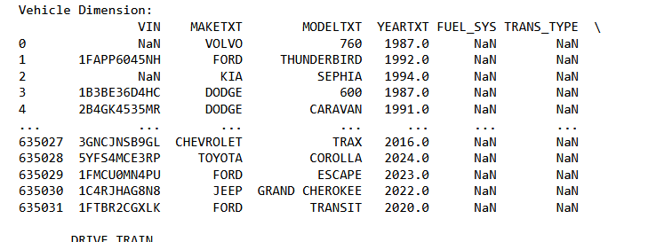
2. & 3. - Data Processing and Data Transformation – Vehicle complaints
Dimensions and Factuals
As our goal should be to build a proper Data Warehouse, organizing the data in a structured way to be stored is critical. For this, we can create Dimension and Factual tables from our dataset, for example:

Slide 17
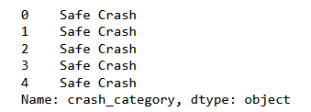
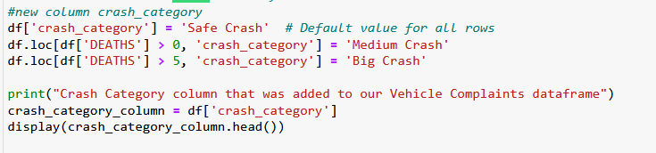
2. & 3. - Data Processing and Data Transformation – Vehicle complaints
Creating a new column: Crash Category
When there is a crash, it is important to understand the severity of it and think about what could be done to save lives in similar situations. With this in mind, I created 3 levels of Crash Severity, considering the number of Deaths:
•if #deaths = 0 → SAFE
•if #deaths >= 1 and <=5 → MEDIUM
•If #deaths >5 →BIG
Note: these values are arbitrary

Slide 18
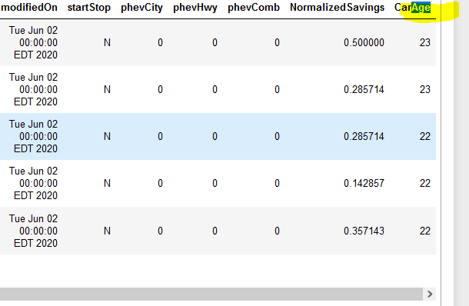
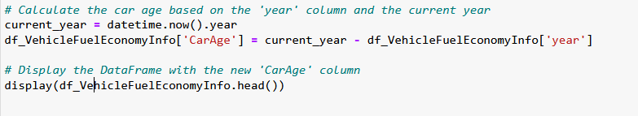
2. & 3. - Data Processing and Data Transformation Vehicle Fuel ECONOMY Info
Creating a new column: Car Age
Considering the Current Year, we can compute the Age of the Vehicle. This info can be important to further analysis as it simplifies the data understanding. For example, we might want to know the percentage of vehicles over 30 years old in the car fleet.

Slide 19
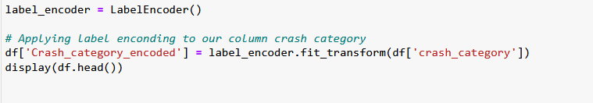
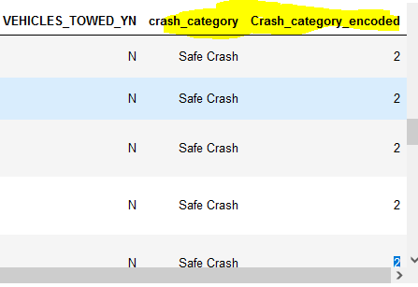
2. & 3. - Data Processing and Data Transformation – Vehicle complaints
Label encoding:
Converting categorical data into numerical values. Label encoding is used to represent categorical data as integers, allowing machine learning models to work with non-numeric data. Now we could run some machine learning model to make assumptions about the crash severity, for instance: which car should I buy, in Portugal, considering I want the safest car possible, from 2006 onwards, etc..?
In this case, since the crash category has 3 possibilities, the encoding will be 0, 1, or 2.

Slide 20
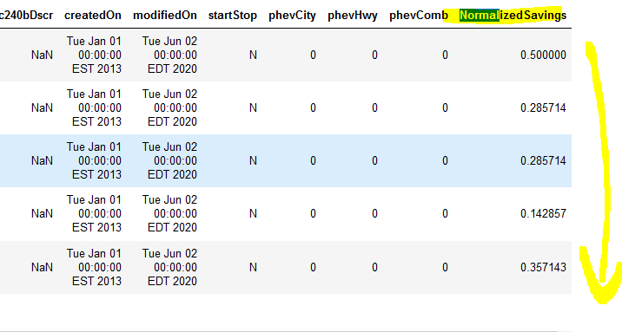
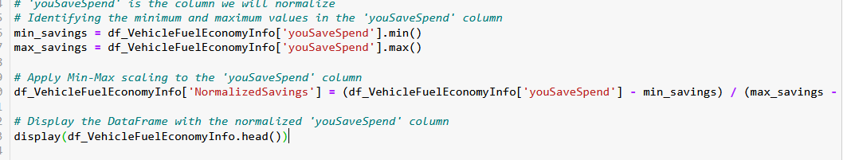
2. & 3. - Data Processing and Data Transformation – Vehicle Fuel ECONOMY Info
Normalization
Some vehicles will allow us to save money, compared to others, just by the costs of running them. This is an important measure if we are looking to buy a new car, for example. But am I really saving money compared to other drivers? By running a normalization algorithm on the “youSaveSpend” column we can have the answer to do. That is what I tried to accomplish here.

Slide 21
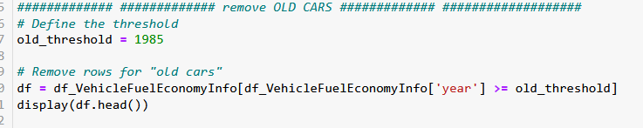
2. & 3. - Data Processing and Data Transformation – Vehicle Fuel ECONOMY Info
Removing rows that are we are uninterested
We might find some data useless for our interests. If we are a company, as said in this challenge, that wants to gather information about the trends in the automotive market, we are not interested in old cars. They are not “trendy” by any means. So we should discard them.

Slide 22
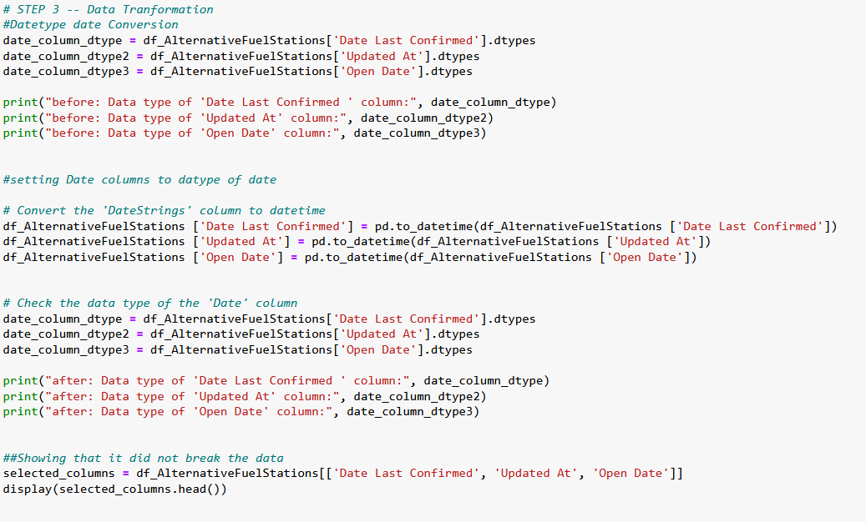
2. & 3. - Data Processing and Data Transformation – Alternative Fuel Stations
Datetype conversion
Data with certain data types should be transformed into their correct type. In the case of dates, this is crucial to work with this kind of data. So, as an example, I chose 3 columns from the Alternative Fuel Stations dataset, that were miss identified as “objects” from the pandas library and corrected their data type into “datetime”. This is better for the manipulation of these columns at a later stage.

Slide 23
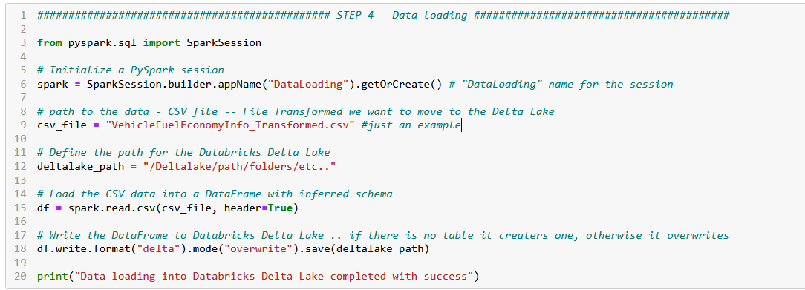
4. DATA LOADING
For Loading the data into the Databricks Delta Lake I created a Spark Session, then I defined the paths of the file I want to Load as well as the Delta Lake path. Then I read the file using the spark read.csv() function. This will consider the header of the CSV to infer the schema of the data. After that, I save the data into Delta Lake. The overwrite mode allows for overwriting an old table. If it does not exist, it creates one.
The reason for choosing Delta Lake over SQL database is that it works well with semi-structured data (CSV, in our case). And, if the schema evolves, for example, new columns, the delta lake can handle it easily.

Slide 24
5. Automation sugestion
We can use Azure Data Factory, for example, to build a pipeline that will copy data from these 3 APIs (Vehicle Complaints, Alternative Fuel Stations, and Vehicle Consumption) automatically. Here is how:
1) The first step is to set up a “Landing Zone”. This is the place where we will store the downloaded data from the APIs, using HTTP GET requests.
2) The second step is to copy the new data into Delta Lake. To do this, we create an Azure Data Factory Pipeline to copy the new data into the Databricks Delta Lake (in this pipeline activity we will check if the “last update date” is newer than the most recent run of our pipeline).
ie: Yesterday (02-11-2023) was the last time we ran the “copy data pipeline”. So every register has, at max, the Last Update Date equal to” 02-11-2023.” But today, on our Landing Zone, there are some registers with the Last Update Date of
“03-11-2023”. This means data is new! So, these are the only rows/registers we should add(copy) to Delta Lake.
After doing that, we automatically update the “last update date” column again. This way, the dataset is ready for our pipeline to run again tomorrow and so on.

Slide 25
5. Automation sugestion
3) Setting up triggers: Creating a Trigger to define when our pipeline should ingest the data to the Landing Zone (and later to the Delta Lake). Probably every day at a fixed timeline (ie: 9 AM) would be a good choice.
Explanation: Since we don’t need real-time data processing, bringing the data in “batches” is perfectly fine and reduces the complexity of the data engineering tasks. Remember that we are an “automotive supplier, interested in understanding the broader trends in the automotive industry”
When this process finishes, we also must have other triggers to execute the Data Processing and Data Transformation steps. These triggers are added to execute the Python Scripts and complete this task.
4) Continuously Monitor this pipeline to check if there were any issues (wrong datatypes, duplicates, no response from the API server side, etc..) with the daily process and fix them in time.

Slide 26





5. Automation sugestion
Schema overview:
LANDING ZONE → DELTA LAKE → Manipulating the Data → Delta Lake
Monitoring

Slide 27
Thank you for your time and feel free to contact me if you are having any trouble accessing the files, running the code, or understanding some topics in this presentation ☺
Bruno Simões

