Slide 1

1 of 9
Introduction
Cheap and available methods to maintain quality of life and limit spread of Covid19

Slide 2
2 of 9
Table of Contents
Page 3 | Executive Summary
Page 4 - 6 | What to buy and from where?
Page 7 - 8 | How to construct?
Page 9 | Where’s the evidence?

Slide 3
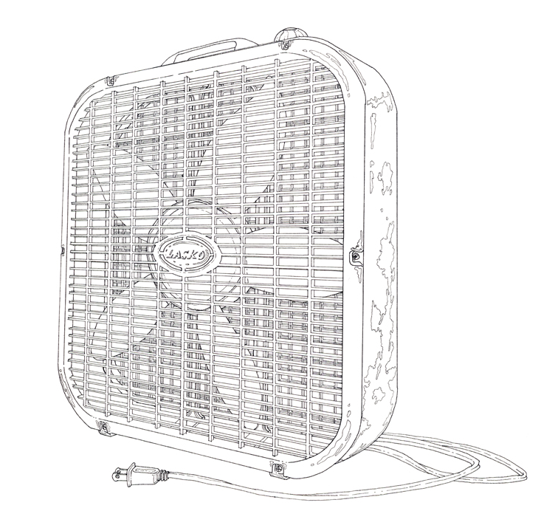
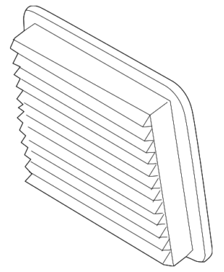
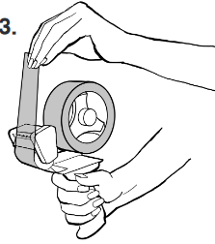
3 of 9
Executive Summary
Up to 99.9% of the viruses 20x smaller than the Covid19 can be removed from a room using available products for just $35
(1)
 |  | Example | Cost | Picture Number
Necessary Products | Fan | Generic 20 in. box fan | $17.00 | (1)
 | Air Filter | Honeywell 20 in. x 20 in. Superior Allergen Pleated FPR 9 Air Filter 3M 20 in x 20 in. 1500 MPR Ultra Allergen | $17.00 | (2)
 | Tape | Shipping tape | $1.00 | (3)
(2)
(3)
Sources:
Fan by Taylor Baldwin: www.taylorbaldwinstudio.com
Air filter by Subaru
Tape by Duck Brand: https://www.duckbrand.com/uploads/activities/pdf/Packaging-Tape-Gun-Instructions-FINAL-copy.pdf

Slide 4
4 of 9
What To Buy and From Where? (Part 1 of 3)
Fans
Comment | Any generic fan will technically work, but you will ideally want to have the fan be the SAME size as the filter or have the fan SMALLER than the filter. 20 x 20. fans and filters are widely available throughout the U.S. so I will recommend this size until the quantity noticeable decreases.
(1)
 |  | What To Buy | From | Cost
Necessary Products | Fan | Lasko 20-in 3-Speed Indoor Box Fan | Lowe’s | $16.96
 |  | Holmes 20-in 3-Speed Indoor Box Fan | Lowe’s | $16.96
 |  | Utilitech 20-in 3-Speed Box Fan | Lowe’s | $18.98
 |  | Lasko 20 in Box Fan | Home Depot | $18.96
 |  | Lasko Slim 20” Box Fan with Smart Save | Walmart | $19.98
 |  | Holmes - 20” 3-Speed Box Fan | Target | $19.99
 |  | Utilitech 20-in 3-Speed Box Fan | Lowe’s | $20.98
 |  | Lasko 20 in. 3-Speed Box Fan | Home Depot | $23.98
 |  | Comford Zone 20” Box Fan | Walmart | $24.50
 |  | Lasko 20 in. Power Plus Box Fan | Home Depot | $26.96
 |  | Lasko 20 in. 3-Speed Weather Shield Performance Box Fan | Home Depot | $28.73
Sources:
Fan by Taylor Baldwin: www.taylorbaldwinstudio.com

Slide 5
5 of 9
What To Buy and From Where? (Part 2 of 3)
Filters
Comment | Ideally you want the filter to be the SAME size as the fan or BIGGER than the fan. 20 x 20. fans are currently widely available throughout the U.S. so I will recommend this size until the quantity noticeable decreases. The filter needs to have a minimum level of “filtration”, which all of the ones listed below meet. The filters NEED to be replaced every 90 days
 |  | What To Buy | From | Cost
Necessary Products | Air Filter | Honeywell 20 in. x 20 in. Superior Allergen Pleated FPR 9 Air Filter | Home Depot | $16.97
 |  | Filtrete Ultra Allergen 20x20, Air Filter | Target | $16.99
 |  | Honeywell 20 in. x 20 in. Elite Allergen Pleated FPR 10 Air Filter | Home Depot | $19.97
 |  | Filtrete 1900 MPR Maximum Allergen (Common: 20-in x 20-in) | Lowe’s | $19.97
 |  | Filtrete Ultimate Allergen 20x20, Air Filter | Lowe’s | $19.99
 |  | Filtrete 1500 Smart Allergen, Vacteria and Virus (Common: 20-in x 20-in) | Lowe’s | $21.98
 |  | Filtrete 2500 (Common: 20-in x 20-in) | Lowe’s | $24.97
 |  | Nordic Pure 20 in. x 20 in. Pleated MERV 12 – FPR 9 Air Filter (3-Pack) | Home Depot | $33.84
(2)
Sources:
2) Air filter by Subaru

Slide 6
6 of 9
What To Buy and From Where? (Part 2 of 3)
Tape
Comment | Shipping tape or other heavy-duty tapes work well otherwise the filter may occasionally fall down. The tape is used to connect the filter to the fan.
 |  | What To Buy | From | Cost
Necessary Products | Shipping tape | Duck 1.88-in x 22.2-Yard Clear Packaging Tape | Lowe’s | $2.58
 |  | Duck Clear 1.88-in x 22.2-Yard Clear Packaging Tape | Lowe’s | $2.68
 |  | 3M Scotch 1.88 in. x 22.2 yds. Heavy Duty Shipping Packaging Tape with Dispenser | Home Depot | $2.97
 |  | HDX 1.88 in. x 22 yds. Clear Heavy Duty Shipping Packaging Tape with 1.5 in. Dispenser | Home Depot | $2.97
 |  | Scotch Shipping 2-in x 22.2-Yard Clear Packaging Tape | Lowe’s | $2.98
 |  | Heavy Duty Shipping Tape with Dispenser –Up&Up | Target | $2.99
 |  | Scotch Mailing Tape with Dispenser, Ultra Clear, 1.88” x 22.2yds | Target | $3.19
 |  | Scotch Shipping * Packaging Tape and Dispenser, 1.88 in. x 50 yds. | Walmart | $3.86
 |  | 3M Scotch 1.88 in x 50 yds. Shipping Tape with Dispenser | Home Depot | $4.97
 |  | Duck Brand Mover’s Edge Refilaable Dispenser – Printed Tape, 1.88 in. x 35 yds | Walmart | $4.97
(3)
Sources:
3) Tape by Duck Brand: https://www.duckbrand.com/uploads/activities/pdf/Packaging-Tape-Gun-Instructions-FINAL-copy.pdf

Slide 7
7 of 9
How To Construct (1 of 2)
Follow the steps in numerical order
1
3
Plug fan into wall.
Turn fan on.
Filter
The fan will have arrows pointing which way it wants the air to flow.
Place the filter behind the fan so that the FRONT of the filter’s arrows align with the BACK of the fan’s arrows.
Filter
4
2
With the fan turned on, draw arrows on the fan pointing which way the air is blowing.
Turn off the fan.
Filter
Use the tape to attach the filter to the fan.
The filter may be bigger than the fan and that’s okay. You do not necessarily need to cut the fan, but you do need to make sure the filter is firmly attached to the fan
Filter
Sources:
Fan by Taylor Baldwin: www.taylorbaldwinstudio.com
Air filter by Subaru
Tape by Duck Brand: https://www.duckbrand.com/uploads/activities/pdf/Packaging-Tape-Gun-Instructions-FINAL-copy.pdf

Slide 8
8 of 9
How To Construct (2 of 2)
Follow the steps in numerical order
5
Filter
Place the fan in a room that typically contains people.
Turn on the fan.
Filter
Sources:
Fan by Taylor Baldwin: www.taylorbaldwinstudio.com

Slide 9
9 of 9
Where’s the evidence?
U.S. Government report from 2009 shows that a HEPA filter removed 99.9% of T7 Virus, a virus 20x smaller than Covid19
This method displayed here uses EXACTLY the same filters used by HEPA filter products that cost hundreds of dollars
The method displayed here is recommended by University of Michigan Medicine as a strong alternative to the several hundred dollar machines
Paper Name | Evaluation Of An Electronic Air Filter For Filtering Bacteria And Viruses From Indoor Air
Authors | Kaewjai Malaithao, Thareerat Kalambaheti, Suwalee Worakhunpiset, and Pongrama Ramasoota
Free Link to Paper | https://pdfs.semanticscholar.org/eb59/ae12c70ae90b15bd15afa35cdb44837af89e.pdf
Quotes | “The filtrating efficiency of the HEPA air filter for filtrating T7 virus was 99.9%

