Slide 1
Property Evaluator
Sound Realty

Slide 2
Contents
1.
Goal of the project.
2.
Roadmap of the project.
3.
Components of the solution.
4.
Open code.
5.
Next Steps.
6.
Questions.

Slide 3
Develop a REST API to reduce the time for a evaluation and to used broadly by Sound Realty.

Slide 4
Project roadmap
Goal
Finally, we have the version 1.0 of our application.
Step 5
Interation, testing and debugging.
Step 4
Development of Dockerfile and containerization of the application.
Step 3
Development of endpoint 2
Step 2
Development of endpoint 1
Step 1
Understanding of the problem and planning.

Slide 5
Property Evaluator Components.
Main components of the solution.
Endpoints
Two endpoints to get predictions from one receiving the columns from future_unseen_examples and other receiving just the columns required for the basic model. The response should be a in JSON format.
Containerization
Application running in a docker container. Available 24/7 with no downtime during the update of the model.
Scalability
We can easily obtain scalability here when necessary by implementing more containers with a load balancer (Nginx) to deal with the requests.

Slide 6
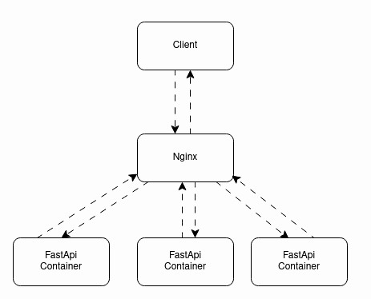
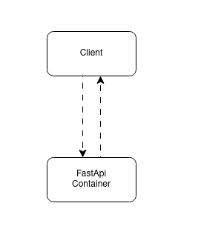
Diagrams

Slide 7
Company Name
Next steps
DATE
MLflow Component
DATE
Develop CI-CD pipeline
DATE
Migrate the solution to the cloud
We’re here!
Develop the MLflow component of the system archiving Experiment tracking and Model registry.
Develop robust CI-CD pipeline automating linting, testing, and deployment
Interating with the last step(especially CD), migrate the solution to the cloud in order to archive auto-scalling.

Slide 8
Any questions?
Ask away!
Let's discuss any doubts or concerns.
If something comes up later, contact brunovnonato@proton.me

