Slide 1
A proof of concept for automated discourse analysis in support of identification of relationship building in blogs
David Phillips and Bruno Amaral

Slide 2
Overview
  Large scale imperical evidence
  Advanced search and content analysis tools
  Identifying how relationships are formed, sustained and changed in public discourse
  Very far reaching for PR, but also all soc sciences, psychology, evolutionary science, political and economic theory.
  Some early evidence about the dynamic of relationships
  Exciting that PR has a fundamental breakthrough in societal research

Slide 3
Reputation, trust, brand loyalty, lobbying, corporate licence to operate depend on relationships
PR is a relationship discipline.
What do we know about the dynamics of relationships?
Formation, Sustaining & Change

Slide 4
Towards Relationships Management
  Widely understood tokens
  Values make up tokens
  Actors have different perception of tokens
  Common beliefs in values support relationships
  Actors with different understanding of value invoke dissonance.

Slide 5
There is considerable research about relationships.
Very few large scale observations to identify the actual building blocks in the formation sustaining and change in relationships
Empirical research on a very large scale needed – especially in discourse.

Slide 6
Personal blogs offer large scale discourse for social observation
Identifying actors
Over time
Tokens & values
Relationships

Slide 7
Triangulated testing:
  Hyperlink network analysis
  Word map networks
  Semantic concept networks

Slide 8
Values and tokens as integral parts of relationships
Hyperlinks can be more than just resource locators — tokens
The subjects actors talk about in blogs reflect actor tokens & values

Slide 9
Our goals
  To explore the possibility of mapping both blogs and relationships between actors
  To draft a methodology for future research in mapping relationships online

Slide 10
The tools
  Urlnet
  Pajek (large network analysis)
  Latent Semantic Analysis
  Word Density Analysis

Slide 11
Looking at networks
The next graph will show us the network around “the infidel bloggers’ aliance” blog

Slide 12
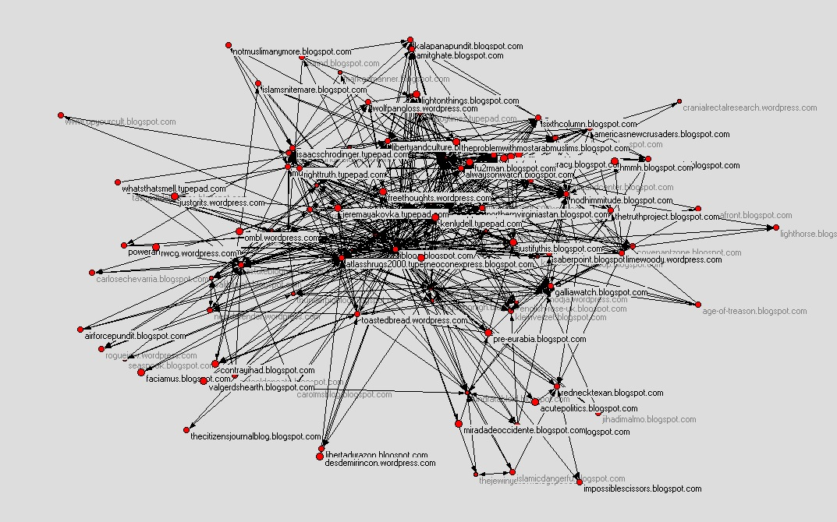

Slide 13
Word frequencies in the LSA Results
word | iraq | islam | gaza | palest | arab | muslim
number of occurences in LSA | 9 | 46 | 6 | 12 | 33 | 12
Notes:
The network was so large, that instead of looking at all the LSA results we opted to count the number of times certain words were mentioned

Slide 14
Looking at networks
The next graph will show us the network around Jeremiah Grossman’s blog

Slide 15
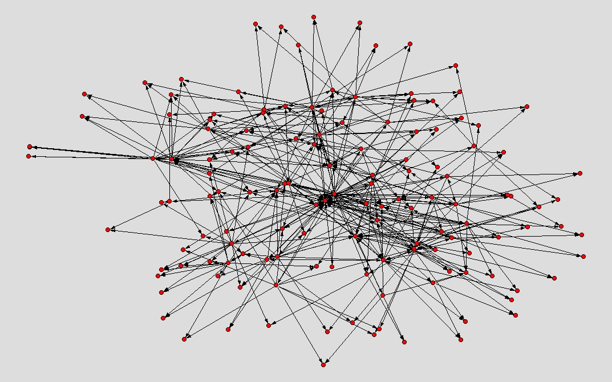

Slide 16
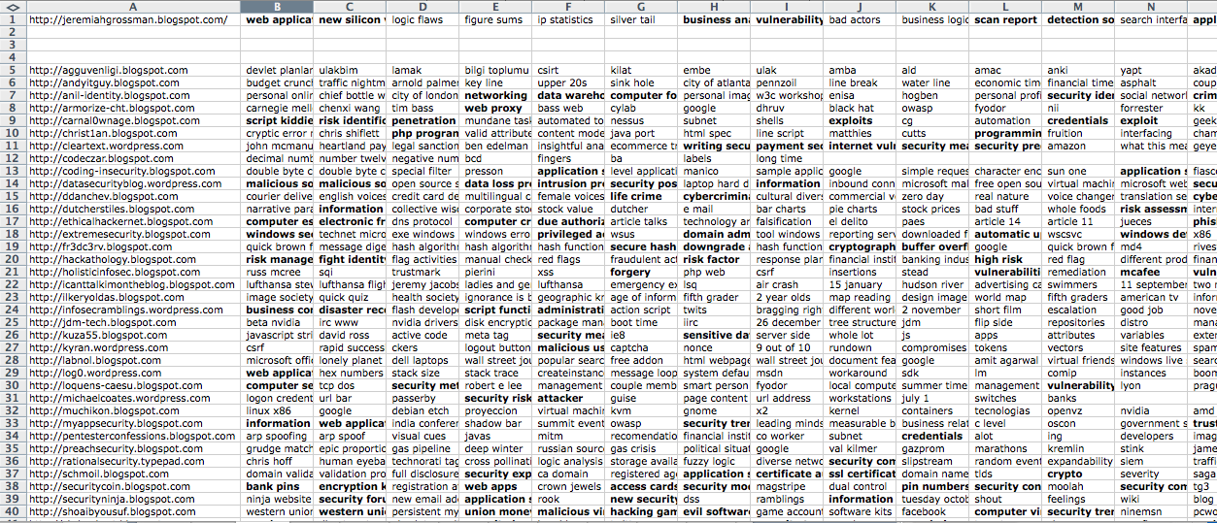

Slide 17
Special thanks to software developers who contributed to this reseach project:
  Girish Lakshminarayana and his team of programmers in India – who developed a special Latent Semantic Analysis tool
  Dale Hunscher Business Systems Analyst University of Michigan Medical School and Owner of South Wind Press – who provided the software and online capability to explore blog networks.

Slide 18
Bruno offers an approach for discourse research that goes to the heart of many areas of research in PR and beyond.
We are beginning to see evidence that common values create relationships and probably publics
Indications that values expressed in discourse on and offline are a dynamic in formation of relationships, networks and social groups.
Potentially powerful theoretical proof for PR research and practice in relationship management

Slide 19
Thank You

