Slide 1
Untitled

Slide 2
lalal
asdasd

Slide 3
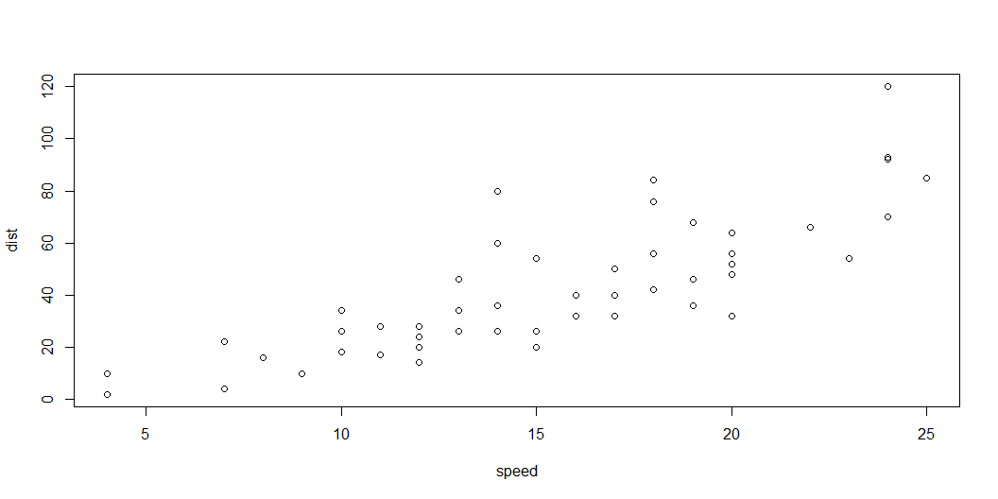
Cod
plot(cars)

Slide 4
Cod
speed | dist
4 | 2
4 | 10
7 | 4
7 | 22
8 | 16
9 | 10
cars |>
head() |>
knitr::kable()

